Slide 1
Cathelicidin LL-37 and its derivatives in therapy of colorectal cancer
PhD candidate: Jakub Włodarczyk
Supervisor: Prof. dr hab. n. med. Jakub Fichna

Slide 2
Presentation outline
Introduction
Colorectal cancer
Cathelicidin LL-37
Short chain fatty acids
Aim of study
Results
Conclusions
Achievements

Slide 3
Colorectal cancer
Lifetime probability
Female: 1 in 25
Male: 1 in 23
Increasing rate of incidence in individuals younger than 55 years old
5-year survival rate - 64%
14% for distant-stage disease
91% for localized disease
Only 1 in 3 new cases is localized

Slide 4
Cathelicidin LL-37
LL-37
Expressed in almost all tissues
Influences migration and proliferation of cells of the immune system
Regulates apoptosis and stimulates tissue regeneration
Maintains the integrity of the intestinal membrane
Participates in inflammation and carcinogenesis

Slide 5
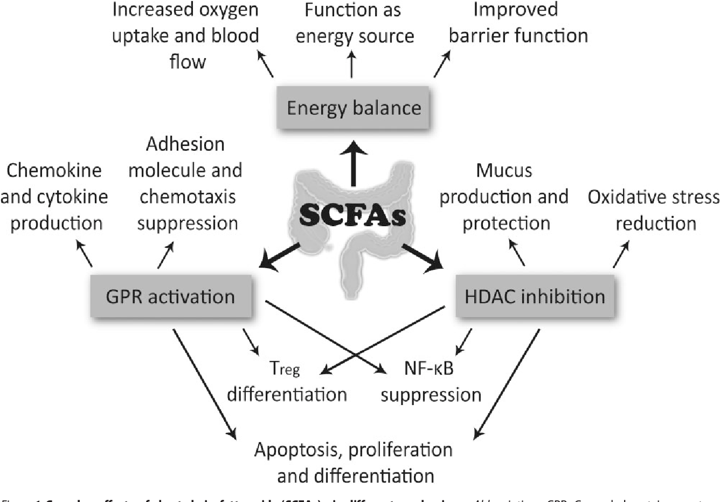
Short chain fatty acids
Pleiotropic effects
Suggested to have beneficial functions in patients with colorectal cancer

Slide 6
Aim of the study
To specify the mechanism of action of LL-37 in the tissue of normal colorectal epithelium and colorectal cancer, and its dependency on vitamin D.
To understand the mechanism of action of the antimicrobial peptide LL37 and to try to use its derivatives as a new, potential anticancer therapy.

Slide 7
Results
25 patients underwent colorectal resection due to CRC
25 samples from cancer tissue
25 samples from healthy intestinal mucosa from surgical margins
mRNA LL-37 expression present in 100% of samples

Slide 8
Results
4-fold increase of LL-37 expression level compared with healthy intestinal mucosa
Expression of LL-37 was significantly higher in stage III(AJCC), when compared to stage I.
In patients with nodal metastases a 3.5-fold increase in LL-37 expression in cancer tissue

Slide 9
Results
Molecular analysis of potential receptors involved in cathelicidin LL-37 mechanism pathways revealed:
significantly reduced expression of TLR3 in the tumor tissue compared to tissue from the healthy margin,
significantly increased expression of FPR-2 was observed in the tumor tissue compared to tissue from the healthy margin,
no differences were observed in the expression of vitamin D receptor, MgrX, TLR 4 and CxCr2.

Slide 10
Results – in vivo and in vitro studies
Synthesis of compounds (KR-12 peptide and its derivatives modified with short-chain fatty acids):
acetic acid,
propionic acid,
butyric acid.

Slide 11
Results – in vitro and in vivo studies
Assessment of the influence of tested compounds on viability of colorectal cancer and normal colon epithelium cell lines.

Slide 12
Results – in vivo and in vitro studies
Evaluation of the action of selected compounds in the mouse model of colorectal cancer.

Slide 13
Results – in vivo and in vitro studies
Molecular analysis of the material obtained from the animal model.

Slide 14
Conclusions
KR-12 and KR-12 modified with propionic acid most significantly decreased the viability of cancer cells, while at the same time they were not cytotoxic to normal cells.
In a mouse model of AOM/DSS-induced colorectal cancer, the beneficial effect of the tested peptides was expressed by:
smaller macroscopic tumor lesions,
smaller number of tumors,
decrease in the analyzed pro-inflammatory cytokines.
In human material, cathelicidin LL-37 expression is significantly elevated in colorectal cancer tissues compared to healthy intestinal epithelium.
Potential receptors involved in the cathelicidin mechanism are TLR3 and FPR-2.

Slide 15
Achievements
During my 4-year PhD program at International Doctoral School:
Author or co-author of 29 publications
Kosciuszko Foundation Scholarship awardee
4-months internship at Johns Hopkins University
Co-author of a patent submitted in USA
4 international and 5 national conferences presentations
Impact factor gathered during PhD program -> 109.377
151.423 including supplements

