Slide 1
Identification of genetic predisposition
to childhood lymphomas
Preliminary data
Bartosz Szmyd
Mentors: Agata Pastorczak, Wojciech Młynarski
Ph.D. Candidate, Department of Pediatrics, Oncology and Hematology
Medical University of Lodz, Lodz, Poland
Resident, Department of Neurosurgery and Neurooncology
Medical University of Lodz, Lodz, Poland
Public Scientific Session, June 2024
International Doctoral School of Medical University of Lodz

Slide 2
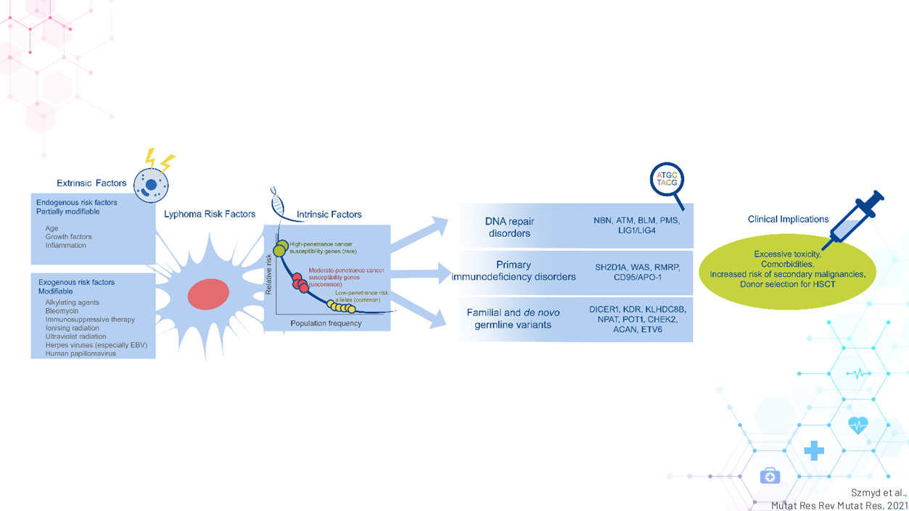
Background
Szmyd et al.,
Mutat Res Rev Mutat Res, 2021

Slide 3
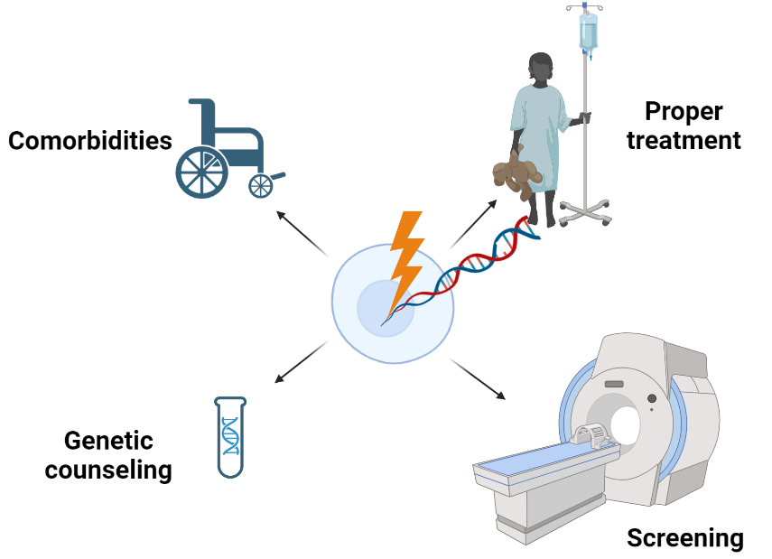
Clinical importance
Created with
Biorender.com

Slide 4
Aim of the study
The primary aim of this study is to find genetic predisposition to lymphoma in pediatric patients based on family history and phenotypical features.

Slide 5
Materials and methods
Inclusion criteria (≥1 criterion):
1. Positive familial history
2. Histopathological types of lymphoma
that are uncommon in children or untypical age
of onset
3. Multiple neoplasms
4. Comorbidities
5. Excessive toxicity
Exclusion criteria (≥1 criterion):
01
Confirmed diagnosis of inherited disorder with defined predisposition to lymphoma
02
Lack of consent to participate in the study
Jongamns et al.,
Eur J Med. Gen 2016

Slide 6
Materials and methods
71 lymphoma
patients
(from 60 families)
Created with
Biorender.com

Slide 7
Results: fulfilled inclusion criteria
Specific subtypes
Comorbidities
32 families
53%
Positive familial history
16 families
27%
Multiple malignancies
16 families
27%
Toxicities
15 families
25%
9 families
15%
Mainly T-LBLs and DLBCLs
Follicular lymphoma
Panniculitis-like T-NHL
T-cell cutaneous lymphoma
HL < 4 y.o.
Immunodeficiency (n=8)
Polyposis (n=3)
Hearing loss (n=2)
Thrombocytopenia (n=2)
Others
Parent/child
(n=9)
Siblings
(n=5)
Others
(n=3)
Hematopetic (n=6)
Brain tumor (n=4)
Teratoma
Ewing sarcoma
Thyroid cancer
Others

Slide 8
Results: positive familial history
No. | Diagnosis | Seq. | Variant
1 | Father (HL), Child (HL, Ewing's sarcoma) | 🗸 | PALB2: NM_024675.4:c.110G>A; p.Arg37His; het
2 | First line cousins with T-LBL | 🗸 | x
3 | Father (Lymphoma, ND), Child (Lymphoma, ND) | 🗸 | x
4 | Brother 1 (T-LBL), Brother 2 (T-LBL, glioblastoma) | 🗸 | PMS2: Compound heterozygous: NM_000535.5:c.1296delC & deletion ex.10-15
5 | Father (HL), Child (HL) | 🗸 | x
6 | Mother (HL), Child (HL) | 🗸 | x
7 | Brother 1 (HL), Brother 2 (HL) | 🗸 | x
8 | Mother (DLBCL), Son 1 (DLBCL), Son 2 (HL), Son 3 (lung cancer); neutropenia, hearing loss | 🗸 | CXCR4: NM_003467.2:c.1012dup; p.Ser338PhefsTer6; het
9 | Father (HL), his brother (HL), Child (HL) | 🗸 | x
10 | Brother (T-NHL) , sister (T-LBL) | 🗸 | x
11 | Father (Kidney cancer), Child (T-LBL) | 🗸 | x
12 | Father (MCL), Child (DLBCL) | 🗸 | x
13 | Sister (T-ALL), Brother (follicular lymphoma) | x | x

Slide 9
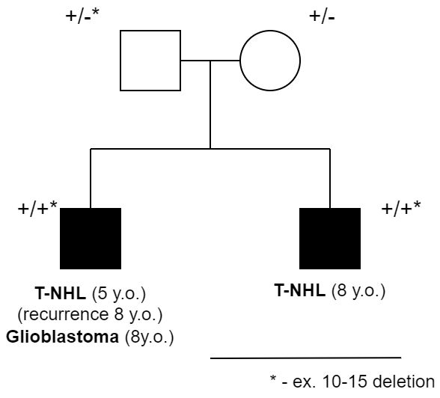
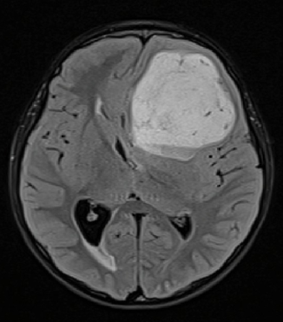
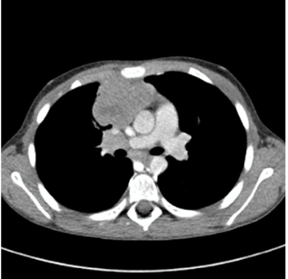
Results: positive familial history (1)
PMS2
Compound heterozygous CMMRD: NM_000535:c.1296delC; p.Asn432LysfsTer16 & ex. 10-15

Slide 10
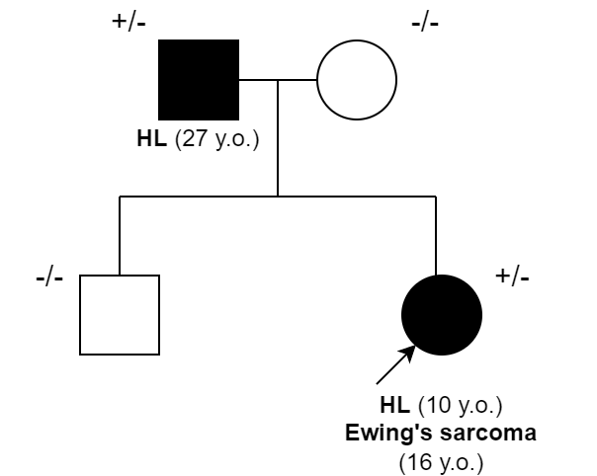
Results: positive familial history (2)
PALB2
NM_024675.4:c.110G>A; p.Arg37His; het
Variants in ES sample:
MRE11A (I120V), PALB2 (R37H), PIM1 (E124Q), RPTOR (A862T), TSC2 (A357V)
Wiltshire et al., Genet Med . 2020

Slide 11
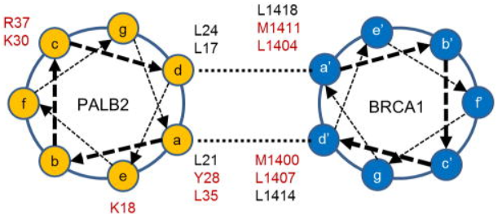
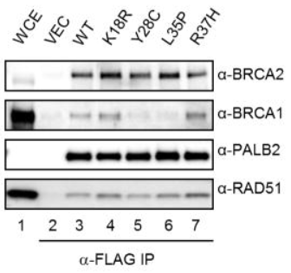
Results: postive familial history (2)
Foo et al.
Oncogene 2017

Slide 12
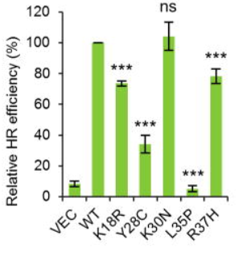
Results: postive familial history (2)
To our surprise, K18R and R37H also impair the HR activity of PALB2 even though they do not appear to reduce the PALB2-BRCA1 interaction
Foo et al.
Oncogene 2017

Slide 13
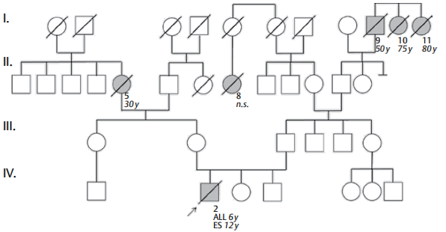
Results: positive familial history (2)
Colorectal cancer
Renal cell carcinoma
Leukemia
+/-
+/-
PALB2
NM_024675:c.(1684 + ?_1685-?)_(2586 + ?_2587-?)del), het
ALL 6y.o.
Ewing sarcoma 12 y.o
Mehaffey et al.
Klin Padiar 2021

Slide 14
Results: comorbidities
No. | Diagnosis | Seq. | Variant
1 | T- LBL, thrombocytopenia | 🗸 | ANKRD26: NM_014915.2:c.4657G>T; p.Glu1553Ter, het
2 | HL, vitiligo | 🗸 | x
3 | Burkitt's lymphoma, hearing loss | 🗸 | x
4 | DLBCL, neutropenia, hearing loss | 🗸 | CXCR4: NM_003467.2:c.1012dup; p.Ser338PhefsTer6; het
5 | DLBCL, immunodeficiency | 🗸 | ATM: compound heterozygous NM_000051:c.434T>G; p.Leu145Arg & large deletion 40-64
6 | T-LBL, BCP-ALL, immunodeficiency | 🗸 | PMS2: Compound heterozygous NM_000535.7:c.1939A>T, p.Lys647Ter and deletion ex10-ex15
7 | Burkitt-like lymphoma, immunodeficiency | 🗸 | x
8 | T-LBL, polyposis, immunodeficiency | 🗸 | MSH6: Compound heterozygous NM_000179.2:c.1135_1139delAGAGA & c.2277_2293delAGAGAGGGTTGATACTT
9 | DLBCL, HL, immunodeficiency | 🗸 | x
10 | HL, immunodeficiency, autism, dysmorphic features | x | x
11 | T-cell cutaneous lymphoma, neutropenia, leukopenia | 🗸 | x

Slide 15
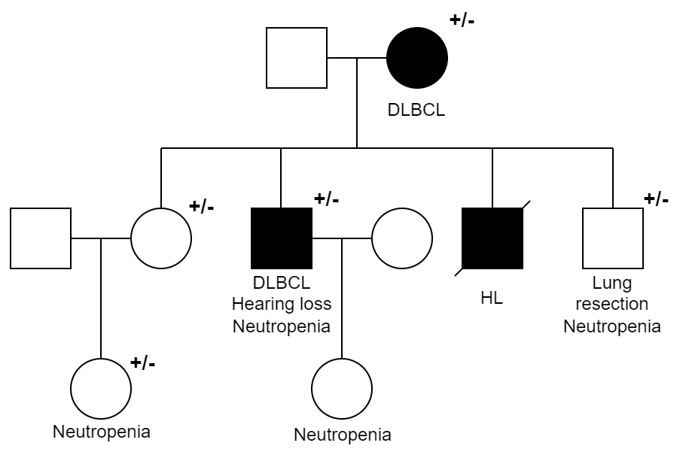
Results: comorbidities
Clinical data
The family with lymphoma (DLBCLs, HL), lung tumor, and neutropenia.
CXCR4
NM_003467.2:c.1012dup; p.Ser338PhefsTer6; het
Likely pathogenic (PVS1 very strong, PM2 supporting)

Slide 16
Results: Histopathological types of lymphoma that are uncommon
in children or untypical age of onset
No. | Diagnosis | Seq. | Variant
1 | Panniculitis-like T-NHL | 🗸 | LCK: NM_005356.5:c.1176C>G; p.Asn392Lys; het
2 | T-cell cutaneous lymphoma | 🗸 | x
3 | HL at the age of 2 y.o. | 🗸 | x
4 | HL at the age of 4 y.o. | x | x
5 | Folicular lymphoma | x | x
In 3 out of 5 patients with DLBCL P/LP variants (NTRK3, ATM, CXCR4) were identified
In 6 out of 9 patients with T-LBL P/LP variants (MMR genes, ANKRD26, BRCA1)

Slide 17
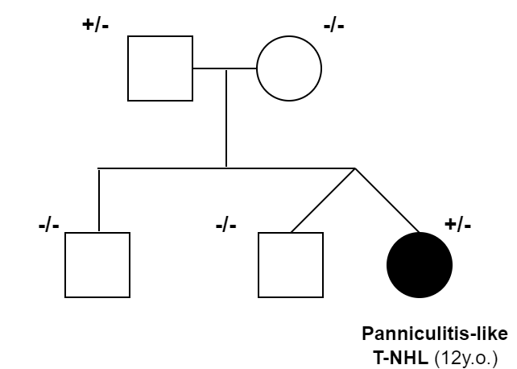
Results: Histopathological types of lymphoma that are uncommon
in children or untypical age of onset
Clinical data
Panniculitis-like T-NHL + immunodeficiency
Rare slow-growing indolent type of NHL.
Often mistaken for inflammation of the fatty tissue.
Mainly: females, age: 40 to 60 y.o.
LCK
NM_005356.5:c.1176C>G; p.Asn392Lys; het
VUS (PM2 sup., PP2 sup., BP4 sup.)

Slide 18
Results: LCK – panicullitis & immunodeficiencies
Sex, ethnicity | Female, white
Age at onset of panniculitis, mo (No. of infections) | 22 (15)
Clinical characteristics of panniculitis | Chronic multiple ulcerating skin nodules (PIP joints) associated with fever
CRP at onset of panniculitis, mg/L (N: <6 mg/L) | 77
Lymphocytes/μL (age, mo) | 1300 (3600–8900) (29)
T cells/μL
CD3⁺ | 520 (2100–6200)
CD4⁺ | 156 (1300–3400)
CD8⁺ | 338 (620–2000)
Other immunologic tests | Low levels of CD4 and CD8 expression at the cell surface, lack of response to T-cell receptor activation
Pathologic findings (age at skin biopsy, mo) | Lobular and septal neutrophilic panniculitis; (24); N+++, M++, CD3⁺ T cells, fat necrosis +, dermis involvement +++
Genetic analysis | Homozygous mutations in LCK (c.1022T > C)
Recurrent infections
CD4+ lymphopenia
Low level of CD4 and CD8 expression on the T-cell Surface
Oligoclonal T-cell repertoire
Profound TCR signaling defect
Hauck et al. J Allergy Clin Immunol 2012
Bader-Meunier et al. Pediatrics 2018

Slide 19
Results: multiple neoplasms
No. | Diagnosis | Seq. | Variant
1 | B-ALL, DLBCL | 🗸 | NTRK3: NM_001012338.2:c.1745G>A; p.Arg582Gln, het
2 | B-ALL, T-LBL, astrocytoma | 🗸 | MSH6: Compound heterozygous NM_000179.2:c.1135_1139delAGAGA & c.2277_2293delAGAGAGGGTTGATACTT
3 | HL, Ewing's sarcoma | 🗸 | PALB2: NM_024675.4:c.110G>A; p.Arg37His; het
4 | B-ALL and T-LBL (synchronic) | 🗸 | PMS2: Compound heterozygous NM_000535.7:c.1939A>T, p.Lys647Ter and intragenic deletion (ex8-ex14)
5 | T-LBL, glioblastoma | 🗸 | PMS2: NM_000535.5:c.1296delC & deletion ex.10-15
6 | T-LBL, glioma | 🗸 | PMS2: compound heterozygous, NM_000535.5:c.1185delC, p.Met396TrpfsTer2 & c.1876G>C, p.Ala626Pro
7 | HL, teratoma | 🗸 | x
8 | DLBCL, HL | 🗸 | x
9 | HL, thyroid cancer | 🗸 | CHEK2: heterozygous, NM_001005735.1:C.573+1G>A
10 | T-LBL, AML | 🗸 | BRCA1: heterozygous, c.4035delA, Glu1346LysfsTer2

Slide 20
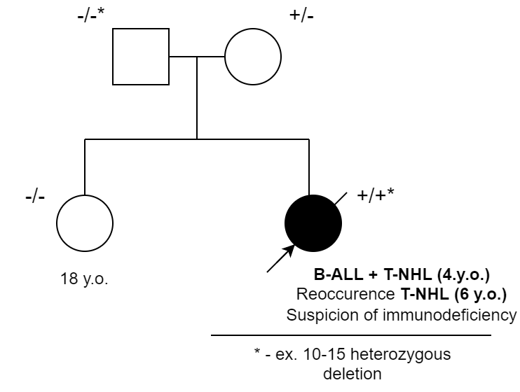
Results: multiple neoplasm (1; CMMRDs)
MSH6
B-ALL (3 y.o.)
T-NHL (7 y.o.)
Astrocytoma
Compound heterozygous CMMRD: NM_000179.2:c.1135_1139delAGAGA & c.2277_2293delAGAGAGGGTTGATACTT
PMS2
PMS2
Compound heterozygous CMMRD: (NM_000535.7:c.1939A>T, p.Lys647Ter and deletion ex10-ex15
Compound heterozygous CMMRD: NM_000535:c.1296delC; p.Asn432LysfsTer16 & ex. 10-15

Slide 21
Results: multiple neoplasms
No. | Diagnosis | Seq. | Variant
1 | B-ALL, DLBCL | 🗸 | NTRK3: NM_001012338.2:c.1745G>A; p.Arg582Gln, het
2 | B-ALL, T-LBL, astrocytoma | 🗸 | MSH6: Compound heterozygous NM_000179.2:c.1135_1139delAGAGA & c.2277_2293delAGAGAGGGTTGATACTT
3 | HL, Ewing's sarcoma | 🗸 | PALB2: NM_024675.4:c.110G>A; p.Arg37His; het
4 | B-ALL and T-LBL (synchronic) | 🗸 | PMS2: Compound heterozygous NM_000535.7:c.1939A>T, p.Lys647Ter and intragenic deletion (ex8-ex14)
5 | T-LBL, glioblastoma | 🗸 | PMS2: NM_000535.5:c.1296delC & deletion ex.10-15
6 | T-LBL, glioma | 🗸 | PMS2: compound heterozygous, NM_000535.5:c.1185delC, p.Met396TrpfsTer2 & c.1876G>C, p.Ala626Pro
7 | HL, teratoma | 🗸 | x
8 | DLBCL, HL | 🗸 | x
9 | HL, thyroid cancer | 🗸 | CHEK2: heterozygous, NM_001005735.1:C.573+1G>A
10 | T-LBL, AML | 🗸 | BRCA1: heterozygous, c.4035delA, Glu1346LysfsTer2

Slide 22
Results: multiple neoplasms
No. | Diagnosis | Seq. | Variant
1 | B-ALL, DLBCL | 🗸 | NTRK3: NM_001012338.2:c.1745G>A; p.Arg582Gln, het
2 | B-ALL, T-LBL, astrocytoma | 🗸 | MSH6: Compound heterozygous NM_000179.2:c.1135_1139delAGAGA & c.2277_2293delAGAGAGGGTTGATACTT
3 | HL, Ewing's sarcoma | 🗸 | PALB2: NM_024675.4:c.110G>A; p.Arg37His; het
4 | B-ALL and T-LBL (synchronic) | 🗸 | PMS2: Compound heterozygous NM_000535.7:c.1939A>T, p.Lys647Ter and intragenic deletion (ex8-ex14)
5 | T-LBL, glioblastoma | 🗸 | PMS2: NM_000535.5:c.1296delC & deletion ex.10-15
6 | T-LBL, glioma | 🗸 | PMS2: compound heterozygous, NM_000535.5:c.1185delC, p.Met396TrpfsTer2 & c.1876G>C, p.Ala626Pro
7 | HL, teratoma | 🗸 | x
8 | DLBCL, HL | 🗸 | x
9 | HL, thyroid cancer | 🗸 | CHEK2: heterozygous, NM_001005735.1:C.573+1G>A
10 | T-LBL, AML | 🗸 | BRCA1: heterozygous, c.4035delA, Glu1346LysfsTer2

Slide 23
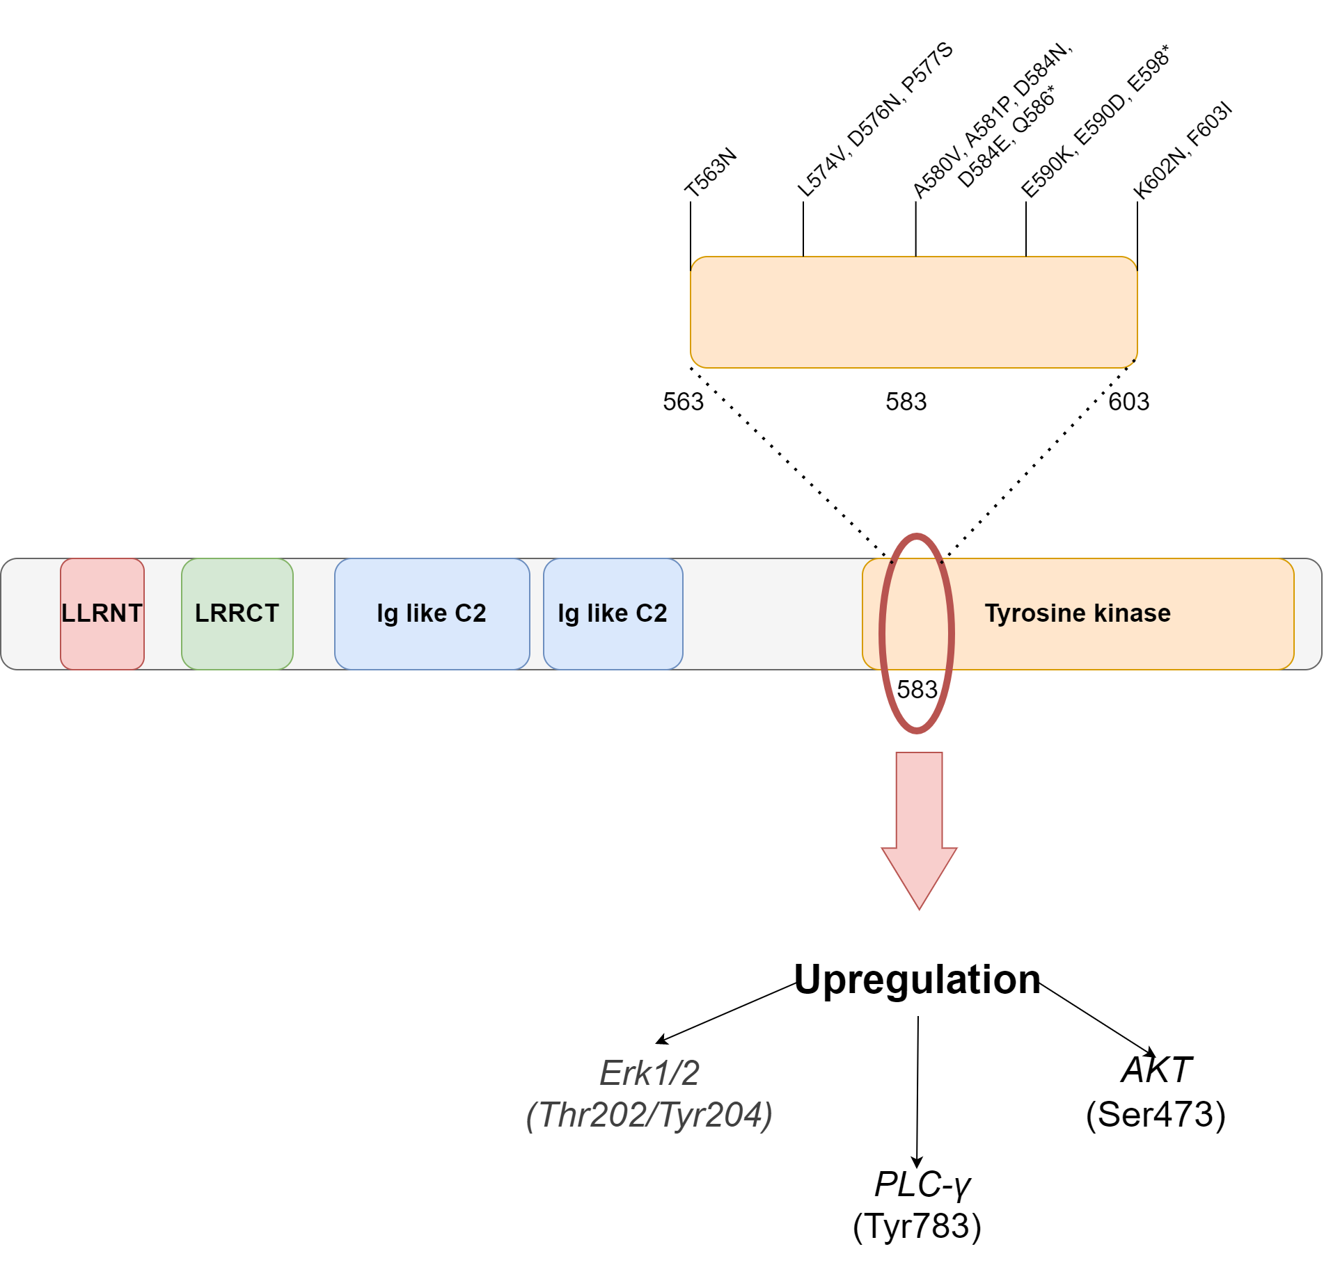
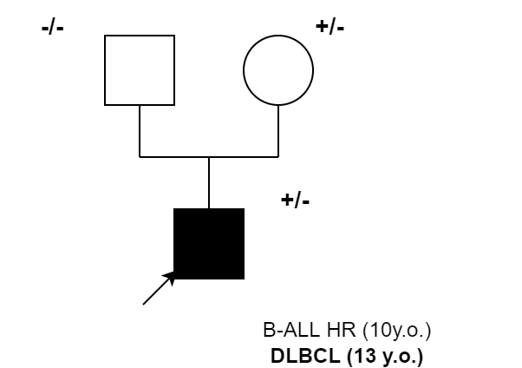
Results: multiple neoplasm (2)
NTRK3
NM_001012338.2:c.1745G>A; p.Arg582Gln, het VUS: PP3 moderate, PM2 supporting
Wook Jin et al.,
Cancers 2020

Slide 24
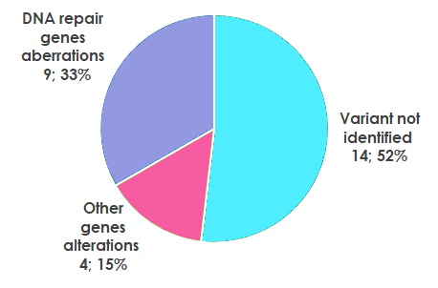
DNA repair genes aberrations

Slide 25
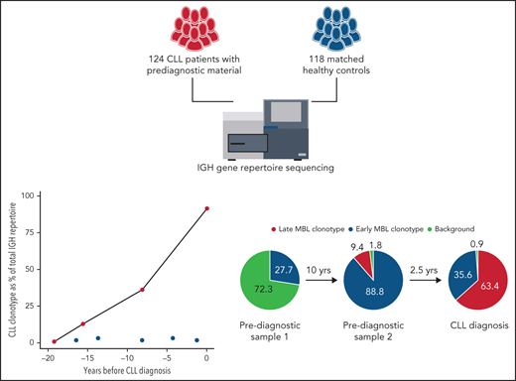
Further perspectives
CMMRD registry
Early detection of lymphoproliferation

Slide 26
Collaborators
Laboratory of Immunopathology and Genetics, Department of Pediatrics, Oncology and Hematology, Central Clinical Hospital of the Medical University of Lodz
Agata Pastorczak Karolina Miarka-Walczyk,
Kamila Wypyszczak
Katarzyna Bąbol-Pokora,
Wojciech Młynarski,
Polish Pediatric Leukemia/Lymphoma Study Group:
Prof. dr hab. Bern Kazanowska
Eryk Latoch
Dawid Przystupski
Justyna Walenciak
Filip Pierlejewski
Agnieszka Wziątek
Katarzyna Derwich
Ninela Irga-Jaworska
M. Radwańska
E. Dudkiewicz
Maryna Krawczuk- Rybak
Bozena Dembowska-Bagińska
Anna Wakulińska

Slide 27
THANK YOU
FOR ATTENTION
Mail: Bartosz.szmyd@umed.lodz.pl

