Slide 1
Human Lung Microvascular Endothelium from certain human individuals may present the constitutive resilience to HCoV-229E infection
Robert Szewczyk,
PhD Student Department of Immunology and Allergy
Tutor: dr hab. n. med. Maciej Chałubiński, prof. UM
Research performed under NCN OPUS grant: 2021/43/B/NZ5/00973

Slide 2
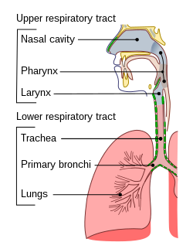
Coronaviridae family
2019~ SARS-CoV-2 pandemic
30% common colds
Severe Acute
Respiratory Syndrome
Sharun, K., Sircar, S., Malik, Y.S., Singh, R.K. and Dhama, K. (2020), How close is SARS-CoV-2 to canine and feline coronaviruses?. J Small Anim Pract, 61: 523-526

Slide 3
Model of response to SARS-CoV-2
MILD
MODERATE
SEVERE
CRITICAL
Clinical symptoms are mild, with no abnormal radiological findings
Fever, cough, and other symptoms are present with pneumonia
Respiratory rate ≥30/min
Oxygen saturation on room air at rest ≤93%
Respiratory failure occurs and mechanical ventilation is required

Slide 4
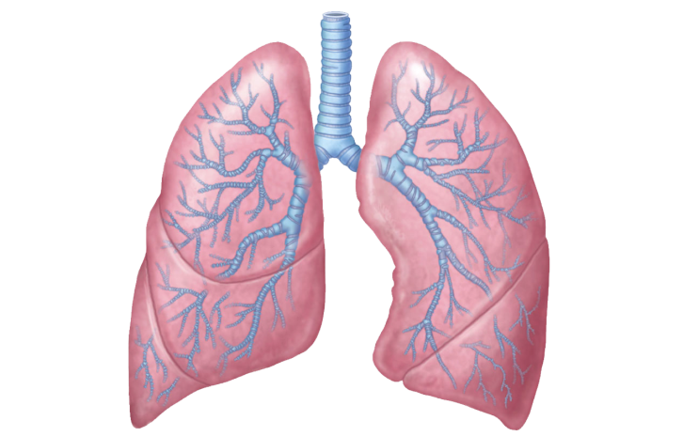
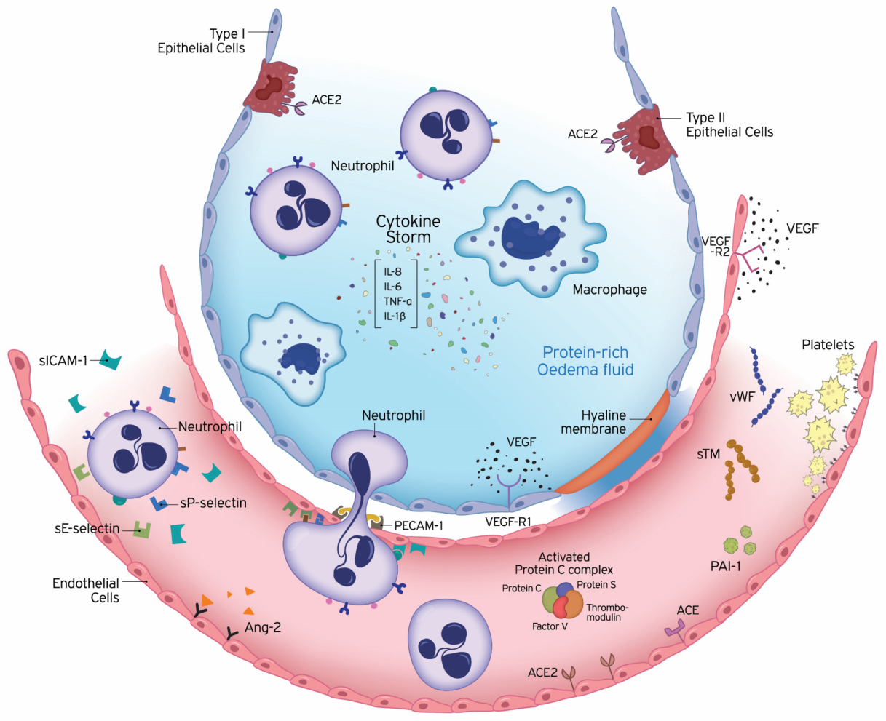
Not only epithelium but also endothelium
Epithelium
Endothelium
close distance
assiliou, A.G.; Kotanidou, A.; Dimopoulou, I.; Orfanos, S.E. Endothelial Damage in Acute Respiratory Distress Syndrome. Int. J. Mol. Sci. 2020, 21, 8793. https://doi.org/10.3390/ijms21228793

Slide 5
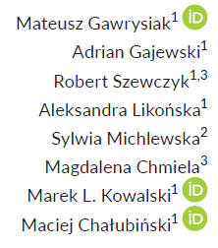
Hypothesis confirmation
1. Endothelium may be infected by respiratory viruses:
2. Endothelium possesses wide range of entry receptors for HCoVs:
3. Endothelium can release many proinflammatory and antiviral cytokines

Slide 6
SARS-CoV-2 detected in endothelium

Slide 7
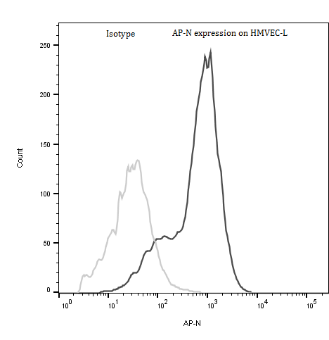
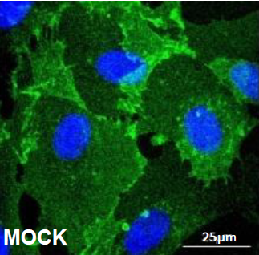
AP-N presence on the surface of vascular pulmonary endothelium

Slide 8
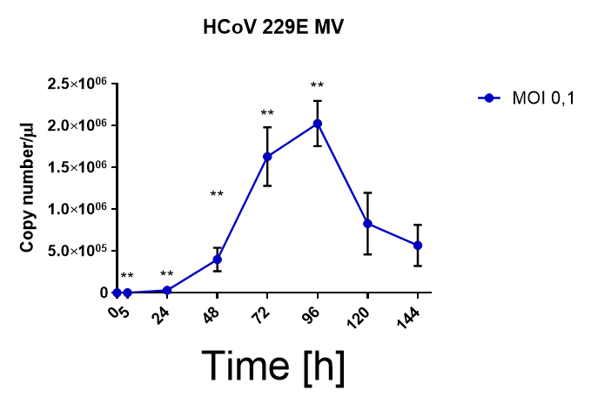
HCoV-229E infected HMVEC-L
*p<0,05

Slide 9
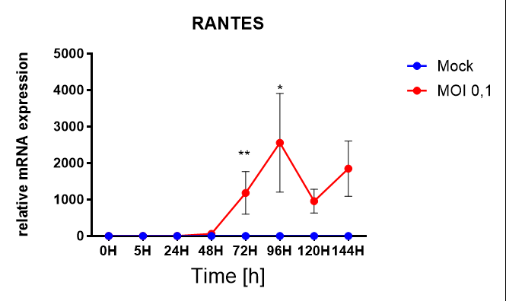
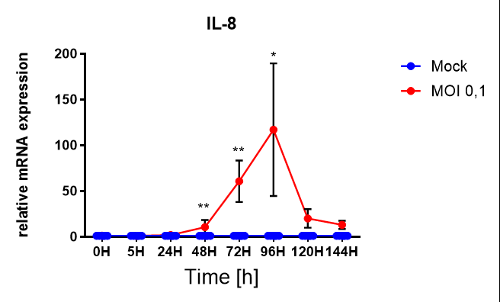
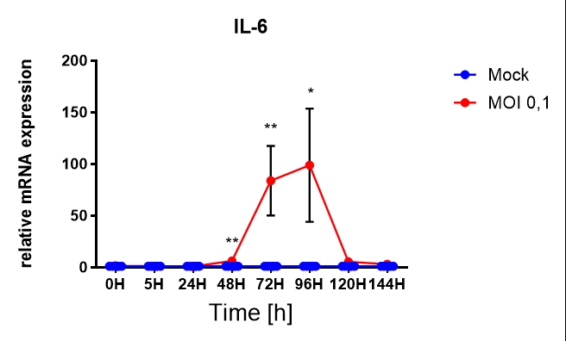
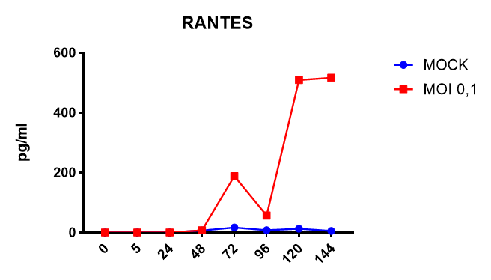
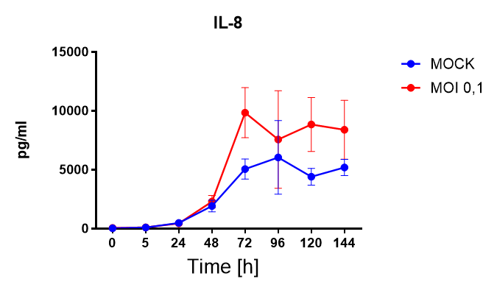
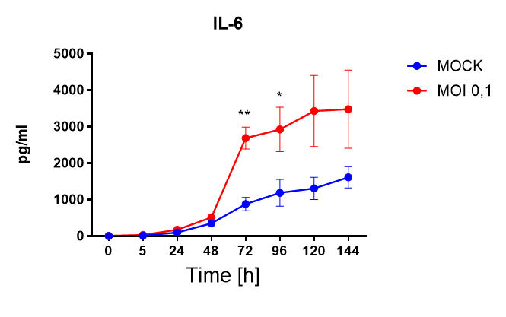
Delayed proinflammatory…
*p<0,05

Slide 10
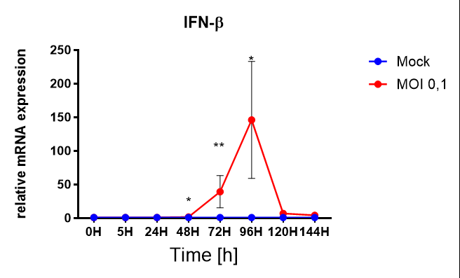
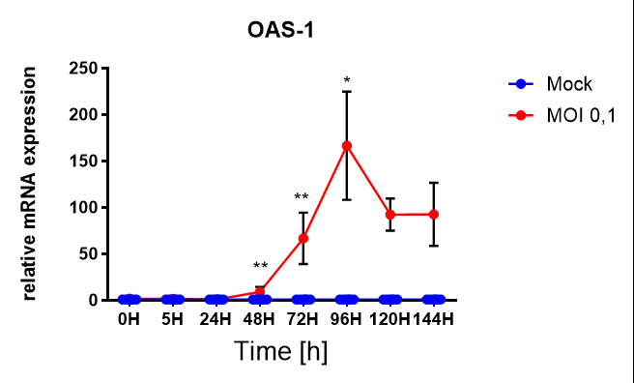
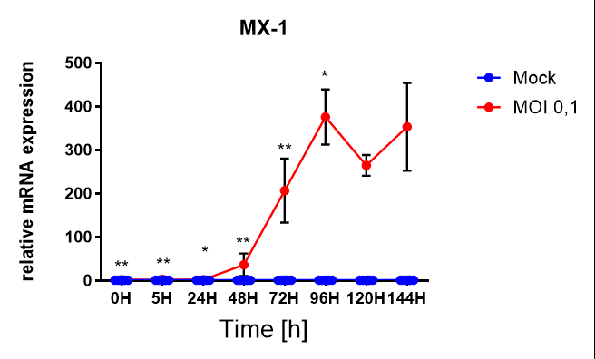
…and antiviral response
*p<0,05
Did endothelium detect virus?

Slide 11
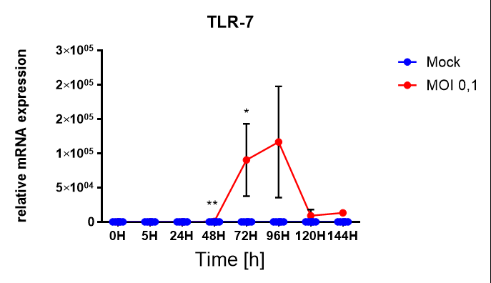
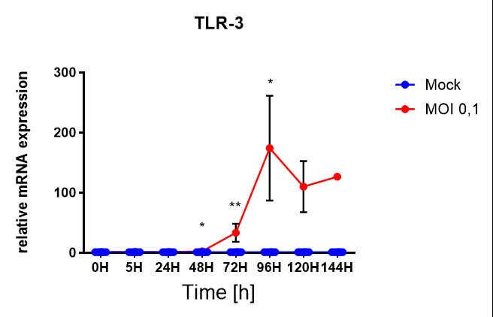
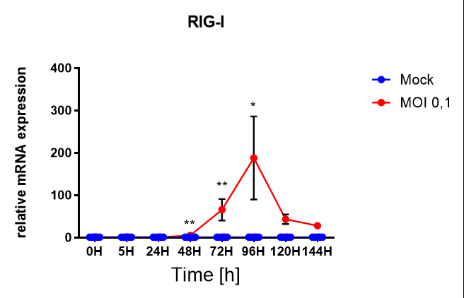
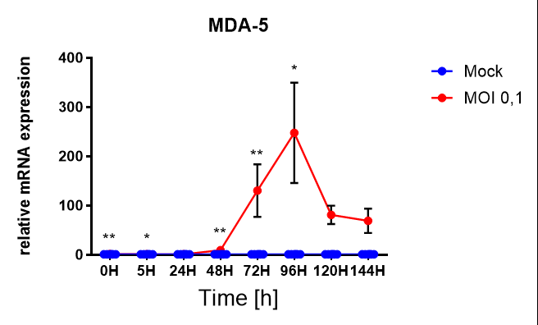
Receptor factors- where is virus?
*p<0,05

Slide 12
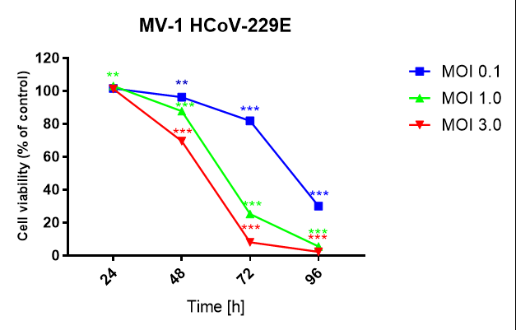
Viability assay RESAZURIN

Slide 13
Two divergent models of response to Coronaviral infection?
1. Very intense inflammatory and antiviral response
2. Asymptomatic infection

Slide 14
Two divergent models of response to Coronaviral infection?
More extensive AP-N presence
Higher viral load directly after infection

Slide 15
Looking for the reasons
?

Slide 16
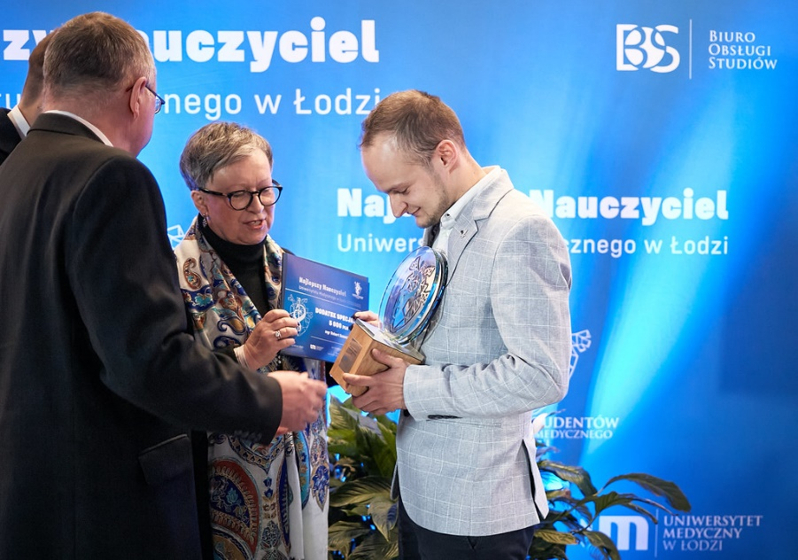
Achievements
Szewczyk R., Kalinowska J., Chałubiński M. (2023) Mechanizmy unikania wrodzonej odpowiedzi immunologicznej przez ludzkie koronawirusy. Alergia Astma Immunologia, 85-94(10)
Laureate of Medical University of Lodz Rector’s Research Grant
,,The Best Academic Teacher of Medical University of Lodz 2023” laureate
Oral presentation: Alliance for Life Sciences: From Strategies to Actions in Central and Eastern Europe, Conference "Personalized Medicine" 26-27 October 2023, Bucharest, Romania
Poster Presentation, Immunology Winter School 2024, European Academy of Asthma nad Clinical Immunology, Zakopane, 8-11 Stycznia 2024
Oral presentation ,,Human Lung Microvascular Endothelium from certain human individuals may present the constitutive resilience to HCoV-229E infection”, XVIII Kongres Polskiego Towarzystwa Immunologii Doświadczalnej i Klinicznej, 16-18 maja 2024, Białystok

