Slide 1
Gait pattern and selected muscle group comparative analysis between patients with osteoarthritis in the hip and knee joints.
Department of Arthroscopy, Minimally Invasive Surgery and Sport Traumatology, Chair of Orthopaedics, Traumatology, and Rehabilitation, Medical University of Lodz
Wojciech Stawerski
Supervisor: Prof. Jarosław Fabiś, M.D., Ph.D.

Slide 2
Introduction
Osteoarthritis in the hip and knee joints often leads to the necessity of undergoing total joint replacement surgery.
There are differences in gait patterns among individuals following hip and knee joint replacement surgeries, yet there is lack of literature on such comparisons and the resulting different management strategies.
Gait disturbances often cause falls, fractures, and deterioration in quality of life.
By providing patients with the opportunity to regain normal mobility, significant reductions in healthcare expanses and improvements in quality of life can be achieved.

Slide 3
Research hypotheses:
The gait pattern in individuals with osteoarthritis in the knee and hip differs from each other.
Muscle imbalance affects the disturbance of specific stages of gait.
Proper rehabilitation leads to an improvement in gait pattern over time.

Slide 4
The aim of the study
to investigate and identify differences in the impact of hip and knee joint pathology (osteoarthritis) on the gait pattern and strength of selected muscle groups in the preoperative period and 2 months after joint replacement surgery;
then to assess the improvement of these disorders after 1 year of application of appropriate postoperative rehabilitation programs.

Slide 5
Materials and Methods:
The study group will include 50 patients with knee osteoarthritis and 50 patients with hip osteoarthritis who are scheduled for joint replacement surgery as a result of these conditions.
Patients will be recruited from the Department of Arthroscopy, Minimally Invasive Surgery and Sport Traumatology, Chair of Orthopaedics, Traumatology, and Rehabilitation, Medical University of Lodz.
The research will be conducted:
before the surgery
2 months after surgery
1 year after surgery

Slide 6
Materials and Methods:
The research will include:
A detailed interview regarding the patients' age, type and duration of the disease, as well as their lifestyle.
Gait pattern, distribution of load on the right and left sides, both in standing and squatting positions, strength of individual muscle groups responsible for gait,
Furthermore, ankle and knee joint positions and limb axis will be assessed to comprehensively evaluate the load on knee and hip joints, muscle involvement, and gait parameters.

Slide 7
In the first year of my activity at the International Doctoral School (2023/2024), I achieved my goals regarding the individual research plan.
I made sure that it was possible to achieve the goals of my doctoral thesis:
I became familiar with the structure and functioning of the mentioned department.
I gained experience in working with patients after joint replacement surgery through daily contact with them in the postoperative period in this department.
I confirmed the possibility of including the planned number of patients in the study within the given time.
I have determined the availability of rehabilitation equipment that will be used in my study.
I have gained experience in using this equipment for planned tests and their interpretation of the obtained results.

Slide 8
In the first year of my activity at the International Doctoral School (2023/2024), I achieved my goals regarding the individual research plan.
I have prepared an application to the ethics committee for approval to conduct my research – the application will be reviewed at the upcoming meeting.
I have created an Excel database related to the topic of my doctoral thesis, where I will collect data.
I collected literature related to my doctoral thesis by creating a database in Zotero, which so far includes 67 references.
I prepared a chapter titled "Gait and its Disorders" for the upcoming textbook "Biomechanika" for physiotherapy students under the editorship of Prof. Jarosław Fabiś.

Slide 9
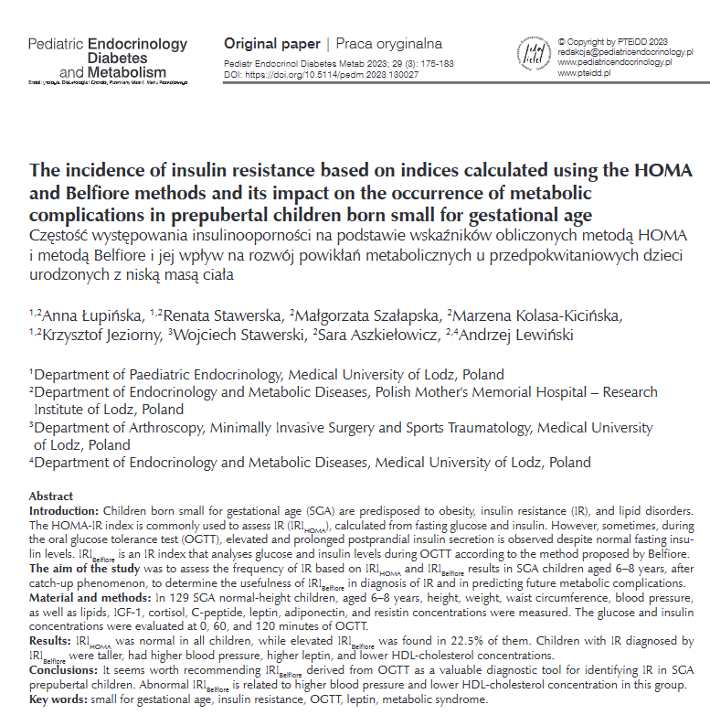
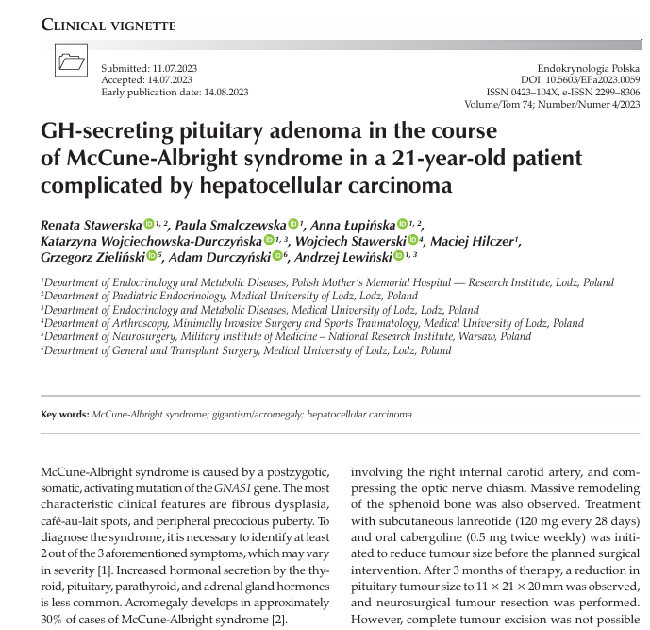
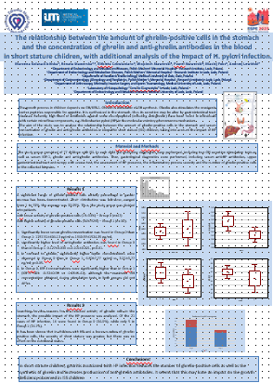
Other activities I conducted in the year 2023/2024 regarding my scientific work:
MNiSW = 100
MNiSW = 70 IF = 2.1,

Slide 10
Other activities I conducted in the year 2023/2024 regarding my scientific work:
I created a database in Excel and entered data for over 400 patients who underwent isometric testing due to shoulder joint disorders.
The database includes retrospective test results.
Currently, the results are undergoing statistical analysis, and based on them, I intend to write a publication on this topic.

Slide 11
Other activities I conducted in the year 2023/2024 regarding my scientific work:
I prepared a paper for publication titled: "Gait Analysis in Patients After Anterior Cruciate Ligament Reconstruction with a Minimum of Two Years of Follow-Up Since Surgery", where I am the first author.
Based on the results obtained, three conclusions were formed:
1. Patients after ACL reconstruction exhibit gait disturbances in the form of limb loading asymmetry.
2. Prolonged loading time of the operated limb during gait may lead to earlier development of knee osteoarthritis after ACL reconstruction.
3. Gait analysis after ACL reconstruction should be a standard auxiliary examination in screening patients at risk of early development of knee osteoarthritis.
The paper will be submitted for verification allowing to publish it in the Polish Orthopedics Journal.

Slide 12
Thank you for your attention

