Slide 1
Julia Sołek
Third year of International Doctoral School
Medical University of Łódź
Promoter: prof.dr hab. Hanna Romańska-Knight
Assistant promoter: dr Marcin Braun
Department of Pathology, Chair of Oncology

Slide 2
Project title
The importance of interactions with the tumor microenvironment of FGFR-dependent resistance to treatment in triple-positive invasive breast cancer
Notes:
My phd project is entitled

Slide 3
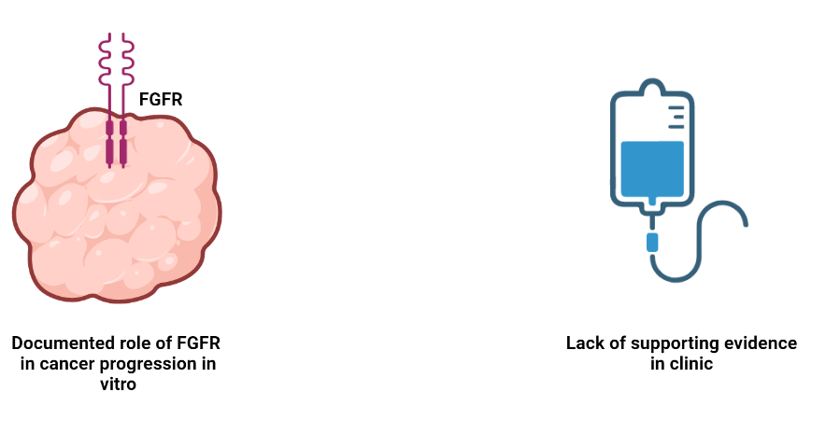
Introduction
Notes:
Increasing numer of study indicate that activation of the FGF/FGFR-axis significantly contributes in development of resistance to endocrine therapy. However, despite this overwhelming mechanistic evidence, the clinical evidence is still missing

Slide 4
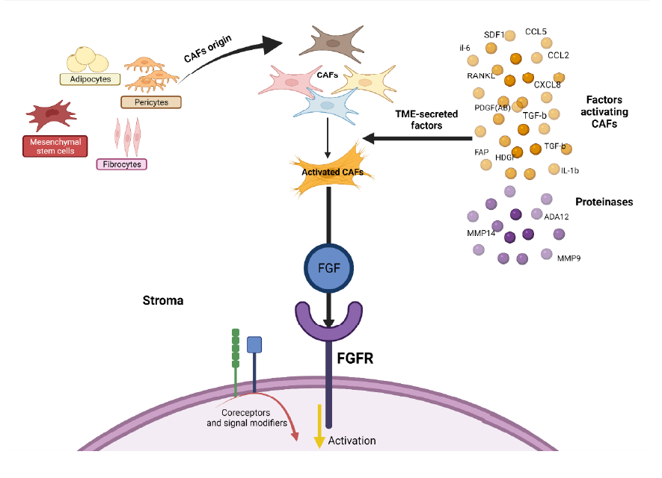
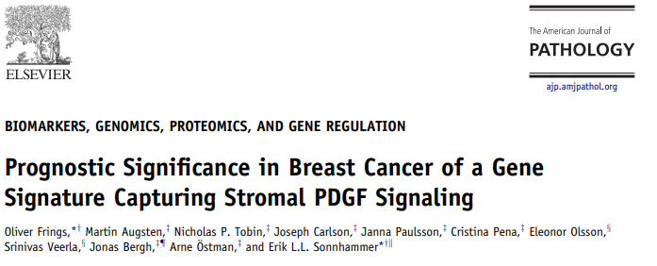
Heterogeneity of the microenvironment
Notes:
Ten obrazek możemy zobaczyć teraz w większym powiększeniu i widzimy, że receptor FGFR jest jak my- odibera nie jednen ale wszystkie bozce ze środowiska i w zaleźnosći od tych bidźców odbiowiednio się zachowuje. Wszystkie te bodźce to inaczej sygnatura stormalna. W ostatnim czasie pokazało się parę prac pokazujących że analizowanie różnych sygantur ma znaczenie w rpzewidywaniu przeżycia

Slide 5
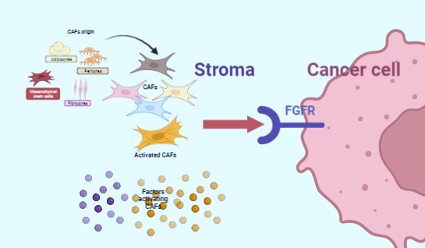
Aim of the study
To assess the predictive and prognostic value of the FGFR in the context of molecular signature of the stroma.
Notes:
To assess the predictive and prognostic value of the FGFR in the contex of molecular signature of the stroma.

Slide 6
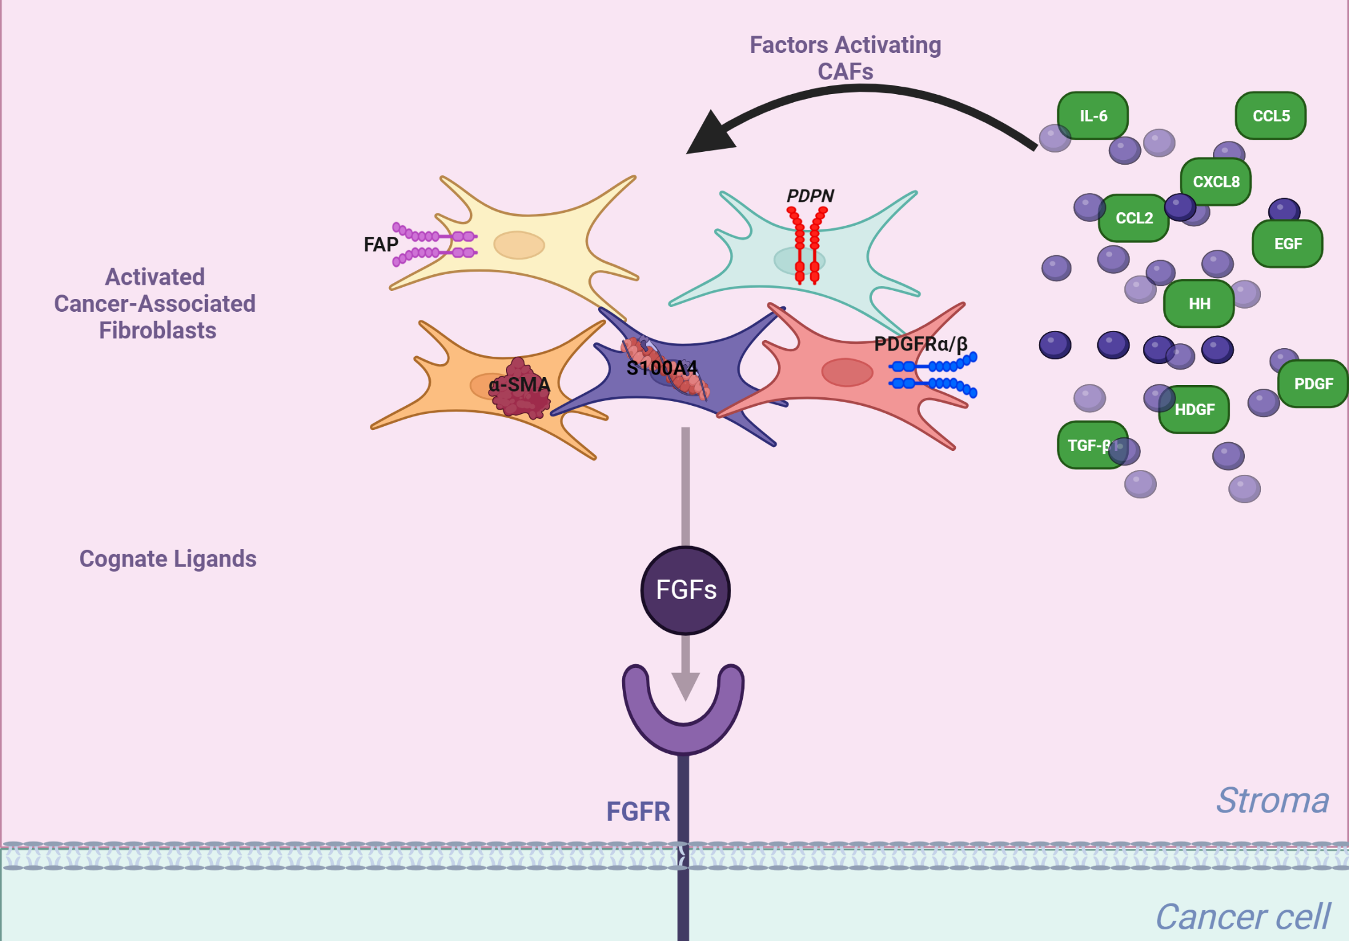
FGFR-centered „stroma” signature
Factors activating CAFs | TGF-β1, HDGF, PDGF, CXCL8, CCL2, CCL5, IL-6, HH, EGF
Phenotypic markers of CAFs | aSMA/ACTA2, S100A4/FSP-1, PDGFR, PDPN, FAP
CAFs-secreted cognate ligands | bFGF (FGF2) , FGF5, FGF17

Slide 7
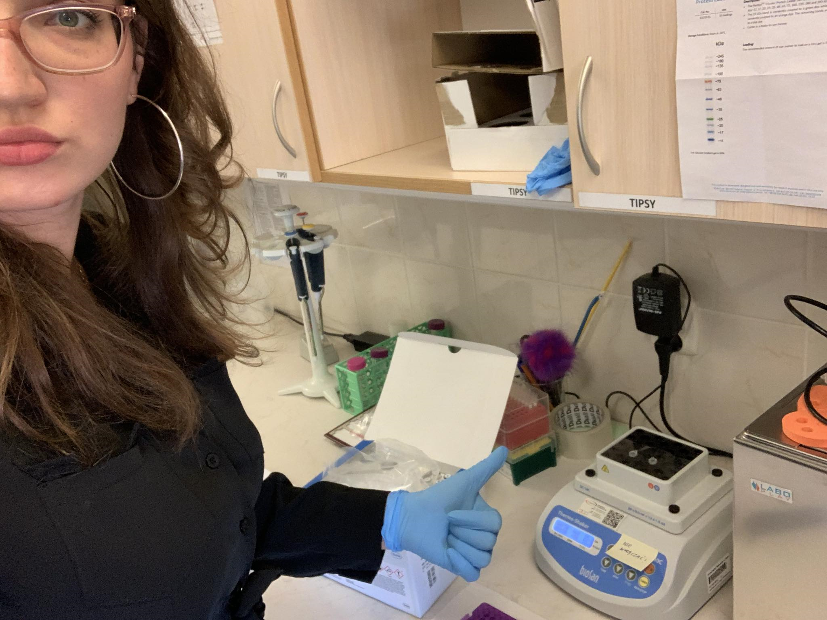
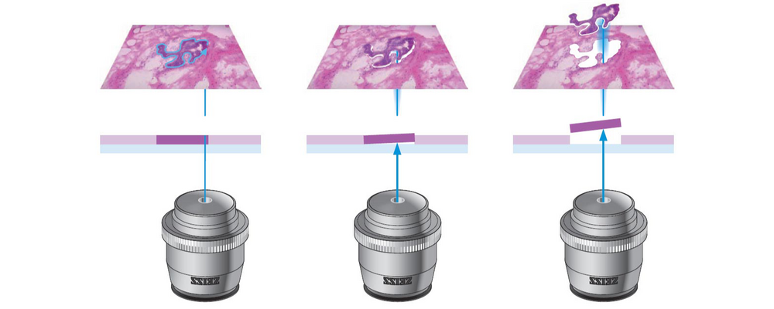
IZOLACJA RNA
PREVIOUS YEARS
Methodology optimalization and isolation of the stromal RNA from 13
patients
CURRENT YEAR
Isolation of the stromal RNA from the
rest 27 patients.
LASER MICRODISSECTION

Slide 8
In silico study TCGA

Slide 9
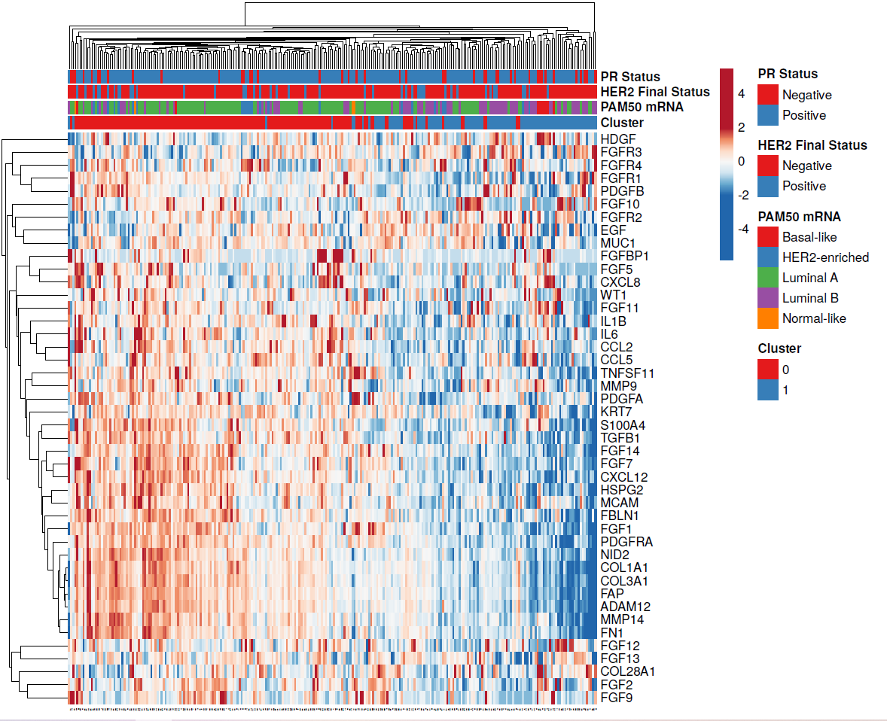
We identified two clusters of ER-positive breast cancer samples based on FGFR-centered „stroma” signature
Cluster 1-enriched with markers from FGFR-centered „stroma” signature
Cluster 2 not enriched with markers from FGFR-centered „stroma” signature
1
2

Slide 10
p for interaction =0.036
Cluster 1-enriched with markers from FGFR-centered „stroma” signature Cluster 2 not enriched with markers from FGFR-centered „stroma” signature
Overall survival

Slide 11
p for interaction =0.0199
Cluster 1-enriched with markers from FGFR-centered „stroma” signature Cluster 2 not enriched with markers from FGFR-centered „stroma” signature
Progression Free Survival

Slide 12
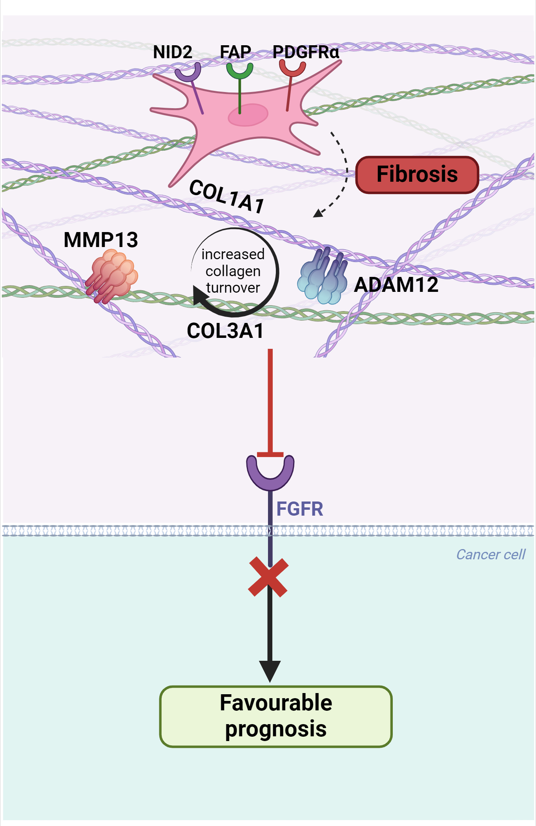

Slide 13
Conclusions and Further Research
The developed signature determines the prognostic value of FGFR1 and FGFR3. The results of the current study determine the starting point for further analyses, in which the signature will be subjected to detailed examination of tissue of origin of the analyzed factors.

Slide 14
Thank you

Slide 15
Table 1. Multivariable Cox proportional hazards model for overall survival including interactions between FGFR3 expression and cluster affiliation
 | Coefficient | HR(95%Cl) | p
Stage (I or II vs III or IV) | -1.406 | 0.25 (0.10-0.61) | 0.003
Cluster (1 vs 2) | -0.490 | 0.63 (0.29-1.37) | 0.243
FGFR1 expression | -0.407 | 0.67 (0.39-1.13) | 0.133
FGFR2 expression | -0.032 | 0.97 (0.52-1.81) | 0.378
FGFR3 expression | 0.356 | 1.43 (0.87-2.35) | 0.159
FGFR4 expression | -0.351 | 0.70 (0.38-1.30) | 0.262
FGFR1 expression * Cluster 1 | 0.882 | 2.42 (0.74-7.92) | 0.145
FGFR2 expression * Cluster 1 | 0.434 | 1.54 (0.59-4.05) | 0.378
FGFR3 expression * Cluster 1 | -1.038 | 0.35 (0.15-0.84) | 0.019
FGFR4 expression * Cluster 1 | 0.790 | 2.20 (0.94-5.16) | 0.069

