Slide 1
EVALUATION IN RATS OF THE ACUTE EFFECTS, SEQUELAE, INFLUENCE OF AGE AND POSSIBLE TREATMENTS OF THE CYTOKINE STORM
First academic year (2023-2024)
Blanca Silván Ros

Slide 2
COTUTELLE AGREEMENT
6 MONTHS
Second year
First year

Slide 3
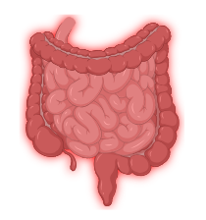
BACKGROUND
Systemic Inflammatory Response Syndrome (SIRS) or sepsis:
Widespread inflammatory response to infection, causing organ dysfunction and high mortality in hospitalized patients.
-vomiting
-paralytic ileus
-visceral pain
-diarrhea
-dehydration
Animal models
Digestive system
Mortality remains high

Slide 4
BACKGROUND
COVID-19: recent type of sepsis and cytokine storm of interest
SARS-CoV-2 infection
Long-term consequences, similar to those affecting sepsis survivors
Prognosis: age, gender, lifestyle, and pre-existing respiratory, endocrine-metabolic, and cardiovascular conditions
Vaccines
More research is needed to understand the acute and long-term effects (sequelae) of the infection, including post-COVID syndrome

Slide 5
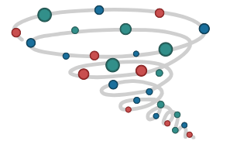
BACKGROUND
- Acute lung injury
- SIRS
ACE2 receptor internalization with cytokine storm
Agonist TLR4
LPS:
-Acute pulmonary and gastrointestinal damage
-Sequelae in the lungs, gastrointestinal tract, and neurological function
LPS+ATP+IMI
Studying severe COVID-19-associated cytokine storm and sepsis
New therapeutic strategies to mitigate disease severity and its sequelae.
ATP (DAMP): exacerbates inflammatory damage in the lungs and other organs
Imiquimod (agonist TLR7): induces symptoms such as fever, weight loss, anorexia, and increased expression of proinflammatory cytokines

Slide 6
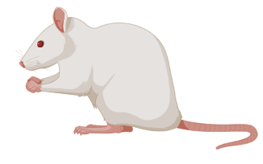
TRADITIONAL MODEL: LPS
Acute effects and sequelae LPS-induced cytokine storm in young male rats.
The potential of N-acetylcysteine (NAC), an affordable antioxidant and mucolytic, to prevent its development.
SPAIN
Animal model
Our aim:
-Evaluating therapeutic and preventive strategies against the cytokine storm associated with severe COVID-19 and its sequelae, as well as other sepsis or SIRS cases.
-Use of NAC can reduce the incidence and severity of LPS-induced cytokine storm consequences.
POLAND
Molecular studies

Slide 7
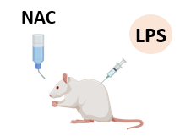
TRADITIONAL MODEL: LPS
SPAIN (ANIMAL MODEL)
Acute
Sequelae
Adult male Wistar rats
(250g-300g)
Clinical Score
Clinical Score
Gastrointestinal Motility
Gastrointestinal Motility
Macroscopic and histological and molecular analyses
Biomarker studies
Organ bath
Macroscopic and histological and molecular analyses
Biomarker studies
Organ bath
N=8-12 per group
Behavioral studies
DONE
Monitoring of weight, food and water intake at least 3 times per week

Slide 8
TRADITIONAL MODEL: LPS
POLAND (MOLECULAR STUDIES)
CT qPCR
Inflammation
Tryptase, TNF-α, IL-6, IL-1β, IL-18, COX-2 and ACE-2
Acute
Sequelae
DONE
ANALYSIS IN PROGRESS
DONE
Lung
Plasma
Distal colom
Proximal colom
Ileum
Antrum and fundus
Lung
Plasma
Distal colom
Proximal colom
Ileum
IN PROGRESS

Slide 9
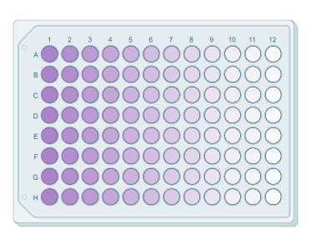
OPTIMIZED MODEL: COCKTAIL
Optimized model of pseudoinfection and sepsis, caused by a proinflammatory cocktail (LPS+imiquimod+ATP), to characterize the acute effects and sequelae.
The impact of age on the response to the cocktail and the consequent cytokine storm by studying male rats of different age groups
SPAIN
Animal model
POLAND
Cell cultures
 | YOUNG | MATURE | OLD
LPS (mg/kg) | 3 | 3 | 1.5
IMI (mg/kg) | 0.1 | 0.1 | 0.1
ATP (mg/kg) | 5 | 5 | 5

Slide 10
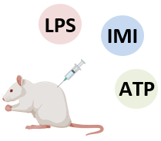
OPTIMIZED MODEL: COCKTAIL
SPAIN (ANIMAL MODEL)
Acute
Sequelae
Young (3 months)
Male Wistar rats:
Mature (8 months)
Old (20-24 months)
Clinical Score
Clinical Score
Gastrointestinal Motility
Gastrointestinal Motility
Macroscopic and histological and molecular analyses
Biomarker studies
Organ bath
Macroscopic and histological and molecular analyses
Biomarker studies
Organ bath
N=8-12 per group
Behavioral studies
DONE
Monitoring of weight, food and water intake at least 3 times per week

Slide 11
OPTIMIZED MODEL: COCKTAIL
POLAND (MOLECULAR STUDIES)
Mouse macrophage cell line RAW 264.7
Translate the observations into clinical conditions of the cytokine storm caused by LPS+ATP+IMI
SELECT THE CONCENTRATIONS
LPS: 1μg/mL
IN PROGRESS
ATP: 200μg/mL and 100μg/mL
GRIESS TEST
NRU TEST
IMI: 30μg/mL and 10μg/mL

Slide 12
PRELIMINARY RESULTS: TRADITIONAL MODEL
Acute and Short-Term Effects:
Adverse effects 24-72 hours post-administration, including weight loss, decreased food and water intake, temperature fluctuations, signs of dehydration, and diarrhea.
Acute gastrointestinal motility disturbances, such as gastroparesis and paralytic ileus, were observed.
Long-Term Effects and Sequelae:
After three weeks, most acute effects normalized
Impact of NAC (N-acetylcysteine):
NAC administration showed benefits in preventing acute immune cell infiltration in the lungs induced by LPS, as well as enhancing lung recovery and overall animal well-being.
No significant effects were observer in the remaining parameters measured.

Slide 13
PRELIMINARY RESULTS: OPTIMIZED MODEL
Acute and Short-Term Effects:
Adverse effects 24-72 hours post-administration, including weight loss, decreased food and water intake, temperature fluctuations, signs of dehydration, and diarrhea.
Acute gastrointestinal motility disturbances, such as gastroparesis and paralytic ileus, were observed.
Long-Term Effects and Sequelae:
After three weeks, most acute effects normalized
Impact of age:
Mortality was significantly higher in older animals, with up to 50% mortality in old rats. Young animals had lower mortality rates but more severe diarrhea.
Old rats had a 25% mortality rate, with survivors exhibiting reduced spontaneous locomotion and increased muscular nociceptive threshold.

Slide 14
CONCLUSIONS
The developed animal models proved effective in simulating the acute inflammatory response associated with COVID-19 and other infections.
This preclinical models offers a valuable and accessible tool for investigating new therapeutic strategies to prevent and treat the severe effects of cytokine storms and sepsis.
Further analysis is needed to understand long-term sequelae better.
Despite the similarity in the short- and long-term effects of the two models, more information is required to identify the differences between them, particularly at the molecular level.

Slide 15
SCIENTIFIC DIVULGATION
SCIENTIFIC PAPERS:
Gastrointestinal motility methods in preclinical research.
Status: Under editorial review
Early gastrointestinal effects of lipopolysaccharide-induced sepsis in a rat model.
Status: Article writing phase
Effect of N-acetylcysteine on the clinical symptoms, brain-gut axis, and lung appearance in the rat model of lipopolysaccharide-induced cytokine storm.
Status: Article writing phase
CONGRESS COMMUNICATIONS:
Oral communication entitled “Effects of N-acetylcysteine on the gut-lung axis in a model of lipopolysaccharide sepsis” at the 27th Annual Meeting of the Spanish Association of Gastroenterology (AEG) March 2024.

Slide 16
WHAT COMES NEXT?
The analysis of the results obtained during this course.
Continuation of PCR and cell cultures.
Publication of the results obtained in the articles that are being written.
Consideration of a possible 3 months international stay in a center (other than URJC or UMED), in order to obtain also the international mention of the doctoral thesis.

Slide 17
THANK YOU FOR YOUR ATTENTION

