Slide 1




TOWARDS NEW BIOMARKERS IN PSORIATIC ARTHRITIS IN PSORIATIC ARTHRITIS
the role of microtrauma, alarmins and lipid mediators in development and resolution of inflammation.
ALAA SHERRI- 2ND YEAR PhD student
Promotor: prof. Anna Lewandowska Polak
Co-promotor: PD Dr. Milena Sokolowska, MD

Slide 2
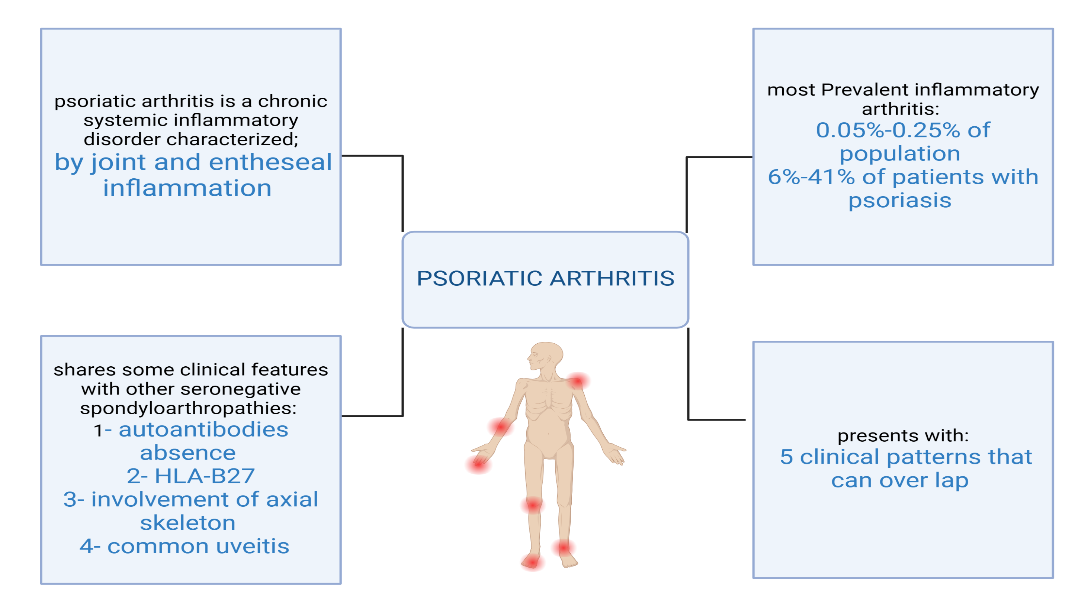

Slide 3
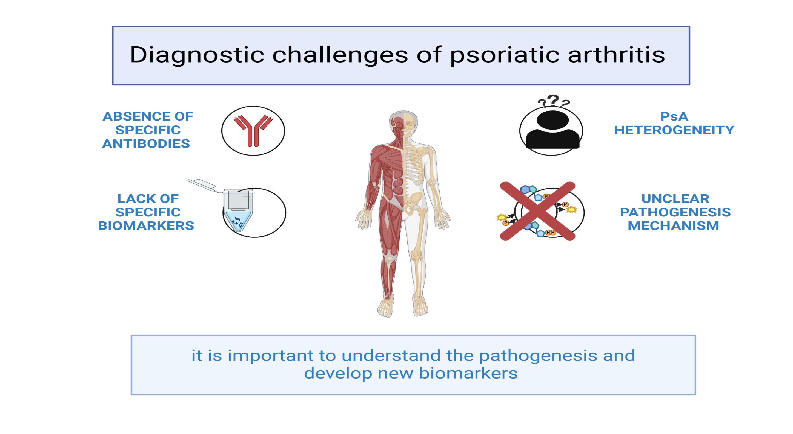

Slide 4
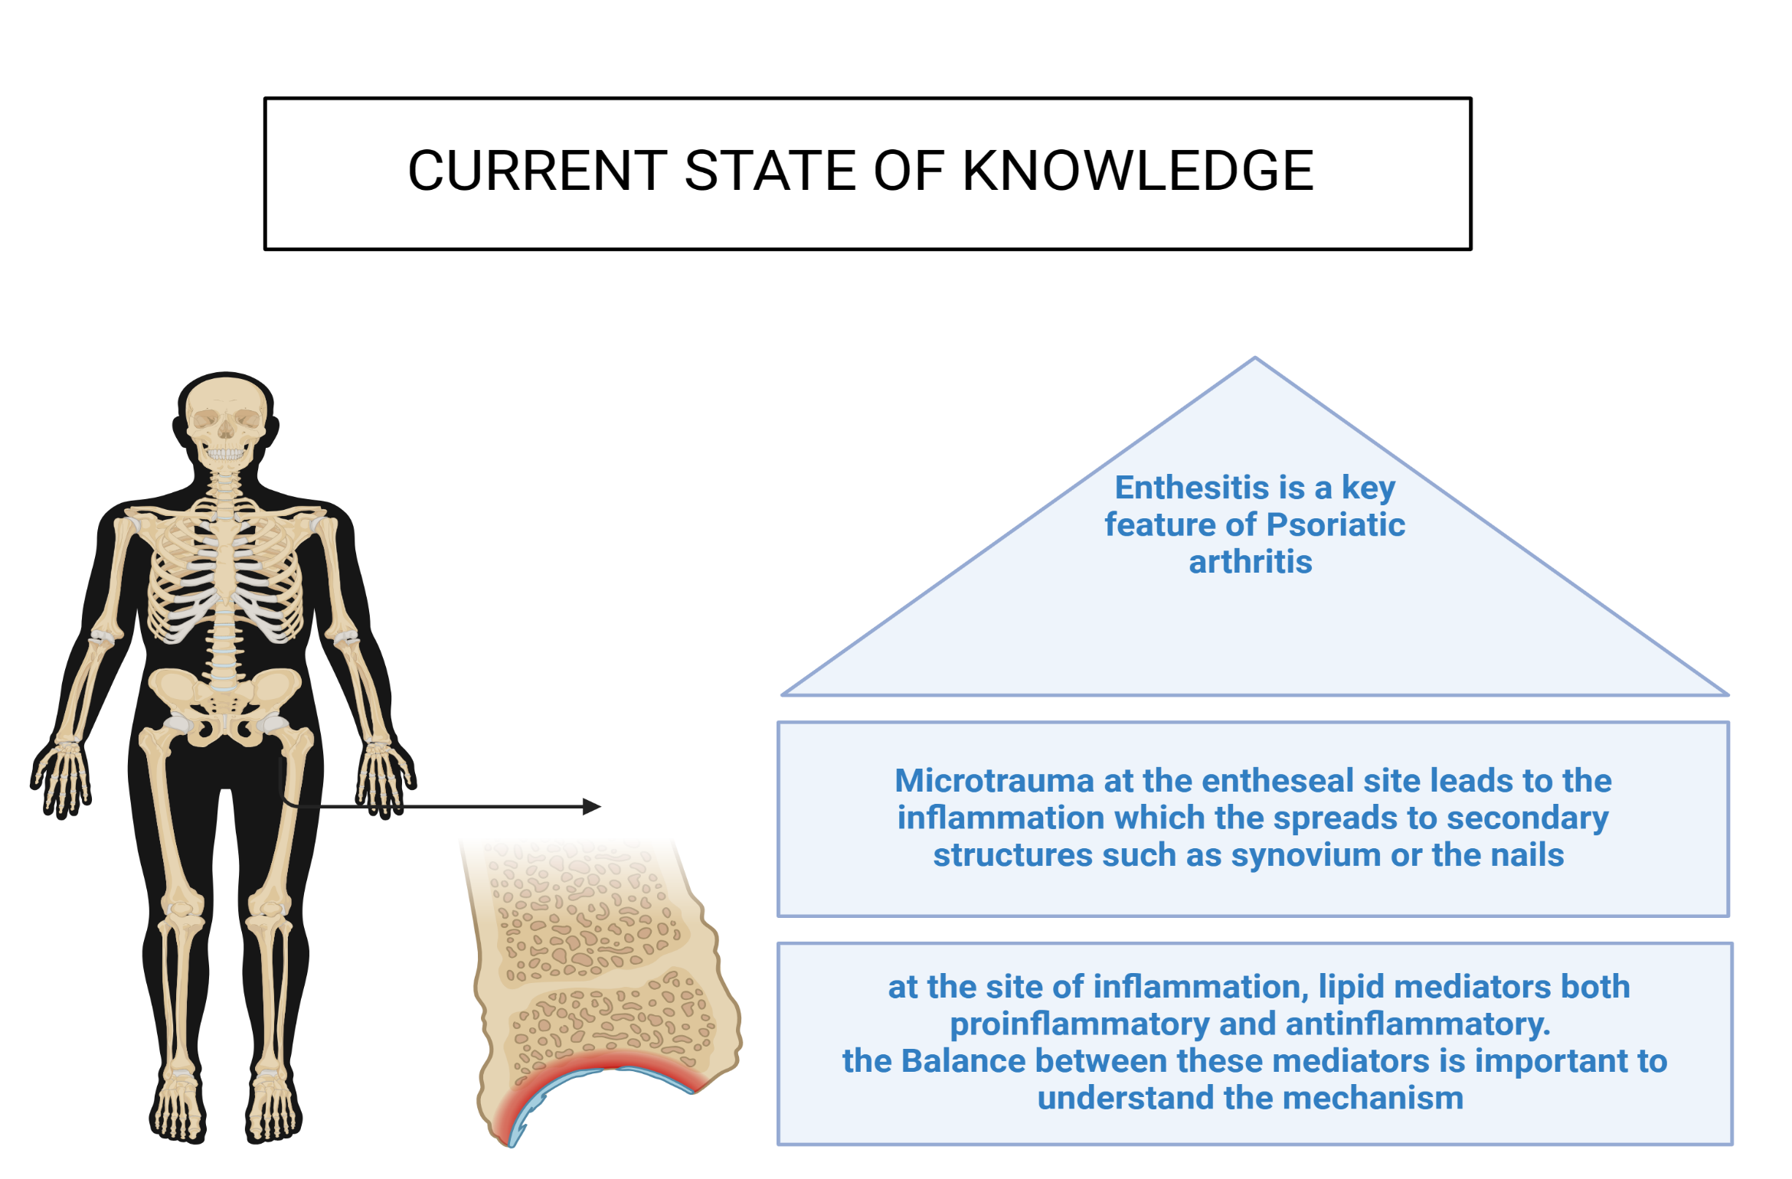

Slide 5
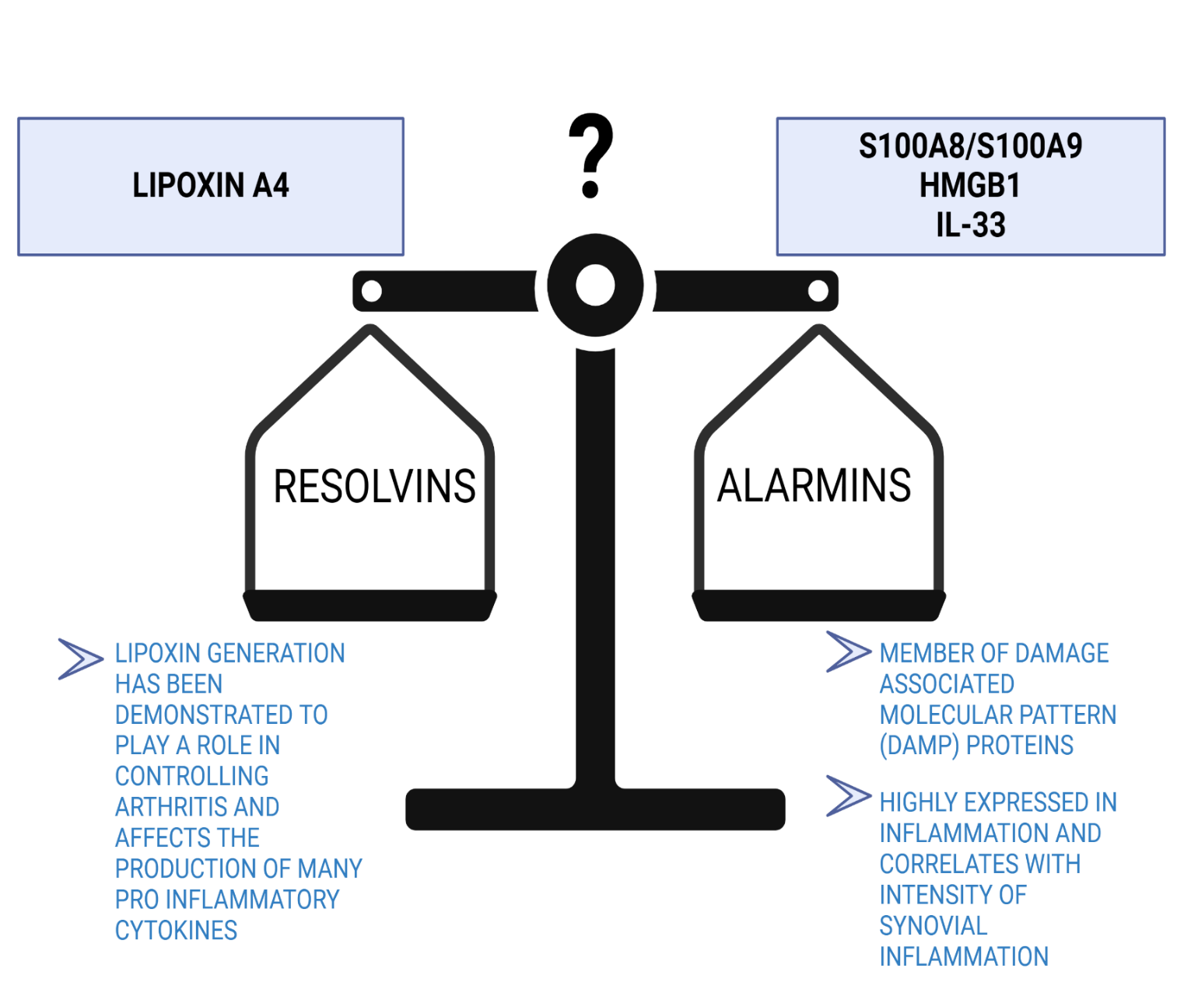

Slide 6
AT THE ENTHESES/ IN ENTHESOPATHY
the main subpopulation of cells found in entheses are macrophages (CD68+) and a scars population of resident T cell
The enthesis contains also cells that express IL23R (CD3+CD4-CD8-Ror gamma t+) and produce IL17, IL22 and Bmp7 in response to IL23
The main source of IL23 are macrophages abundant in place of inflammation in enthesis

Slide 7
Hypothesis
the resolution of chronic inflammation triggered by nonspecific factors like injury is impaired in patients with psoriatic arthritis
Main aims
The main aim of the study is to discover new biomarkers for psoriatic arthritis
To examine in depth immunological background behind psoriatic arthritis
The role of chosen danger-associated molecular patterns (alarmins) i.e. S100A8/A9 and counteracting specialized lipid mediators i.e. lipoxin A4 in this process will be examined
The potential role of the studied alarmins and eicosanoids as biomarkers will be assessed

Slide 8

METHODS

Slide 9
Target population, Control,& comparison groups
PSA:
Serum:60*
PBMC: (30)
HC:
Serum: 100*
PBMC: (30)
PSO:
Serum: (30)
PBMC: (30)
Recruitment stage will be finalized by the end of June 2024
Samples will be shift to SIAF
RA:
Serum:100*
PBMC: 30
*: available
(): Traget

Slide 10
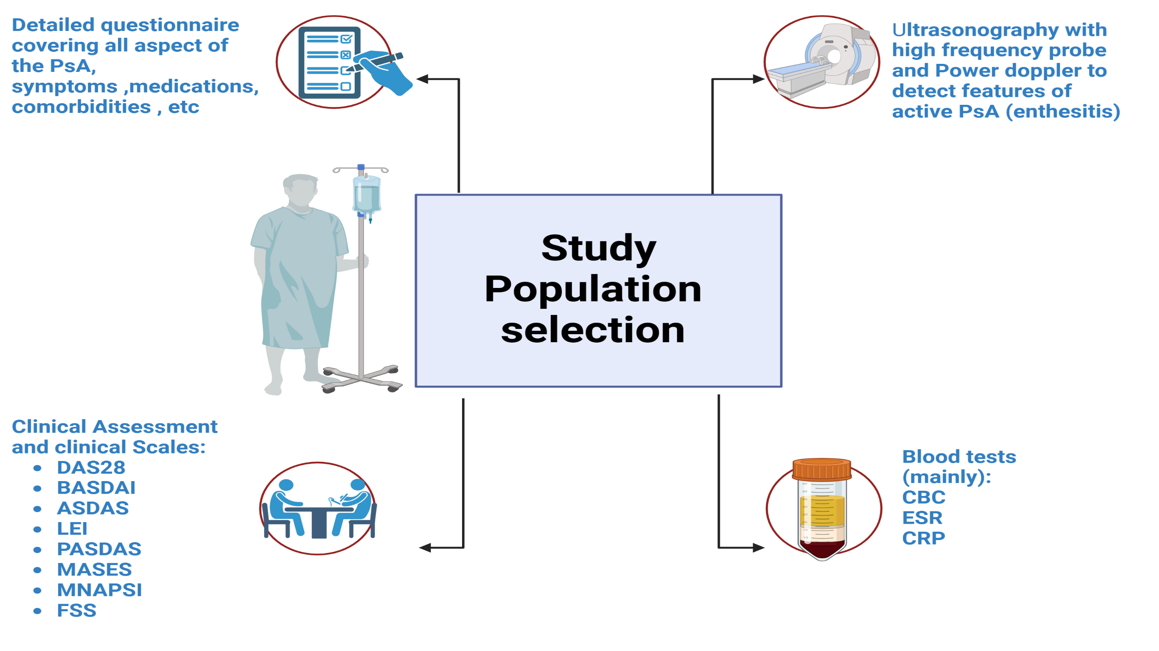

Slide 11
Methods employed
In-vivo
In-vitro
Ex-vivo
Assessment of lipoxin A4, resolvin E1 and alarmins in serum
Assessment of lipoxin effect on resolution of inflammation in PBMC
In depth immunophentyping and assessment of lipoxin A4 receptor, and calprotectin metabolism & signaling pathways
Probable use of targeted lipidomics*

Slide 12
In-vivo
Assessment of lipoxin A4, resolvin E1 and alarmins in serum:
The lipoxin A4, resolvin E1 and alarmins (S100A8/S100A9, HMGB1, IL33) concentration in serum from patents with PsA will be assessed by ELISA method using commercially available ELISA kits (R&D System, Inc., Minneapolis, MN, IBL International GmbH, Hamburg, Germany, Assay Designs Inc., Ann Arbor, USA).
And this expression will be correlated to the psoriatic arthritis subtypes and severity

Slide 13
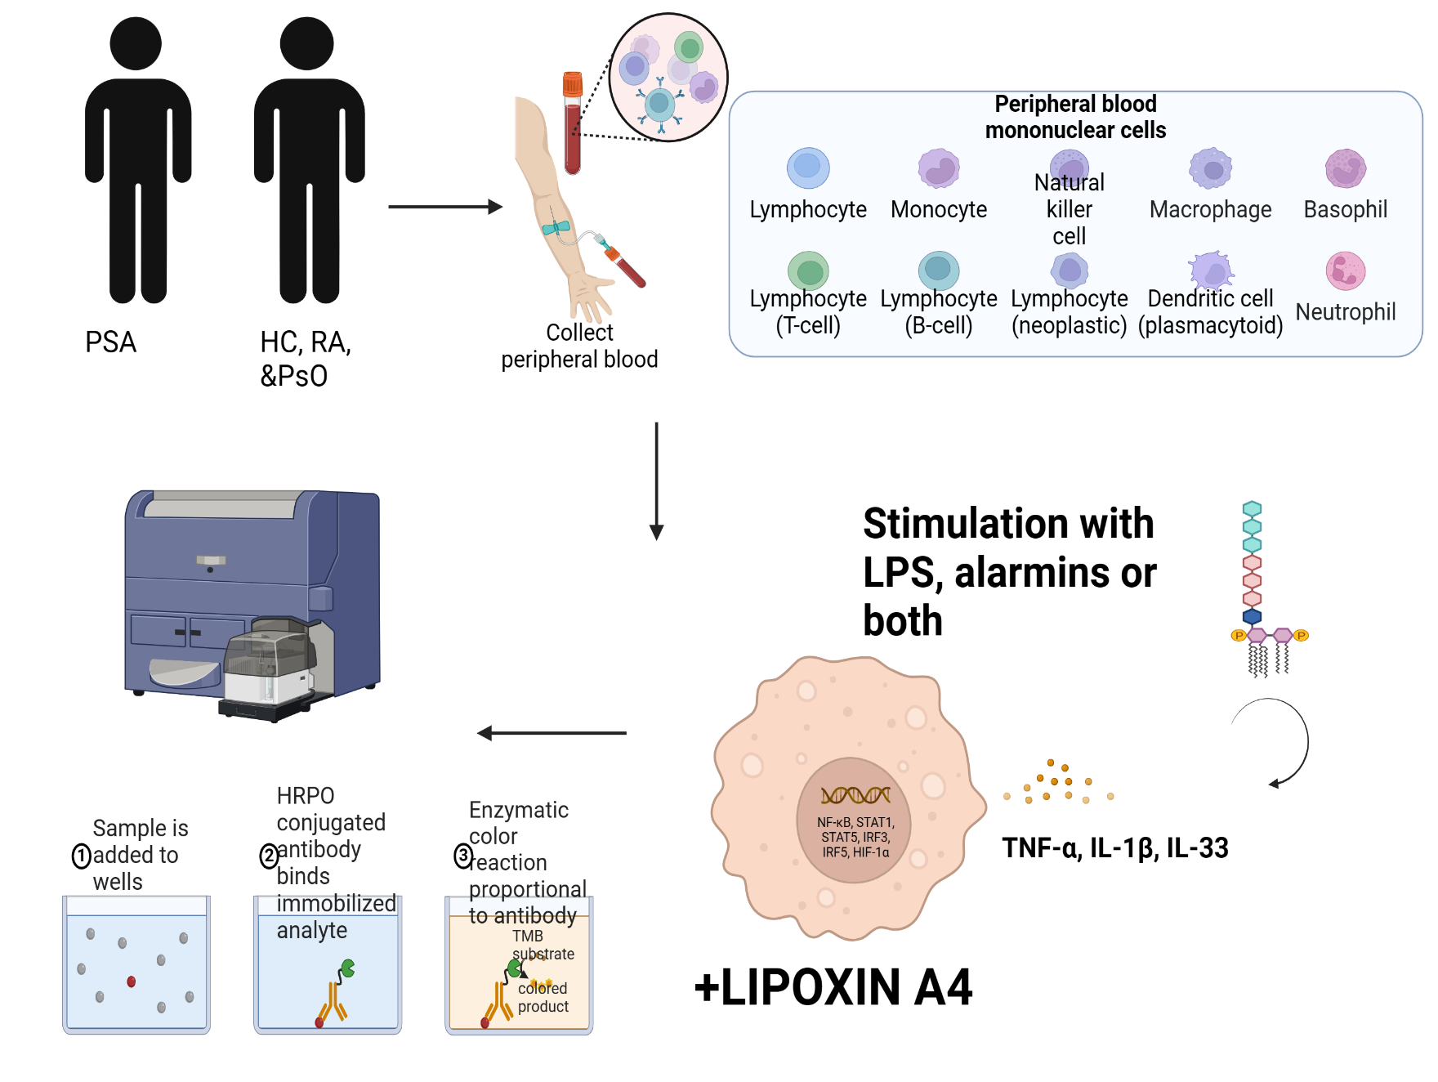
In-vitro
Advancements and updates during visit
Seahorse Assay kits:
Fatty acid oxidation assay kit (palmitate oxidation stress test kit)
ATP rate assay kit
Will be used as metabolism assay for CD4+ cells and monocytes in psoriatic arthritis samples

Slide 14
RESULTS (preliminary)
The basal and LPS-induced pro-inflammatory cytokine production by PBMCs was lower in PsA patients as compared to healthy subjects. Strikingly, co-stimulation with LXA4 resulted in a significant increase in pro-inflammatory cytokine secretion in PsA, in contrary to the reduction observed in healthy subjects.

Slide 15
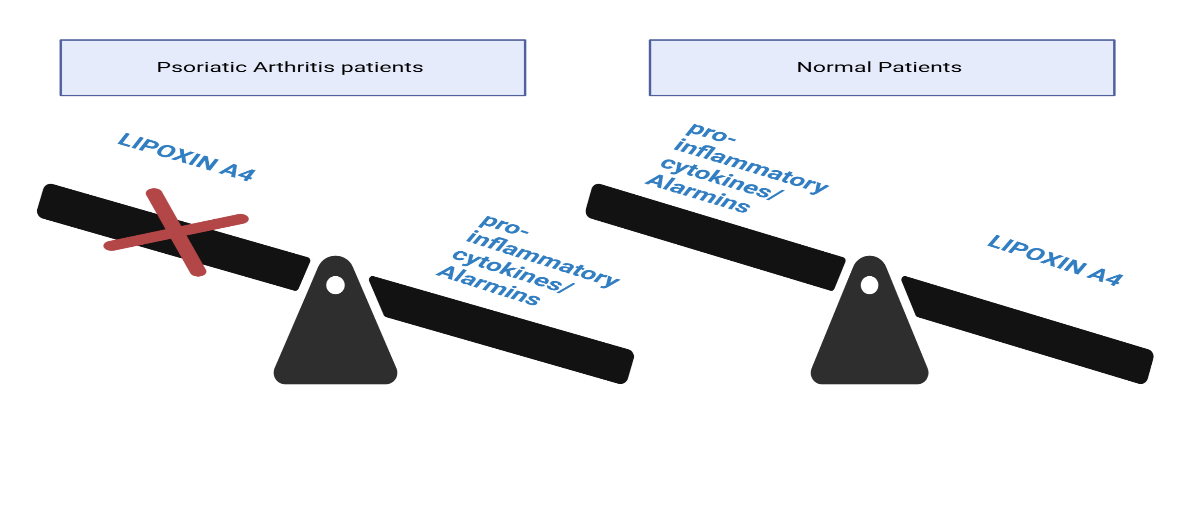
As a conclusion these preliminary data suggests that the resolution of inflammation is impaired in patients with psoriatic arthritis.
The role of lipoxin A4 in resolution of inflammation has been studied in psoriasis but still not investigated in psoriatic arthritis
Our project needs to be expanded and further aspects needs to be studied and validated

Slide 16
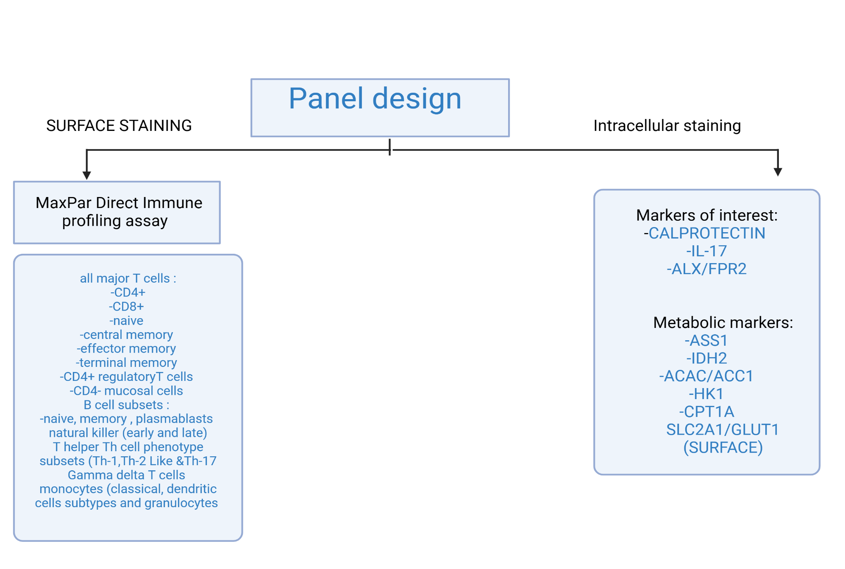
EX-vivo experiments
Purpose of this panel:
Immunophenotyping Head to head comparison between
10 PsA patients
10 RA patients
10 PsO patients
10 HC patients
Subset of the psoriatic arthritis patients taking monoclonal antibodies (3 patients)
Show the expression of different target antibodies
- Clustering the cell population and showing different metabolic pathway

Slide 17

Achievements
Publications
Research visits
Conferences
Awards
Primary angiitis of the CNS and ANCA-associated vasculitis: from pathology to treatment
DOI: 10.1007/s00296-023-05461-9
6 month training and research conduction at the swiss institute for asthma and allergy SIAF
Active participation (oral presentation) in the XX.International Medical Doctoral Conference in Hradec Kralove
OncoPhd conference 2023 active participation (oral presentation) and the winner of the Session VII ”Clinical Adults.

Slide 18
THANK YOU FOR YOUR ATTENTION
Special Thanks:
- Prof. Joanna Makowska, head of the rheumatology clinic
-Joanna Sarnik, PhD, head of rheumatology clinic lab
-Nino Stocker, Msc, laboratory technician from SIAF
-Ernesto Lopez, phD (standard bio tools )
Please keep this slide for attributi
on

