Slide 1
Clinical significance of selected biomarkers of inflammatory and congestive processes in heart failure
Maria Sawościan, MD
Supervisor: Professor Małgorzata Lelonek, MD, PhD
Department of Noninvasive Cardiology

Slide 2
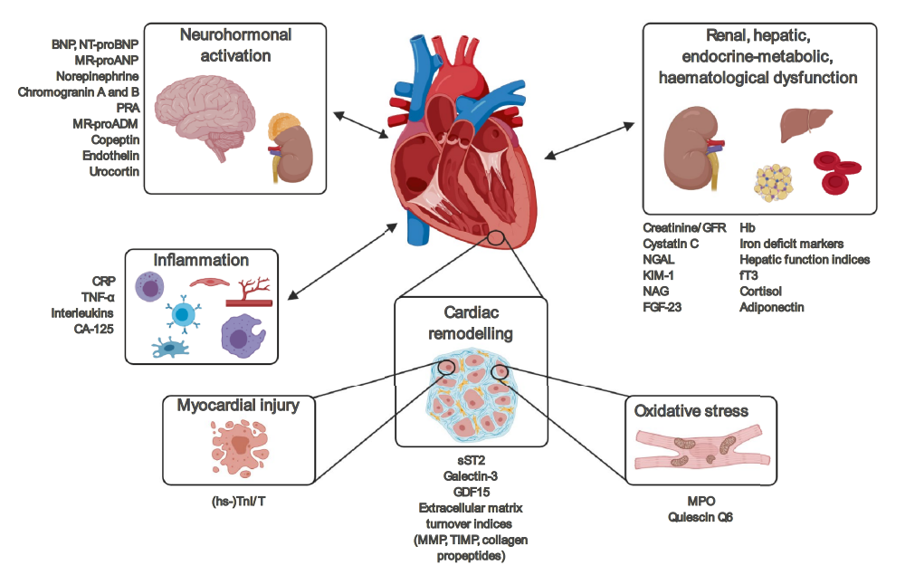
Introduction
Heart failure (HF) is a common disease with an incidence of more than 10% in the population over 70 years of age.
It is extremely important to select an appropriate set of biomarkers that may be helpful in the differential diagnosis of HF, risk stratification and treatment modification.
The commonly used biomarker should meet the relevant criteria, such as: high sensitivity and specificity, standardization, repeatability and universal availability, also for economic reasons.
Source: Castiglione V, Aimo A, Vergaro G, et al. Biomarkers for the diagnosis and management of heart failure. Heart Fail Rev. 2022; 27(2): 625–643

Slide 3
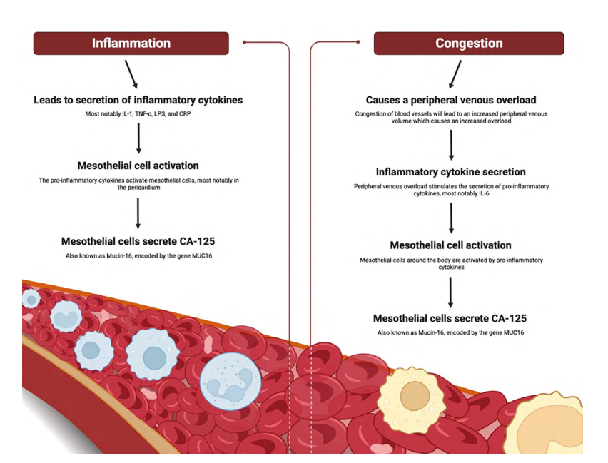
CA-125 – not only for the oncologists - the mutual interaction between inflammation and congestion in heart failure
Source: Sawościan M, Lelonek M. CA-125: a promising biomarker in heart failure. Summary of the current knowledge

Slide 4
Heart failure cut-off groups according to CA-125 levels
Source: Sawościan M, Lelonek M. CA-125: a promising biomarker in heart failure. Summary of the current knowledge

Slide 5
Purpose, Materials & Methods
The aim of the study is to assess the usefulness of biomarker determination in clinical practice in patients diagnosed with heart failure.
The study is based on a retrospective analysis of patients with HF hospitalized from November 2021 to December 2023 at the Department of Non-Invasive Cardiology of the Medical University of Lodz and a1-year follow-up.
Statistical analysis is performed using Statistica 13.3 PL (StatSoft, Tulsa, USA). The analysis is performed in the groups of exacerbation of HF vs stable HF.

Slide 6
Study population
Inclusion criteria
Exclusion criteria
1. Patients consecutively admitted to the ward due to heart failure, regardless of left ventricular ejection fraction.
2. Patients with laboratory tests specified in the protocol, including biomarkers of inflammatory and congestive processes in heart failure.
1. Active neoplasma
2. Infections that may exacerbate HF
3. Acute coronary syndrome
4. Cirrhosis
5. Pregnancy period

Slide 7
Study population
205 hospitalised consecutively
51 records excluded from analysis - 18 without HF - 33 rehospitalisations
154 included in analysis

Slide 8
Results - demographics

Slide 9
Comparison of variables according to the occurrence of heart failure exacerbation
Variable | HF worsening |  | P-value
 | Yes (N=92) Me (IQR) | No (N=62) Me (IQR)
hsTnT [ng/L] | 20.00 (13.00 - 32.50) | 12.00 (10.00 - 21.00) | 0.0002
NT-proBNP at admission [pg/mL] | 1 249.00 (412.50 - 2 371.00) | 344.00 (192.00 - 775.00) | <0.0001
hs-CRP [mg/l] | 2.29 (0.88 - 4.87) | 1.42 (0.74 - 4.21) | 0.1600
CA-125 at admission[U/ml] | 14.85 (9.20 - 32.55) | 12.95 (9.90 - 20.40) | 0.1577

Slide 10
Comparison of variables according to the occurrence of heart failure exacerbation
Variable | HF worsening |  | P-value
 | Yes (N=92) Me (IQR) | No (N=62) Me (IQR)
Systolic BP [mmHg] | 127.00 (113.00 - 140.00) | 128.00 (115.00 - 141.00) | 0.8732
Diastolic BP [mmHg] | 80.00 (73.00 - 85.00) | 79.00 (69.00 - 86.00) | 0.4171
LVEF [%] | 52.00 (41.50 - 56.00) | 55.00 (46.50 - 60.00) | 0.0148
LVD [mm] | 49.50 (46.00 - 57.00) | 47.00 (44.00 - 53.00) | 0.0603
IVSD [mm] | 11.00 (10.00 - 13.00) | 11.00 (10.00 - 12.00) | 0.4921
PWD [mm] | 10.00 (9.00 - 11.00) | 10.00 (9.00 - 11.00) | 0.3923
LAV [mL] | 99.00 (70.00 - 139.00) | 73.00 (57.00 - 107.00) | 0.0042
TAPSE [mm] | 21.00 (16.00 - 23.50) | 22.00 (19.00 - 25.00) | 0.0563
PASP [mmHg] | 42.00 (35.00 - 50.00) | 35.00 (28.00 - 39.00) | 0.0519
IVC [mm] | 18.00 (16.00 - 21.00) | 20.00 (15.00 - 23.00) | 0.8295
6MWT | 219.00 (158.00 - 280.00) | 283.50 (227.00 - 350.00) | 0.0010

Slide 11
Comparison of variables according to the occurrence of heart failure exacerbation
Variable | HF worsening |  | P-value
 | Yes (N=92) N (%) | No (N=62) N (%)
Cardiac Implantable Electronic Device | 19 (20.65%) | 8 (12.90%) | 0.3058
DM | 39 (42.39%) | 24 (38.71%) | 0.6486
HA | 81 (88.04%) | 54 (87.10%) | 0.8609
Dyslipidemia | 89 (96.74%) | 59 (95.16%) | 0.6197
Chronic Coronary Syndrome | 56 (60.87%) | 25 (40.32%) | 0.0123
Chronic Kidney Disease | 40 (43.48%) | 8 (12.90%) | <0.0001
ID | 56 (60.87%) | 23 (37.10%) | 0.0066
Hyperurycemia | 60 (65.22%) | 32 (51.61%) | 0.0914
Nicotinism | 34 (36.96%) | 29 (46.77%) | 0.2242
Alcohol abuse | 3 (3.26%) | 5 (8.06%) | 0.1877
Myocardial infraction | 26 (28.26%) | 14 (22.58%) | 0.4643
PCI/CABG | 36 (39.13%) | 18 (29.03%) | 0.2503
Stroke/TIA | 10 (10.87%) | 8 (12.90%) | 0.8683

Slide 12
Comparison of variables according to the occurrence of heart failure exacerbation
Variable | HF worsening |  | P-value
 | Yes (N=92) N (%) | No (N=62) N (%)
Cardiac Implantable Electronic Device | 19 (20.65%) | 8 (12.90%) | 0.3058
DM | 39 (42.39%) | 24 (38.71%) | 0.6486
HA | 81 (88.04%) | 54 (87.10%) | 0.8609
Dyslipidemia | 89 (96.74%) | 59 (95.16%) | 0.6197
Chronic Coronary Syndrome | 56 (60.87%) | 25 (40.32%) | 0.0123
Chronic Kidney Disease | 40 (43.48%) | 8 (12.90%) | <0.0001
ID | 56 (60.87%) | 23 (37.10%) | 0.0066
Hyperurycemia | 60 (65.22%) | 32 (51.61%) | 0.0914
Nicotinism | 34 (36.96%) | 29 (46.77%) | 0.2242
Alcohol abuse | 3 (3.26%) | 5 (8.06%) | 0.1877
Myocardial infraction | 26 (28.26%) | 14 (22.58%) | 0.4643
PCI/CABG | 36 (39.13%) | 18 (29.03%) | 0.2503
Stroke/TIA | 10 (10.87%) | 8 (12.90%) | 0.8683

Slide 13
Comparison of variables according to the occurrence of heart failure exacerbation
Correlation | N | R | p
TC [mmol/L] & CA-125 at admission[U/ml] | 154 | -0.05 | 0.5259
LDL [mmol/L] & CA-125 at admission[U/ml] | 151 | -0.01 | 0.9365
HDL [mmol/L] & CA-125 at admission[U/ml] | 154 | -0.11 | 0.1868
non-HDL [mmom/L] & CA-125 at admission[U/ml] | 154 | -0.03 | 0.7244
TG [mmol/L] & CA-125 at admission[U/ml] | 153 | -0.07 | 0.3617
hsTnT [ng/L] & CA-125 at admission[U/ml] | 154 | 0.25 | 0.0022
NT-proBNP at admission [pg/mL] & CA-125 at admission[U/ml] | 154 | 0.42 | <0.0001
hs-CRP [mg/l] & CA-125 at admission[U/ml] | 151 | 0.25 | 0.0016

Slide 14
Comparison of variables according to the occurrence of heart failure exacerbation
Correlation | N | R | p
Systolic BP [mmHg] & CA-125 at admission[U/ml] | 136 | -0.11 | 0.2070
Diastolic BP [mmHg] & CA-125 at admission[U/ml] | 136 | -0.05 | 0.5611
LVEF [%] & CA-125 at admission[U/ml] | 152 | -0.12 | 0.1497
LVD [mm] & CA-125 at admission[U/ml] | 141 | 0.13 | 0.1219
IVSD [mm] & CA-125 at admission[U/ml] | 140 | -0.04 | 0.6696
PWD [mm] & CA-125 at admission[U/ml] | 140 | 0.03 | 0.7355
LAV [mL] & CA-125 at admission[U/ml] | 142 | 0.27 | 0.0012
TAPSE [mm] & CA-125 at admission[U/ml] | 143 | -0.26 | 0.0018
PASP [mmHg] & CA-125 at admission[U/ml] | 37 | 0.31 | 0.0644
IVC [mm] & CA-125 at admission[U/ml] | 38 | 0.28 | 0.0830
6MWT & CA-125 at admission[U/ml] | 122 | -0.13 | 0.1506

Slide 15
Univariate logistic regression model for the dependent variable HF exacerbation
Variable | OR (95%CI) | P-value
6MWT | 0.993 (0.99 - 1.00) | 0.0014
CA-125 at admission[U/ml] | 1.018 (1.00 - 1.03) | 0.0232
hs-CRP [mg/l] | 1.027 (0.98 - 1.07) | 0.2343
NT-proBNP at admission [pg/mL] | 1.001 (1.00 - 1.00) | 0.0001
hsTnT [ng/L] | 1.030 (1.01 - 1.05) | 0.0114
TG [mmol/L] | 0.828 (0.48 - 1.43) | 0.5001
non-HDL [mmom/L] | 0.602 (0.42 - 0.86) | 0.0060
HDL [mmol/L] | 0.447 (0.17 - 1.19) | 0.1063
LDL [mmol/L] | 0.576 (0.39 - 0.85) | 0.0051
TC [mmol/L] | 0.653 (0.48 - 0.90) | 0.0085
RDW [%] | 1.725 (1.29 - 2.32) | 0.0003
TAPSE [mm] | 0.926 (0.86 - 1.00) | 0.0554
LVEF [%] | 0.966 (0.936 – 0.997) | 0.0316

Slide 16
Conclusions
Our results indicate multi-morbidity of hospitalised HF patients and the need for a holistic approach to the patient, as well as a diverse set of biomarkers.
The outcomes emphasized and confirmed the significance of ID screening and the role of hsTnT, NT-proBNP and CA-125 as a set of HF biomarkers.

Slide 17
Publications
a) Szulc-Bagrowska J, Sawościan M, Kołodziejczyk K, Lelonek M. Iron deficiency in patients with heart failure and higher incidence of strokes. Folia Cardiologica 2022;17(5):283-288. DOI: 10.5603/FC.a2022.0031.
b) Kiełbowicz P, Kosegarten YF, Sawościan M, Lelonek M. Iron deficiency, heart failure, cerebrovascular accidents - what is the connection? Folia Cardiologica 2023;18(1):16-23. DOI: 10.5603/FC.a2023.0002.
c) Sawościan M, Lelonek M. CA-125 — a promising biomarker in heart failure. Summary of the current state of the knowledge. Folia Cardiologica, DOI: 10.5603/FC.a2022.0052.
d) Sawościan M, Lelonek M. Empagliflozin in the predischarge period. Świat Medycyny I Farmacji (2023) 1, 54-57.
e) Sawościan M, Lelonek M. Ivabradine in the pre-discharge period - tips and tricks. Świat Medycyny I Farmacji (2023) 1, 36-41.
f) Sawościan M, Lelonek M. Dapagliflozin therapy and reduction of death from cardiovascular causes. Świat Medycyny i Pharmacy (2023) 6, 8-13.
h) Major K, Sawościan M, Budnik M, et al. Baseline characteristics of Polish patients with heart failure with ejection fraction > 40%: Results of HF-POL, the first study of Heart Failure Association. Polish Heart Journal. DOI: https://doi.org/10.33963/v.phj.99195

Slide 18
Achievements
1. Participation as a sub-investigator in the ZEUS and HERMES clinical trial, which assesses the impact of the investigational drug on biomarkers of inflammatory processes in patients with heart failure
(hs-CRP, NT-proBNP)
2. Participation as a sub-investigator in the POSEIDON clinical trial, which assesses the role of biomarkers of inflammatory processes in patients with heart failure (hs-CRP, NT-proBNP)
3. Poster presentation of current research results related to the implementation of the doctoral dissertation during the Conference of the Heart Failure Association of the Polish Society of Cardiology
16-17/06/2023 in Łódź.
4. Participation in the SOIT PRO - School Of Insulinresistance Therapy training and obtaining the title of "Insulin Resistance Friendly Specialist" - online 23/09/2023
5. Participation in the 10th Lodz Heart Failure Workshop - online 03/02/2023
6. Participation in the 2nd Congress of the Polish Society for the Treatment of Obesity - Warsaw 01-02/12/2023
7. Participation in the Certification of Lipidologists – online 06/04/2023 – 16/12/2023
8. Participation in the Local Meeting of Investigators of the HERMES and ZEUS clinical trial - Warsaw 21-22/03/2024
9. Speech during the scientific meeting "From a heart attack to a drug program" - online November 9, 2023
10. Participation in the "Together for Lipidology" conference - Warsaw 22-23/03/2024
11. Speech during the workshop "Navigating Medical Research: A Comprehensive Guide for Aspiring Researchers" organized by SKN at the Department of Non-Invasive Cardiology - CKD Łódź 13/12/2023
12. Co-tutor of the SKN at the Department of Non-Invasive Cardiology
13 . Membership in the Polish Society of Cardiology, Polish Lipidological Society, Polish Society for the Treatment of Obesity, Polish Society of Lifestyle Medicine

Slide 19
Thank you for your time!
maria.sawoscian@umed.lodz.pl

