Slide 1
Analysis of Pancreatic Cyst microbiome
Praveen Malik 3rd year PhD Candidate
Supervisor Prof. Dr. adam Durczyński

Slide 2
Introduction
ObjectiveS, Materials & Methods
Results
Conclusions
Activities
Bibliography

Slide 3
Introduction
There were two studies done since 2021
1) Microbiome in pancreatic fluid – preliminary analysis of pancreatic cystic lesion (article published)
2) Microbiota and serum tumour markers in patients with pancreatic cystic neoplasm (article submitted)

Slide 4
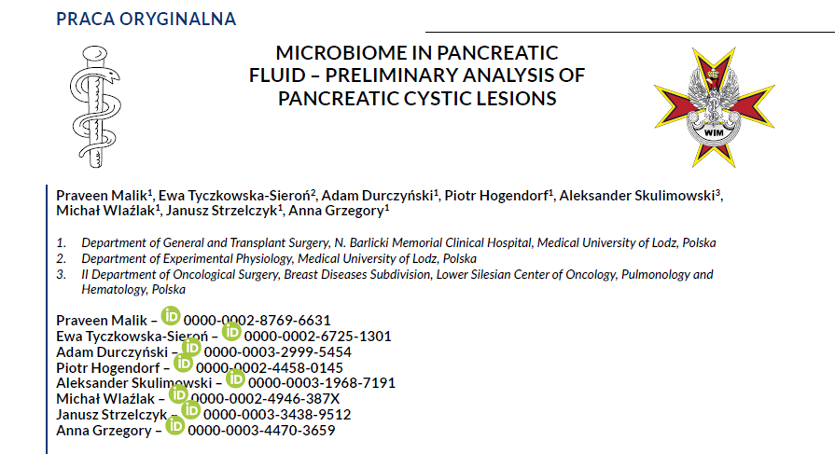
Published in
LEKARZ WOJSKOWY
MILITARY PHYSICIAN
2023.10.20
Preliminary Analysis

Slide 5
Summary (first study)
30 patients with pancreatic cysts undergoing surgery in 2022-2023 at the Department of General and Transplant Surgery, Medical University of Lodz, were enrolled in the study. Preoperative biochemical parameters blood levels were analyzed. Bacterial culture results were taken from the nasal vestibule, the skin of the groin, and from cyst fluid and bile (in case of cholecystectomy) and histopathological reports were analyzed.
Results
Mean age was 58.77 ±13.56 years. 10 patients (33.3%) had malignant lesions. Nine patients (30%) had positive cultures from the cyst fluid. 6 of them had malignant conditions. In the malignant group, patients were statistically significantly older (68.40±5.70 y vs. 53.95±13.86 y, p=0,004), tumour diameters were smaller (4.00±2.00 cm vs. 8.50±5.77 cm, p=0,003) and Ca 19-9 level were higher (100.22±186.46 ng/ml vs. 12.35±16.08 ng/ml, p=0,045) than in a benign group.
Conclusion
The occurrence of specific types of bacteria in patients with malignant pancreatic cysts appears to be of significant clinical importance. Further studies are needed.

Slide 6
Summary (Second Study)
One of the main precursory lesions for pancreatic carcinoma are pancreatic cystic neoplasms (PCN). Differentiation between the various types of cysts is a clinical challenge. The aim of the study was the assessment of serum tumour markers compared with microbiological status, biochemical parameters and histopathological results in patients with PCN. We confirmed in population of 59 PCN patients the association between microbiological and histopathological status and serum inflammatory and tumour markers. Patients with positive cultures had tendency to higher incidence of cancers, increased c-reactive protein levels and longer hospitalization period. C-reactive protein level had a correlation with tumour markers levels.

Slide 7
Objective, Material and Methods
Objective: To assess microbiological status and the serum tumour markers compared with biochemical parameters and histopathological results in patients with PCN.
Material and Methods: 59 patients with pancreatic cysts treated in 2022-2023 were enrolled in the study. Preoperative serum inflammatory and tumour markers were measured. Bacterial culture results were taken from the nasal vestibule, the skin of the groin, and from cyst fluid and bile (in case of cholecystectomy) and histopathological reports were analyzed.

Slide 8
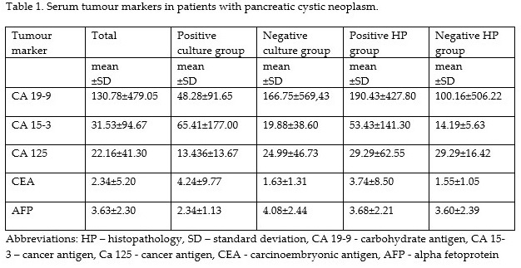
Results
Seven (41.18%) patients with positive culture had cancer compared with 12 (28.57%) negative patients (p=0.35). In cystic pancreatic cancer group CA19-9 level was higher (190.43±427.80 ng/ml) than among benign lesions (100.16±506.22 ng/ml) (p=0.02). Among patients with positive culture CRP level was higher (31.84±70.91 mg/l vs 10.94±28.75 mg/l; p=0.03). Serum AFP levels were lower in patients with positive culture (2.34±1.13 vs. 4.08±2.44 ng/ml, respectively; p=0.04). Furthermore, CRP level was positively correlated with CA19-9, CA 125 level and negatively correlated with AFP level and hospitalization period

Slide 9
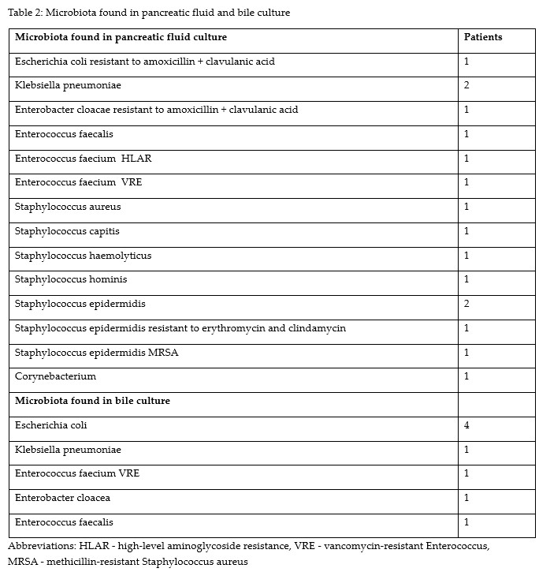
Results

Slide 10
Conclusions
Patients with positive intraoperative cultures had a tendency to a higher incidence of cancers, increased CRP levels and longer hospitalization period.
Patients with malignant lesions had CA19-9 level higher than patients with negative histopathology.
CRP level was positively correlated with CA19-9 level, CA 125 level and negatively correlated with AFP level .
Further studies on correlation between microbiological, biochemical and histopathological status of patients with pancreatic cystic neoplasm are needed.

Slide 11
An abstract for the International Surgical Week ISW 2024 to be held in Kuala Lumpur, Malaysia from 25 to 29 August 2024 was submitted.
Abstract number 2318 entitled “Microbiota and serum tumor markers in patients with pancreatic cystic neoplasm.”
has been provisionally accepted for a Poster Exhibition presentation.
INTERNATIONAL SOCIETY OF SURGERY
Scientific Secretariat ISW 2024
Seefeldstrasse 104, 8008 Zurich
Switzerland
Presenting Author Dr. n. med. Anna Grzegory
First author dr. Praveen Malik

Slide 12
Poster presentation at the conference held in Cracow, Poland in May 2024.
Abstract was titled “Microbiota and serum tumor markers in patients with pancreatic cystic neoplasm.”
XXX Zjazd Polskiego Towarzystwa Chirurgii Onkologicznej (PTChO)
16-18 May 2024, Kraków.
Presenting Author Dr. n. med. Anna Grzegory
First author dr. Praveen Malik

Slide 13
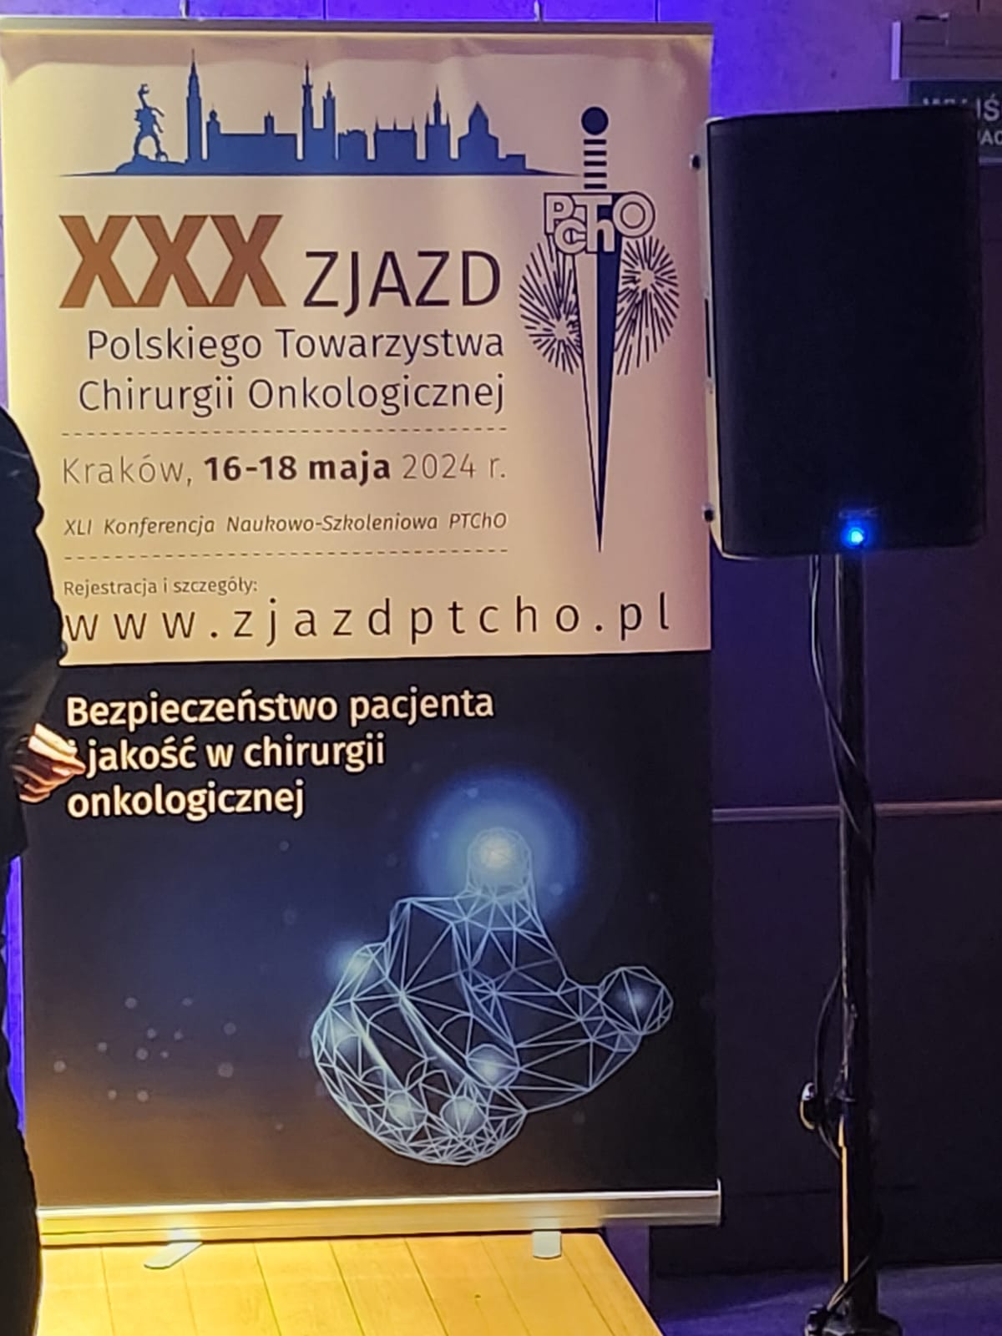
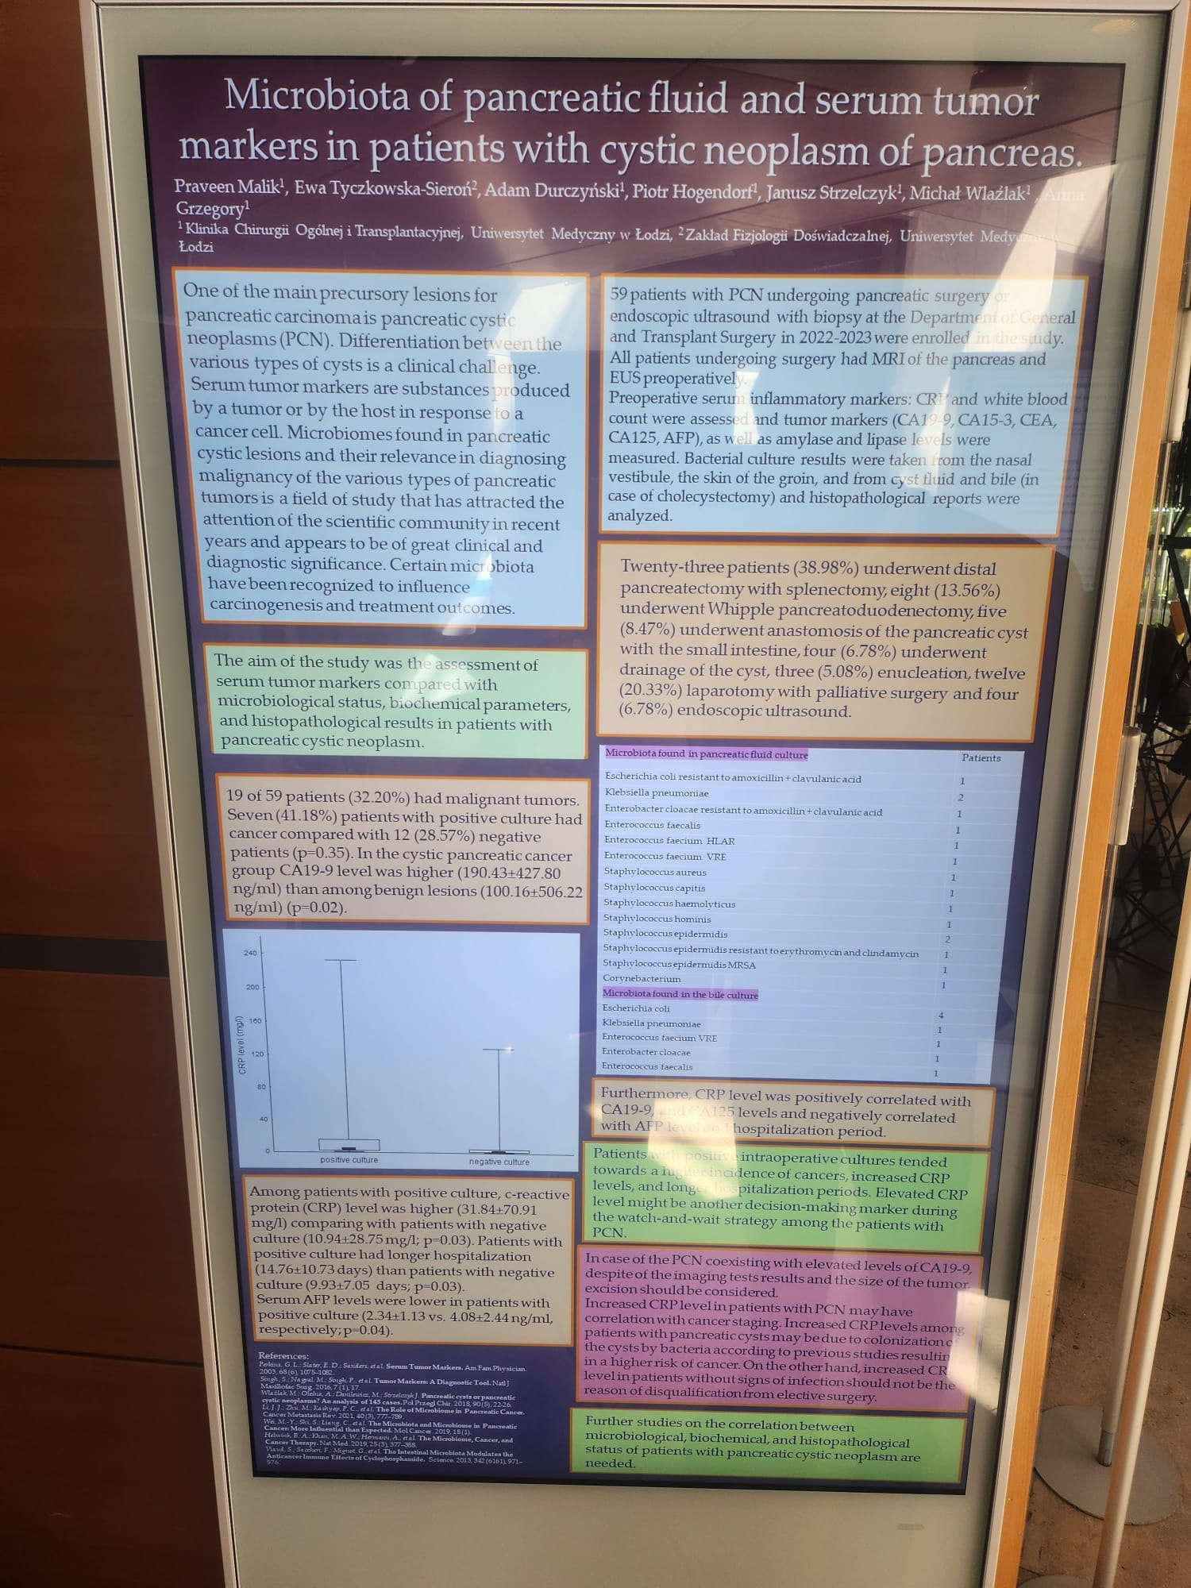
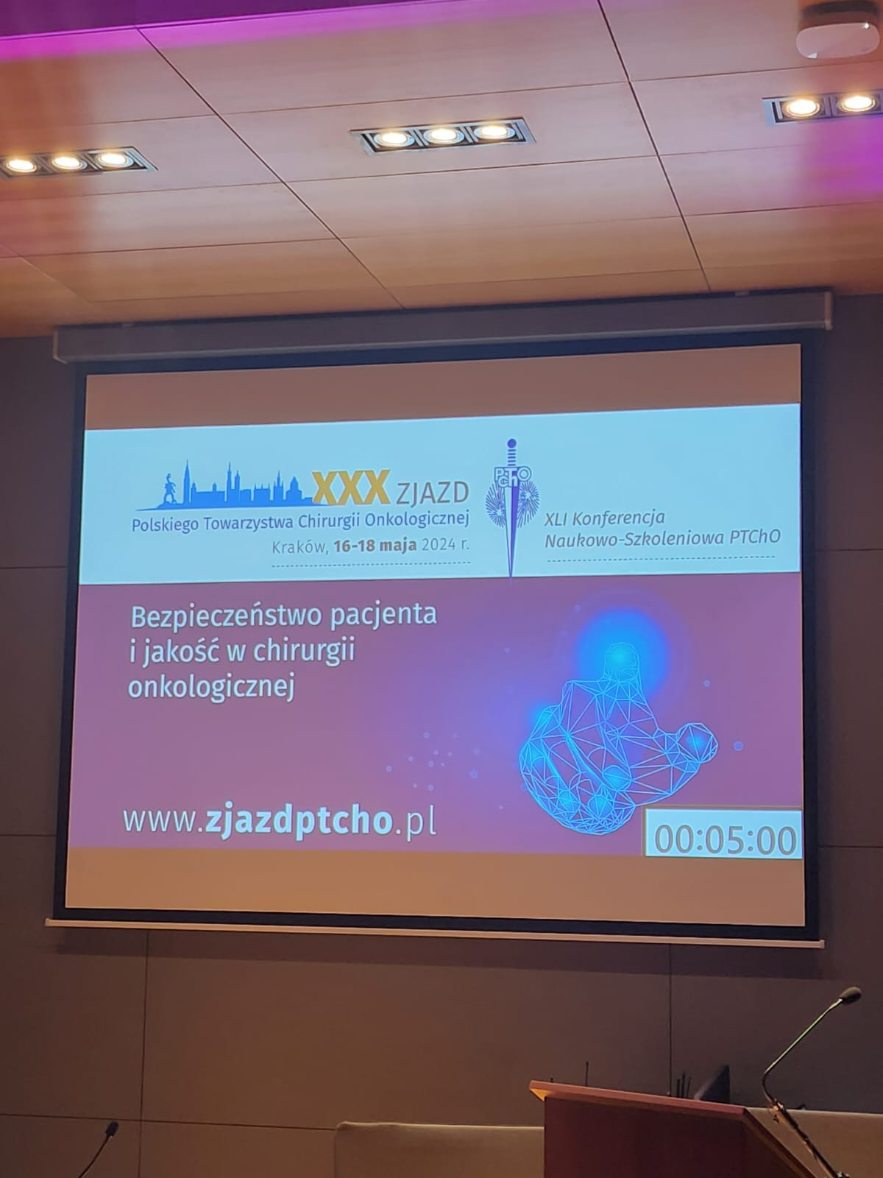

Slide 14
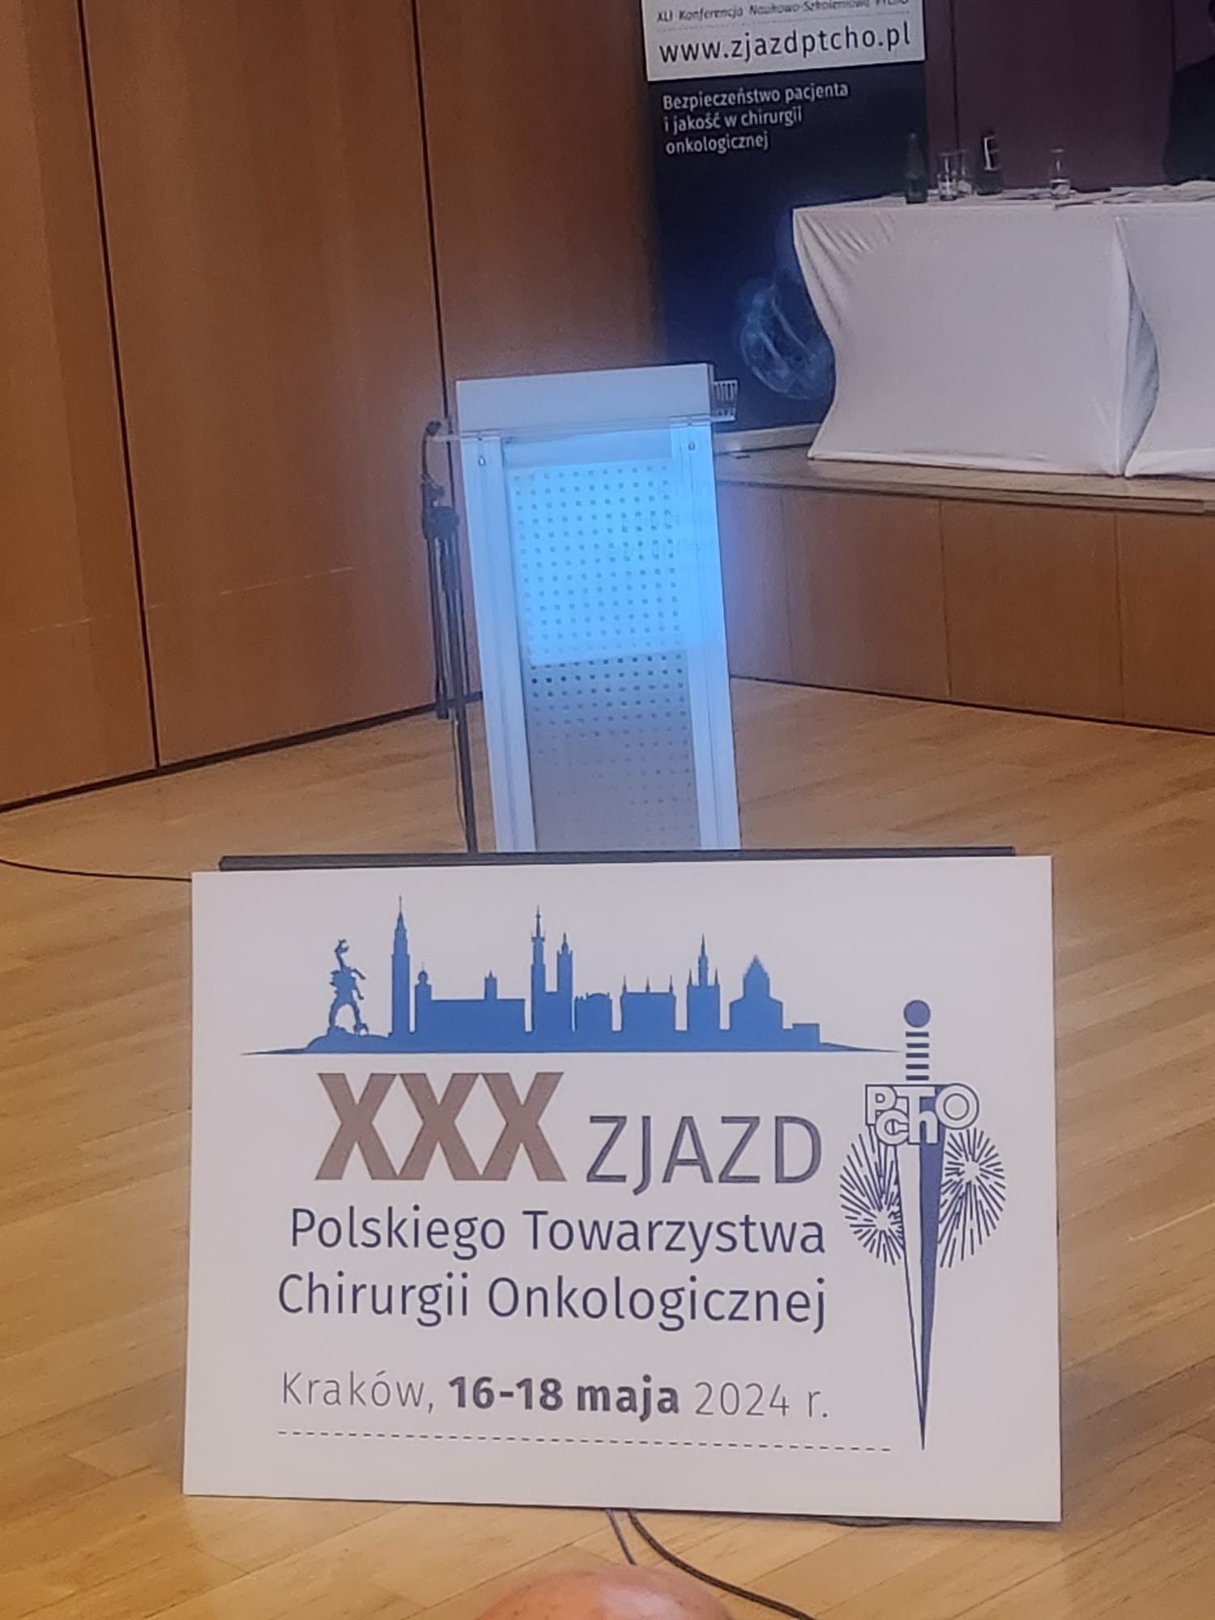
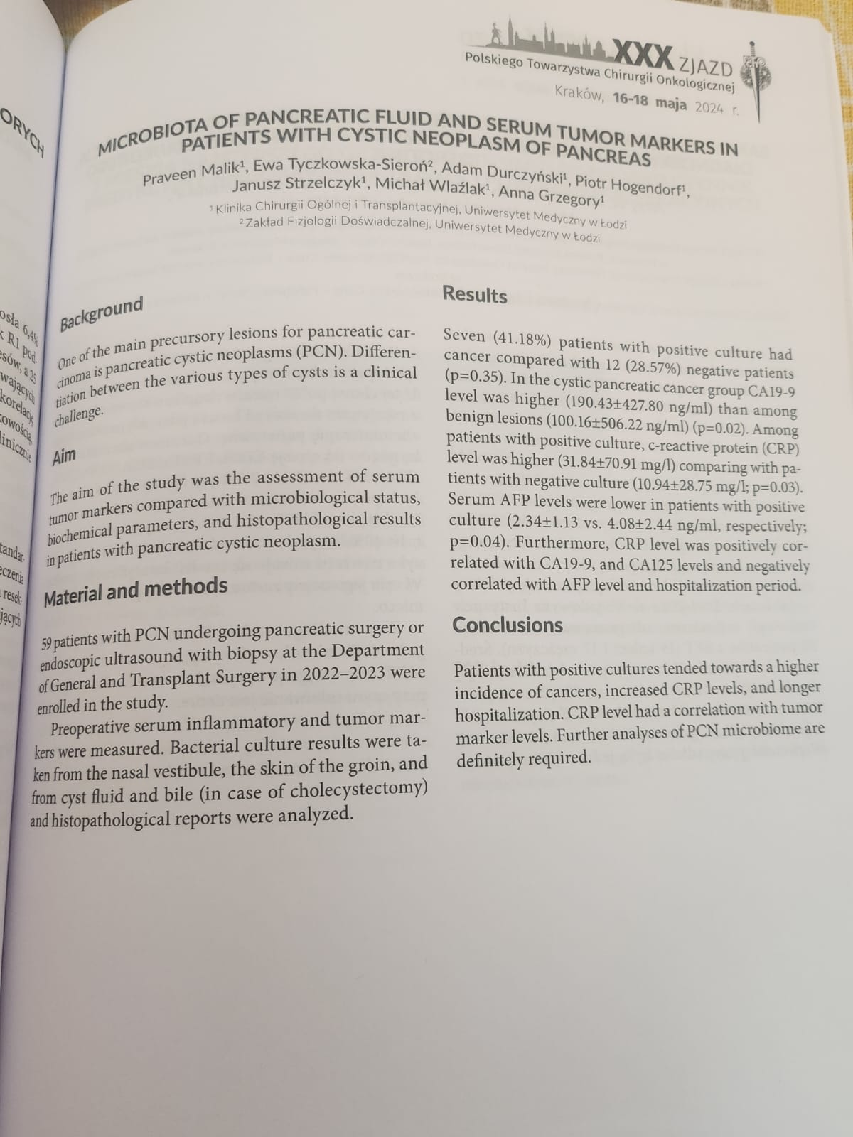

Slide 15
Published/Submitted Articles and Doctoral Thesis
1) Microbiome in Pancreatic Fluid - Preliminary Analysis of Pancreatic Cystic Lesions
Praveen Malik, Ewa Tyczkowska-Sieroń, Adam Durczyński, Piotr Hogendorf, Aleksander Skulimowski, Michał Wlaźlak, Janusz Strzelczyk, Anna Grzegory
Published on 2023.10.20 in Military Physician (Lekarz Wojskowy)
2) Microbiota of Pancreatic Fluid and Serum Tumor Markers in patients with Cystic Neoplasm of pancreas
Praveen Malik, Ewa Tyczkowska-Sierón, Adam Durczyński, Piotr Hogendorf, Anna Grzegory
Manuscript submitted to Biomarkers journal and is currently under review.
3) Usefulness of magnetic resonance imaging (MRI) in the assessment of pancreaticojejunostomy after modified Puestow procedure
Aneta Szmiel, Adam Durczyński, Praveen Malik et al.
Manuscript submitted to Polski Przegląd Chirurgiczny and is currently under review.
4) Collection and organization of material and references and commencement of writing introduction i.e. pancreatic cancer types, risk factors, diagnosis, epidemology etc. for the doctoral thesis.

Slide 16
References (part of it)
Perkins GL, Slater ED, Sanders GK, Prichard JG. Serum tumor markers. Am Fam Physician. 2003 Sep 15;68(6):1075-82. PMID: 14524394.
Nagpal M, Singh S, Singh P, Chauhan P, Zaidi MA. Tumor markers: A diagnostic tool. Natl J Maxillofac Surg. 2016 Jan-Jun;7(1):17-20. doi: 10.4103/0975-5950.196135. PMID: 28163473; PMCID: PMC5242068.
Li, J.J., Zhu, M., Kashyap, P.C. et al. The role of microbiome in pancreatic cancer. Cancer Metastasis Rev 40, 777–789 (2021). https://doi.org/10.1007/s10555-021-09982-2
Wei, MY., Shi, S., Liang, C. et al. The microbiota and microbiome in pancreatic cancer: more influential than expected. Mol Cancer 18, 97 (2019). https://doi.org/10.1186/s12943-019-1008-0
Helmink, B. A., Khan, M. A. W., Hermann, A., Gopalakrishnan, V., & Wargo, J. A. (2019). The microbiome, cancer, and cancer therapy. Nature Medicine, 25(3), 377–388. https://doi.org/10.1038/s41591-019-0377-7
Viaud, S., Saccheri, F., Mignot, G., Yamazaki, T., Daillère, R., Hannani, D., et al. (2013). The intestinal microbiota modulates the anticancer immune effects of cyclophosphamide. Science, 342(6161), 971 LP–971976. https://doi.org/10.1126/science.1240537

Slide 17
Thank you

