Slide 1
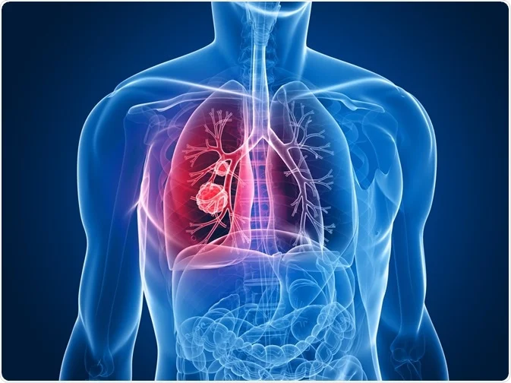
Radiomic features of
non small cell lung cancer after SBRT.
MD. Mateusz Pajdziński
Promoter – Professor Jacek Fijuth, PhD Łukasz Kuncman

Slide 2
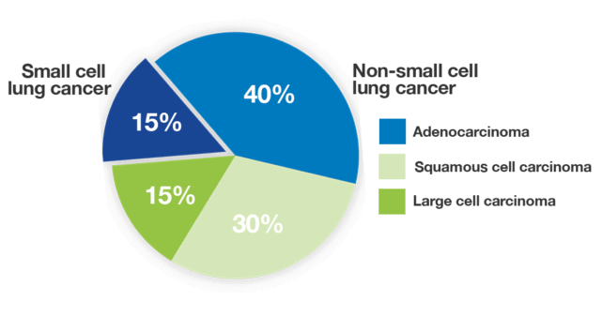
The most common cancer in Poland;
The first cause of cancer related deaths in Poland and worldwide;
Most cases are diagnosed in metastatic stage;
https://lcfamerica.org/lung-cancer-info/types-lung-cancer/

Slide 3
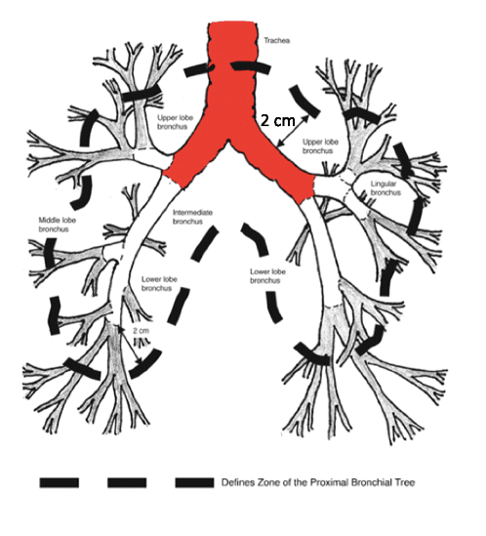
Tumours in the lungs
Peripheral tumours:
Lie more than 2 cm from proximal bronchial tree and do not abut chest wall.
Central tumours:
Abut 2cm expansion from proximal bronchial tree;
Ultracentral tumours:
abut esophagus,trachea, proximal bronchial tree, heart, great vassels.
Baker, Sarah & Dahele, Max & Lagerwaard, Frank & Senan, Suresh. (2016). A critical review of recent developments in radiotherapy for non-small cell lung cancer. Radiation Oncology. 11. 10.1186/s13014-016-0693-8.

Slide 4
SBRT for lung cancer
https://www.nccn.org/guidelines/category_1

Slide 5
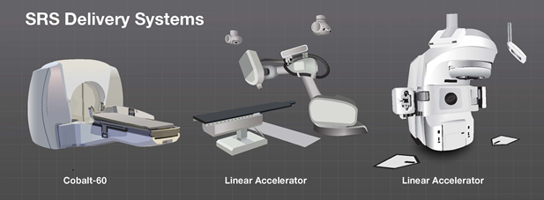
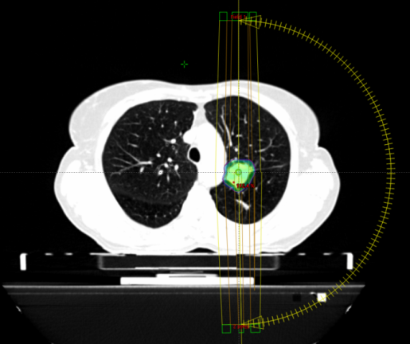
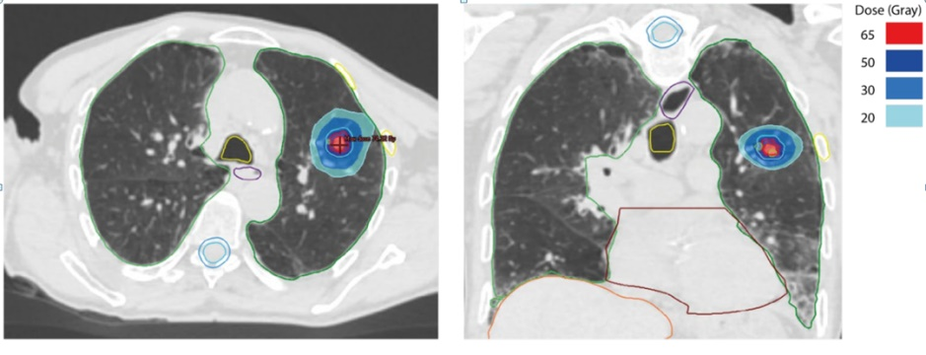
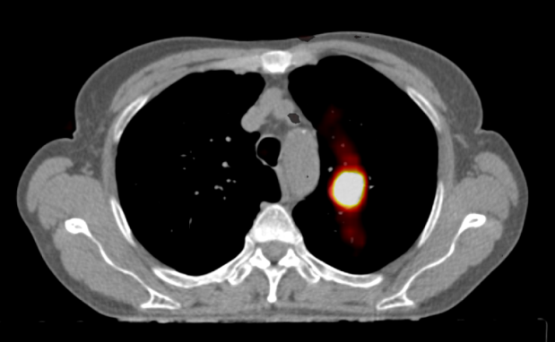
Stereotactic radiotherapy – what is it?

Slide 6
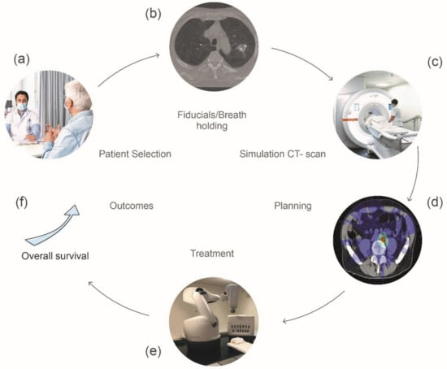
SBRT planning
Kinj, Rémy & Muggeo, Emilien & Schiappacasse, Luis & Bourhis, Jean & Herrera, Fernanda. (2022). Stereotactic Body Radiation Therapy in Patients with Oligometastatic Disease: Clinical State of the Art and Perspectives. Cancers. 14. 1152. 10.3390/cancers14051152.

Slide 7
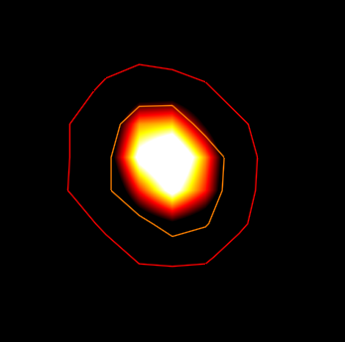
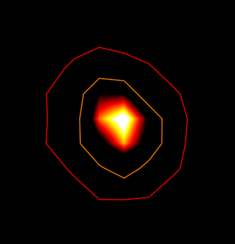
Aim
To find SUV which help automatically delineate GTV.
Study population
Patients which have undergone SBRT of the non small cell lung cancer from last 5 years, which have been treated in Zakład Teleradioterapii in Wojewódzkie Wielospecjalistyczne Centrum Onkologii i Traumatologii im.M.Kopernika in Łódź.
Methods
Analysis of radiomic features from gross tumour volume delineated on computed tomography and positron emission tomography and their relationship with dosimetric parameters
SUV min 4,1
SUV min 1,8

Slide 8
Patients from 2019 to 2024 with non small cell lung cancer were screened according to inclusion criteria of this trial
114 patients were qualified but 15 were excluded due to technical issues with exporting dicom data
99 patients after stereotactic radiation therapy have been included in the analysis so far
T1-T2,N0, M0
Most commonly used fractionation schedule was 50 Gy in 5 fraction during 11 days of treatment
9 local, 11 locoregional and 15 distal reccurences were diagnosed
27 patients died due to progression of the disease during follow-up
Awaiting for data from other oncology centre

Slide 9
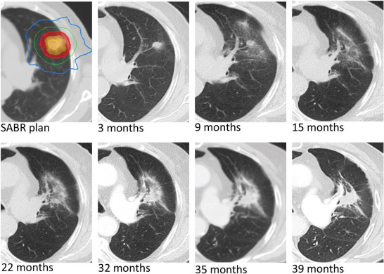
Evolution of CT images
High-risk CT features for detection of local recurrence after stereotactic ablative radiotherapy for lung cancer, Radiotherapy and Oncology, Volume 109, Issue 1, 2013.

Slide 10
Evolution of CT images
How to recognize
a recurrence ?
High-risk CT features for detection of local recurrence after stereotactic ablative radiotherapy for lung cancer, Radiotherapy and Oncology, Volume 109, Issue 1, 2013.

Slide 11
Aim
To find predictive factors for reccurence after SBRT.
Study population
Patients which have undergone SBRT of the non small cell lung cancer from last 5 years, which have been treated in Zakład Teleradioterapii in Wojewódzkie Wielospecjalistyczne Centrum Onkologii i Traumatologii im.M.Kopernika in Łódź.
Methods
Analysis of radiomic features from gross tumour volume delineated on positive emission tomography and comparison of this data with positive emission tomography from follow-up phase

Slide 12
Achievements
Participaion in ESTRO course: „Basic clinical radiobiology”, Porto 2023
Participation in ESTRO course: “Prostate cancer SBRT – FALCON course”, 2023
Active participation in „Lung Cancer Delineation Masterclass” Warsaw 2024
Lecture in Łodzki Oddział Polskiego Towarzystwa Onkologii Klinicznej, Łódź 2023
Poster presentation on ESTRO meeting: „Development of a CT-only autosegmentation model for hippocampal delineation in radiation therapy” Glasgow 2024.
Awaiting for review of 3 original papers in journals with IF >2

Slide 13
Refferences:
https://www.nccn.org/guidelines/category_1
Lodeweges JE, van Rossum PSN, Bartels MMTJ, van Lindert ASR, Pomp J, Peters M, Verhoeff JJC. Ultra-central lung tumors: safety and efficacy of protracted stereotactic body radiotherapy. Acta Oncol. 2021 Aug;60(8):1061-1068. doi: 10.1080/0284186X.2021.1942545. Epub 2021 Jun 30. PMID: 34191670.
Baker, Sarah & Dahele, Max & Lagerwaard, Frank & Senan, Suresh. (2016). A critical review of recent developments in radiotherapy for non-small cell lung cancer. Radiation Oncology. 11. 10.1186/s13014-016-0693-8.
Kinj, Rémy, Emilien Muggeo, Luis Schiappacasse, Jean Bourhis, and Fernanda G. Herrera. 2022. "Stereotactic Body Radiation Therapy in Patients with Oligometastatic Disease: Clinical State of the Art and Perspectives" Cancers 14, no. 5: 1152. https://doi.org/10.3390/cancers14051152
Kinj, Rémy & Muggeo, Emilien & Schiappacasse, Luis & Bourhis, Jean & Herrera, Fernanda. (2022). Stereotactic Body Radiation Therapy in Patients with Oligometastatic Disease: Clinical State of the Art and Perspectives. Cancers. 14. 1152. 10.3390/cancers14051152.
Kitty Huang, Sashendra Senthi, David A. Palma, Femke O.B. Spoelstra, Andrew Warner, Ben J. Slotman, Suresh Senan,
High-risk CT features for detection of local recurrence after stereotactic ablative radiotherapy for lung cancer, Radiotherapy and Oncology, Volume 109, Issue 1, 2013.

Slide 14
THANK YOU FOR YOUR ATTENTION

