Slide 1
Academic year 2023/2024
Notes:
1

Slide 2
PhD thesis
„Evaluation of the expression of the vitamin D receptor and the CYP27B1 protein in the course of bladder cancer in vitro and in patients after cystectomy and TURBT.”
Supervisors:
Associate Professor Elzbieta Sarnowska, PhD, Department of Experimental Immunotherapy, Maria Sklodowska-Curie National Research Institute of Oncology, Warsaw, Poland.
Associate Professor Michal Panek, MD, PhD, Clinic of Internal Medicine, Asthma and Allergy, Medical University of Lodz, Lodz, Poland.

Slide 3
PhD thesis
1st AIM: Assess the correlation between vitamin D3 concentration, vitamin D3 receptor expression and CYP27B1 protein on bladder cancer cell lines at different stages of histological malignancy treated with various concentrations of Vit D3 (0.1, 0.2, 0.3 nM)
2nd AIM: Assess the expression of vitamin D3 and CYP27B1 receptors in patients diagnosed with bladder cancer after transurethral resection of the bladder tumor (TURBT) and cystectomy

Slide 4
Materials and methods
Vitamin D3 with 3 different doses (0.1, 0.2, 0.3 nM)
Specific anti-VDR and anti-CYP27B1 antibodies
T24, 5637, SW1710 and SW780 bladder cancer cell lines→ ICC
Post-operative material from 103 patients with confirmed bladder cancer at various stages according to the TNM scale (NMIBC- 51%, MIBC-49%) → IHC

Slide 5
Results
ICC
IHC
VDR was present in both the nucleus and the cytoplasm, with the SW780 line having the lowest amount of VDR.
Vit D3 supplementation resulted in VDR translocation to the cell nucleus, with SW1710 and T24 lines responding best to vit. D3. The higher dose of vit. D, the more VDR translocation to the nucleus.
The more advanced the disease according to TNM, the lower amount of VDR in the postoperative material. (p<0.0235)
Patients with HG-G2, G3 bladder cancer, regardless of the TNM classification, showed a significant reduction in VDR level compared to patients with LG-G1, G2 bladder cancer (p<0.0173).

Slide 6
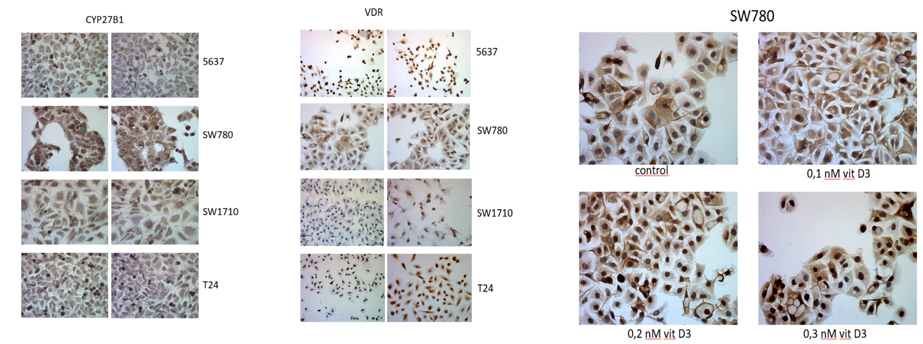
BC cell lines treated with vitamin D

Slide 7
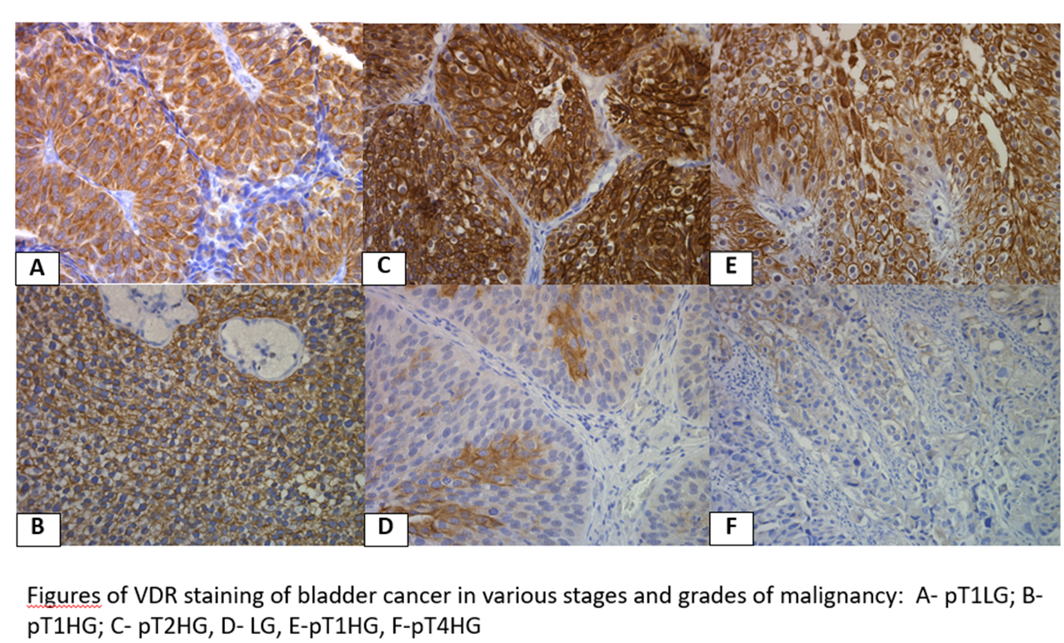

Slide 8
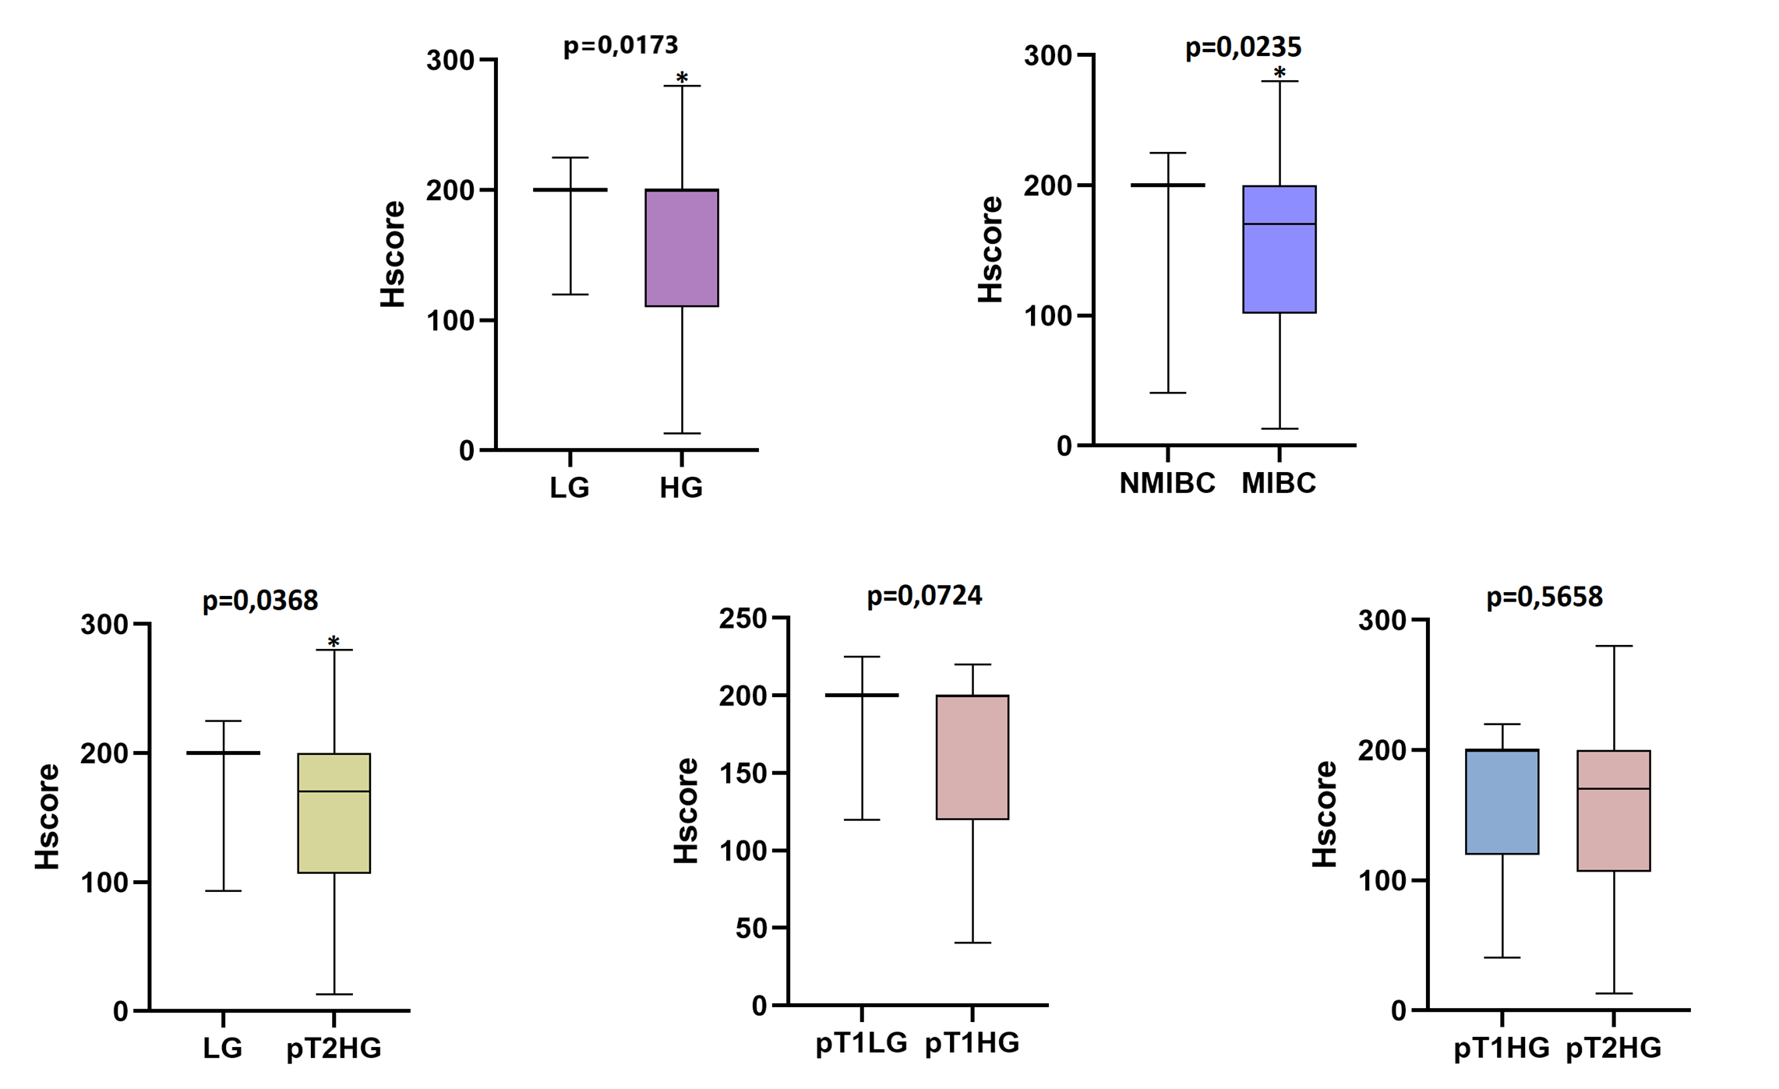
VDR Hscore comparison between different groups of patients.

Slide 9
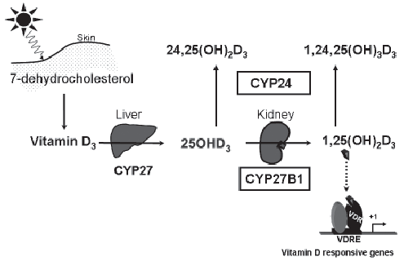
VDR
https://www.researchgate.net/figure/The-synthesis-and-metabolism-of-vitamin-D-Abbreviations-CYP27-vitamin_fig1_7489031

Slide 10
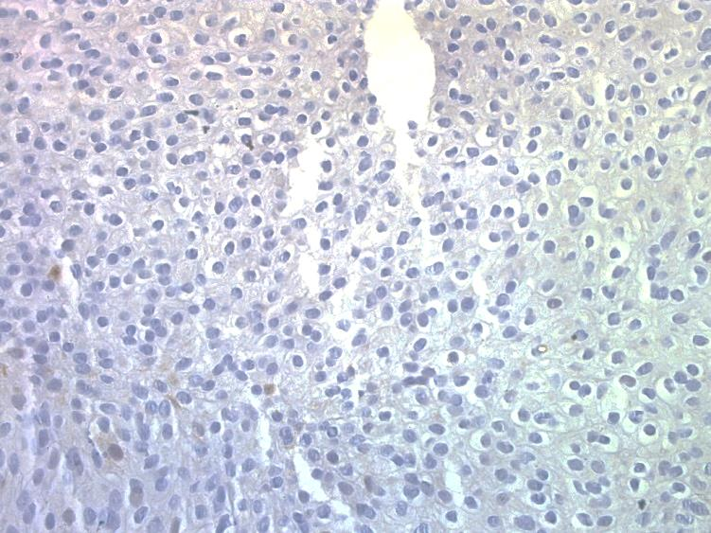
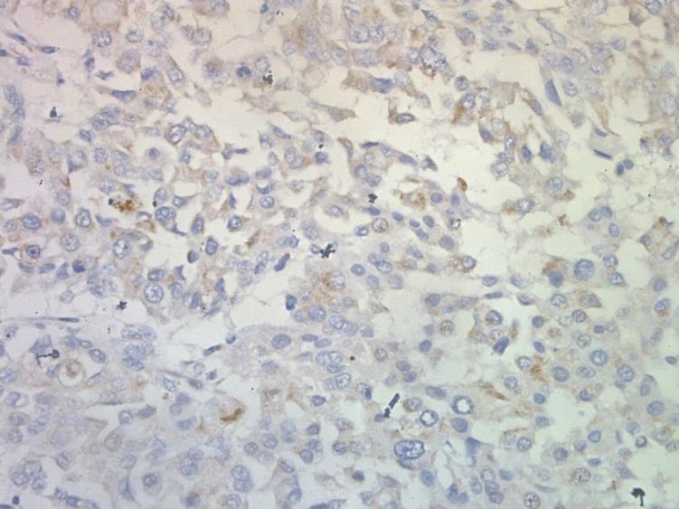
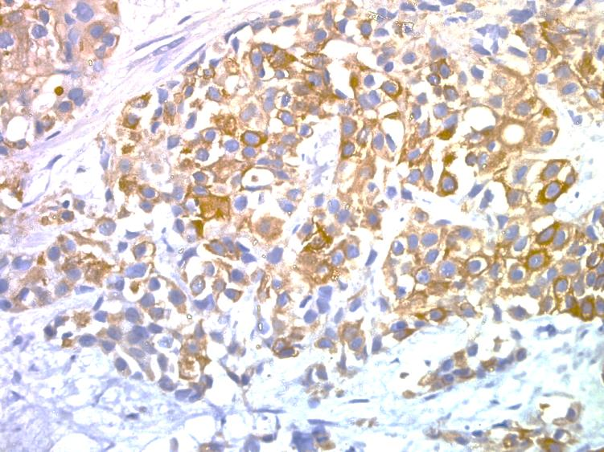
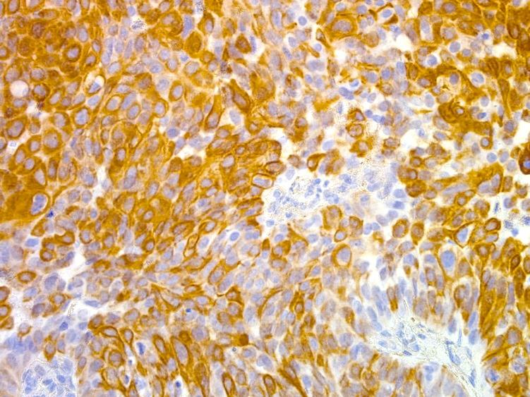
CYP27B1 in bladder cancer
P1
P2
P3
P4
CYP27B1 staining in BC clinical samples P-patient.
CYP27B1 protein level did not correlates with LG vs HG tumors as well as with staging according to TNM.

Slide 11
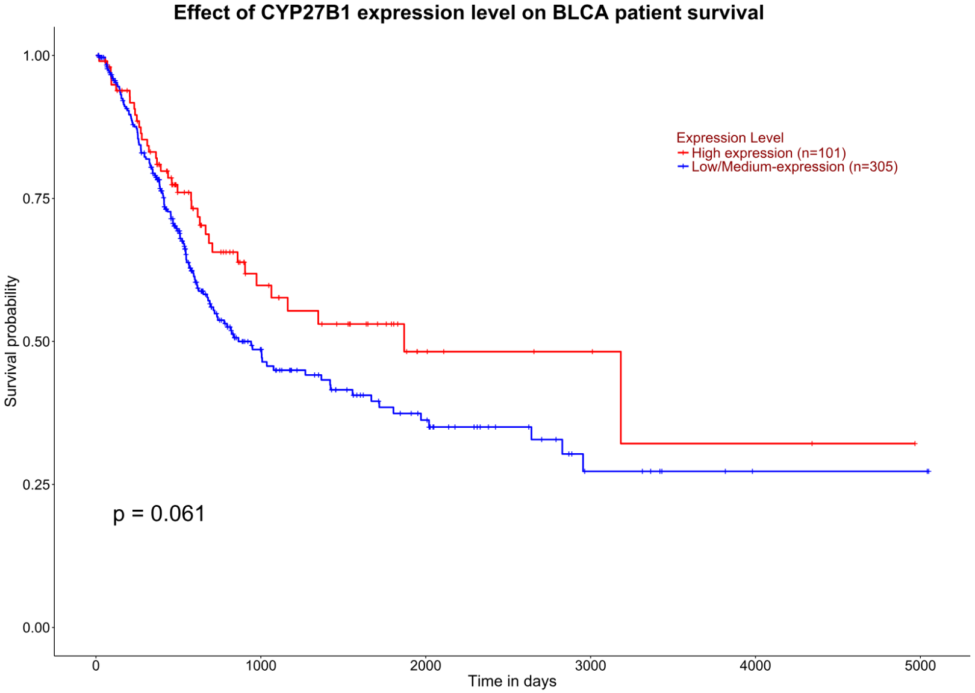
According to TCGA databse the low level of CYP27B1 expression correlates with worst prognosis although it is not highly significant.

Slide 12
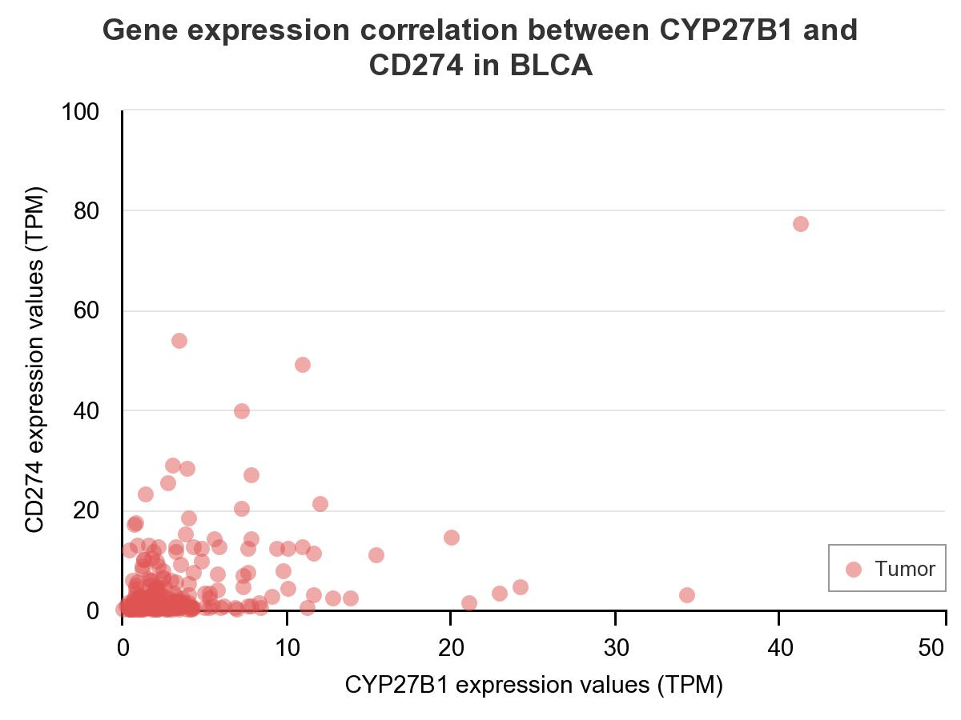
Pearson Correlation coefficient: 0.44
CYP27B1 positively correlates with CD274 expression – CD274 encodes PD-L1 protein what can be important in immunotherapy response.

Slide 13
Conclusions
The amount of VDR decreases with increasing malignancy of the tumor
The VDR receptor in cancer cells is located mainly in the cytoplasm, which proves that this receptor is inactive
In cell lines treated with various concentrations of Vit D3 (0.1, 0.2, 0.3 nM) VDR translocations to the cell nucleus were observed, which indicates activation of the receptor, which may affect the expression of many genes.

Slide 14
Conclusions vol.2
The level of VDR protein can help determine the severity of the disease and its malignancy.
The level of the VDR receptor could be used in the future as a marker of malignant and invasive lesion in the urinary bladder.

Slide 15
Scientific achievements 2023/2024
Publication as second author- "Response to letter to the editor: are there anatomical limiting factors to foreskin reconstruction at the time of single-stage hypospadias repair?" Journal of Pediatric Urology, 2024, ISSN 1477-5131, doi.org/10.1016/j.jpurol.2024.02.025
Publication as co-author "Management of chronic obstructive pulmonary disease-news in the GOLD 2024 Report." Therapy 4/2024

Slide 16
Oral presentations with PhD results
The 54th Scientific Congress Of The Polish Urological Association in Lodz, Poland, 13-15th June 2024
1. Oral presentation 'Evaluation of correlation of VIRADS score and patients with non-invasive bladder cancer after TURBT’
2. Oral presentation "Evaluation of the correlation of VIRADS score and recurrence rate in patients with muscle-invasive bladder cancer after cystectomy"
Oral presentation at the Multi-Robot International Conference 'WRSE Urology NextGen 2024’ in Melle, Belgium, 25-26th April 2024

Slide 17
Participation in courses
Participation in the course "Implantation of the urethral sphincter AMS 800 by Boston Scientific" organised by Meden-Inmed in Warsaw
Participation in the course "Radiological protection of the patient" with passing the final exam authorising to perform medical procedures with ionising radiation - organised by the company Pozytron in Warsaw

Slide 18
Thank you
Bartlomiej Olczak, MD, urology resident, PhD student
bartlomiej.Olczak@umed.lodz.pl
bartlomiej.Olczak@cskmswia.gov.pl

