Slide 1
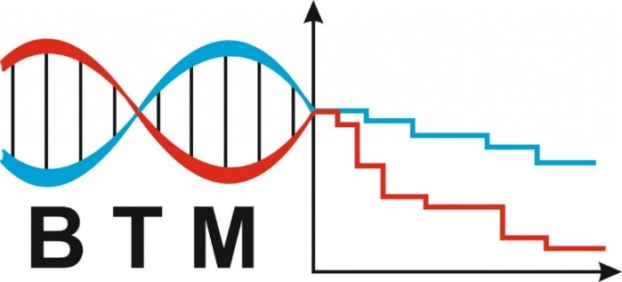
Comprehensive characterization of tumor immune contexture changes induced by cytotoxic agents in lung and rectal cancer
PhD student: Zuzanna Nowicka, MD Promotor: Prof. Wojciech Fendler
Department of Biostatistics and Translational Medicine, Medical University of Lodz, Poland

Slide 2
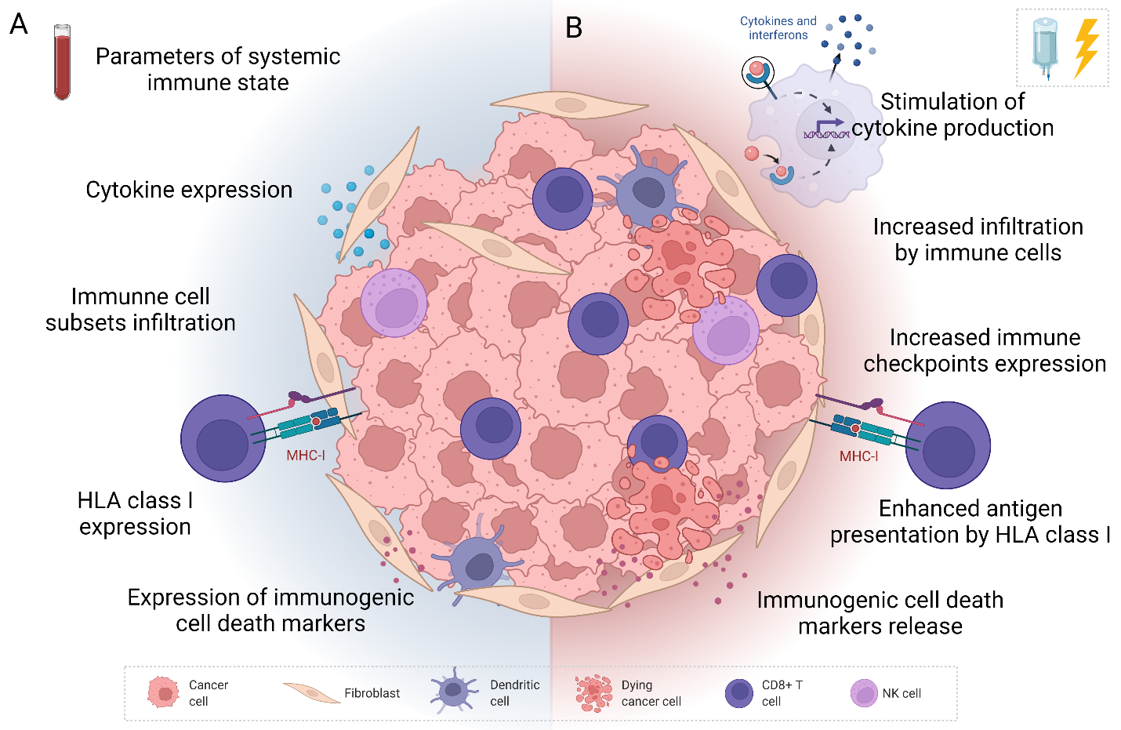

Slide 3
Research aims
To characterize the systemic response to radiotherapy and the spatial immune microenvironment of non-small-cel lung cancer (NSCLC) tumors resected shortly after chemoradiotherapy
To evaluate lymphocyte infiltration in rectal tumors resected after neoadjuvant chemoradiotherapy (CHRT) with respect to their intrinsic radiosensitivity established via gene expression-based indices.
We hypothesize that radiotherapy is more immunogenic in tumors characterized by high intrinsic radiosensitivity.

Slide 4
Identifying predictors of radiation-induced lymphopenia
To identify predictors of radiation-induced lymphopenia in patients with NSCLC treated with RT, we retrospectively analysed data of 306 patients treated with radical-intent RT
Patients were treated in three participating centers

Slide 5
Variable | IMRT (N=125) | VMAT (N=181) | p
Age [years] | 64.57 (60.24-68.69) | 67.5 (62.0-71.6) | 0.005
Sex
F | 40 (32.00%) | 70 (38.67%) | 0.463
M | 85 (68.00%) | 111 (61.33%)
Histology
Adenocarcinoma | 25 (20.0%) | 61 (33.7%) | <0.001
Squamous cell carcinoma | 52 (41.6%) | 88 (48.62%)
Adenocarcinoma/ Squamous cell carcinoma | 1 (0.8%) | 3 (1.66%)
Large cell neuroendocrine carcinoma | 1 (0.8%) | 8 (4.42%)
Large cell carcinoma | 0 (0.0%) | 3 (1.66%)
NOS | 46 (36.8%) | 18 (9.94%)
T
0 | 4 (3.2%) | 5 (2.76%) | <0.001
1 | 7 (5.6%) | 36 (19.89%)
2 | 35 (28.0%) | 63 (34.81%)
3 | 43 (34.4%) | 54 (29.83%)
4 | 36 (28.8%) | 23 (12.71%)
Variable | IMRT (N=125) | VMAT (N=181) | p
N
0 | 9 (7.2%) | 26 (14.36%) | 0.238
1 | 21 (16.8%) | 30 (16.57%)
2 | 82 (65.6%) | 104 (57.46%)
3 | 13 (10.4%) | 21 (11.6%)
AJCC stage
1 | 1 (0.8%) | 5 (2.76%) | 0.006
2 | 6 (4.8%) | 28 (15.47%)
3 | 118 (94.4%) | 148 (81.77%)
Concurrent chemotherapy | 39 (30.47%) | 74 (40.0%) | 0.108
Lymphopenia < 500/µL | 64 (51.2%) | 68 (37.57%) | 0.017
Prescribed RT dose [Gy] | 66.0 (60.0-66.0) | 60.0 (60.0-66.0) | <0.001
N fractions | 30.0 (30.0-33.0) | 30.0 (30.0-33.0) | <0.001
Treatment duration [days] | 43.0 (41.0-44.0) | 42.9 (39.0-45.0) | 0.510
PTV volume [cm3] | 485.3 (375.4-639.3) | 317.2 (197.8-435.8) | <0.001
Baseline ALC [103/µL] | 2.08 (1.57-2.59) | 2.01 (1.5-2.53) | 0.509
Time to baseline ALC [days] | 6.0 (1.0-19.0) | 4.0 (0.0-36.0) | 0.475
Nadir ALC [103/µL] | 0.49 (0.34-0.67) | 0.59 (0.43-0.76) | 0.008

Slide 6
Lymphocyte decline during RT

Slide 7
Individual fits: exponential decay equation

Slide 8
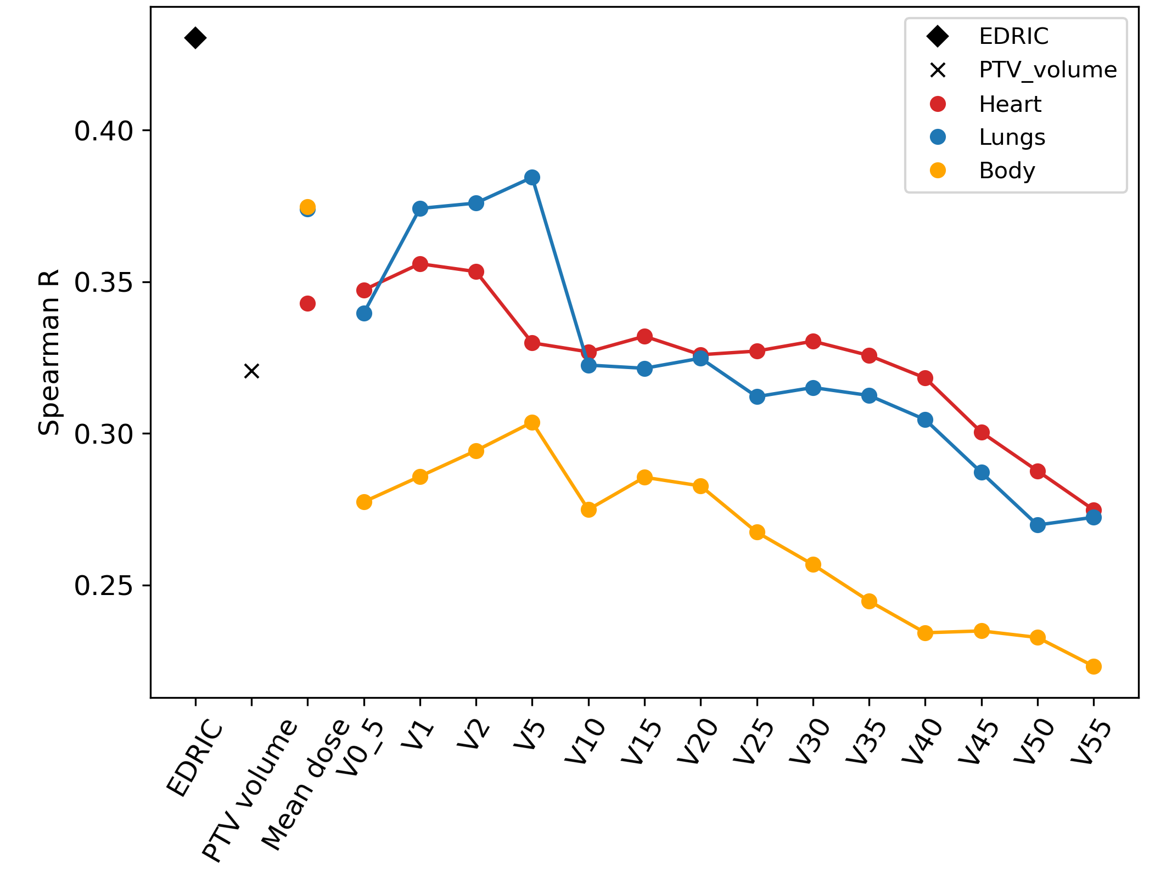
Dosimetric predictors of lymphopenia

Slide 9
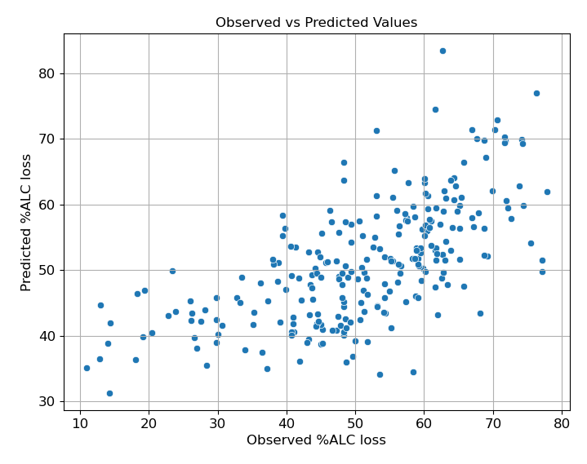
Final model performance
Multivariable model based on CRT use, baseline ALC and first principal component (PC1) of the dosimetric predictors showed good predictive performance
bias-corrected R²=0.403

Slide 10
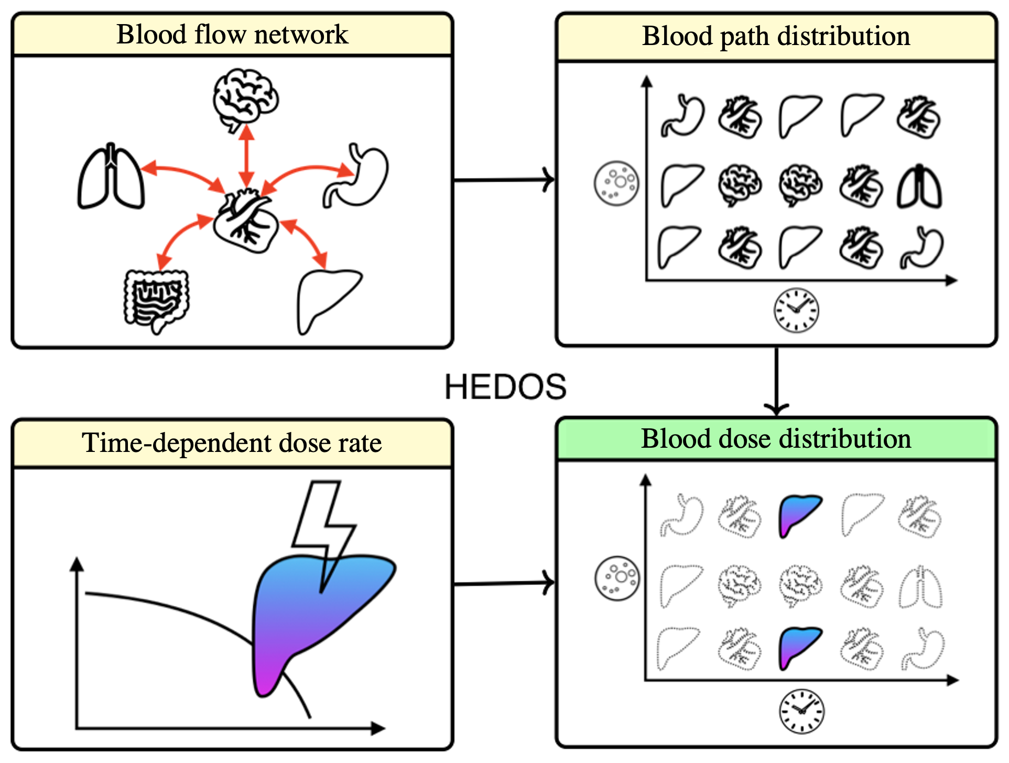

Slide 11
Complementary approach: characterizing immune microenvironment of NSCLC before and after RT
Patients with locally advanced NSCLC
Patients with primary resection (N=36)
Patients who received CHT before surgery (N=19)
Patients who received CHRT before surgery (N=27)
Approval was obtained from the bioethics committee (RNN/102/21/KE, KE/187/22)

Slide 12
Complementary approach: characterizing immune microenvironment of NSCLC before and after RT
 | H&E Digital pathology | Multiplex IF AKOYA | 2-antibody IHC PD-L1, LKB1 | Mutation panel | Spatial transcriptomics (GeoMx on selected ROI / 10X Visium)
Primary resection | x | x | x |  | x
RCHT | x | x | x | x | x
CHT | x | x | x |  | x

Slide 13
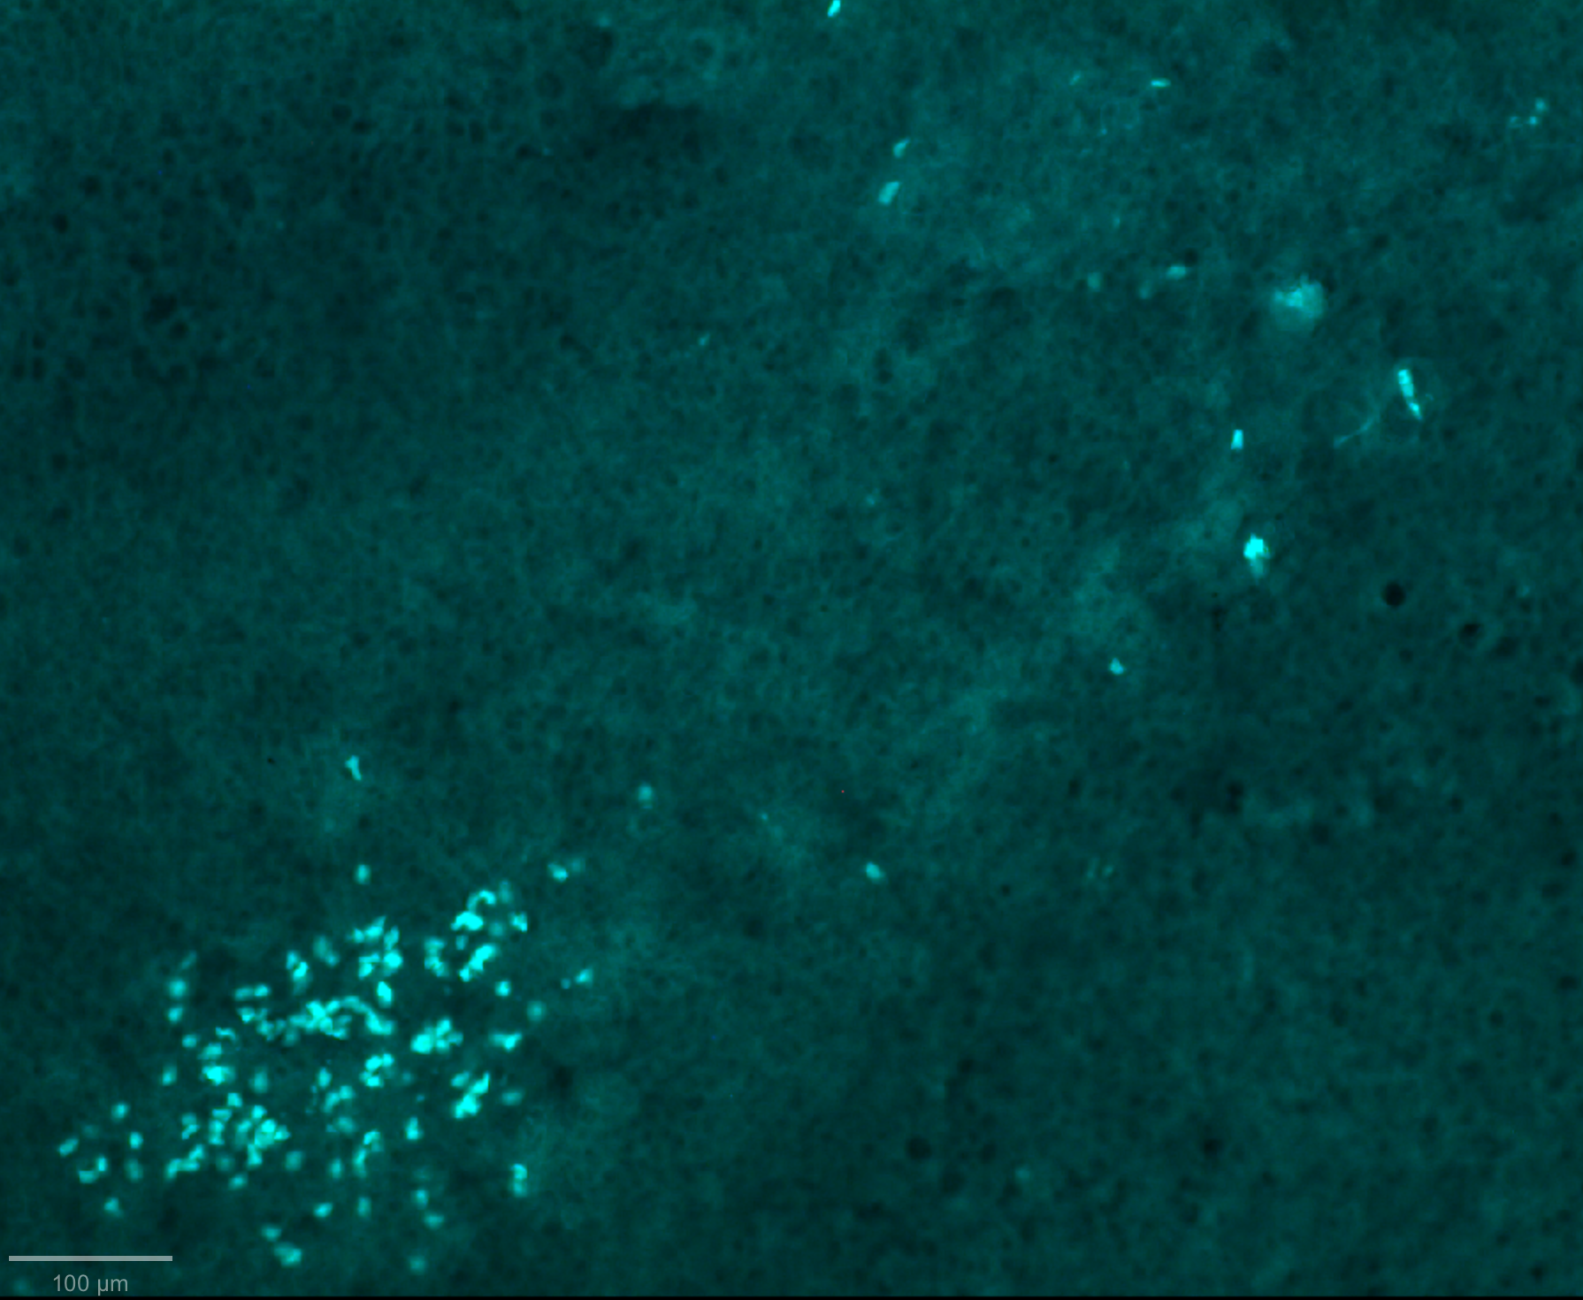
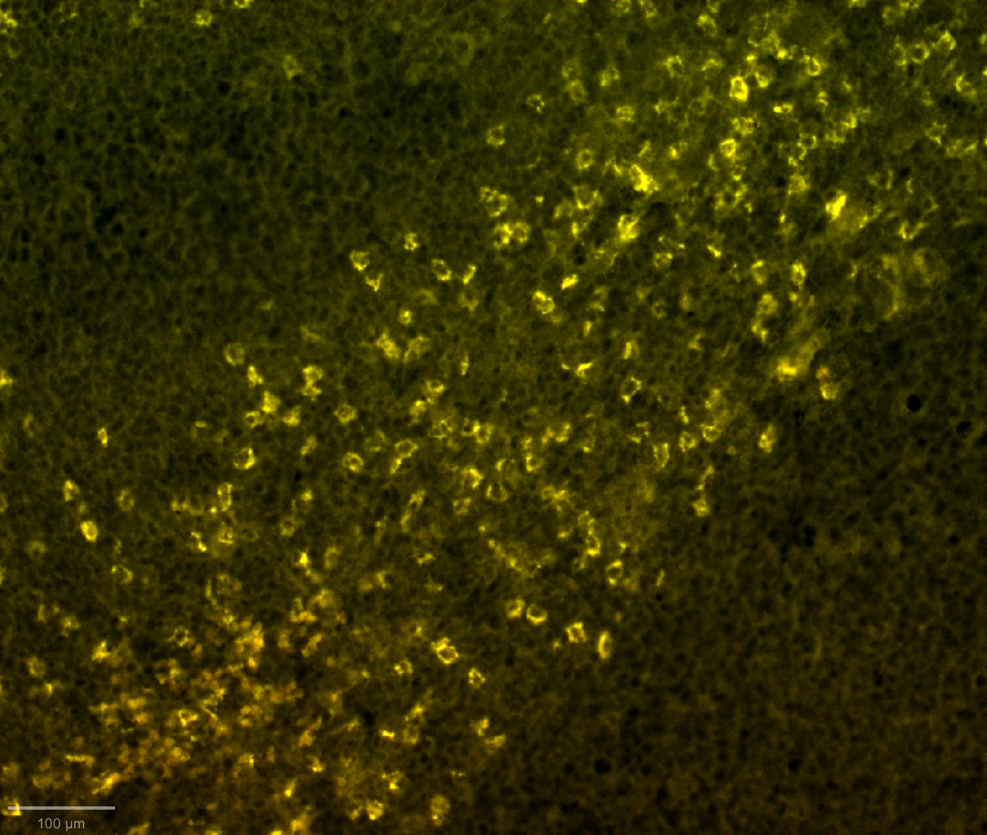
Complementary approach: characterizing immune microenvironment of NSCLC before and after RT
Single-plex immunofluorescence staining for CD8 (A) and CD68 (B) in control tonsil tissue, performed during slide library preparation using Opal 7 solid tumor immunology kit.

Slide 14
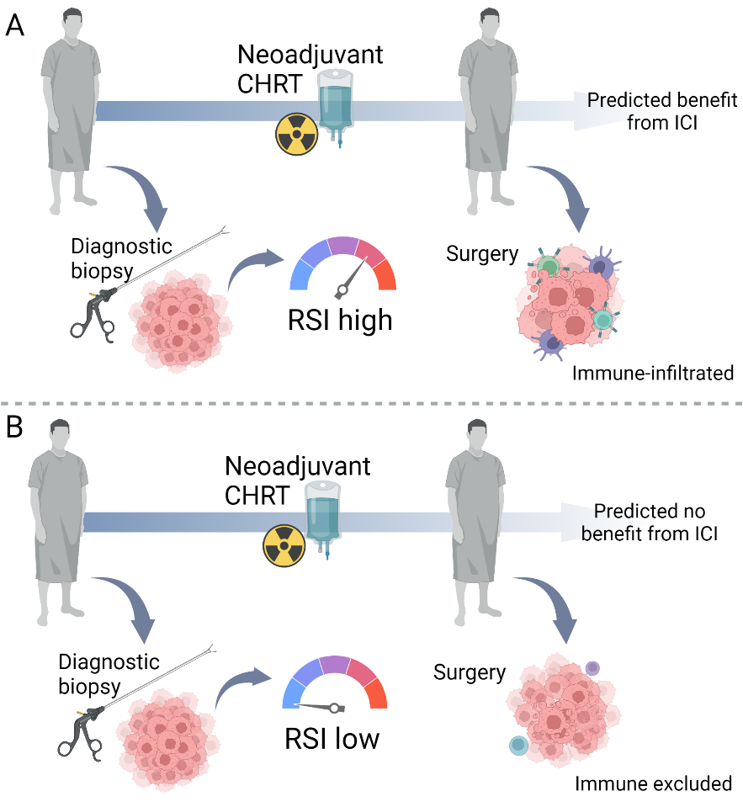
Intrinsic tumour radiosensitivity as a marker of chemoradiotherapy-induced immunogenic effects in rectal cancer

Slide 15
Radiosensitivity as marker of chemoradiotherapy-induced immunogenic effects in rectal cancer
Bioethics committee approval was obtained (RNN/23/23/KE)
Patient recruitment was initiated in three participating cancer centers (WUM, Barlicki Clinical Hospital and Brzeziny Medical Center)
Diagnostic tumour biopsies and post-operative material will be collected according to the standard procedures and used for laboratory assessments (gene expression using NanoString nCounter in pre-operative material and IHC staining for infiltrating lymphocytes in pre- and post-operative samples)

Slide 16
Conclusions
The results achieved during the projects led during this doctoral work will have a significant impact on improving the understanding of the interaction between cytotoxic therapy and the patient's immune system.
As a result, we will provide tools to optimize drug combinations and achieve better treatment outcomes for patients with non-small cell lung cancer and rectal cancer.

Slide 17
Funding
This research is supported by the National Science Centre and Polish National Agency for Academic Exchange PRELUDIUM BIS Grant no. 2020/39/O/NZ5/01696 awarded to WF and from National Science Centre PRELUDIUM grant no. 2022/45/N/NZ5/01240 awarded to ZN.

