Slide 1
„Influence of the type of smoked cigarettes on indicators of oxidative stress in surgical and non-surgical specialists"
Artur Nowak MD
Department of Immunopathology
artur.nowak@stud.umed.lodz.pl
Promoter: Rafał Pawliczak MD PhD

Slide 2
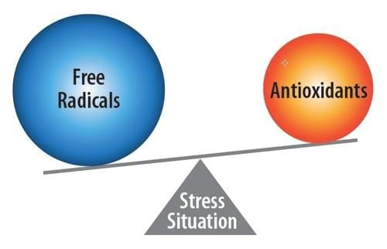
Oxidative stress
Oxidative stress is defined as an imbalance between the activity of reactive oxygen species (ROS) and the activity of antioxidants.The disturbances can occur both at the cellular and the whole body levels.
Long-term oxidative stress is one of the key risk factors for the development of diseases, including atherosclerosis, Alzheimer's disease, Parkinson’s disease and heart diseases.
Factors that may increase the risk of long-term oxidative stress include smoking, alcohol, obesity, and a diet high in sugar and fat.

Slide 3
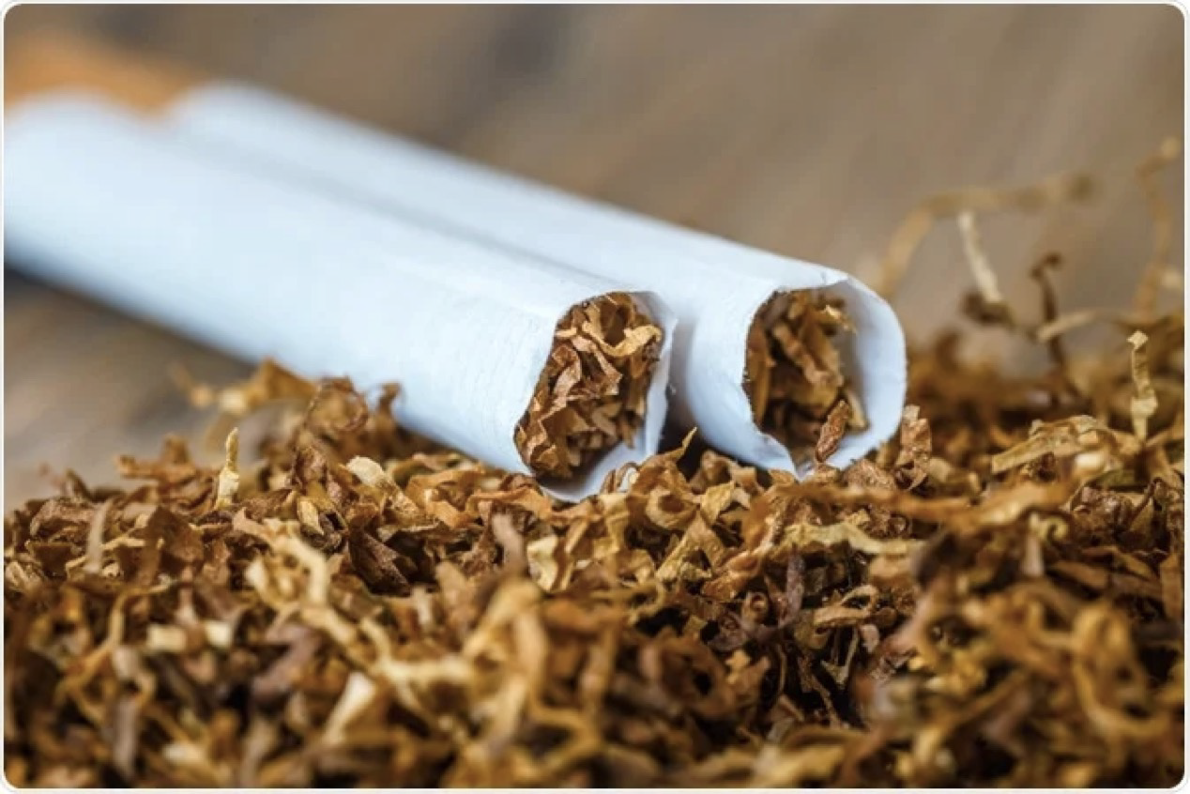
Tobacco smoking
Tobacco kills up to half of its users.
Tobacco kills more than 8 million people each year. More than 7 million of those deaths are the result of direct tobacco use while around
1.2 million are the result of non-smokers being exposed to second-hand smoke.
Over 80% of the world's 1.3 billion tobacco users live in low- and middle-income countries.
In 2019, more than one fifth of Poles - 21%, admit to heavy (everyday) smoking.

Slide 4
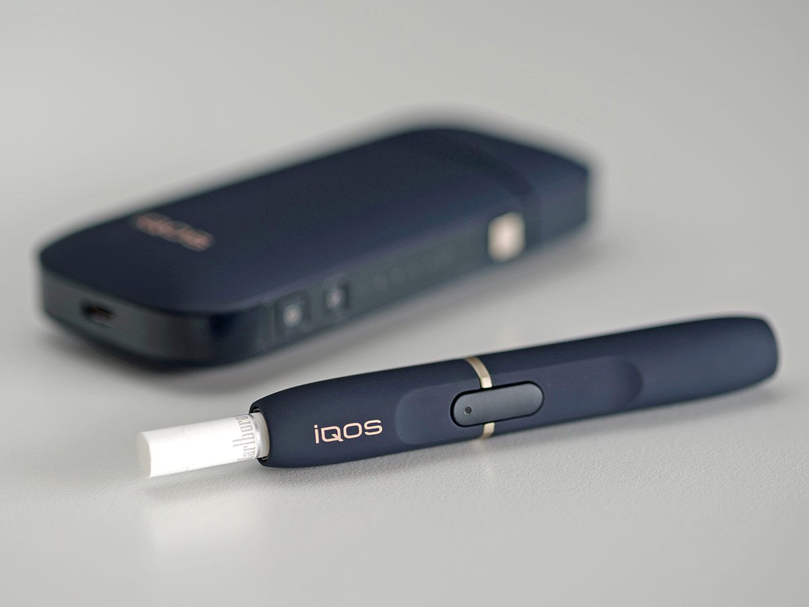
Heat-not-burn tobacco products
HNBs are tobacco products that produce aerosols containing nicotine and other chemicals. HNB tobacco products heat tobacco to 350 degrees Celsius using battery-powered heating systems.
HNB tobacco products are not e-cigarettes. HNBs heat tobacco to produce nicotine, while e-cigarettes heat an e-liquid, which may or may not contain nicotine and, in most cases, is tobacco-free.
Like the electronic cigarette, HNB cigarettes are promoted by their manufacturers as a much safer alternative for smokers.
Smoking is a risk factor for many diseases. Tobacco smoke is highly carcinogenic and contains nearly 4,000,000 chemicals, many of which are carcinogenic.

Slide 5
Heat-not-burn tobacco vs e-cigarettes

Slide 6
Aim
Cigarette smoking remains a pervasive global health concern, contributing to a myriad of debilitating conditions. One critical aspect of its detrimental impact is the induction of oxidative stress (OS)
The aim of my project was to prove that the use of stimulants such as tobacco and the method of their consumption have an impact on the human body.
One of the tasks of the project was to demonstrate the relationship between smoking and an increase in oxidative stress.
I tested also the levels of reactive oxygen species in smoking and non-smoking physicians taking into account surgical and non-surgical specialties, including resident physicians

Slide 7
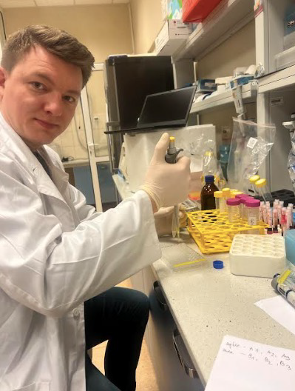
Methodology
The prospective study conducted on surgical and non-surgical physicians who smoke various types of cigarettes worked at the Nicolaus Copernicus Hospital in Lodz and at the Polish Mother's Health Center Institute in Lodz (Poland). The Fagerström’s test for nicotine dependence was used to determine degree of nicotine addiction. The differences in oxidative stress indicators among physicians with surgical and non-surgical specialization who smoke different types of cigarettes was analyzed by the Cellular Reactive Oxygen Species (ROS) Assay Kit.
The study protocol has been accepted by Ethical Committee of the Medical University of Lodz RNN/74/22/KE

Slide 8
Results
In this study 35.1% of surgical and 40.5% of non-surgical physicians indicated signs of nicotine addiction.
The Fagerström score was significantly higher in surgical than non-surgical physician specialties (5.4±1.372 vs. 4.7±1.310; p=0.001).
Significantly higher ROS level was observed in conventional cigarette (CS) smokers, e-cigarette (EC) smokers and tobacco heating products (THP) smokers compared to non-smokers (p<0.05).
In addition, there was a significantly lower ROS level in THP smokers compared to CS smokers (p<0.05) and EC smokers (p<0.05).
There was a significantly higher ROS level in physicians with surgical specialization who smoke CS (p<0.001) and EC (p=0.004) compared to non-surgical physicians.

Slide 9
Nicotine addiction among physicians with surgical and non-surgical specialization.
Fagerström's test for nicotine dependence was performed among 205 physicians with surgical and non-surgical specialization who smoke different types of cigarettes.
Differences between Fagerström score (a) for surgical and non-surgical specialization of physicians was analyzed by Mann-Whitney U test. The Fagerström score was presented as mean±SD. p<0.05 was considered significant. No signs, biological signs or biological and psychical signs of nicotine addiction
(b) were presented as a number and percentage of physicians with surgical and non-surgical specialization.

Slide 10
The differences in ROS level among physicians who smoked different types of cigarettes.
DCF fluorescence intensity for ROS were detected in the cytosol of lymphocytes isolated from the blood samples of 205 physicians with surgical and non-surgical specialization who smoke different types of cigarettes by the use of the cell permeation reagent dichlorodihydrofluorescein diacetate (H2DCFDA).
The final results are the mean of three independent measurements. The values was presented as mean±SD. * for p<0.05 (vs. non-smokers); # for p<0.05 (vs. THP smokers).
Abbreviations:
CS – conventional cigarette;
EC – e-cigarette;
THP – tobacco heating product.

Slide 11
The differences in ROS level among physicians with surgical and non-surgical specialization.
DCF fluorescence intensity for ROS were detected in the cytosol of lymphocytes isolated from the blood samples of 205 physicians with surgical and non-surgical specialization who smoke different types of cigarettes by the use of the cell permeation reagent dichlorodihydrofluorescein diacetate (H2DCFDA).
The final results are the mean of three independent measurements. The values was presented as mean±SD. * for p<0.05 (vs. non-smokers); ** for p<0.01 (vs. non-smokers); *** for p<0.001 (vs. non-smokers) $ for p<0.05 (vs. CS smokers); # for p<0.05 (vs. THP smokers);
Abbreviations:
CS – conventional cigarette;
EC – e-cigarette;
THP – tobacco heating product.

Slide 12
Publications
Nowak A, Pawliczak R. Harmfulness of e-cigarettes. Alergologia Polska – Polish Journal of Allergology. 2023;10(4):271-279.doi:10.5114/pja.2023.133770
’’The impact of the type of smoked cigarettes on the oxidative stress indicators in surgical an non-surgical specialties of physicians” – the article was sent to the Antioxidants journal , IF 7

Slide 13
Bibliography
1. Chaumont.M De Becker.B, Zaher.W, Culié.A, Deprez.G, Christian Mélot.C, Reyé.F, Van Antwerpen.P, Delporte.C, Debbas.N, Boudjeltia.KZ, Van de Borne.P. Differential Effects of E-Cigarette on Microvascular Endothelial Function, Arterial Stiffness and Oxidative Stress: A Randomized Crossover Trial. Sci Rep. 2018 Jul 10;8(1):10378.
2. Guanghe.W, Wenjing.L, Weimin.S. Toxicity Assessment of Electronic Cigarettes . Inhal Toxicol. 2019 Jun;31(7):259-273.
3. Kopa PN, Pawliczak R. IQOS - a heat-not-burn (HnB) tobacco product - chemical composition and possible impact on oxidative stress and inflammatory response. A systematic review. Toxicol Mech Methods. 2020 Feb;30(2):81-87
4. Lorgis.L, Zeller.M, Dentan.G, Sicard.P, Richard.C, Buffet.P, Huillier.I.L, Beer.J.C, Cottin.Y, Rochette.L, Vergely.C. The free oxygen radicals test (FORT) to assess circulating oxidative stress in patients with acute myocardial infarction. Atherosclerosis.2010 Dec;213(2):616-21.
5. Garelnabi.M.O, Brown.W.V, Le.N-A . Evaluation of a novel colorimetric assay for free oxygen radicals as marker of oxidative stress. Clin Biochem. 2008 Oct;41(14-15):1250-4.

Slide 14
Thank you

