Slide 1
PUBLIC SCIENTIFIC REVIEW SESSION 2023/2024 The effectiveness of treating psoriasis using biological drugs depends on laboratory parameters, disease activity scores, and environmental factors Michał Niedźwiedź^{1,2}, Agnieszka Czerwińska³, Aleksandra Lesiak^{1,4}
¹Department of Dermatology, Paediatric Dermatology and Oncology, Medical University of Lodz, Lodz, Poland.
²International Doctoral School, Medical University of Lodz, Lodz, Poland.
³Laboratory of Autoinflammatory, Genetic and Rare Skin Disorders, Medical University of Lodz, Lodz, Poland.
⁴Institute of Geophysics, Polish Academy of Sciences, Warsaw, Poland.

Slide 2
Seasonality in dermatology
atopic dermatitis | ↑ | cold weather | Japan, Furue 2011 Europe, Wecker 2024
erythema multiforme | ↑ | spring/summer | USA, Harvell 2016
shingles | ↑ | summer | Poland, Norval 2002
diffuse hyperpigmentation in infants | ↑ | monsoon season | India, Dabas 2020
dermatology manuscript submissions | ↓ | lowest in May | Alikhan 2011

Slide 3
Psoriasis - chronobiology
source | observation | author
majority of patients | better in summer months | clinical observation
UK | 67% exacerbation in winter | Ferguson 2021
USA | winter flaring and summer clearing | Pascoe 2015
Japan | no difference between the seasons | Kubota 2015
UK | 72% diurnal variation of flares and itch | Ferguson 2021
UK | night shift work - risk for psoriasis | Li 2013
Internet searches for psoriasis | highest interest in late winter/early spring | Kardes 2019 Wu 2019

Slide 4
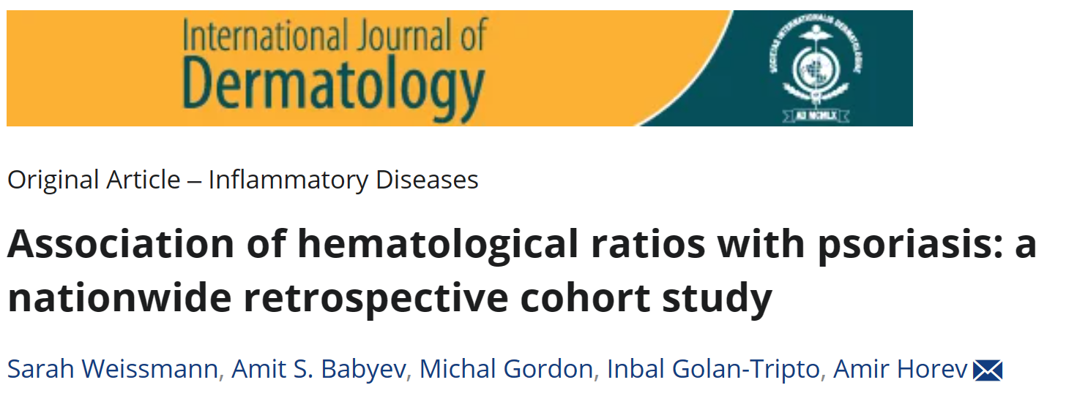
Inflammatory blood parameters
different reaction for each biological medication
predictor parameters for personalized therapy?

Slide 5
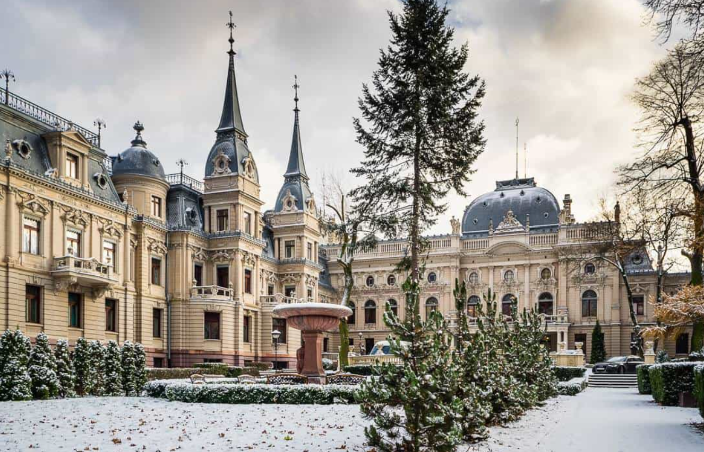
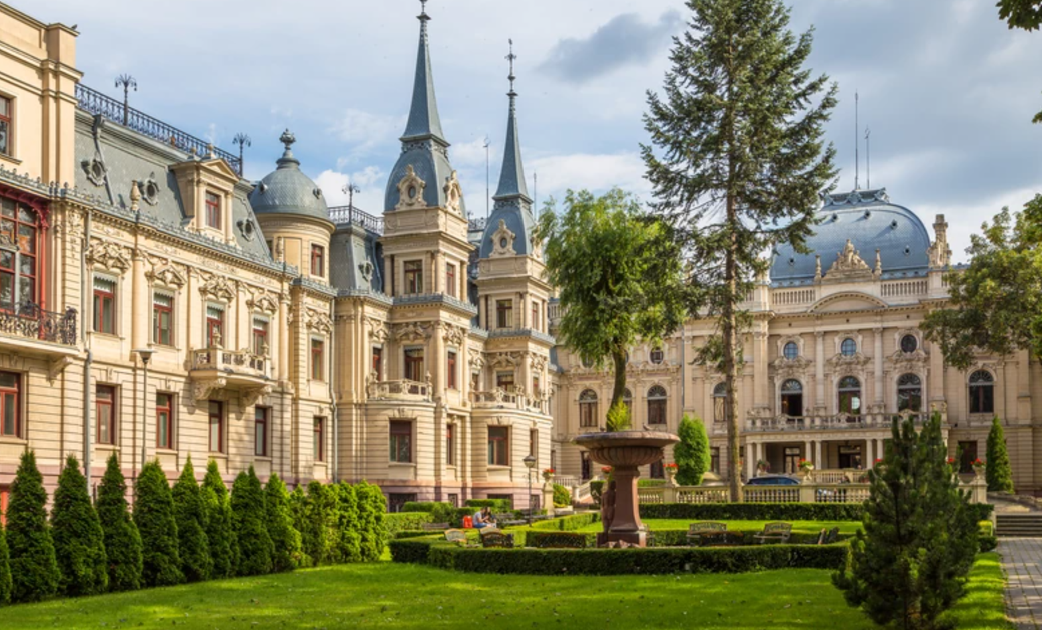
Study hypothesis
The effectiveness of treating psoriasis using biologic drugs depends on:
the moment of starting therapy,
initial disease severity scores,
inflammatory blood parameters.

Slide 6
Study design
patients with psoriasis vulgaris (PV) fulfilling the criteria for biological treatment
outcome of psoriasis treatment assessed by scores of psoriasis severity:
Psoriasis Area and Severity Index (PASI),
Body Surface Area (BSA),
Dermatology Life Quality Index (DLQI).
inflammatory blood indexes
NLR —neutrophil count/lymphocyte count;
NMR —neutrophil count/ monocyte count;
PLR —platelet count/lymphocyte count;
SII — neutrophile count × (platelet count/lymphocyte count ratio)

Slide 7
Study design
patients divided into two groups
beginning the treatment in the cold period of the year (October-March)
beginning the treatment in the warm period of the year (April-September)
difference in response to the treatment in groups analysed
(standard statistical tests for the differences between samples – Wilcoxon rank-sum and Kolmogorov-Smirnov tests)

Slide 8
Study design
The scores and blood parameters recorded at the beginning of therapy, after 1 month, 4 months, 7 months,10 months,13 months, and so on (…).
start of the therapy
1st month
4th month
7th month
10th month
13th month
16th month
19th month

Slide 9
Research plan bucketlist
Literature review | ✓
Individual research plan | ✓
Obtaining the approval from Bioethics Committee | ✓
Creating the database | ✓
Preliminary study | ✓
Completing the collecting data
Statistical analysis
Presenting results at the conferences
Publication of the results
Further investigation and grant aplications

Slide 10
Bioethics Committee approval

Slide 11
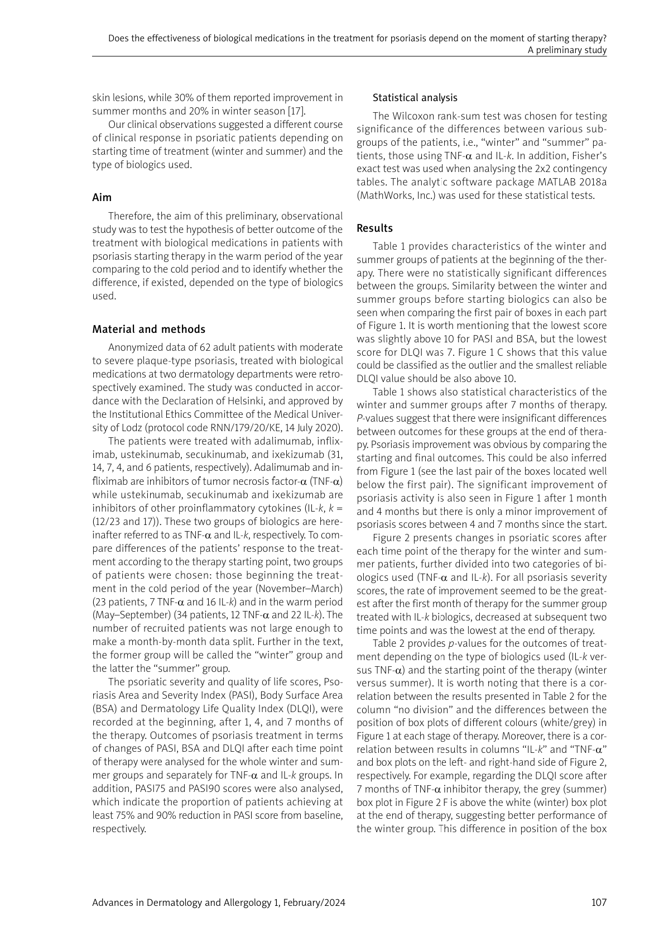
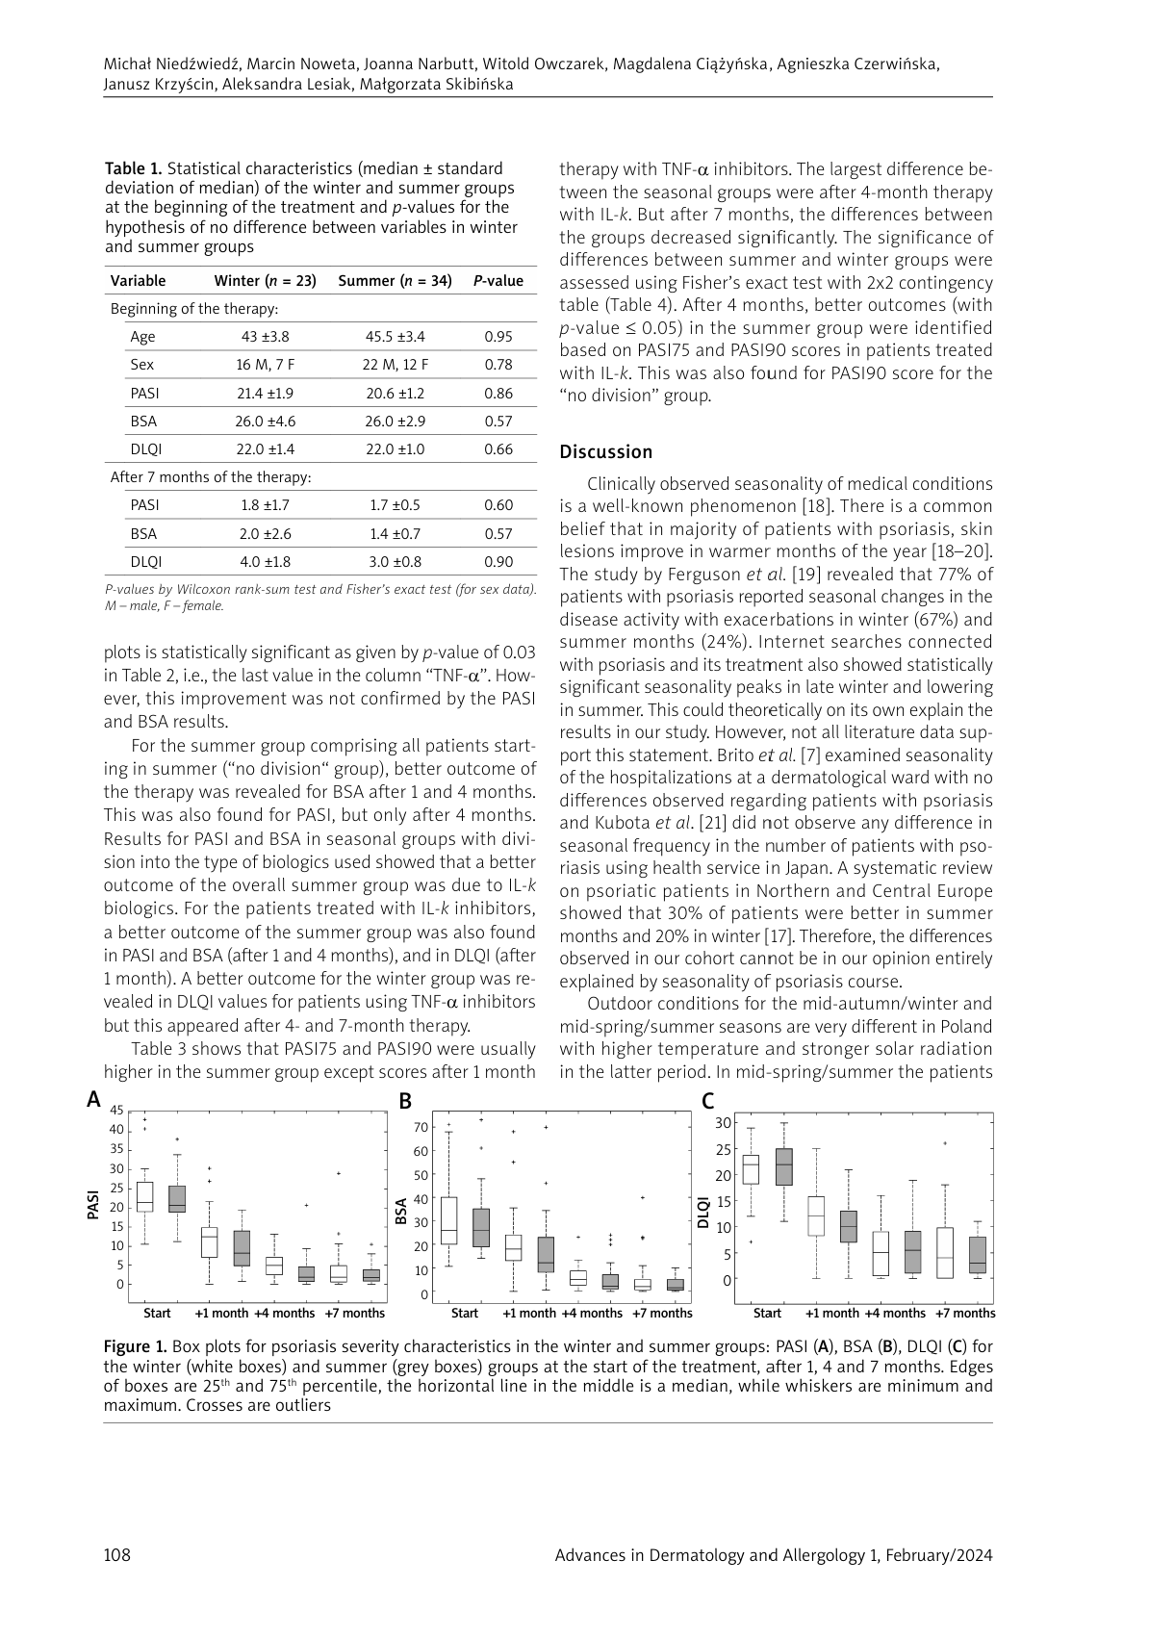
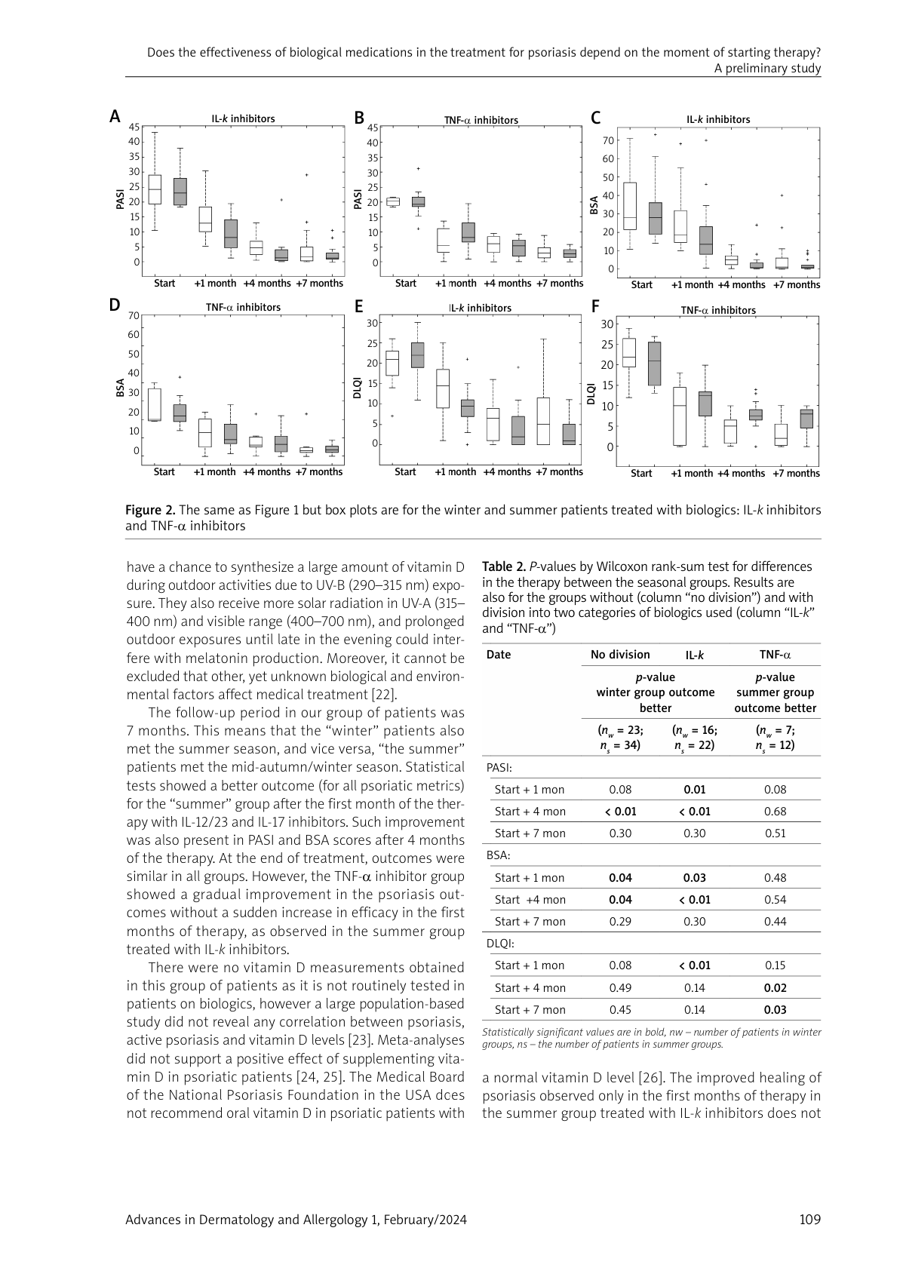
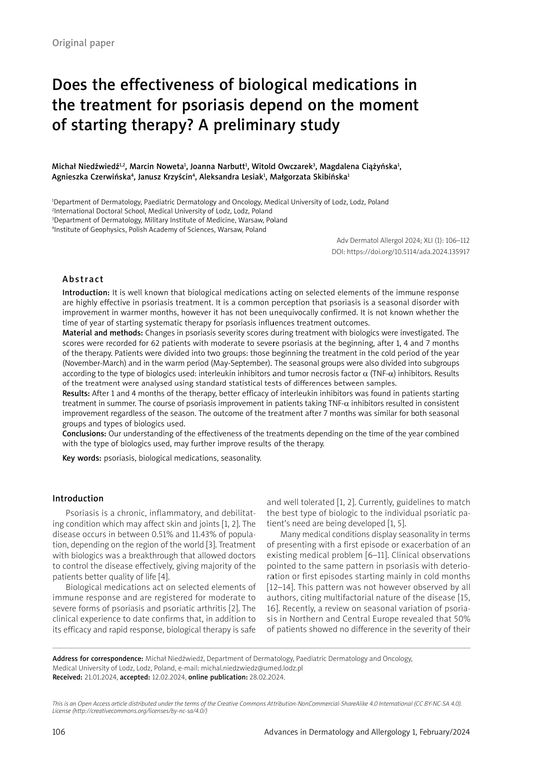
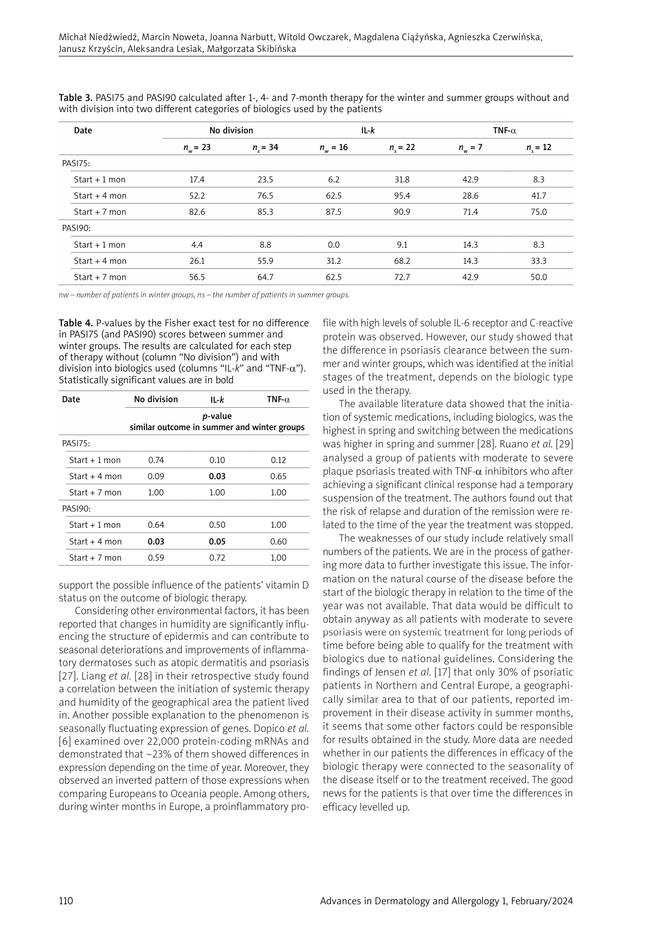
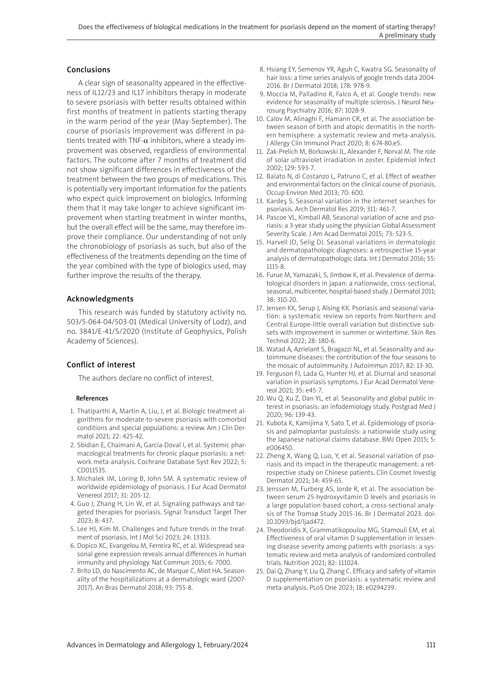
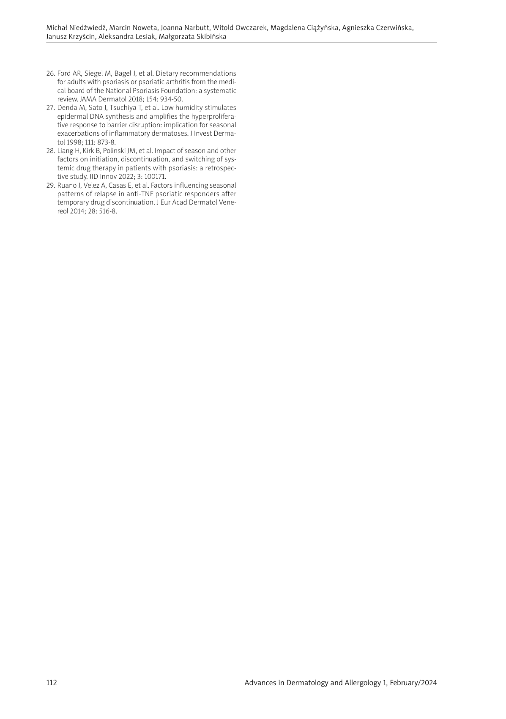
Preliminary study
IF: 1.4
MEiN: 70

Slide 12
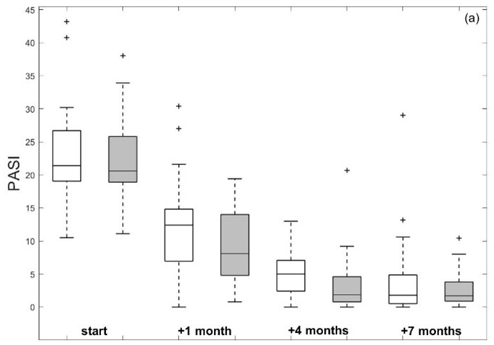
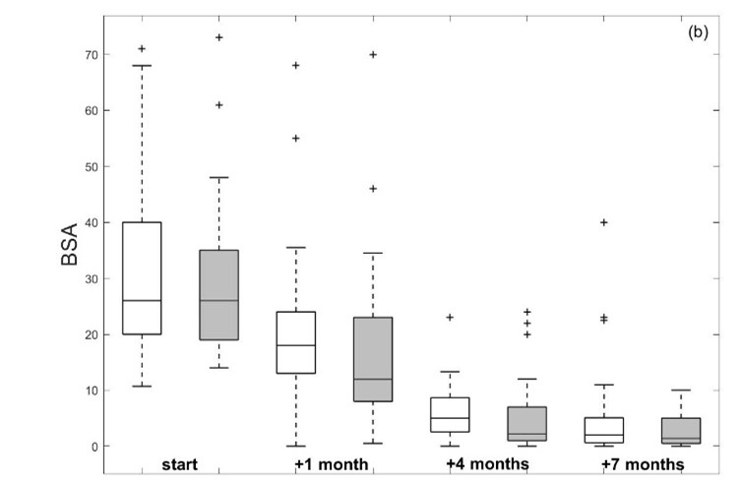
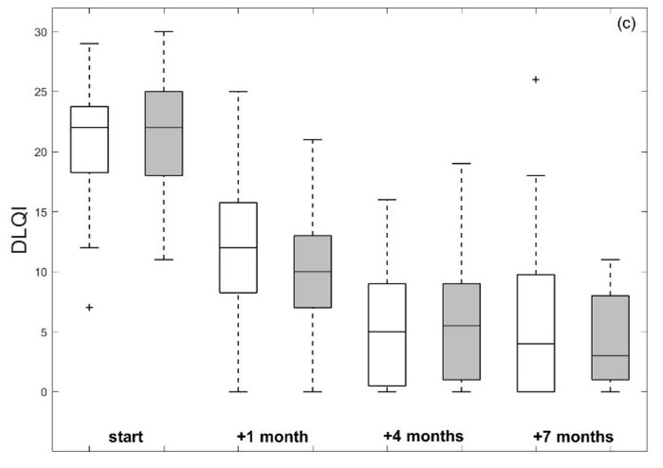
Results of a preliminary study
patients starting biologics in warmer months improved significantly faster in PASI, BSA and DLQI scores when compared to the winter group
differences in results between cold and warm periods groups became statistically insignificant in the 7th month of treatment.
Results for the cold (white) and warm (grey) group of the psoriatic patients

Slide 13
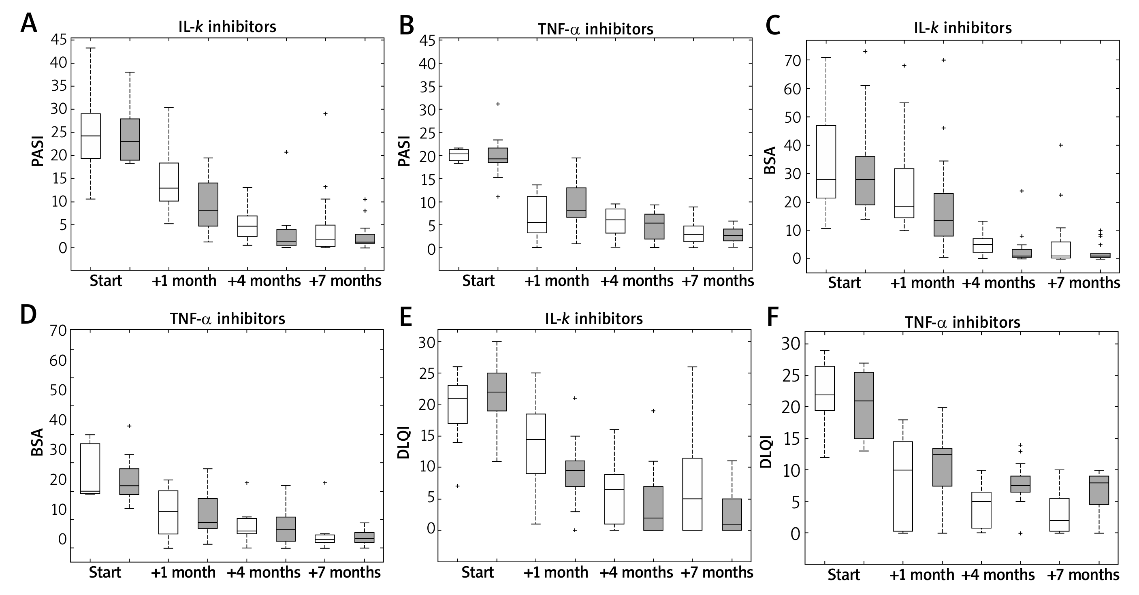
Results of a preliminary study
a clear sign of seasonality in the effectiveness of IL12/23 and IL17 inhibitors therapy - better results starting therapy in the warm period of the year (May-September).
no seasonality in TNF-α inhibitors observed

Slide 14
Remaining questions
Improvement related to the chronobiology of psoriasis – mechanism?
How can we use this phenomenon for our patients?

Slide 15
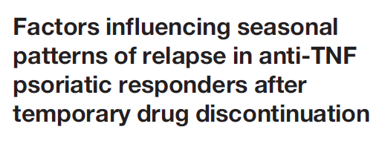
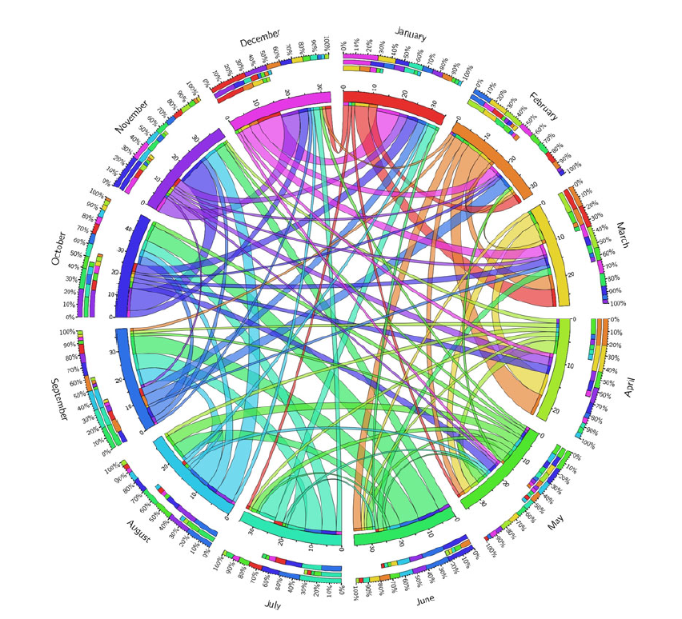
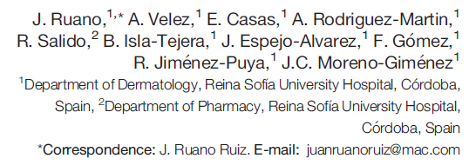
similar observations by Ruano et al. (2013)
discontinuation of anti-TNF-alpha biologics in summer – the lowest risk of relapse

Slide 16
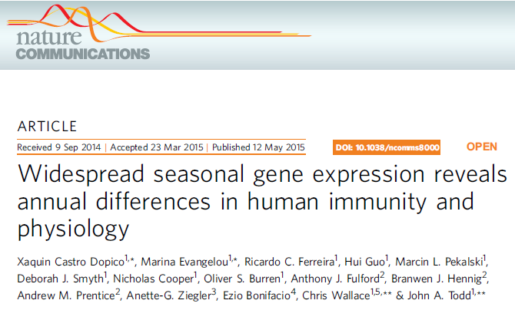
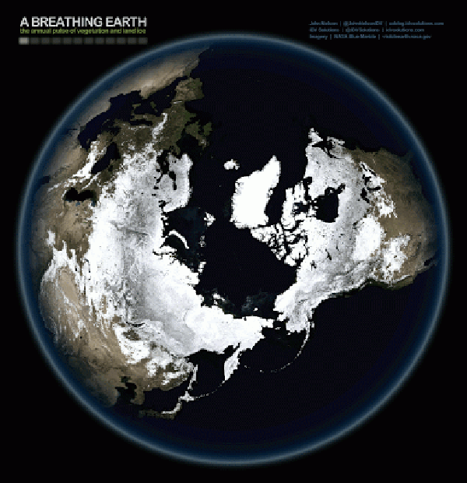
mRNA expression of proteins related to the immune system - seasonal pattern
in European winter increased levels of soluble IL-6 receptor and C-reactive protein (CRP) observed
confirmation of peak incidence in winter of cardiovascular, psychiatric and autoimmune diseases
this phenomenon may also explain seasonality of psoriasis

Slide 17
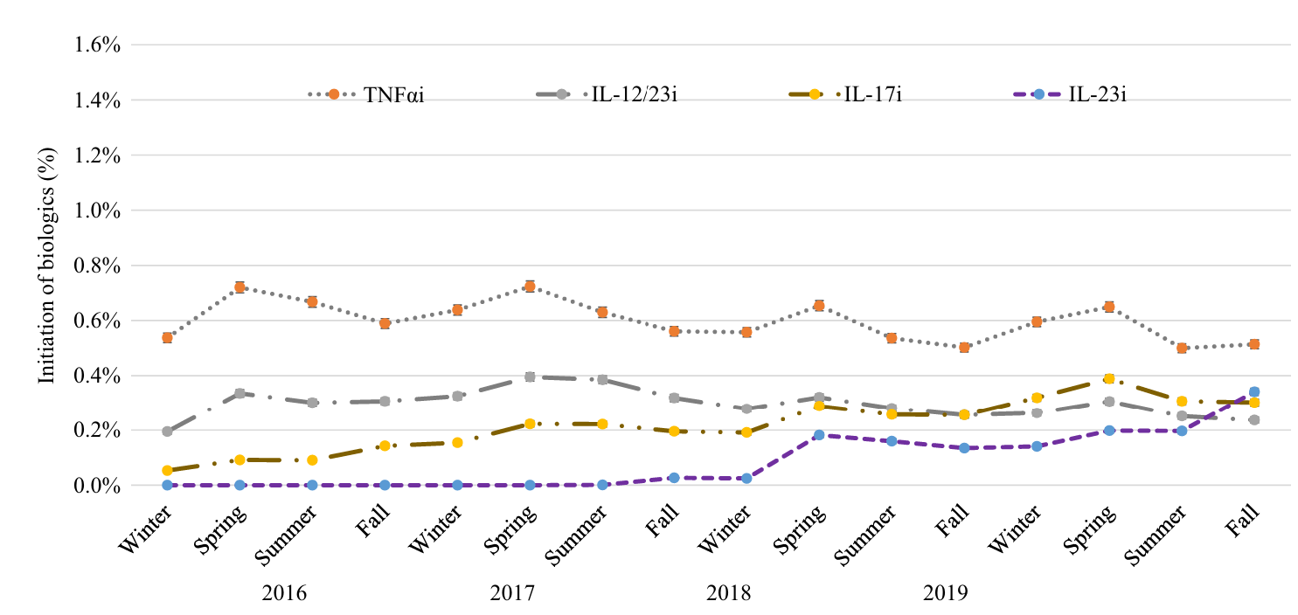
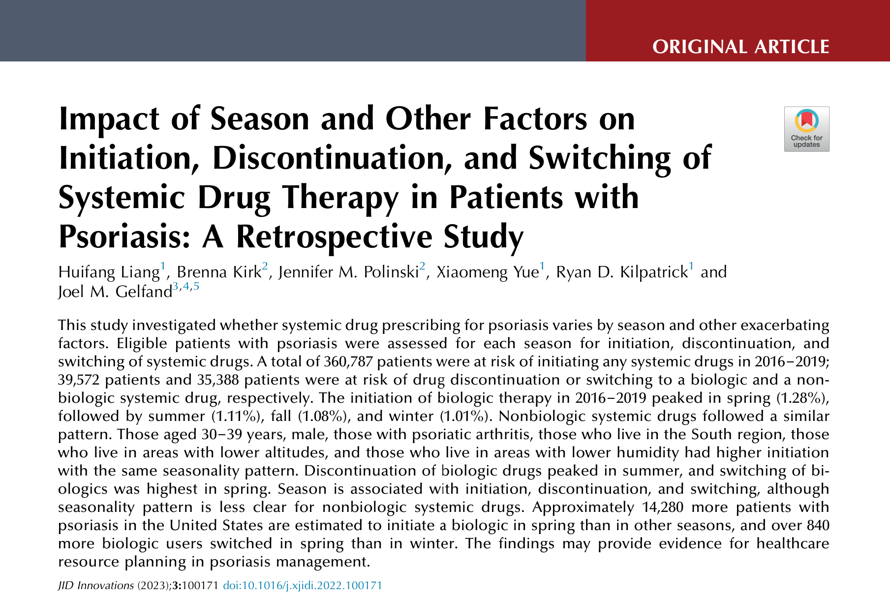

Slide 19
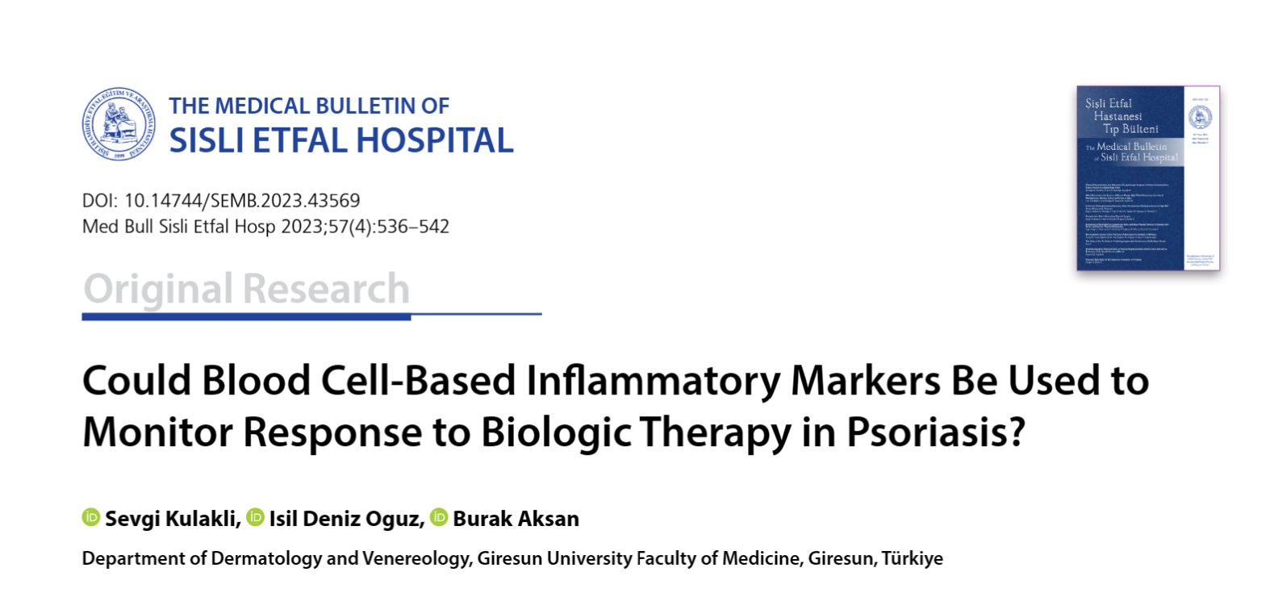

Slide 20
Conclusions
The seasonality of diseases related to a different expression of genes with more pro-inflammatory immune system observed in winter.
Patients should be informed that their response to the treatment in cold period of the year could be slower, but it would not influence the overall improvement.

Slide 21
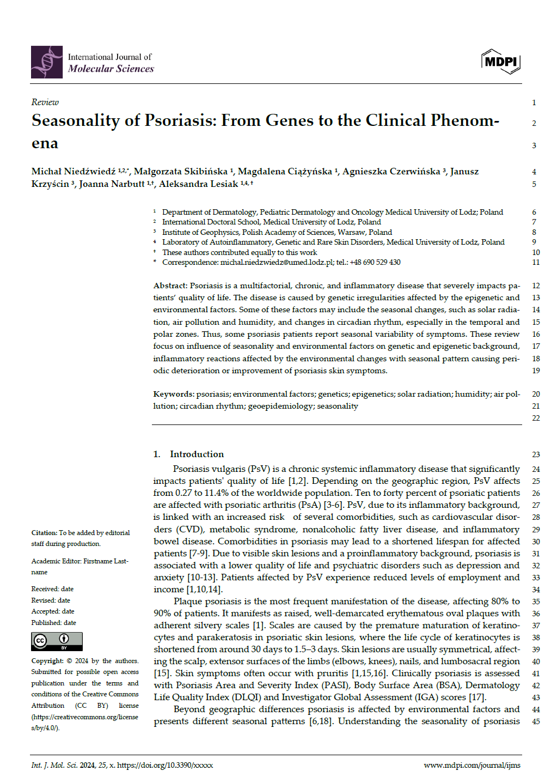
Literature review – in progress
under review

Slide 22
Congresses and conferences
 | CONFERENCES | LOCATION | DATE | TYPE OF PARTICIPATION | TITLE OF THE PRESENTATION
1 | 32nd Congress of the European Academy of Dermatology And Venereology | Berlin, Germany | 11-14th Oct 2023 | active | - Unilateral breast enlargement – coincidence or unknown side effect of systemic isotretinoin treatment - When the sun cause pain - recurrent edema in a 12-year-old patient
2 | Dermoskopia w Nauce i Praktyce. Kurs dla rezydentów dermatologii | Warsaw, Poland | 28th Oct 2023 | passive
3 | Dermatologia Praktyczna | Lodz, Poland | 17-18th Nov 2023 | passive
4 | ExCute | Lodz, Poland | 12-13th Mar 2024 | passive
5 | II Kongres Immunologii Sanofi | Warsaw, Poland | 4-5th Apr 2024 | passive
6 | Juvenes Pro Medicina | Lodz, Poland | 9-12th May 2024 | juror in Dermatology session

Slide 23
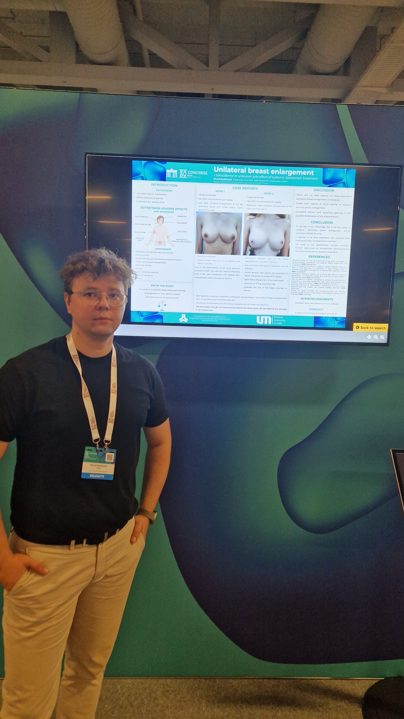
European Academy of Dermatology and Venereology Congress, 11-14 th October Berlin

Slide 24
European Academy of Dermatology and Venereology Congress, 11-14 th October Berlin

Slide 25
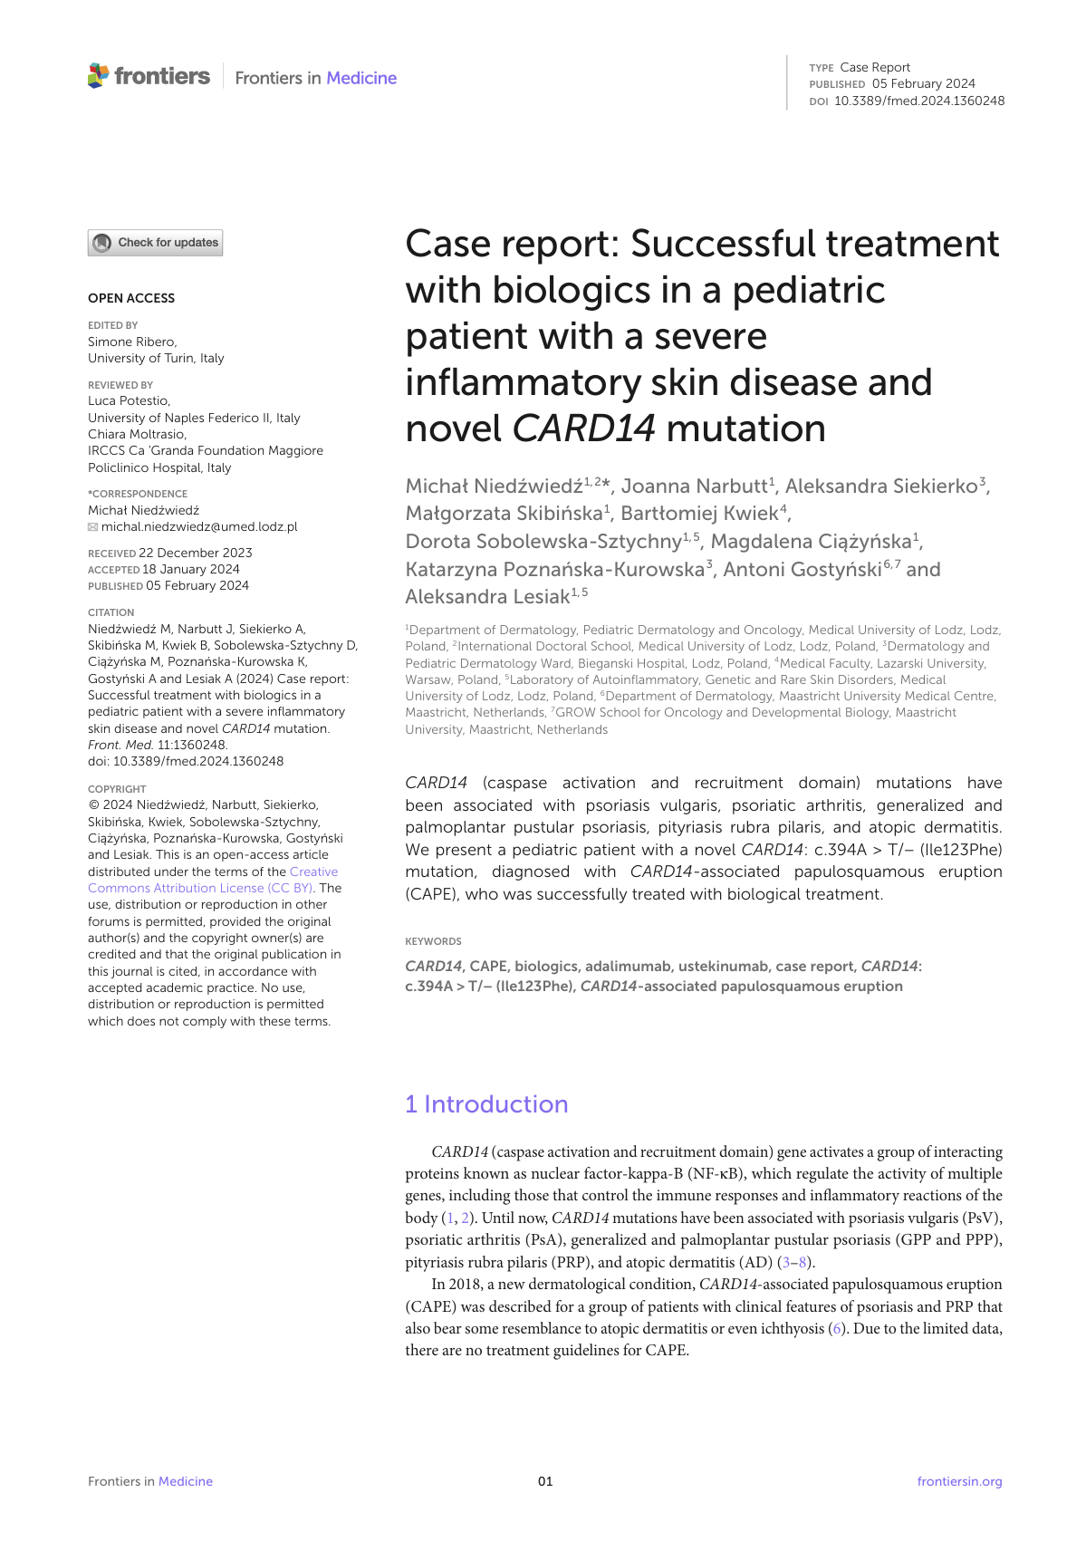
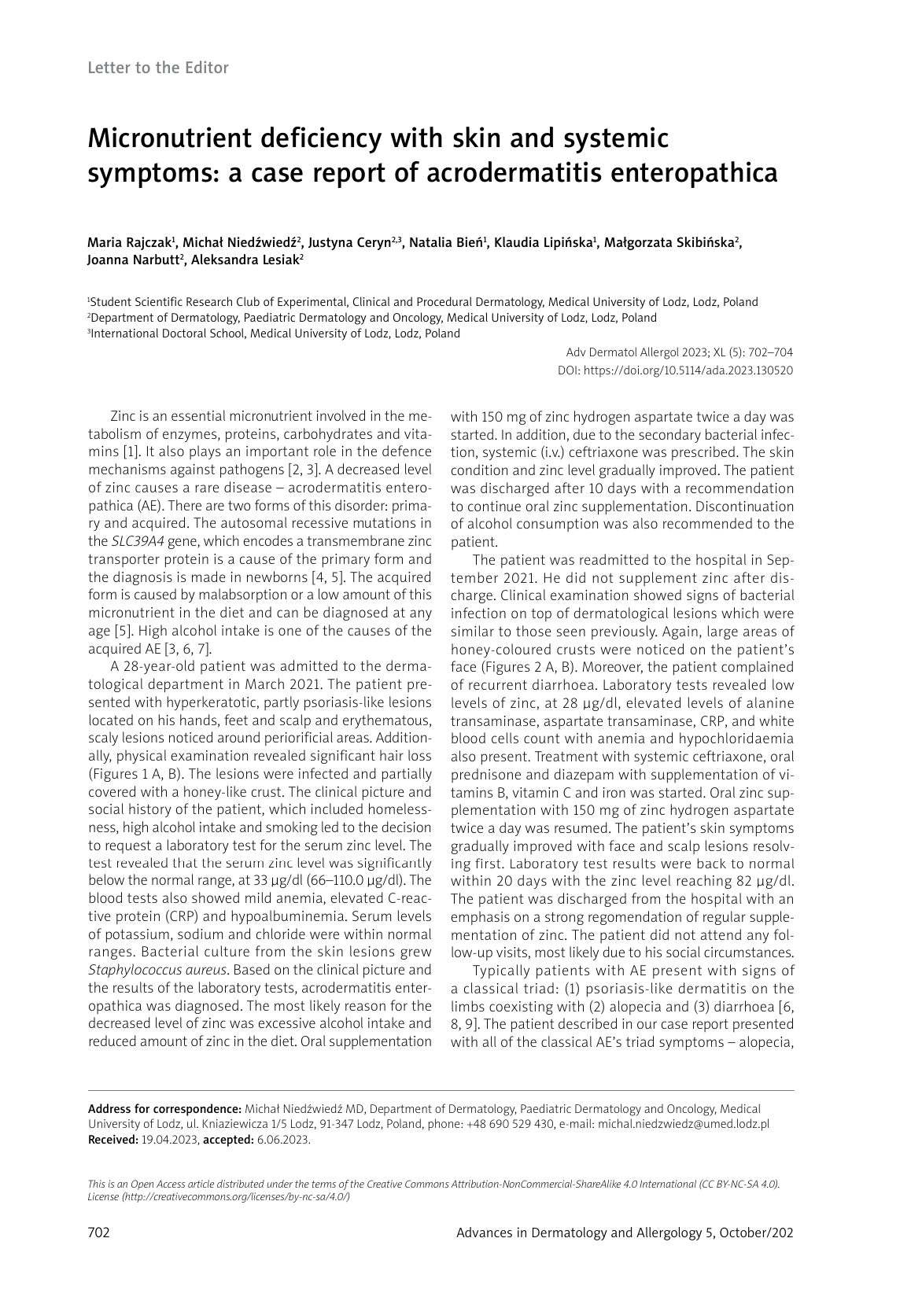
Publications
IF: 1.4
MEiN: 70
IF: 3.4
MEiN: 70
IF: 1.4
MEiN: 70

Slide 26
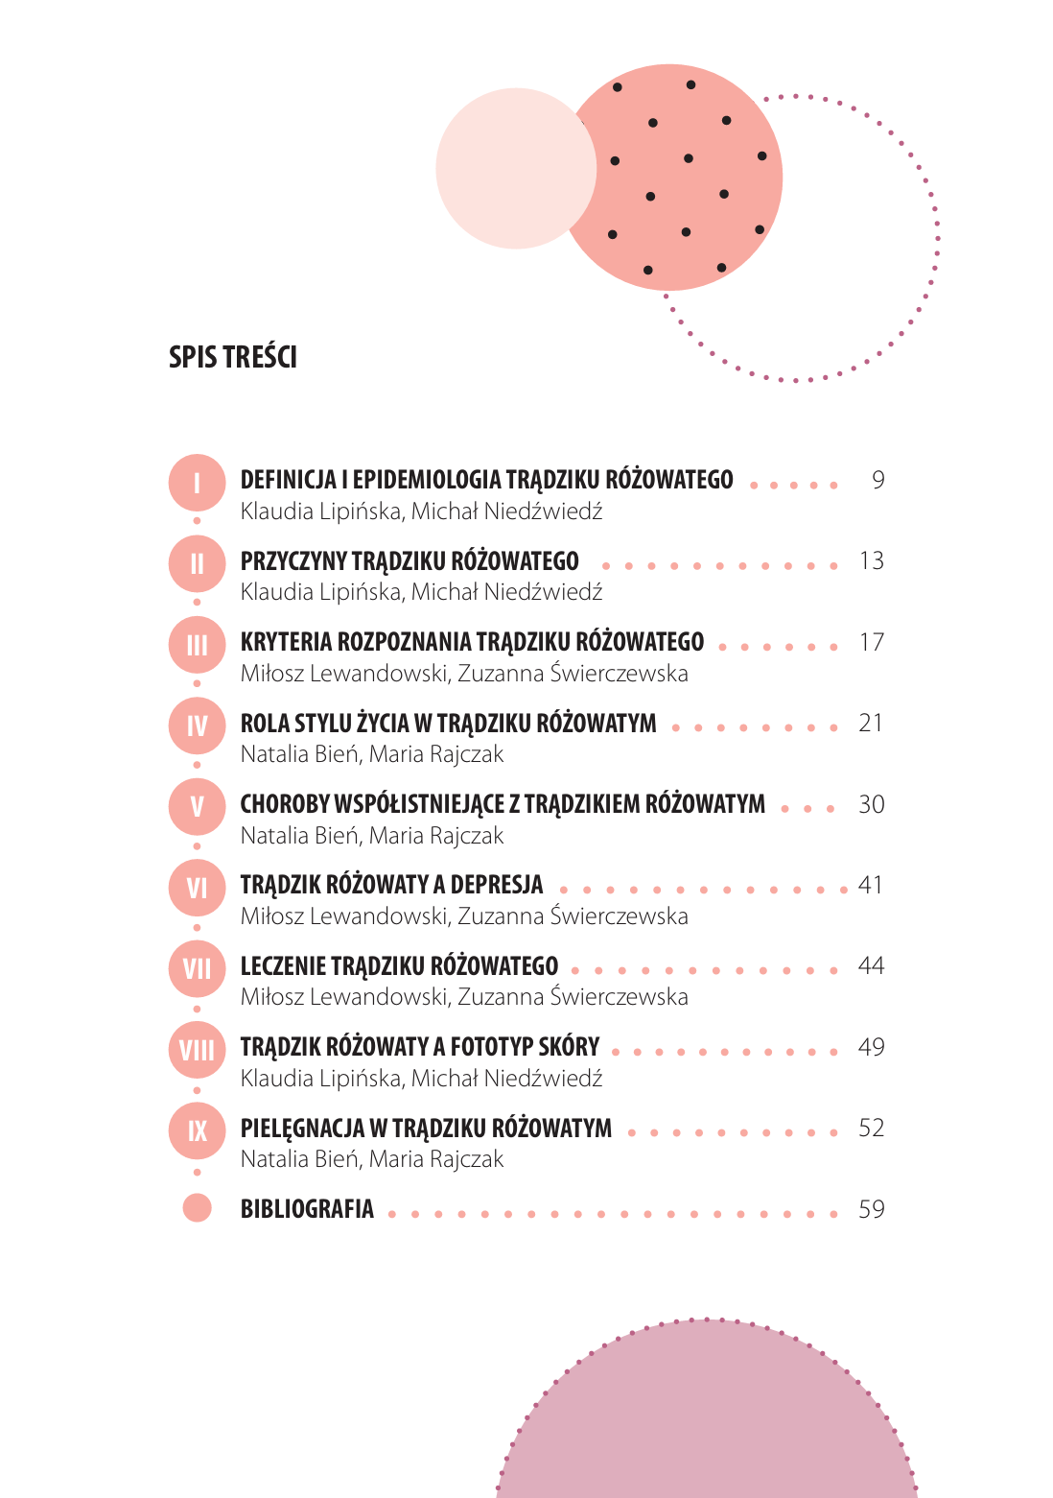
Publications

Slide 27
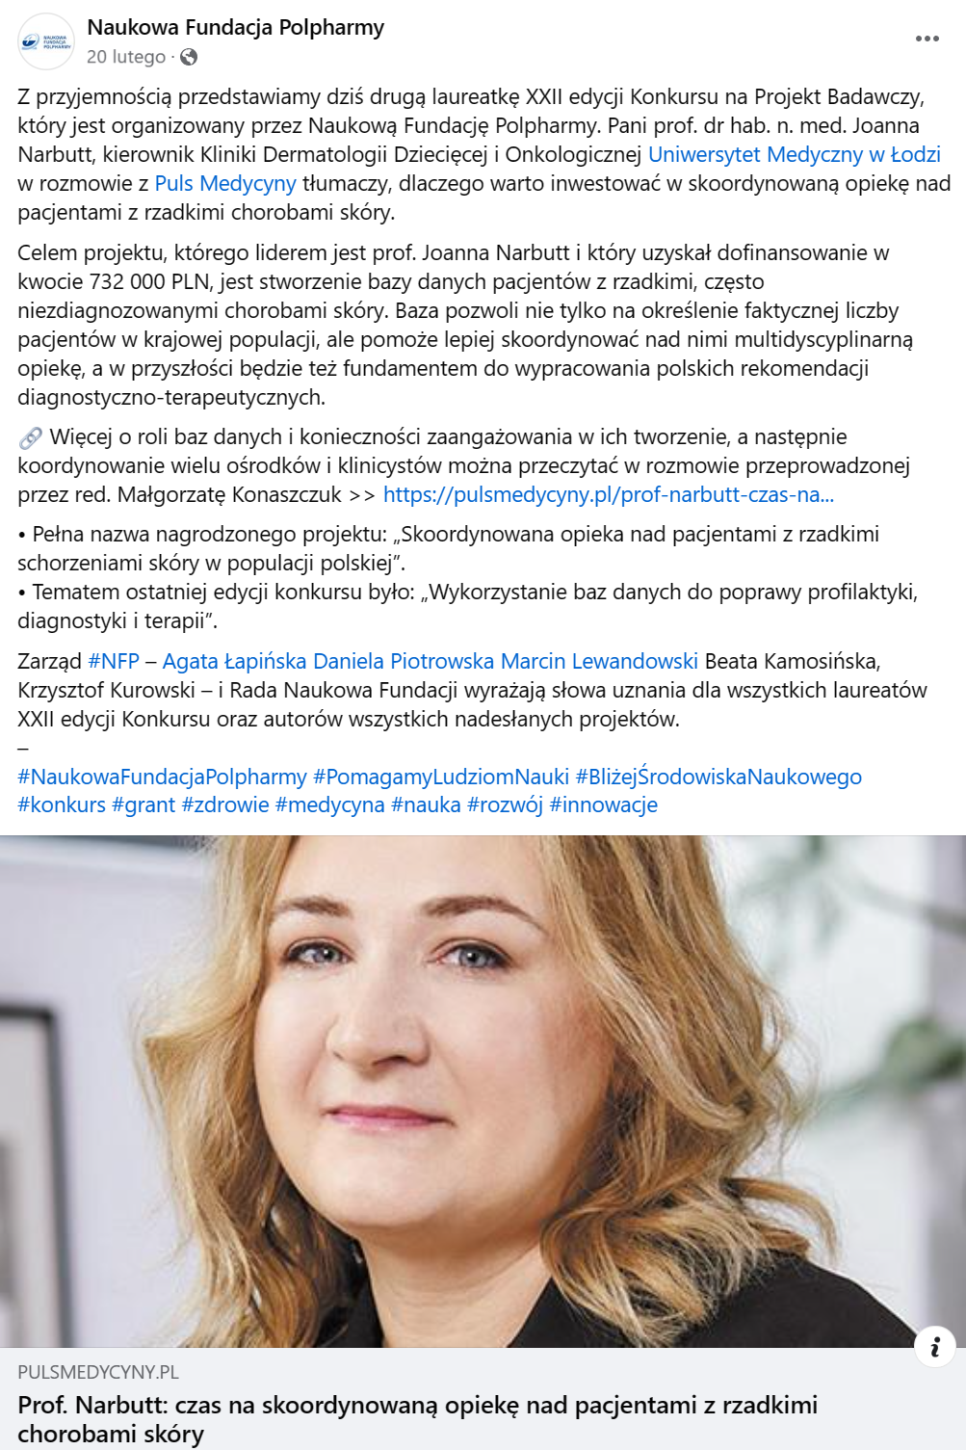
Polpharma’s Scientific Fundation Grant

Slide 28
Classes with students

Slide 29
Summary
obteined Bioethical Comettee aproval
3 research paper (with total IF: 6.2, MEiN: 210)
3 chapters in a monography
1 scientific grant
5 conferences and congresses, 2 posters
However…

Slide 30
(…) there is still much to do…

Slide 31
Plans for next academic years
completing gathering data and presentation and publication of the results
survey study for patients with psoriasis regarding the seasonal exacerbation of symptoms
scoping review on monitoring inflammatory blood parameters in patients with psoriasis during treament with biologics
further molecular investigations
applying for „Preludium” National Scientifc Centre

Slide 32
Thank you for your attention!
References:
Denda M et al. Low humidity stimulates epidermal DNA synthesis and amplifies the hyperproliferative response to barrier disruption: implication for seasonal exacerbations of inflammatory dermatoses. J Invest Dermatol. 1998 Nov;111(5):873-8.
Touma Z et al. Does the change in season affect disease activity in patients with psoriatic arthritis? Ann Rheum Dis. 2012 Aug;71(8):1370-3.
Ruano J et al. Factors influencing seasonal patterns of relapse in anti-TNF psoriatic responders after temporary drug discontinuation. J Eur Acad Dermatol Venereol. 2014 Apr;28(4):516-8.
Ferguson FJ et al. Diurnal and seasonal variation in psoriasis symptoms. J Eur Acad Dermatol Venereol. 2021 Jan;35(1):e45-e47.
Dopico XC et al. Widespread seasonal gene expression reveals annual differences in human immunity and physiology. Nat Commun. 2015 May 12;6:7000.
Pascoe VL, Kimball AB. Seasonal variation of acne and psoriasis: A 3-year study using the Physician Global Assessment severity scale. J Am Acad Dermatol. 2015 Sep;73(3):523-5.
Kubota K et al. Epidemiology of psoriasis and palmoplantar pustulosis: a nationwide study using the Japanese national claims database. BMJ Open. 2015 Jan 14;5(1):e006450.
Li WQ et al. Rotating night-shift work and risk of psoriasis in US women. J Invest Dermatol. 2013 Feb;133(2):565-7.
Wu Q et al. Seasonality and global public interest in psoriasis: an infodemiology study. Postgrad Med J. 2020 Mar;96(1133):139-143.
e-mail: michal.niedzwiedz@student.umed.lodz.pl
https://images.app.goo.gl/UdPfxj7tgPYjimpS9

