Slide 1
Assessment of inflammatory parameters and local allergic reaction in diagnosis and endotypic classification of allergic rhinitis
Doctoral student: Mohamad Mahdi Mortada, MD
Supervisor : Marcin Kurowski, MD, PhD, Associate Professor
Department of Immunology and Allergy, Medical University of Lodz.

Slide 2
Background
Allergic rhinitis (AR) is a very common condition with rhinorrhea, sneezing, nasal itching, and congestion as its clinical manifestation
Statistics show that around 30% of adults and 40 % of children are affected by AR

Slide 3
Local allergic rhinitis
Local Allergic Rhinitis (LAR) is characterized through symptoms similar to the ones seen in AR, presence of local mucosal synthesis of allergen-specific immunoglobulin E (sIgE) and positive response to nasal provocation with allergen.
However, sIgE sensitization cannot be ascertained neither through skin prick test (SPT) nor through serum sIgE assessment.

Slide 4
Dual allergic rhinitis
Dual allergic rhinitis (DAR) is described in patients who are diagnosed with both; allergic rhinitis (AR) and local allergic rhinitis (LAR)

Slide 5
Epidemiological studies regarding LAR are not numerous.
Its prevalence varies between 3% to 60% depending on the studied population and the employed methodology.

Slide 6
Local Allergic Rhinitis
Mechanisms of local mucosal allergic inflammation occurring during LAR are not fully elucidated.
The possibility to prove the presence of local mucosal production of specific IgE and other proteins and mediators might allow for the implementation of new management protocols as allergen immunotherapy (AIT) for LAR patients.

Slide 7
Hypothesis
In a considerable proportion of patients in whom symptoms are suggestive for seasonal or perennial allergic rhinitis but sIgE cannot be ascertained, allergic inflammation process and IgE mediated reaction may occur only at the level of local mucosa. Multiple unidentified mediators and pathways can be responsible for the development of this type of allergic rhinitis

Slide 8
AIMS
Pathogenesis of LAR
01
Characteristics and distinct clinical features of LAR
02
Inflammatory mechanism occurring post-NPT
03
Biomarkers which might be used in the identification of patients with LAR
04
local mucosal sIgE synthesis In LAR patients
05

Slide 9
Methods
Clinical assessment: TNSS/ VAS scores and the skin prick test (SPT)
Specimen collection: nasosorption, nasal lavage and blood drawing.
Nasal provocation test (NPT) is also to be used during the off-season and specimen collection from the subjects will be performed before and after NPT.

Slide 10
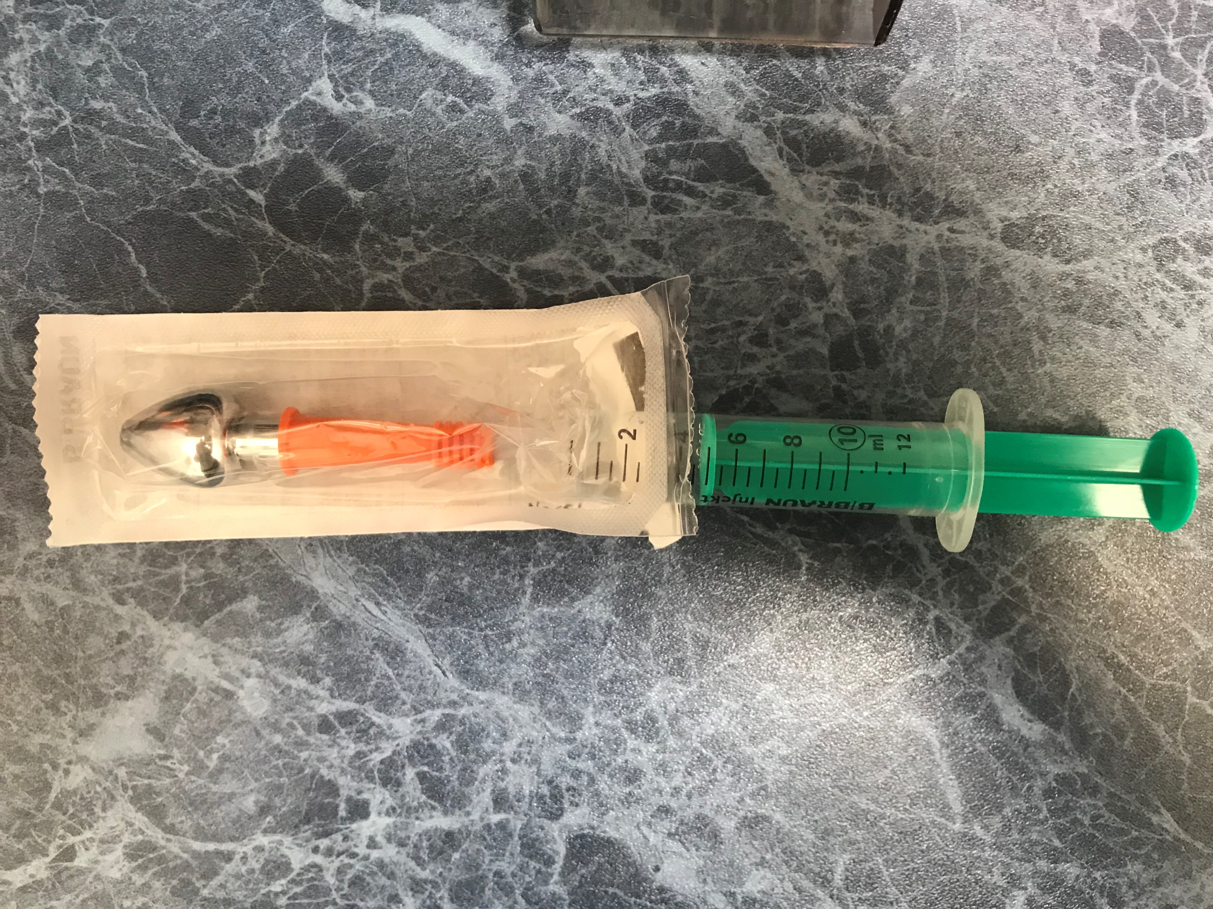
Nasosorption

Slide 11
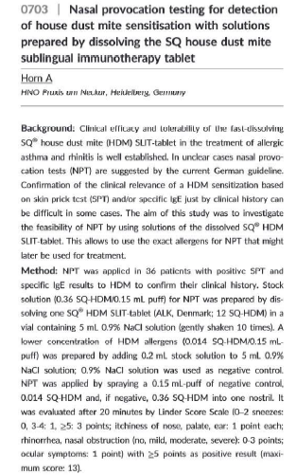
NPT protocols
Eifan AO, Fedina A, Durham SR, Scadding GW. Comparison of nasal allergen challenges with dissolved Timothy grass pollen tablets and aqueous extract. Allergy. 2021 May;76(5):1543-1545. doi: 10.1111/all.14590. Epub 2020 Oct 6. PMID: 32946601.
Horn A Nasal Provocation Testing for Detection of House Dust Mite Sensitization with Solutions Prepared by Dissolving the SQ House Dust Mite Sublingual Immunotherapy tablet, poster presentation, abstract 0703, EAACI 2018, Munich.

Slide 12
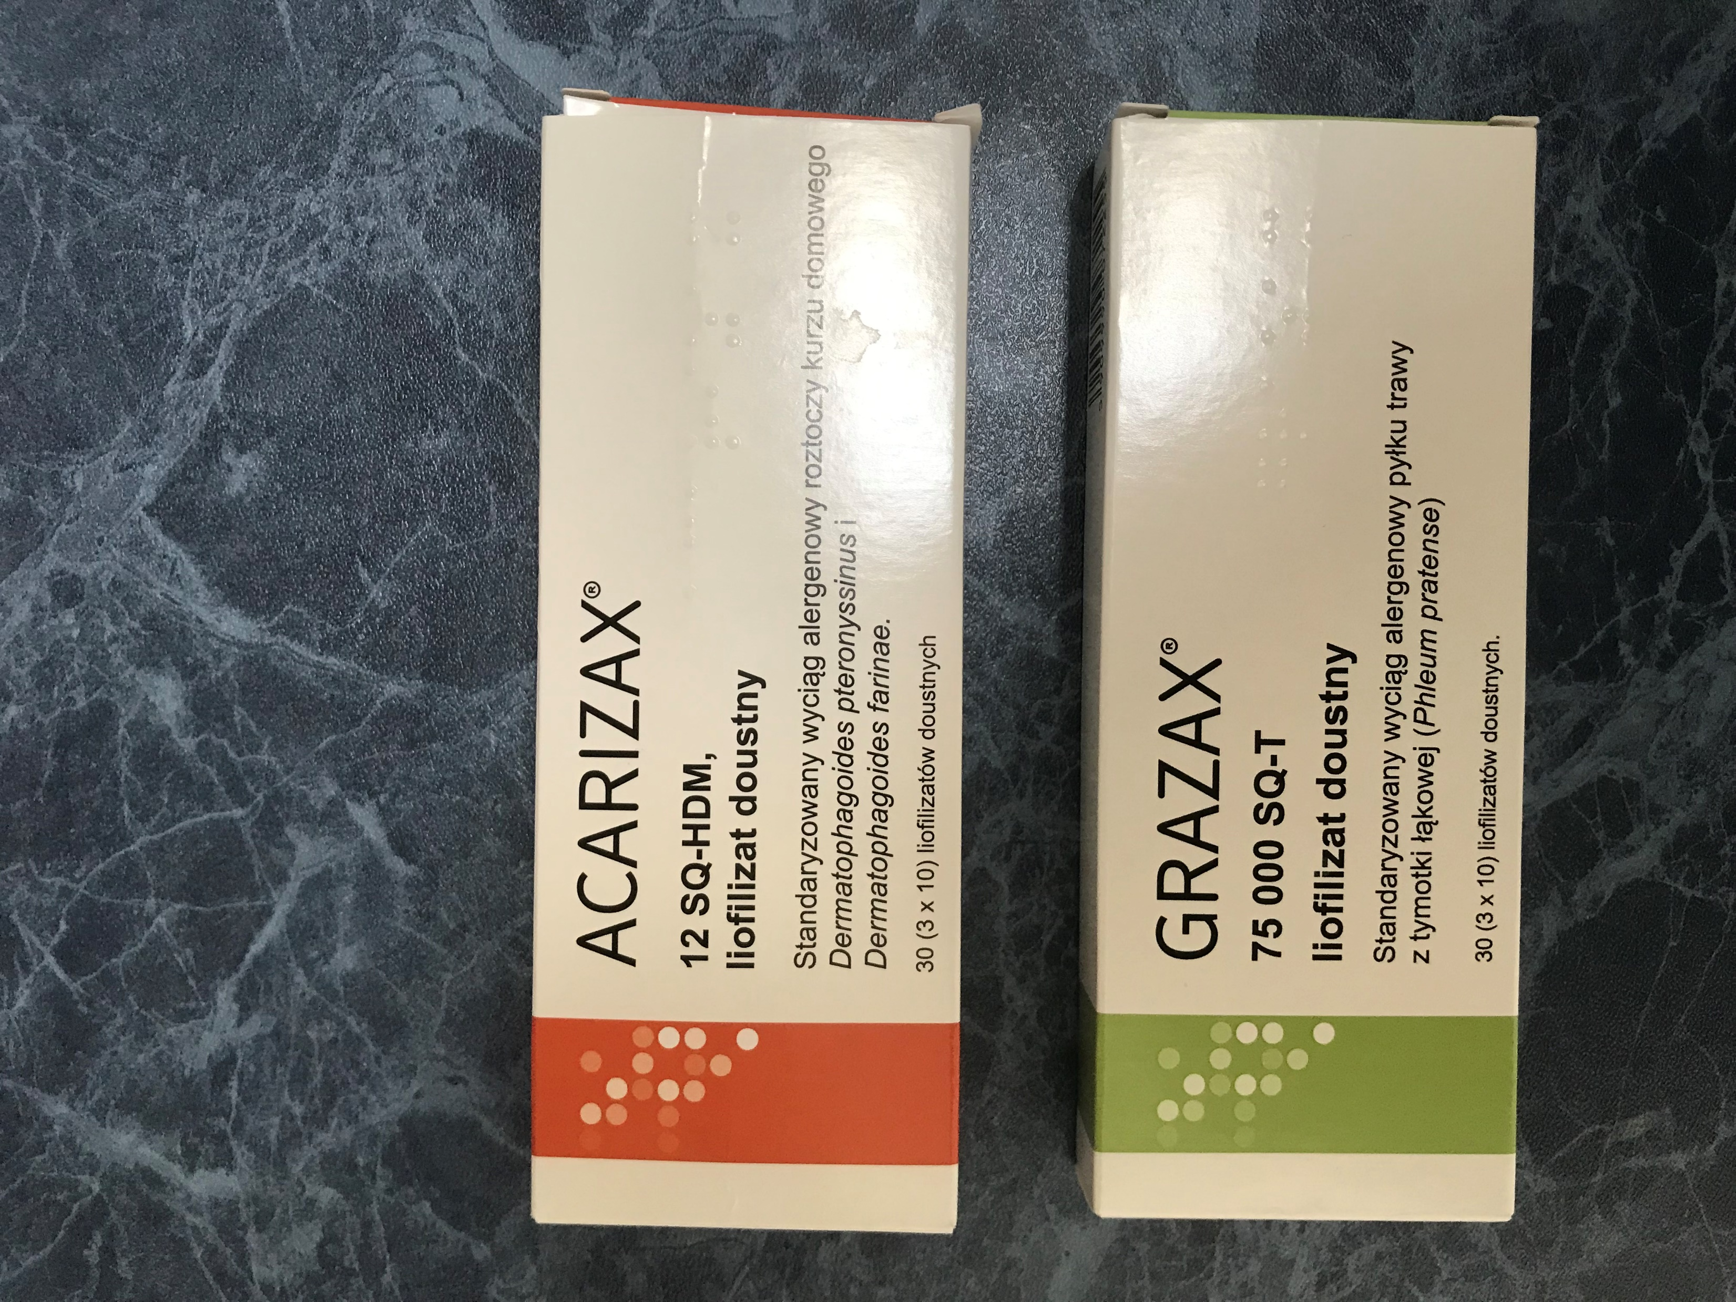

Slide 13
Subjects' recruitment
Approval from the Bioethical committee was received in May 2022 (RNN/76/22/KE)
We started recruiting subjects from among outpatients treated at the center for Asthma and Allergy Diagnosis and Treatment, Department of Immunology and Allergy, Central Teaching Hospital of the Medical University of Lodz.
The center has experience in conducting studies that assess local airway inflammation with the use of standard and innovative tools of nasal secretion acquisition.
All recruited subjects received detailed explanations of the methods used in samples collection and signed written consent for the participation in the study.

Slide 14
Recruited Subjects
Subjects (N=46) |  | Suspected LAR (n=35) | DAR (n=7) | AR (n=4)
Age in years |  | (18-71) | (27-70) | (20-68)
Gender | Female | 68.5 % | 28.5% | 60%
 | Male | 31.5% | 71.5% | 40%

Slide 15
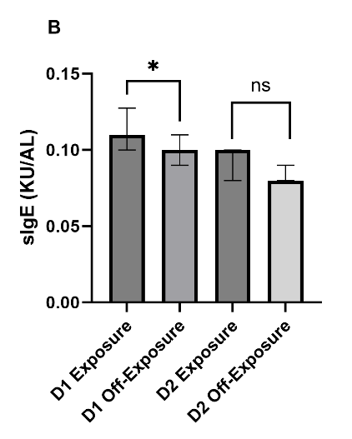
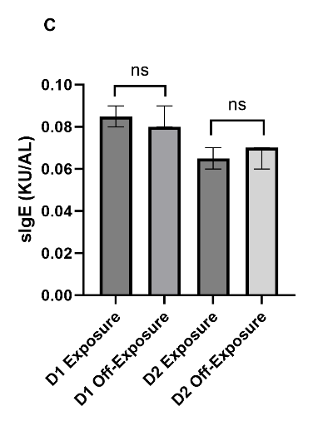
Period of increased HDM exposure vs. Off-Exposure period
Lavage
Nasosorption

Slide 16
TNSS/VAS Pre vs. Post NPT
 | TNSS |  | VAS
 | Pre - NPT | Post-NPT | Pre-NPT | Post-NPT
(+) NPT, n=8 | 4.5; [2.25-5] | 3.5; [2.25-4.75] | 4.45; [2.675-7.375] | 5.7; [4.475;7,2]
(-) NPT, n=10 | 3; [0.75-5] | 1; [0-2] | 2.25; [0.825-6.35] | 1.4; [0.375-3.4]
p=0.0077
p=0.032

Slide 17
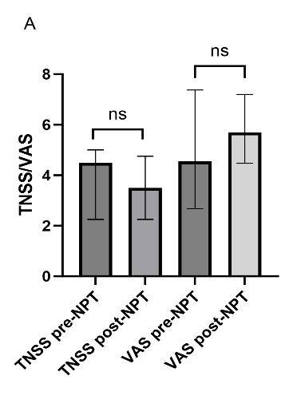
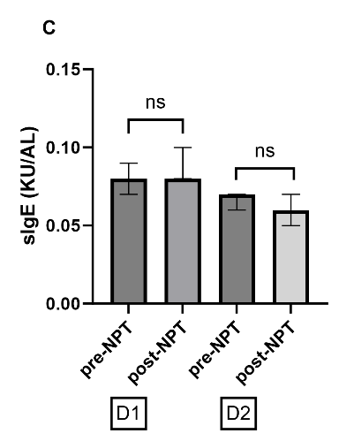
After a positive NPT
Lavage
Nasosorption

Slide 18
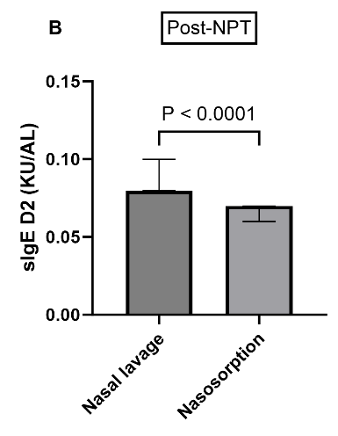
Lavage vs. Nasosorption

Slide 19
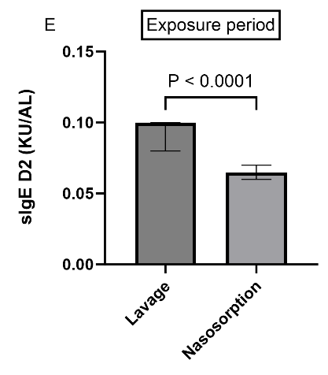
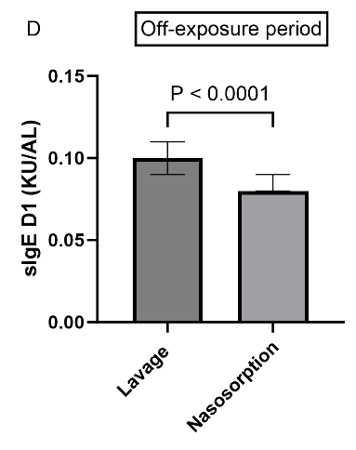
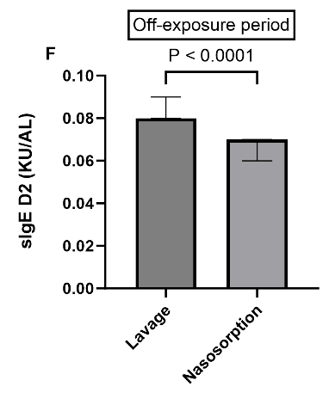
Lavage vs. Nasosorption

Slide 20
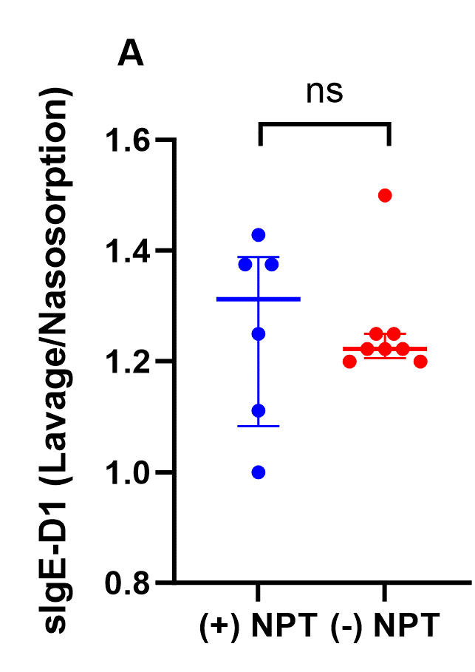
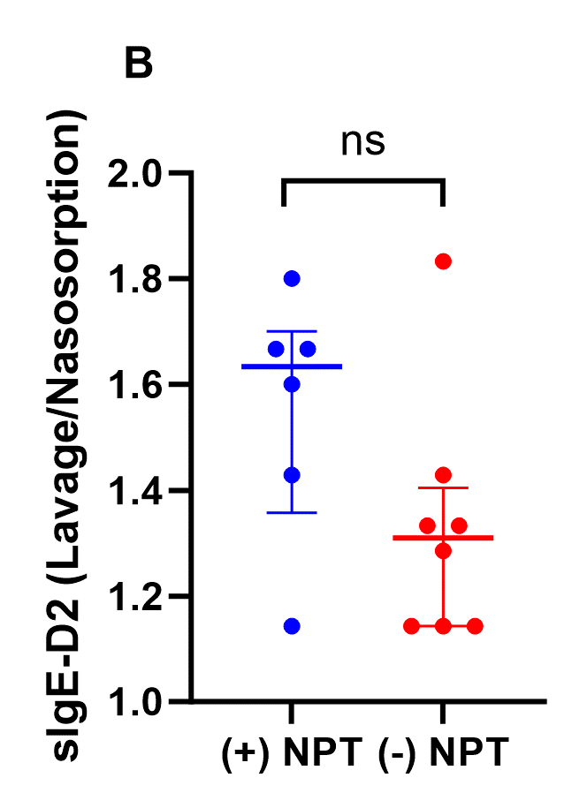
Relative sIgE value (sIgE in lavage/sIgE in nasosorption)

Slide 21
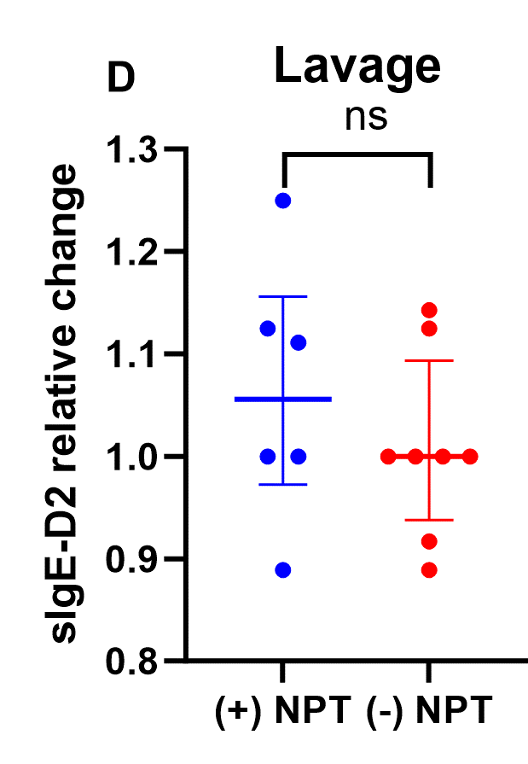
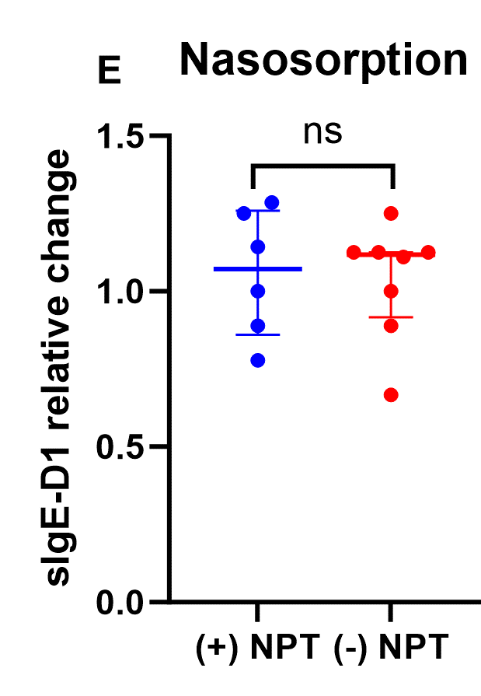
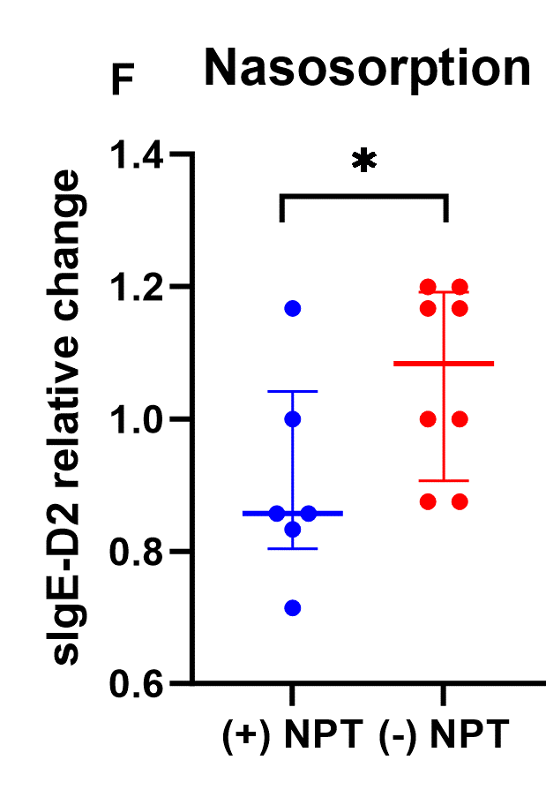
Individual relative change (sIgE post-NPT/sIgE pre-NPT)

Slide 22
Next steps
Assessment of sIgE to grass pollen allergen and the chosen mediators (YKL-40 and TSLP) levels.
The collection of samples from the recruited subjects is being performed on a weekly basis.
Healthy control subjects are also to be recruited and from whom samples will be collected accordingly

Slide 23
Keynotes
TNSS/ VAS methods are helpful as a subjective assessment tool of suspected LAR subjects.
More information can be acquired through sIgE assessment in nasal secretions of suspected LAR subjects.
Assessment of mediators in nasal secretions which is planned in the next steps of our research may provide new insights into the endotypical and phenotypical classification of allergic rhinitis.
Proper identification of the suspected LAR patients may help in providing them with a better management plan.

Slide 24
Thank you for your attention !

Slide 25
Achievements and Research Activity

Slide 26
Publications
Mortada MM, Kurowski M. Challenges in Local Allergic Rhinitis Diagnosis, Management, and Research: Current Concepts and Future Perspectives. Medicina (Kaunas). 2023 May 11;59(5):929. doi: 10.3390/medicina59050929. PMID: 37241161; PMCID: PMC10222918 .
Manuscript of the 1st research article. Title: Assessment of symptoms and mucosal specific IgEs presence induced by NPT and natural dust mites exposure in LAR patients. Submitted to the Journal of Personalized Medicine (ISSN: 2075-4426).
Mortada Mohamad Mahdi, Kurowski Marcin. Assessment of inflammatory parameters and local allergic reaction in diagnosis and endotypic classification of allergic rhinitis. Alergia Astma Immunologia, 2023, vol. 28, nr 2, s.60-60.
Mortada Mohamad Mahdi*. Mucosal IgE production in local allergic rhinitis, a potential diagnostic criterion, and an implementation in allergen immunotherapy.European Journal of Clinical and Experimental Medicine, 2023, s.101-101.
Mortada M.M., Kurowski M. Assessment of allergic reaction and specific immunoglobulin e level in nasal secretion of local allergic rhinitis patients. Acta medica (Hradec Kralove) / Universitas Carolina, Facultas Medica Hradec Kralove, 2023, vol. 66, nr 2, s.88-89. DOI:10.14712/18059694.2023.20.

Slide 27
Conferences
20th International Medical Doctoral Conference. 29/11-01/12 2023, Educational Centre of the Faculty of Medicine in Hradec Kralove, Hradec, Czech Republic. Poster presentation: Assessment of allergic reaction and specific Immunoglobulin E level in nasal secretion of local allergic rhinitis patients.
EAACI Congress 2024, 31/05-03/06 2024, Valencia Spain. Poster presentation : Assessment of symptoms and mucosal specific IgEs presence induced by NPT and natural dust mites exposure in LAR patients.

Slide 28
Other achievements
Sherri, A., Mortada, M.M., Makowska, J. et al. Primary angiitis of the CNS and ANCA-associated vasculitis: from pathology to treatment. Rheumatol Int (2023). https://doi.org/10.1007/s00296-023-05461-9
Leading a team in the genetics scientific circle – Investigation of the topic of microRNA and Liquid biopsy in the diagnosis of bladder cancer preparation of systematic review
Recipient of STER NAWA Scholarship
Teaching experience – delivering seminars and clinical classes to English Division Students during the academic year 2023/2024

