Slide 1


Quantification of non-methylated INS gene fragment in circulating
cell-free DNA as a biomarker of beta cell death – clinical application
Arkadiusz Michalak, MD, PhD student (4th year)
Supervisor: prof. Agnieszka Szadkowska, MD, PhD

Slide 2
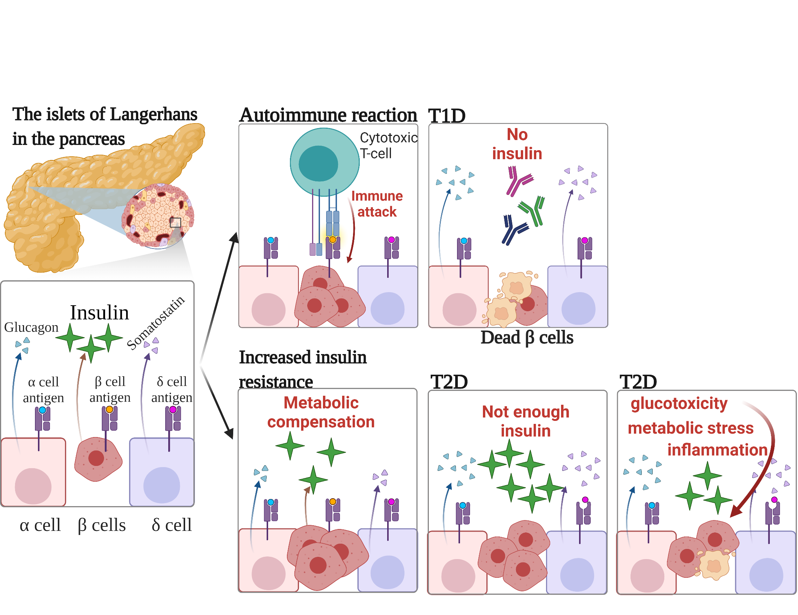

Introduction – why beta cells?
Beta cells are unique in their capability to produce and secrete insulin
Their death is the primary cause of type 1 diabetes (T1D) – leading type of diabetes in childhood

Slide 3
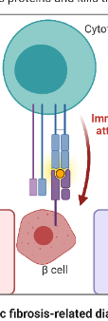
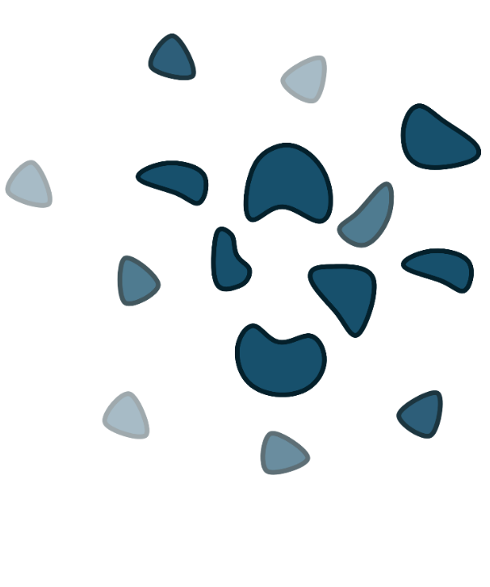
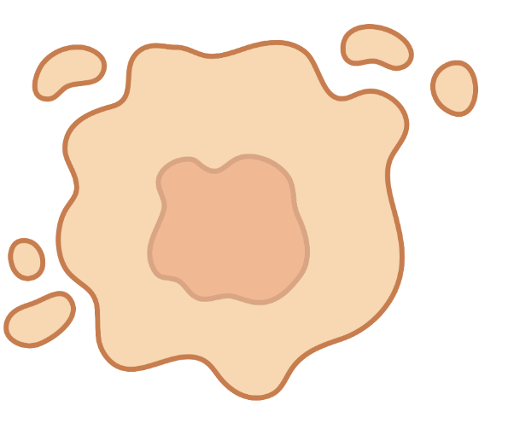

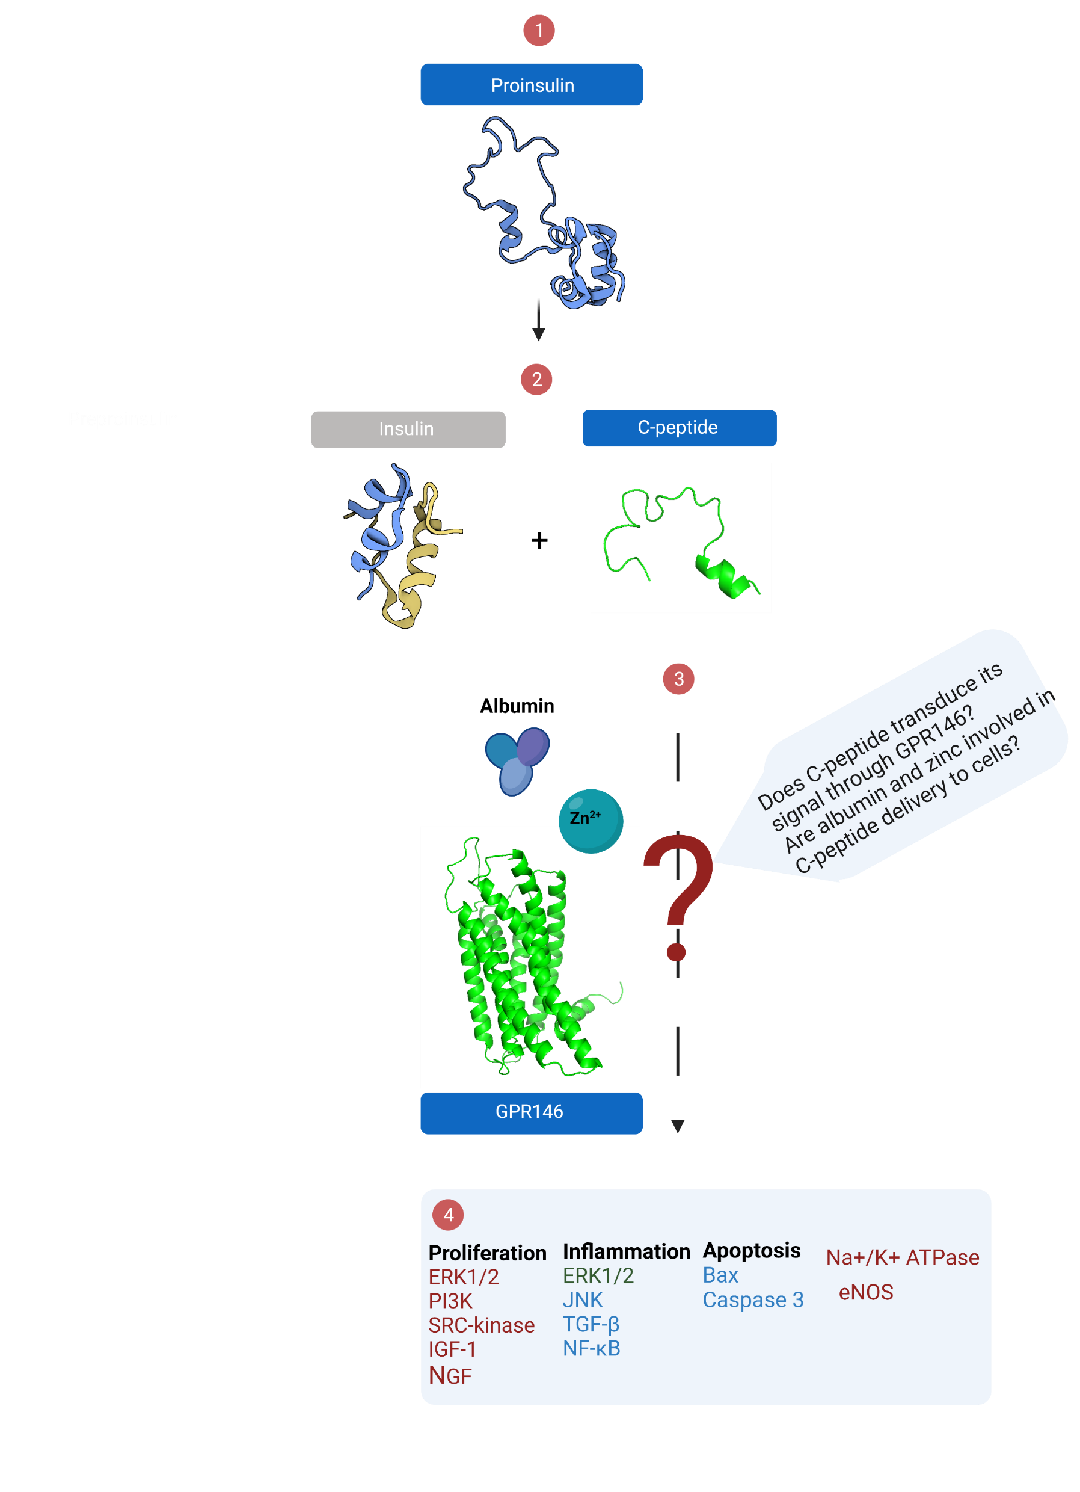
Current methods of beta cell monitoring in the clinic
Cellular autoimmunity
β cell damage
And antigen exposure
Antibody production
Islet-specific autoantibodies:
Clear sign of ongoing autoimmune proces
Predicts long-term risk of T1D
No information about beta cells` death dynamics
Can be utilized only for T1D
C-peptide:
Released in equimolar amount to insulin
Longer half-life
Biomarker of endogenous insulin secretion
Detectable loss in late stages of beta cell destruction (compensation by surviving cells)
Proinsulin
Insulin
C-peptide

Slide 4
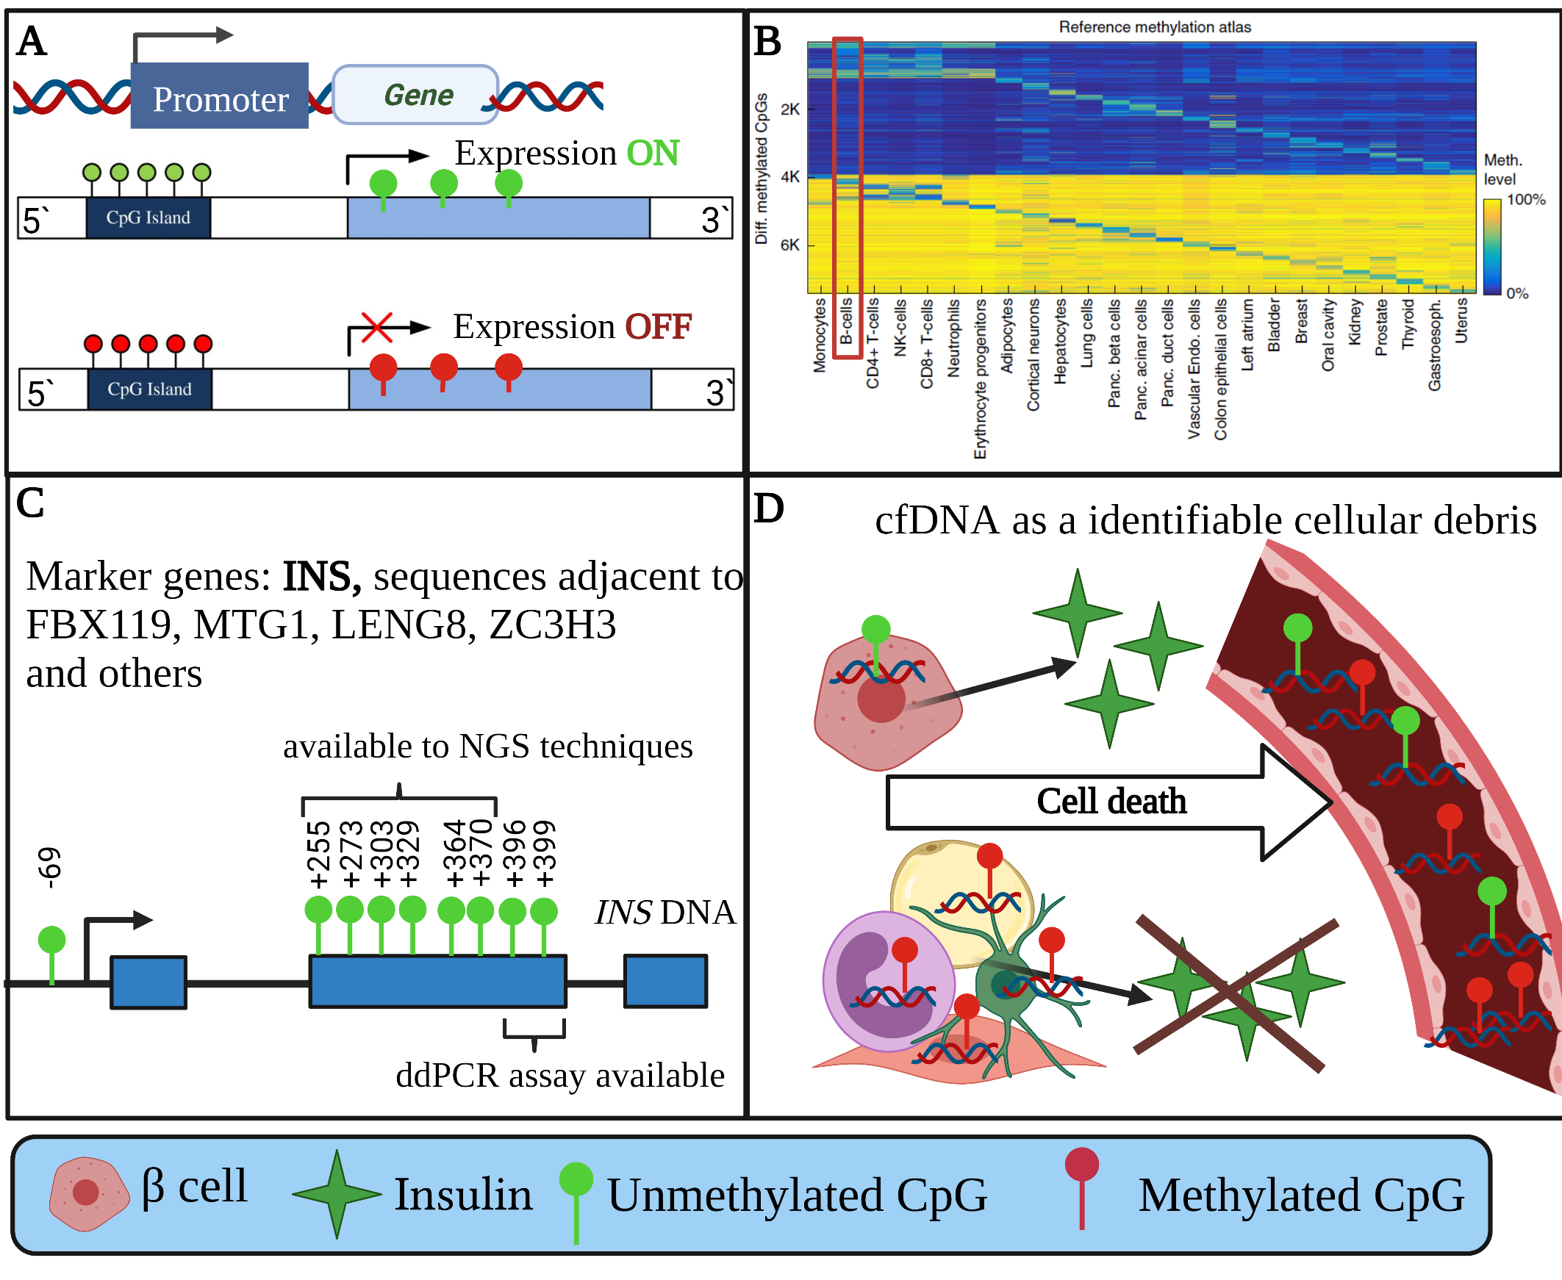
New method – beta cell epigenetic fingerprint
A: Gene methylation is a known epigenetic mechanism that silences gene expression
B: Methylation pattern of beta cell`s DNA is known and unique
C: Insulin gene (INS) and othere marker genes can be used to identify beta cell DNA
D: Beta cell`s death results in its DNA entering circulation – where it can be detected. Beta cell-specific circulating cell-free DNA (B-cfDNA) can thus be a new, short-term biomarker of beta cell death.

Slide 5
2023/2024 aims
  Select an optimal metric for B-cfDNA measurement
  Compare B-cfDNA at T1D onset between:
    Children with and without diabetic ketoacidosis (DKA)
    Children who achieve or not partial clinical remission (PR) after 3 months of T1D

Slide 6


Study groups and data collection
New-onset T1D
T1D follow-up
Aantibody-negative siblings of children with T1D
Adults with T1D undergoing islet allotransplants
Timepoint
Beetween 2-5th day
Since insulin administration
3m
6m
9m
12m
During autoantibody testing
Before
transplant
1h
6h
after T1D diagnosis
after transplant
Additional
data
Body weight, heigh, fasting and stimulated c-peptide,
Presence of DKA
Body weight, height, daily dose of insulin, HbA1c, fasting c-peptide
Body weight, heigh
Body weight, heigh,
daily dose of insulin, HbA1c, fasting c-peptide, CGM data
DKA criteria (ISPAD2018): HbA1c [%] + 4*DDI [Ui/kg] <9.

Slide 7
Results – 97% complete recruitment
New-onset T1D
Screened:
N=195
Allotransplanted adults
Recruited:
N=5
Included
N=156
Recruited for follow-up
N=89
Siblings tested for autoantibodies
N=62
Retained in follow-up
3m: N=76
6m: N=73
9m: N=69
12m: N=65
Autoantibody-negative included for analysis
N=30
ASSAYED:
N=42
N=43 (samples)

Slide 8
Results – 97% complete recruitment
New-onset T1D
Screened:
N=195
Allotransplanted adults
Recruited:
N=5
Included
N=156
Recruited for follow-up
N=89
Siblings tested for autoantibodies
N=62
Retained in follow-up
3m: N=76
6m: N=73
9m: N=69
12m: N=65
Autoantibody-negative included for analysis
N=30
ASSAYED:
N=42
N=43 (samples)

Slide 9
Group characteristics (N=42)
Characteristic | N (%)
Sex – female | 25 (59.5%)
DKA at admission (2018 definition) | 14 (33.3%)
Way of insulin administration | IV – 11 (26.2%) SC – 31 (73.8%)
Islet-associated autoantibodies | One – 3 (7.1%) Two – 11 (26.2%) Three – 12 (28.6%) Four – 16 (38.1%)
 | Mean±SD
Age [years] | 10.3±2.8
pH at admission | 7.31±0.13
Daily insulin dose [UI/kg] | 1±0.4
Fasting c-peptide [ng/L] | 0.35±0.24

Slide 10
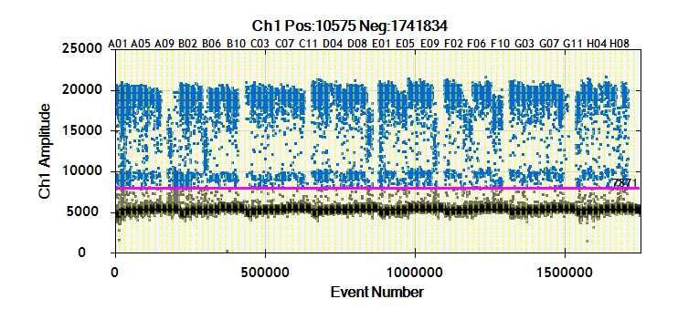
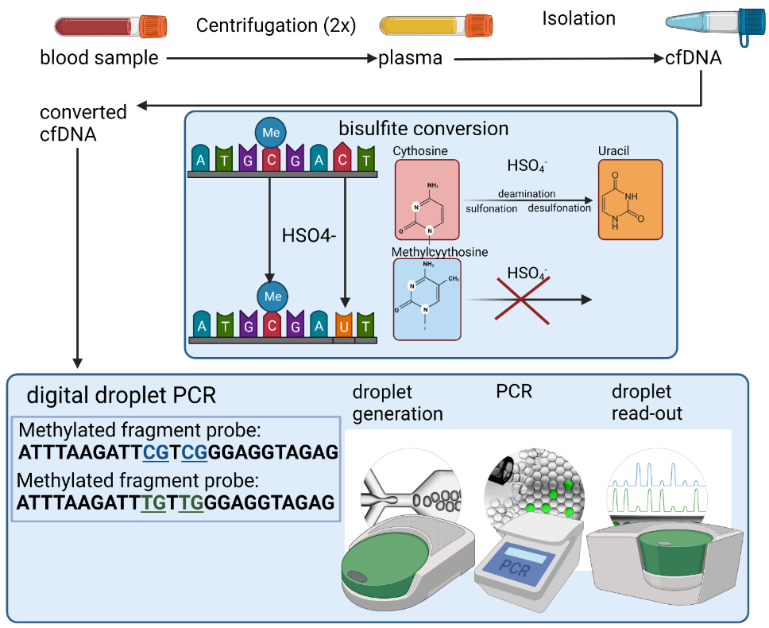
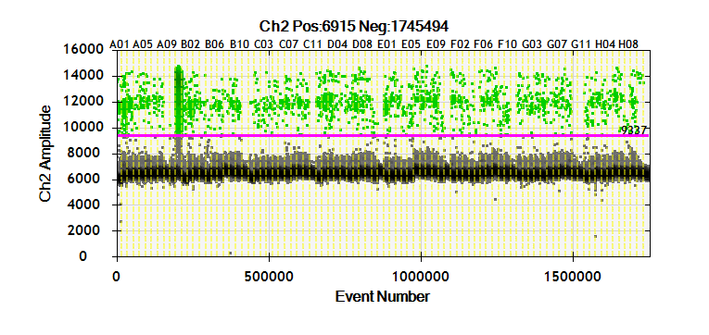
Laboratory methods and results

Slide 11
Candidate B-cfDNA metrics
Unmet copies / ml – number of unmethylated copies of target INS fragment per ml of plasma – ABSOLUTE MEASURE
Unmet/met ratio – ratio of number of unmethylated to methylated copies of target INS fragment – RELATIVE MEASURE
Unmet fraction – ratio of number of unmethylated to all copies of target INS fragment –
RELATIVE MEASURE
Beta-value = (N of unmethylated copies / (N of all target copies + constant (10)) –
RELATIVE MEASURE
M-value = log2((N of unmethylated copies + constant)/(N of methylated copies + constant)) (constant = 1) –
RELATIVE MEASURE

Slide 12
B-cfDNA metrics vs clinical features (N=42)
 | Unmet copies/ml | Unmet/met ratio | Unmet fraction | Beta-value | M-value
Unmet copies/ml | x | 0,137 | 0,150 | 0,228 | -0,020
Unmet/met ratio |  | x | 0,999 | 0,567 | 0,659
Unmet fraction |  |  | x | 0,586 | 0,645
Beta-value |  |  |  | x | -0,182

Slide 13
BcfDNA M-value associated with DKA at T1D onset
 | DKA+ (N=14) | DKA- (N=28) | p-value
Age at diagnosis [years] | 10.6±3.0 | 10.1±2.8 | 0.6426
BMI z-score | -0.7±1.3 | -0.4±1.1 | 0.5030
Daily insulin dose [UI/kg] | 1.3±0.5 | 0.9±0.3 | 0.0528
HbA1c [%] | 12.9±2.1 | 13.1±3.3 | 0.8610
fasting c-peptide [ng/L] | 0.3±0.2 | 0.4±0.3 | 0.1636
B-cfDNA [copies/ml] | 774.6±932.4 | 496.4±817.9 | 0.3272
B-cfDNA [Unmet/met ratio] | 0.16±0.05 | 0.2±0.05 | 0.2863
B-cfDNA [fraction] | 0.13±0.03 | 0.15±0.03 | 0.2910
B-cfDNA [B-value] | 0.07±0.02 | 0.06±0.02 | 0.5184
B-cfDNA [M-value] | -2.0±0.3 | -1.8±0.3 | 0.0219
Lower M-value = less beta cell remnants = less intensive beta cell destruction

Slide 14
Follow-up summary
76 (85.4%) achieved PR after 3 months
Median duration of PR was 12.3 months
3 5 7 9 11 13
T1D duration [months]
T1D duration | 3-5m | 5-7m | 7-9m | 9-11m | 11-13m | 13-15m
N at risk | 76 | 73 | 63 | 55 | 47 | 2
Censored | 3 | 3 | 2 | 5 | 35 | 2
Complete | 0 | 7 | 6 | 3 | 10 | 0

Slide 15
At-onset B-cfDNA M-value associated with achieving PR after 3 months of T1D
 | Remitters (N=29) | Non-remitters (N=11) | P-value
Age at T1D diagnosis [years] | 10,14+/-2,81 | 10,82+/-2,92 | 0,5045
ph | 7,33+/-0,13 | 7,28+/-0,16 | 0,3791
HCO3- | 18,12+/-7,10 | 15,13+/-7,49 | 0,2475
BMI z-score | -0,57+/-1,25 | -0,19+/-0,93 | 0,3704
insulin dose [UI/kg] | 0,99+/-0,29 | 1,15+/-0,57 | 0,2570
fasting c-peptide [ng/L] | 0,37+/-0,26 | 0,30+/-0,21 | 0,4653
stimulated c-peptide [ng/L] | 0,75+/-0,56 | 0,65+/-0,52 | 0,6503
stimulated to fasting c-peptide ratio | 2,09+/-0,59 | 2,14+/-0,41 | 0,8239
HbA1c [%] | 12,85+/-2,85 | 13,42+/-3,17 | 0,5876
B-cfDNA [copies/ml] | 564,78+/-902,78 | 614,98+/-830,67 | 0,8735
B-cfDNA [Unmet/met ratio] | 0,18+/-0,05 | 0,16+/-0,04 | 0,1678
B-cfDNA [Unmet fraction in total] | 0,15+/-0,04 | 0,14+/-0,03 | 0,1771
B-cfDNA [Beta-value] | 0,06+/-0,02 | 0,07+/-0,02 | 0,6463
B-cfDNA [M-value] | -1,74+/-0,29 | -2,06+/-0,34 | 0,0046
Lower M-value = less beta cell remnants = less intensive beta cell destruction

Slide 16
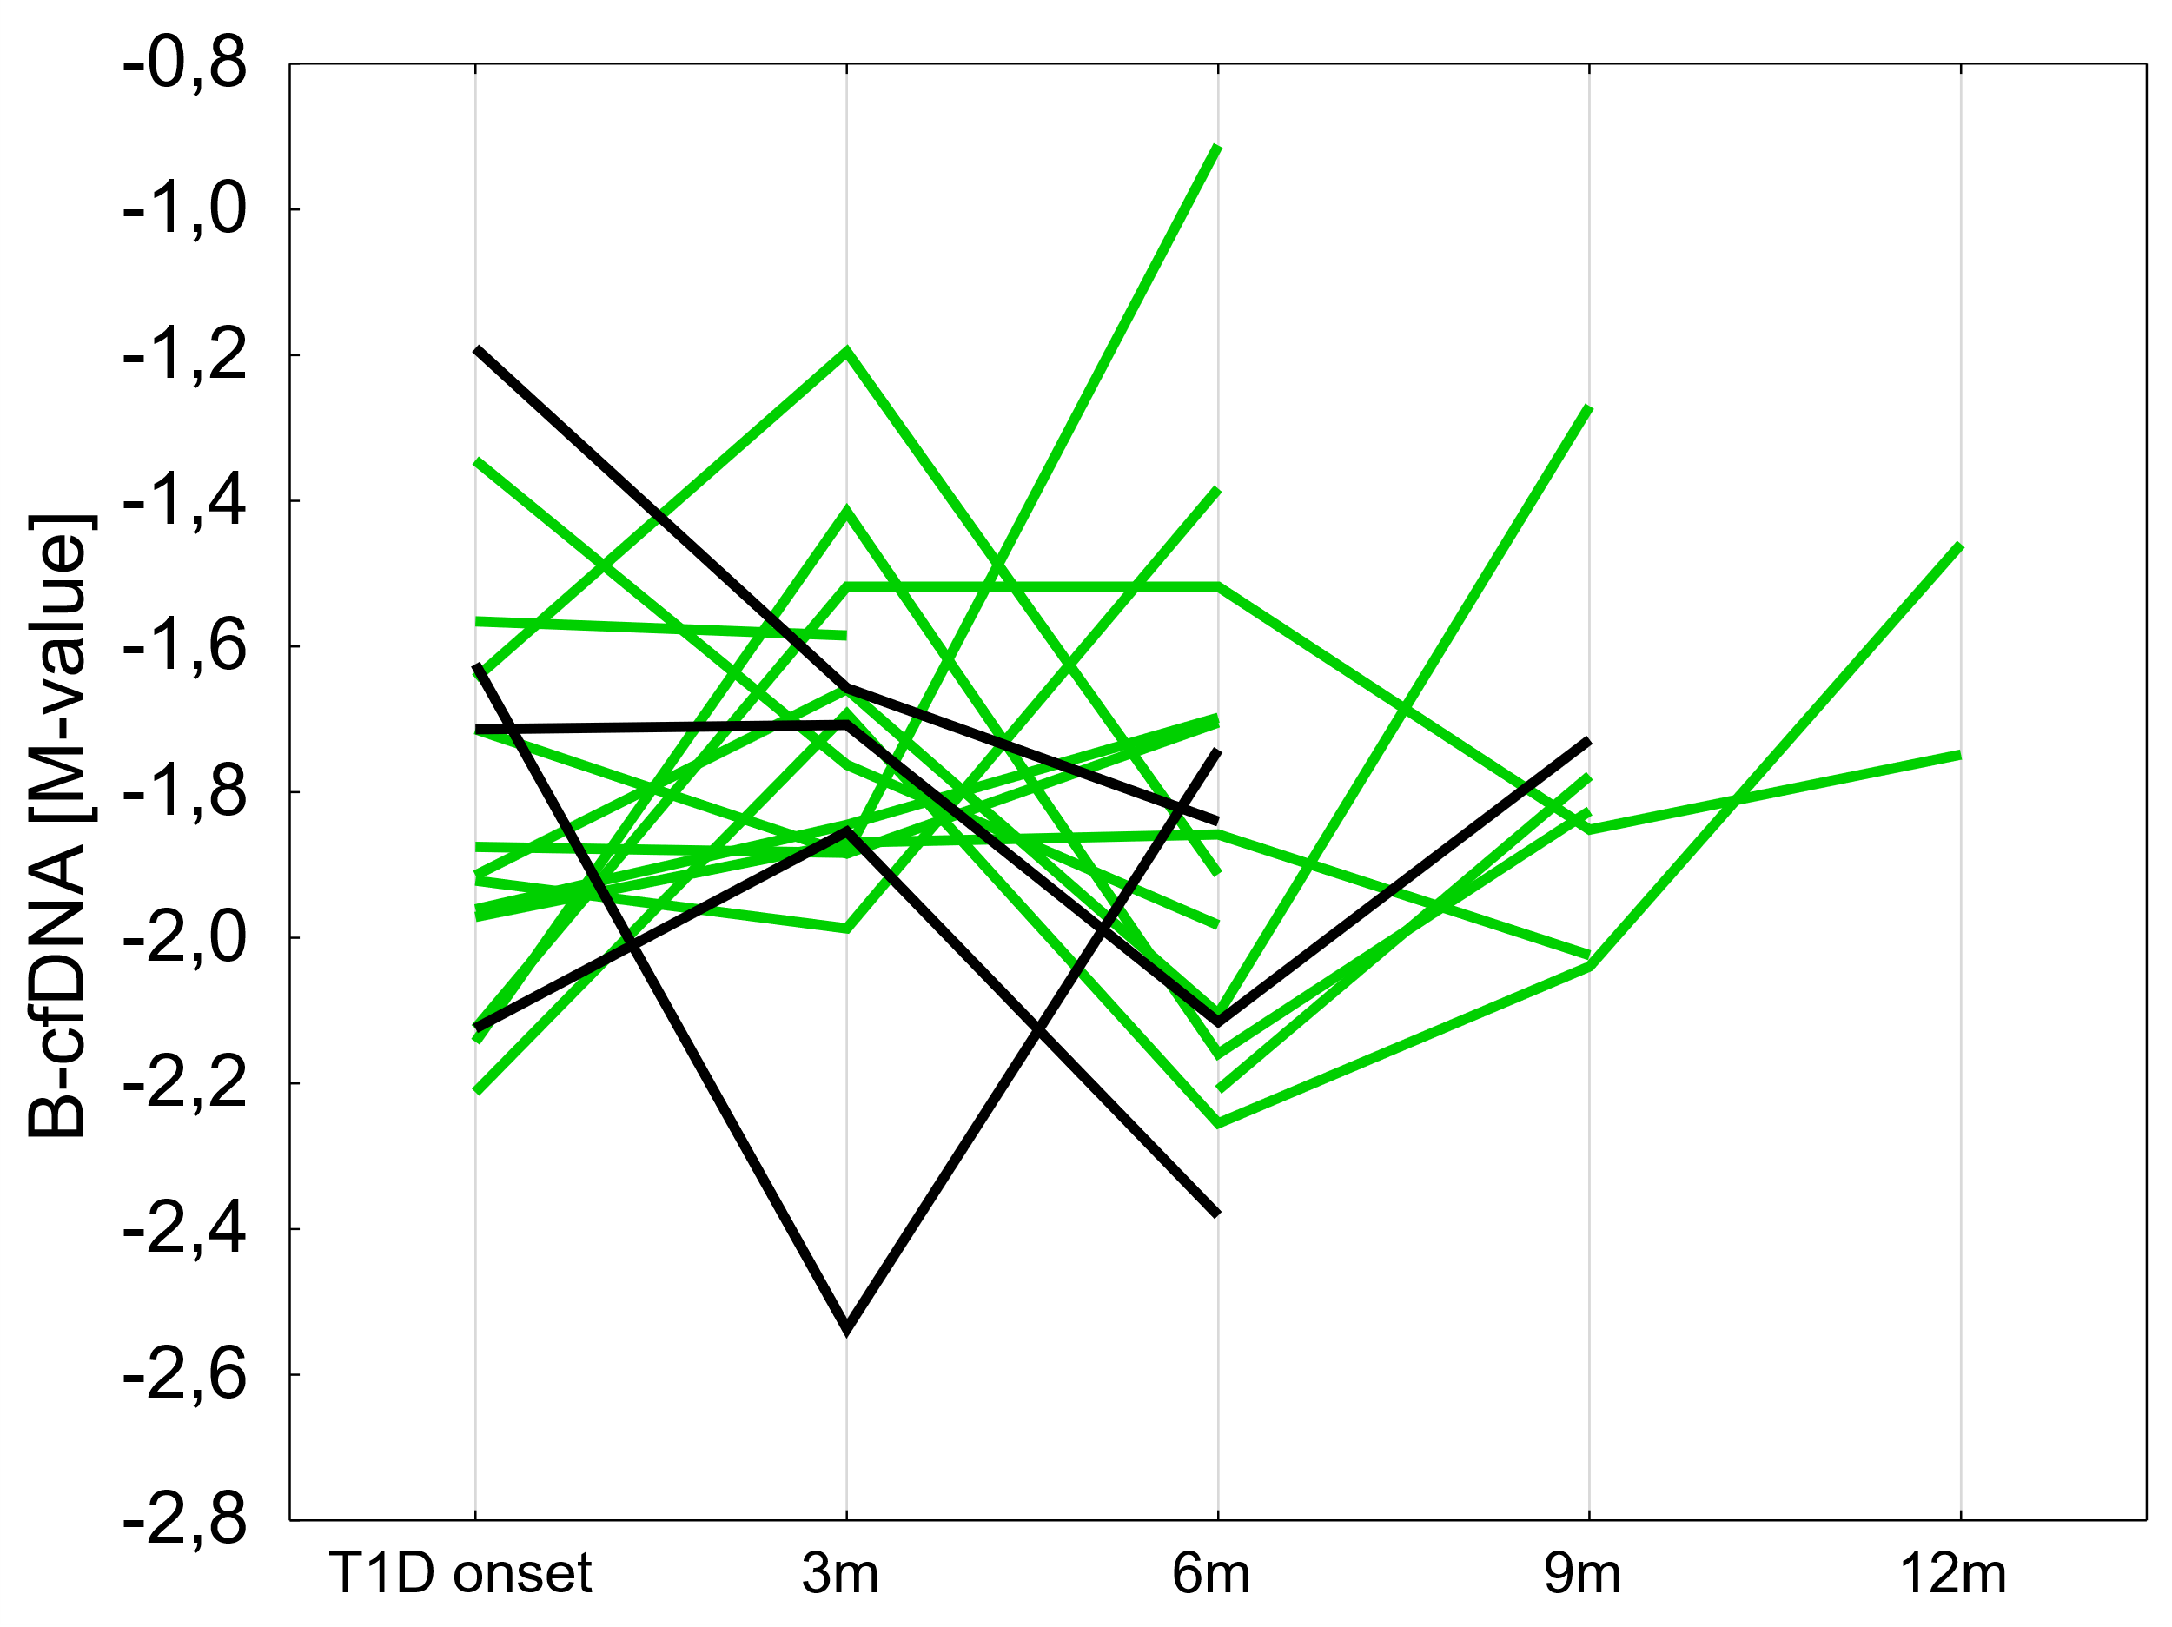
B-cfDNA evolution in follow-up (N=17)
First visit without PR
Visits with PR
PR throughout observation
PR ended within
No clear association – more data needed

Slide 17
Conclusions
We succesfully recruited target number of patients in a timely manner
Material transfer and assays were slightly delayed
M-value appears to be most effective metric quantifying B-cfDNA
Despire weak association with clinical characteristics, M-value was associated with DKA and risk of not entering PR
Lower amount of B-cfDNA associated with DKA and lower chance of entering PR might be proxy for smaller number of living beta cells

Slide 18
Publications
Michalak A, Chrzanowski J, Kuśmierczyk-Kozieł H et al, Lisdexamphetamine versus methylphenidate for paediatric patients with attention-deficit hyperactivity disorder and type 1 diabetes (LAMAinDiab): protocol for a multicentre, randomised cross-over clinical trial in an outpatient telemedicine-supported setting; BMJ Open. 2023 Dec 12;13(12):e078112. doi: 10.1136/bmjopen-2023-078112.
M Skalska, A Myśliwiec, A Michalak, et al, Metabolic control level and glucose variability in adolescents with type 1 diabetes during low and high-intensity exercise, Eur Rev Med Pharmacol Sci 2024 Mar;28(5):1987-1997. doi: 10.26355/eurrev_202403_35613.

Slide 19
Other achievements
Epigenetic biomarkers of destruction of residual beta cells after diagnosis of type 1 diabetes – links to diabetic ketoacidosis and partial clinical remission., NCN (National Science Centre) – PRELUDIUM22 (2023/49/N/NZ5/0232), 209 999 PLN
Kościuszko Foundation award for fellowship in Joslin Diabetes Centre (Boston, USA) in the academic year 2024/2025

Slide 20
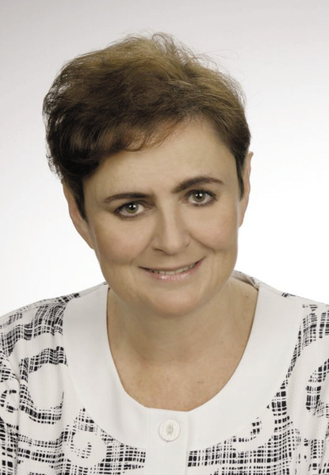
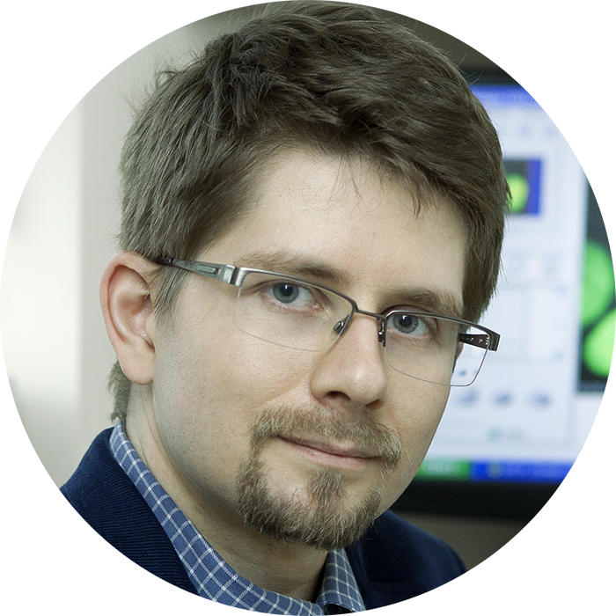


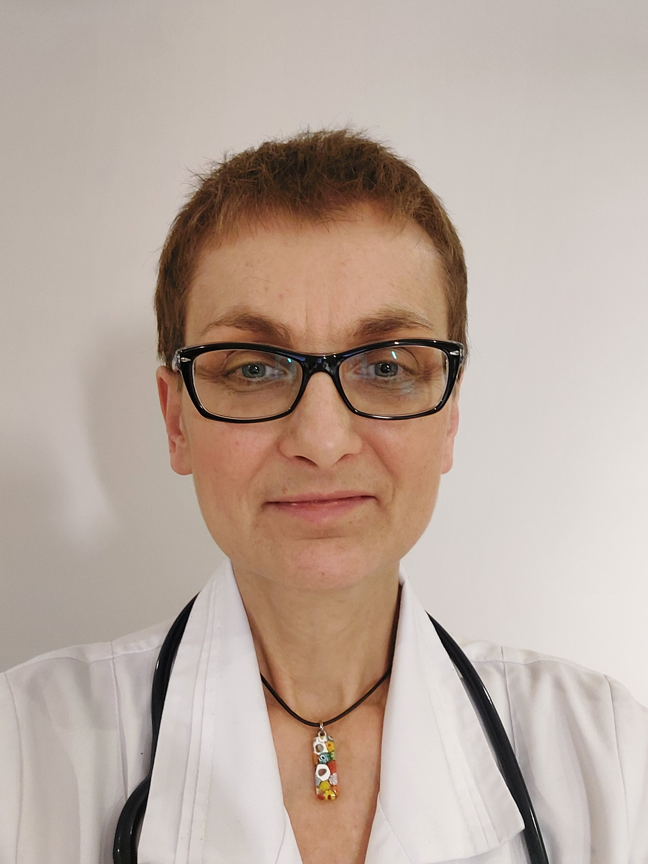


Friends and collaborators
PhD thesis supervisor
Collaborators
Dep. Of Biostatistics and Translational Medicine
Prof. Agnieszka Szadkowska
Dep. of Pediatrics, Diabetology, Endocrinology and Nephrology
Aleksandra Olejniczak,
MD
Prof. Wojciech Fendler
Prof. Piotr Witkowski
The University of Chicago Medicine
Ewelina Perdas, PhD
Hanna Kuśmierczyk,
MD
Prof. Beata Mianowska
Medical students: Jacek Burzyński, Barbara Pernak, Julia Wykrota

