Slide 1
Risk factors of geriatric syndromes in older adults
Ganna Kravchenko, MD
Department of Geriatrics,
Medical University of Lodz, Poland
Supervisor:
Tomasz Kostka, MD, PhD, Professor
Assistant supervisor:
Bartłomiej Sołtysik, MD, PhD

Slide 2
Results of the first year
Publication:
1. Ganna Kravchenko, Renata Korycka-Bloch, Serena S. Stephenson, Tomasz Kostka, Bartłomiej K. Sołtysik. Cardiometabolic Disorders Are Important Correlates of Vulnerability in Hospitalized Older Adults. Nutrients. 2023, 15: 3716. (IF 5,9)
2. Stephenson SS, Guligowska A, Cieślak-Skubel A, Wójcik A, Kravchenko G, Kostka T, Sołtysik BK. The Relationship between Nutritional Risk and the Most Common Chronic Diseases in Hospitalized Geriatric Population from Central Poland. Nutrients. 2023 Mar 27;15(7):1612. (IF 6,7)
Participation in conferenses: 1. EUGMS CONGRESS 2023 (Helsinki, Finland, 20-22 September 2023), The Impact Of Chronic Kidney Disease On Vulnerability In Hospitalized Older Subjects (Poster presentation),
2. 45th ESPEN Congress on Clinical Nutrition and Metabolism (Lyon, France, 11-14th September 2023), Low total cholesterol levels are associated with a high risk of malnutrition in older adults (Poster presentation).

Slide 3
Introduction
Magnesium deficiency has been associated with a number of chronic conditions, including cardiovascular diseases, type 2 diabetes mellitus and some geriatric syndromes (frailty).
Purpose
This study investigated the association between serum magnesium concentration and most common cardiometabolic diseases and drugs in older hospitalized patients.

Slide 4
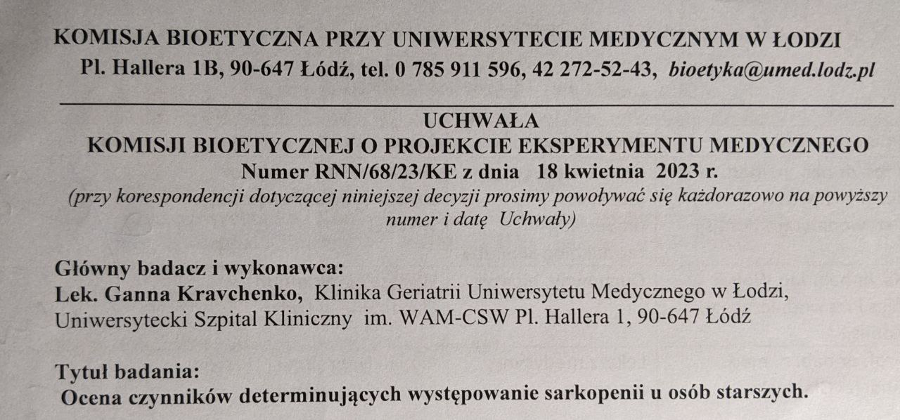
- patients 60 years old and more, - hospitalized in the Geriatric Department, - signed informed consent, - 1537 patients – from database of the department, added in 2022-2023.
Subjects:

Slide 5
Methods
- Scrutinizing anamnesis from the patients’ medical histories,
- Scrutinizing taken medicines from the patients’ medical histories,
- Body weight and height measurement,
- Body mass index (BMI) calculation,
- Collecting data on serum magnesium and albumin levels from blood samples,
- Nutritional Risk Assessement (NRS),
- Vulnerable Elderly Survey 13 Scale (VES-13).

Slide 6
Concomitant cardiometabolic diseases:
- arterial hypertension (HT),
diabetes mellitus type 2 (DM),
atherosclerosis,
lipid disorders,
current or previous stroke,
coronary artery disease (CAD),
current or previous myocardial infarction (MI),
atrial fibrillation (AF),
heart failure (HF),
chronic kidney disease (CKD).

Slide 7
Most common drugs:
Novel oral anticoagulants (NOAC),
Acetylsalicylic acid (ASA),
Thienopiridines,
Vitamin K antagonists (VKA),
Heparins,
b-blockers,
Ca-channel blockers,
Alfa-blockers,
Angiotensin-converting enzyme inhibitors (ACEI),
Sartans,
Diuretics,
Statins,
Allopurinol,
Oral hypoglycemic drugs,
Insulin.

Slide 8
General characteristics of the study population (n=1537) according to sex
Parameter | Women (n=1098) | Men (n=439) | p-value
Age, years | 84 (78-88) | 81 (74-87) | <0.0001
BMI | 25.8 (22.7-30.0) | 26.0 (22.9-29.3) | 0.9
Mg | 0.8 (0.71-0.87) | 0.81 (0.74-0.87) | 0.03
Albumins | 38.5 (33.5; 42.1) | 37.3 (32; 41.8) | 0.02
VES-13 | 8 (4; 10) | 7 (3; 9) | <0.0001
NRS | 1 (1; 3) | 2 (1; 3) | 0.2

Slide 9
General characteristics of the study population according to sex
Parameter | Women (n=1098) | Men (n=439) | p-value
Arterial hypertention | 939 (85.5%) | 338 (77%) | <0.0001
Diabetes mellitus | 357 (32.5%) | 160 (36.4%) | 0.14
Lipid disorders | 474 (43.2%) | 163 (37.1%) | 0.03
Atherosclerosis | 630 (57.4%) | 219 (49.9%) | 0.008
Stroke | 188 (17.1%) | 78 (17.8%) | 0.8
Coronary artery disease | 371 (33.8%) | 161 (36.7%) | 0.3
Myocardial infarction | 92 (8.4%) | 77 (17.5%) | <0.0001
Atrial fibrillation | 277 (25.2%) | 126 (28.7%) | 0.2
Heart failure | 648 (59%) | 248 (56.5%) | 0.4
Chronic kidney disease | 610 (55.6%) | 221 (50.3%) | 0.06

Slide 10
General characteristics of the study population according to sex
Parameter | Women (n=1098) | Men (n=439) | p-value
NOAC, % | 177 (16.1%) | 78 (17.8%) | 0.4
ASA, % | 367 (33.4%) | 142 (32.3%) | 0.7
Thienopiridines, % | 40 (3.6%) | 26 (5.9%) | 0.05
WKA, % | 30 (2.7%) | 25 (5.7%) | 0.005
Heparins, % | 91 (8.3%) | 38 (8.7%) | 0.8
Beta-blockers, % | 669 (60.9%) | 324 (53.3%) | 0.006
Ca channel blockers, % | 336 (30.6%) | 110 (25.1%) | 0.03
Alpha-blockers, % | 21 (1.9%) | 141 (32.1%) | <0.0001
ACEI, % | 421 (38.3%) | 153 (34.9%) | 0.2
Sartans, % | 207 (18.9%) | 61 (13.9%) | 0.02
Diuretics, % | 606 (55.2%) | 209 (47.6%) | 0.007
Statins, % | 482 (43.9%) | 198 (45.1%) | 0.7
Allopurinol, % | 122 (11.1%) | 53 (12.1%) | 0.6
Oral hypoglycemic drugs, % | 223 (20.3%) | 106 (24.1%) | 0.1
Insulin, % | 93 (8.5%) | 46 (10.5%) | 0.2

Slide 11
Serum magnesium levels in women according to comorbilities

Slide 12
Serum magnesium levels in men according to comorbilities

Slide 13
Serum magnesium levels in women according to taking medications

Slide 14
Serum magnesium levels in men according to taking medications

Slide 15
Conclusions:
The study revealed a significant association between presence of some common cardiometabolic disease and drugs and lower magnesium level in older hospitalized patients.
We highly suggest an assessment of magnesium level in these patients. Further research is needed to determine the optimal dosage, duration, and long-term effects of magnesium supplementation in these specific groups of patients.

Slide 16
- continue to perform Handgrip strength test, body composition analysis, and increase the research group up to 1000 patients, - completion and publication of the article entitled "The relationship between serum magnesium levels, cardiometabolic diseases and cognitive performance in hospitalized older adults" as first author, - presentation of the results at the Juvenes pro medicina conference (May 2024, accepted for PhD section) and the European Geriatric Medicine Congress.
Prognosis:

Slide 17
Thank you for your attention!

