Slide 1
High-speed videoendoscopy: a journey from research tool to daily clinical practice
Magdalena Kowalczyk
Department of Otolaryngology, Head and Neck Oncology
Medical University of Lodz

Slide 2
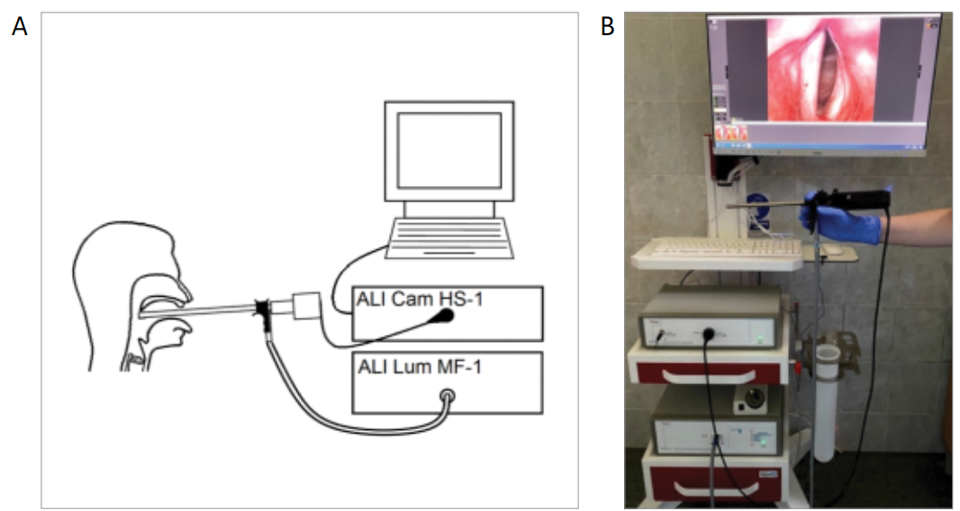
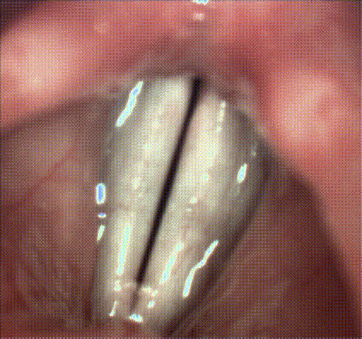
High-speed video examination
Real oscillations of the vocal folds
Asynchronic voices and patients with prologned phonation problems
2000-3200 fps
Simultaneously recorded audio data
Need for an objectification of the HSV analysis!

Slide 3
Aim of the study
Methodology of HSV examination and analysis
Artifical Intelligence Methods
Objective Parameters
Kymographic Parameters (Jitter and Shimmer group)
Stiffness Asymmetry Index (SAI)
Clinical use
Objective differentiation of vocal lesions
HSV in the follow-up in patients after phonosurgery
Cycle Detection Compliance

Slide 4
HSV examination methodology – why we need simultanous audio recording?

Slide 5
Correlations between kymographic parameters based on the high-speed videoendoscopy including different cross-sections of the glottis (anterior, middle, posterior) and parameters based on simultaneously recorded audio signal.

Slide 6
HSV methodology – Cycle Detecion Compliance
Audio signal simultaneously recorded to the HSV is used as the control of correctness of HSV analysis (mostly the F0 determination).
Neither compliance in the glottis cycle detection nor higher amount of glottis cycles detected for the analysis increased the correlations between parameter values based on the high-speed video and audio data
Future studies are required to esthablished the clinical usefulness of the audio data recorded simultaneously to HSV e.g. for the differentiation of the laryngeal disorder including different organic lesions.

Slide 7
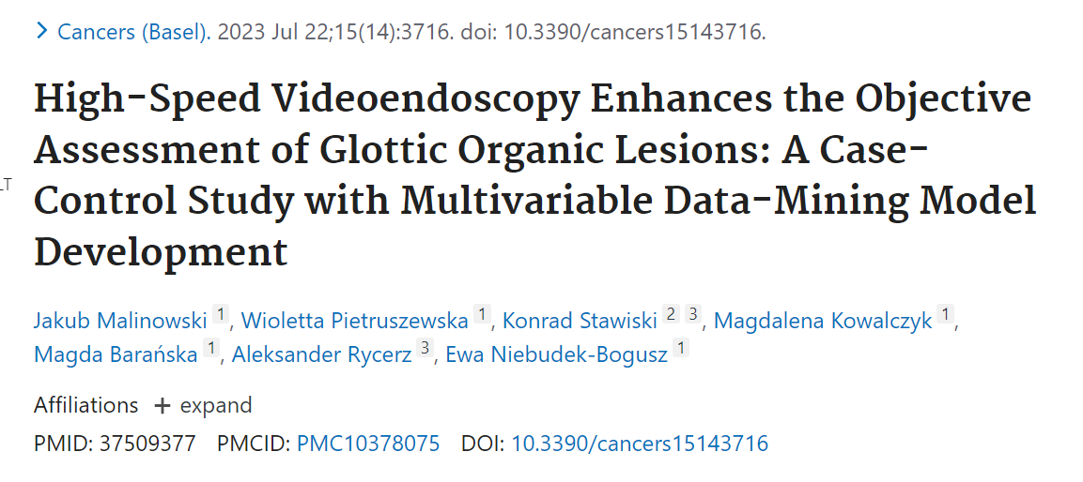
Objective HSV parameters in the clinical use - kymographic analysis

Slide 8
Objective HSV parameters in the clinical use - Stiffness Asymmetry Index (SAI)
Detection of non-vibrating areas
Unilateral vocal lesions
Illustration of the detected different size regions of the vocal folds vibrating at the fundamental frequency indicated by the different values of SAI and the corresponding values of the parameter (approximate values), (a) SAI = 0.0, (b) SAI = 0.0, (c) SAI = 0.25, (d) SAI = 0.5, (e) SAI = 0.75 [38]. The red dashed line marks the axis of symmetry of the glottis, and the blue and green areas correspond to the detected areas of vibration of the right and left vocal folds, respectively.
Cancers (Basel). 2022 Sep 27;14(19):4697. doi: 10.3390/cancers14194697.
Assessment of Vocal Fold Stiffness by Means of High-Speed Videolaryngoscopy with Laryngotopography in Prediction of Early Glottic Malignancy: Preliminary Report
Justyna Kaluza 1, Ewa Niebudek-Bogusz 2, Jakub Malinowski 2, Pawel Strumillo 1, Wioletta Pietruszewska 2

Slide 9
Objective HSV parameters in the clinical use - Stiffness Asymmetry Index (SAI)
Diagnosis | Number of subjects (n=103)
Normophonic | 21 (20.4%)
Benign | 39 (37.9%)
Malignant | 43 (41.7%)
Malignant
Benign
Normophonic

Slide 10
Future perspectives…
SAI
Kymographic parameters
Differentiantion of vocal lesions
and
Follow-up in patients after phonosurgery

Slide 11
High-speed videoendoscopy: a journey from research tool to daily clinical practice
Magdalena Kowalczyk
Department of Otolaryngology, Head and Neck Oncology
Medical University of Lodz

