Slide 1
Gut Microbiota in policythemia vera patients
Michał Kośny MD, 1st year of International Doctoral School Medical University of Lodz, 2nd year residency in Hematology, department of Hematooncology Copernicus Memorial Hospital in Lodz
Supervisor: prof. Joanna Góra-Tybor, department of Hematology

Slide 2
Population
BCR-ABL negative myeloproliferative neoplasms (MPN) are a group of diseases characterized by clonal proliferation of hematopoietic cells from the myeloid lineage. The most common BCR-ABL negative MPN, with an annual incidence of approximately 2.5 per 100,000 individuals and a median age of onset of 60 years, is polycythemia vera (PV). The primary feature of PV is the uncontrolled production of red blood cells, resulting in increased red blood cell mass and excessive blood viscosity. The key pathogenetic mechanism of PV is the dysregulation of the JAK-STAT signaling pathway. The JAK2 kinase (Janus kinase) plays an important role in regulating the proliferation and differentiation of precursor cells in various cell lineages as an intracellular signal transducer derived from hematopoietic stimulatory factors, including erythropoietin (Epo), granulocyte growth factor, thrombopoietin, and other cytokines. Increased synthesis of pro-inflammatory cytokines sustains the state of chronic inflammation characteristic of MPN. Mutations in the JAK2 kinase lead to its constitutive activation.

Slide 3
Polycythemia Vera
Increased risk of thromboembolic events (main cause of death)
Bleeding
Fatigue
Itching, especially after exposure to hot water
Erythromelalgia
Splenomegaly
Possible transformation to Acute myeloid leukemia or myelofibrosis

Slide 4
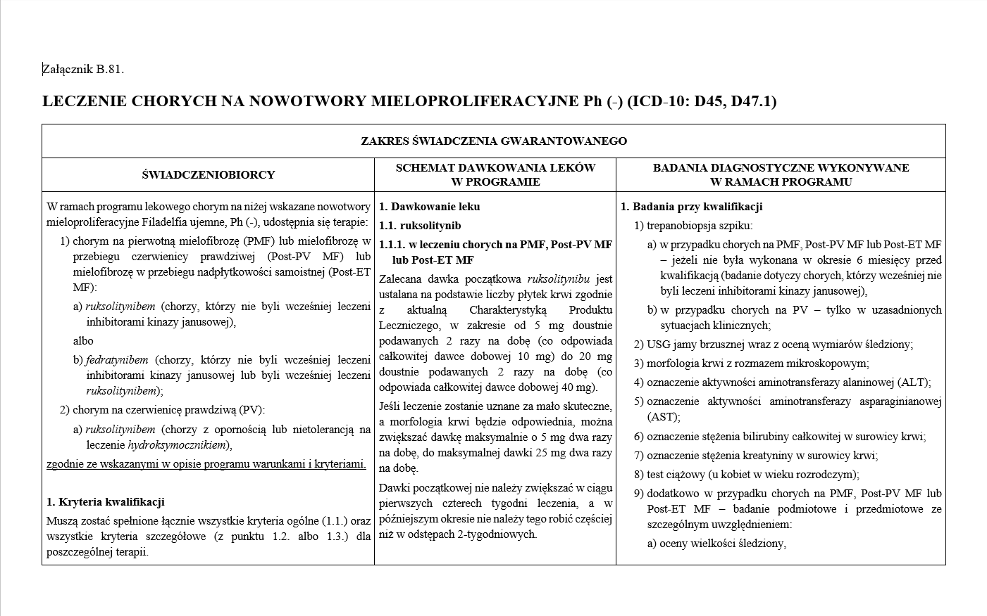
Treatment options in PV in Poland
Hematocrit control:
Phlebotomy
Hydroxyurea
Interferon α (IFN α)
Ruxolitinib (JAK2 inhibitor)
Thrombosis prophylaxis:
Aspirin

Slide 5
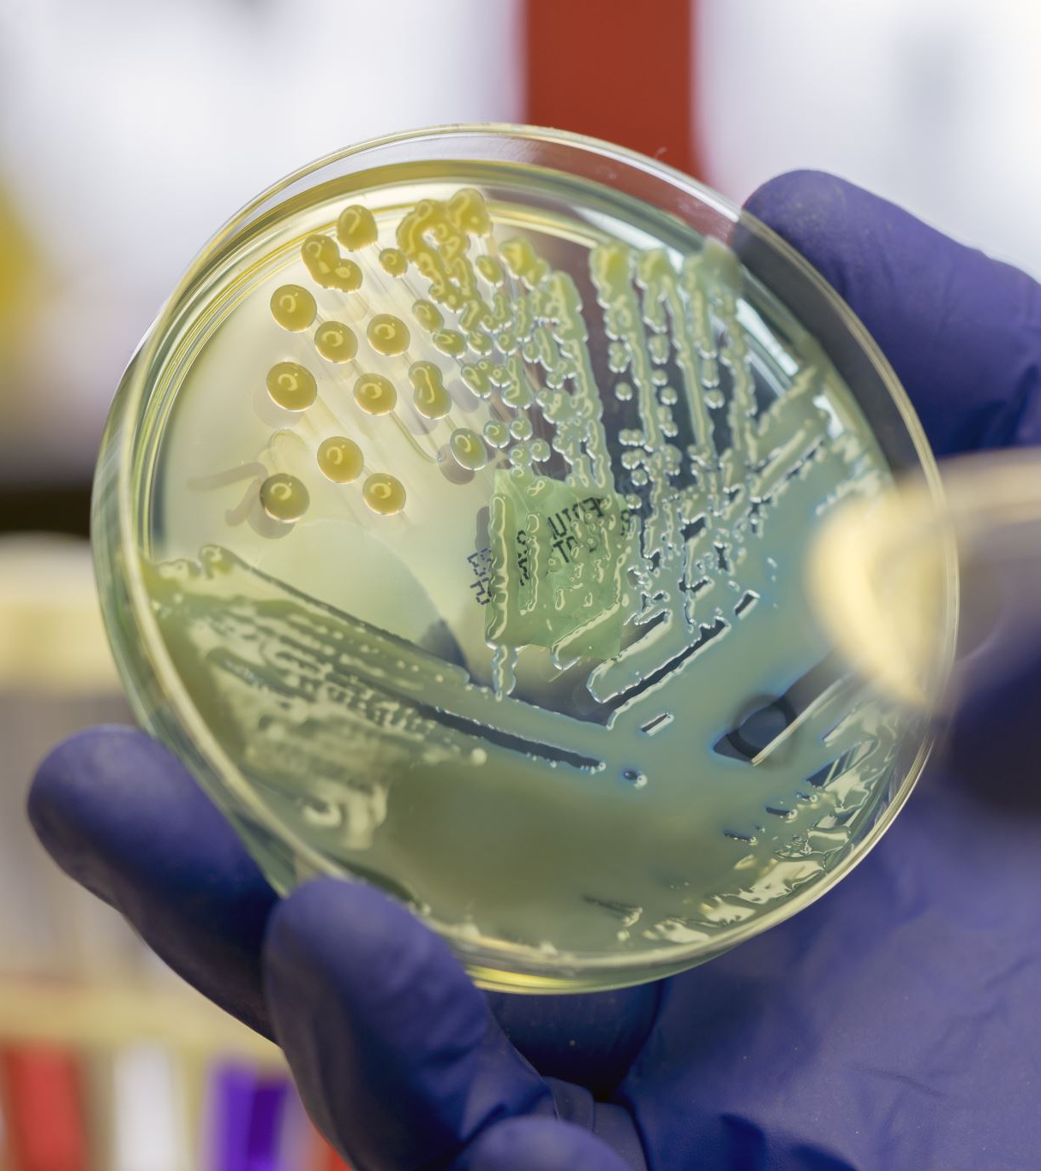
Why Microbiota
Chronic inflammation is considered to be a factor that may promote the development of cancer because the inflammatory state promotes the development, proliferation, and survival of cancer cells.
Reports published in recent years indicate a potential influence of dysbiosis in the gut microbiota on the stimulation of inflammatory and neoplastic processes. Few studies on changes in gut microbiota in patients with MPN suggest possible differences in the composition of bacterial flora compared to healthy populations. So far, differences in gut microbiota composition have been described in several diseases of autoimmune origin or closely related to the presence of inflammation, such as systemic lupus erythematosus, diabetes, obesity or atherosclerosis. Studies conducted on mice populations have demonstrated a direct influence of specific bacteria in the gastrointestinal tract on the quantity of hematopoietic and precursor cells. Differences in gut-residing bacteria may involve, for example, the production of certain bacterial strains such as short-chain fatty acids, which are attributed with immunomodulatory function.

Slide 6
Study Group
Study group will consist of patients diagnosed with Policythemia Vera (PV) before starting treatment - 30 individuals, patients treated with HU, IFN-α, ruxolitinib for at least one year - 20 patients each. Additional criteria:
ability to provide written informed consent to participate in the study
aged at least 18 years
not taking antibiotics for at least one month prior to inclusion in the study (preferably over 3 months)
no history of gastrointestinal diseases (cancer, non-specific inflammatory bowel diseases, stomach/intestinal resections, liver diseases such as viral hepatitis).
Samples will be collected from all individuals included in the study:
stool - a fecal sample intended for NGS analysis of gut microbiota using shotgun sequencing
blood - for transcriptomic studies and JAK2V617 VAF (variant allele frequency) assesment

Slide 7
Control Group
The control group will consist of 30 healthy individuals matched for age structure to the study group selected based on a health questionaire. Primarily without any inflammatory, autoimmune, infectious diseases, not taking medications regularly and not taking antibiotics for at least 3 months prior to inclusion in the study.

Slide 8
Methods
The collected material will be treated as a "fingerprint" or "snapshot" because the microbiota and immunological transcriptome profiles will be determined in both groups based on individual samples. Stool and blood will be collected simultaneously and subjected to next-generation sequencing. The obtained metagenomic data will undergo statistical and bioinformatic analysis focusing on verifying the hypothesis of a more pro-inflammatory and dysbiotic phenotype of gut microbiota in patients with myeloproliferative neoplasms compared to healthy individuals, and in relation to different treatment methods. A stool sample for microbiota composition analysis will be subjected to shotgun sequencing NGS using Illumina technology in a standard scheme. The results will be sequence reads of the metagenome, allowing taxonomic composition, metabolic pathway profile, resistome, and functional potential of gut microbiota to be obtained.
From the blood sample, quantitative determination of the JAK2V617F allele frequency will be performed, followed by correlation with the gut microbiome.

Slide 9
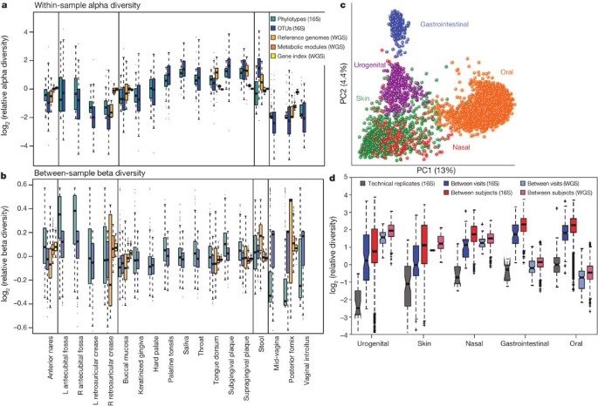
Results
The results will be sequence reads of the metagenome, allowing taxonomic composition, metabolic pathway profile, resistome, and functional potential of gut microbiota to be obtained. Differences between study groups will be assessed. From the blood sample, the results of quantitative determination of the JAK2V617F allele frequency will be performed, followed by correlation with the gut microbiome. Correlation between gut microbiome and serum levels of pro-inflammatory cytokines.
The Human Microbiome Project Consortium. Structure, function and diversity of the healthy human microbiome. Nature 486, 207–214 (2012). https://doi.org/10.1038/nature11234

Slide 10
Potential Outcome
Gut microbiota in patients with polycythemia vera may be a significant prognostic factor. Polycythemia vera is an incurable disease, its treatment is based on reducing the risk of thromboembolic events and attempting to control hematopoietic processes or reducing hematocrit, for example, through phlebotomy. Determining the difference in the pro-inflammatory potential of gut-residing bacteria may help identify risk factors for disease progression, such as secondary myelofibrosis or acute myeloid leukemia. Drugs used in the treatment of polycythemia vera are expensive and not always available, and they also have many side effects. Demonstrating the influence of pro-inflammatory gut dysbiosis that could change the handling of the disease.

Slide 11
REPORT ON IMPLEMENTATION OF THE INDIVIDUAL RESEARCH PLAN
Academic year 2023/2024

Slide 12
The conclusions for the Bioethics Committee and the application for the "Preludium" grant are currently being prepared for submission by the end of the academic year.
I regularly conduct classes with students in the Hematology clinic. The classes include seminars and practical sessions at the patient's bedside either with Polish and English speaking students. (30h this year)
Patient recruitment for the study will begin after obtaining approval from the bioethics committee.

Slide 13
Hematological Congresses
XXXI zjazd Polskiego Towarzystwa Hematologów i Transfuzjologów Katowice (14-16.09.2023)
Wyzwania w Hematologii Kraków (3-4.11.2023)
XIIIth Hematology Experts Forum 15-16.03.2024 Warszawa
Nowotwory Układu Krwiotwórczego Łódź19-20.04.2024
V międzynarodowa konferencja Hematologia Kliniczna i Doświadczalna w Lublinie 10-12.05.2024.
Policythemia Vera Preceptorship London 11-12.04.2024

Slide 14
Policythemia Vera Preceptorship

Slide 15
Publications
Bogaczyk A, Potocka N, Paszek S, et al. Absolute Quantification of Selected microRNAs Expression in Endometrial Cancer by Digital PCR. Int J Mol Sci. 2024;25(6):3286. Published 2024 Mar 14. doi:10.3390/ijms25063286 - IF 5.6 MEIN 140
Morawiec R, Matuszewska-Brycht O, Maeser P, Kośny M, Krejca M, Drożdż J. Decreasing numbers of valve-related infective endocarditis cases. An urgent call to action to improve diagnostic pathways: A retrospective tertiary center perspective (2015-2022). Kardiol Pol. 2024;82(1):79-81. doi:10.33963/v.kp.96587 - IF 3.7 MEIN 100
Morawiec R, Matuszewska-Brycht O, Maeser P, Kośny M, Krejca M, Drożdż J. Are in-hospital mortality predictors based on complete blood count useful in patients with infective endocarditis? A retrospective tertiary center perspective (2015-2022). Pol Arch Intern Med. 2023;133(12):16617. doi:10.20452/pamw.16617 - IF 4.8 MEIN 200
Total IF 14.11
Total MEIN 440

Slide 16
Co-authorship
I collaborated with Prof. Joanna Góra-Tybor in preparing chapters on BCR-ABL negative myeloproliferative neoplasms in the latest edition of Hematology from the "Wielka Interna" textbook series (not published yet).

Slide 17
Clinical Trials
Since April 2024, I have had the opportunity to be a co-investigator in the ABM study conducted by Prof. Krzysztof Jamroziak from the Warsaw Medical University titled "Multicenter Phase 2 Clinical Study Evaluating the Safety and Efficacy of the Sargramostim Combination with the D-VCd Scheme (Daratumumab, Bortezomib, Cyclophosphamide, Dexamethasone) in Untreated Patients with Light Chain Amyloidosis (STARLIGHT Study)."

