Slide 1


The role of hypoxia-sensitive miRNA181a, miRNA199a, and SIRT1 in diabetes mellitus development in obstructive sleep apnea patients.
Filip Karuga
Tutors:
prof. Piotr Białasiewicz, MD, PhD; Agata Gabryelska MD, PhD
Department of Sleep Medicine and Metabolic Disorders
Medical University of Lodz
Notes:
My name is… 5th year medical studen, I would like to present the work entitled ….

Slide 2
Introduction
Obstructive Sleep Apnea (OSA)
  Episodes of apnea or hypopnea during sleep.
Associated with :
obesity, hypertension, diabetes, cardiovascular events, stroke and road accidents
  Prevalence :
  moderate and severe (AHI > 15)
  49.7% men and 23.4% women
Notes:
OSA is a sleep disorder characterized by eposiodes of apnea or hypopnea during sleep due to compelete or partial upper Airways obstruction. Is associated with conditions like …. OSA is relatively prevalent disorder affecting around 49,7% of men and 23,4 of women in its moderate or severe form. We are speaking about severe or moderete form when the AHI > 15, what means that there are more than 15 event of AH for one hor of sleep.

Slide 3

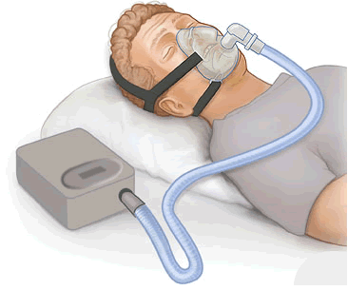
Obstructive Sleep Apnea (OSA)
Typical symptoms:
unrefreshing sleep
snoring
excessive daytime sleepiness
  Golden standard treatment:
  CPAP (continuous positive air pressure)
  Golden standard diagnosis:
    PSG (polysomnography)
Notes:
OSA is characterized by typical sypthoms like: … Which looks like this, patients is conacted to the machine during all night and it helps to keep the airways continuously open.

Slide 4
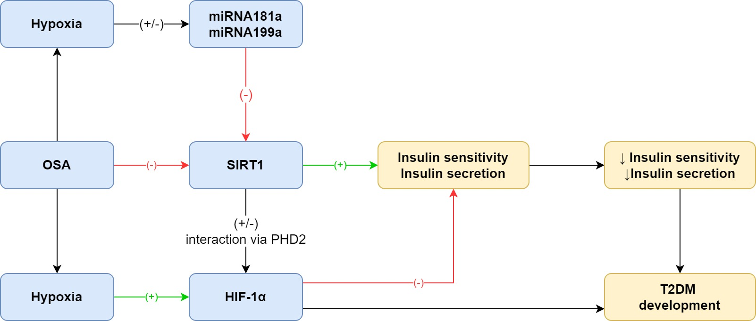
Patomechanism
Karuga, F.F.*; Malicki M.* et al. Obstructive Sleep Apnea, Circadian Clock Disruption, and Metabolic Consequences. Metabolites 2023, 13, 60.
Notes:
Pateints with diagnosed OSA were divided into 2 gropus. Study group where the patients had CVD and control group where the patients had no CVD. The study group consisted of 18patients, and the contorl group of 42 patients. In our study CVD includes conditions like:…. Furthermore

Slide 5
Hypothesis
We hypothesize that there exists an interaction between hypoxia sensitive miRNA181a, miRNA199a and SIRT1 mRNA, which leads to a decrease in SIRT1 protein expression in obstructive sleep apnea, what is one of the possible pathomechanism of diabtes type 2 (T2DM) development in this group of patients.

Slide 6
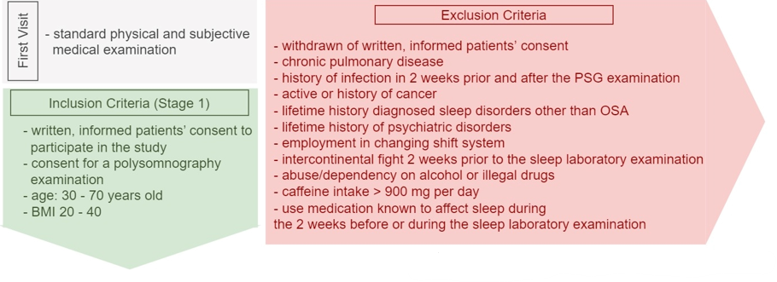
First visit
.

Slide 7
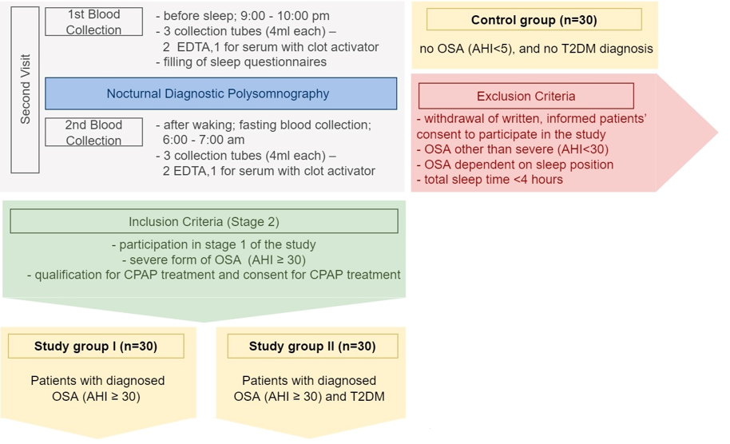
Second visit (cross-sectional)

Slide 8
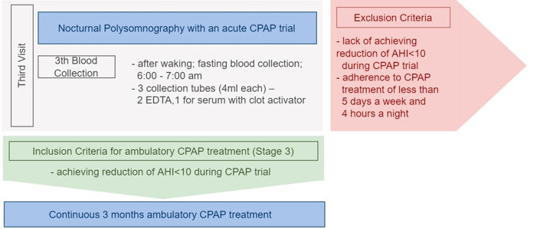
Third visit (prospective study)*
.

Slide 9

Fourth visit*
.

Slide 10
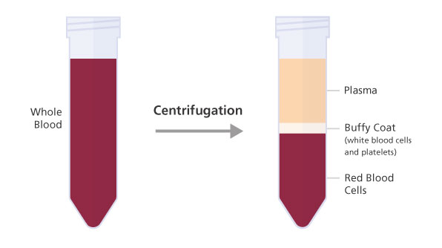

Material
-80 Celsius degree

Slide 11
Study groups
 | Control group | OSA group | OSA & DMT2 group | p-value
N | 17 (35%) | 11 (23%) | 20 (42%) | N/A
Sex [male] | 13 (76%) | 9 (81%) | 15 (75%) | 0.192
Age [years old] | 47 (IQR: 44-60) | 48 (IQR: 43-63.5) | 57.5 (IQR 49-64.5) | 0.126
BMI [kg/m²] | 30.450 (IQR: 27.765-31.888) | 34.602 (IQR: 30.623-37.265) | 36.977 (IQR: 32.272-41.663) | 0.014
AHI [incidents/h] | 1.5 (IQR: 1.0-3.9) | 50.2 (IQR: 40.0-75.7) | 50.9 (IQR: 27.6-65.4) | <0.001
52 patients were enrolled in the study, 4 of them were excluded due to PSG technical issues or withdrawal of consent for morning blood collection → N=48

Slide 12
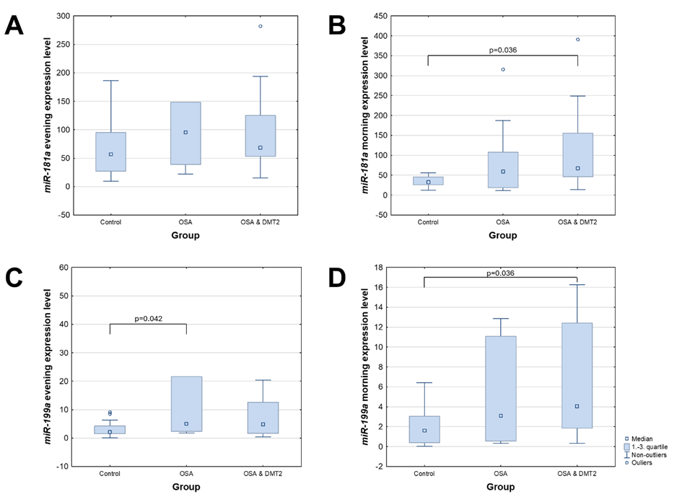
miRNA
snRNA RNU6B – endogenous control, method qRT-PCR
Notes:
-

Slide 13
 | No OSA, (control group) n=17 | OSA (OSA+ OSA&T2DM) n=31 | T2DM (OSA&T2DM) n=20 | No T2DM (control + OSA) n=28 | p
Sex | 23.5% ♀ | 22.6% ♀ | 25% ♀ | 21.4% ♀ | -
Age | 49.9 ± 8.1 | 55.1 ± 11.9 | 56.5 ± 11.1 | 50.9 ± 10.3 | -
BMI | 30.24 ± 4.74 | 35.65 ± 6.31 | 36.67 ± 6.73 | 31.64 ± 5.16 | -
miRNA-181a evening | 56.946* (27.03-94.88) | 79.188* (53,34-125.18) | 68.441 (53.36-119.01) | 69.018 (28.54-97.05) | *.07
miRNA-199a evening | 2.081* (1.52-4.95) | 5.043* (2.27-12.60) | 4.838 (1.80-12.37) | 4.018 (1.94-8.63) | *.036
SIRT1 evening | 1.83x10⁻⁴ (2x10⁻⁵ – 8.22x10⁻⁴) | 3.12x10⁻⁴ (8.8x10⁻⁵ – 6.88x10⁻⁴) | 3.51x10⁻⁴ (1.47x10⁻⁴ – 7.41x10⁻⁴) | 1.79x10⁻⁴ (2x10⁻⁵ – 6.21x10⁻⁴) | >0.05
miRNA-181a morning | 32.685* (25.88-45.45) | 67.276* (40.10-139.33) | 67.618** (47.50-152.97) | 39.869** (25.46-66.76) | *.021 **.019
miRNA-199a morning | 1.605* (0.38-3.05) | 3.102* (1.84-11.53) | 4.065** (1.86-12.20) | 2.173** (0.43-4.75) | *.018 **.07
SIRT1 morning | 2.39x10⁻⁴ (2.6x10⁻⁵ – 6.52x10⁻⁴) | 1.9x10⁻⁴ (0.66x10⁻⁵ – 6.47x10⁻⁴) | 3.23x10⁻⁴ (6.7x10⁻⁵ – 6x10⁻⁴) | 1.34x10⁻⁴ (3x10⁻⁵ – 6.94x10⁻⁴) | >0.05

Slide 14
Protein
SIRT1
Random selection of samples from three diffrent groups
Total protein level in samples - average 130 mg/ml (BCA test)
Verification of cell membrane integrity by flow cytometry and additional membrane lysis: RIPA buffer, Sonication – various combinations.
Concentration of SIRT1 protein below the detection level of 0.31ng/ml
Notes:
1st step: measurement of total protein level in samples - average 130 mg/ml (BCA test)
2nd stage: thawing randomly selected samples from each of the tested groups, setting the range of the ELISA test curve was 0.78-50ng/m. The tests carried out allowed to draw the following conclusions:
- the ELISA test worked correctly (correct standard curve)
- in the tested samples, the concentration of SIRT1 was below the detection level
3rd stage: Cell membrane and nuclear membranes lysis method optimalization. Verification of cell membrane integrity by flow cytometry after thawing and membrane lysis.
Sonication
(S) Lysis bufor
(BL) Lysis bufor + Sonication
(BL+S)
x - an appropriate volume of lysis buffer was added to the sample
3 layouts: 1:1, 1:4 and 1:9 (volume of sample : volume of lysis buffer). - an appropriate volume of lysis buffer was added to the sample
3 layouts: 1:1, 1:4 and 1:9 (volume of sample : volume of lysis buffer).
x -vortex 5 sec. and incubation on ice for 30 min. -vortex 5 sec. and incubation on ice for 30 min.
- sonication on ice 4 x 5sec. with a break of 30 sec. x - sonication on ice 4 x 5sec. with a break of 30 sec.
- incubation on ice 2 min. x - incubation on ice 2 min.
- centrifugation 14,000xg, 10 min, 4C (to embed cell fragments) - centrifugation 14,000xg, 10 min, 4C (to embed cell fragments) - centrifugation 14,000xg, 10 min, 4C (to embed cell fragments)
- collecting the supernatant and down to -20C - collecting the supernatant and down to -20C - collecting the supernatant and down to -20C
After performing enzyme immunoassays, only two combinations out of eight had SIRT1 levels measured:
- BL 1:1 (no additional dilution) - concentration 0.14ng/ml,
- BL+S 1:4 (no additional dilution) - concentration 6.95ng/ml
Due to the fact that the samples were tested without repetition, it was difficult to say whether the effect would be reproducible.
4th step: SIRT1 level determination using ELISA for 16 samples from 3 different test groups [BL(1:4)+S procedure].
Despite damage to cell and nuclear membranes, no SIRT1 was detected in any of the samples tested. Therefore, its concentration in the material remained lower than the sensitivity of the enzyme immunoassay used (0.31ng/ml) - the level of SIRT1 protein in patients from 3 research groups is lower than 0.31ng/ml

Slide 15
Correlations

Slide 18

Conclusions
Patients with OSA and T2DM had increased expression of miRNA-181a, which presented a negative correlation with SIRT1 expression and a positive correlation with HOMA-IR. Increased insulin resistance mediated via miRNA-181a and SIRT1 is a possible mechanism responsible for the common incidence of T2DM in patients suffering from OSA.
Moreover, it is very possible that both miRNA-181a and miRNA-199a are sensitive to any cellular contamination, which reduces their chances of being implemented in clinical use for OSA diagnosis as serum biomarkers.
The study is supported by National Science Center, Poland, Preludium 20 Grant no. 2021/41/N/NZ5/00486.

Slide 19
Further steps
Adiponectin serum protein level assessment due to unsuccessful SIRT1 intracellular determination.
Publication of preliminary data.
Presentation of data at Sleep Conference 2024
Assessment of patients recruited to prospective study (CPAP trial and at least 3 months follow-up). Reduction of N from 30 per group down to around 10 patients per group.
Final publication

Slide 20
Thank You for your attention

