Slide 1
Assessment of the gamma-aminobutyric acid pathway in patients with obstructive sleep apnea with particular severity of depressive symptoms
Lek. Piotr Kaczmarski
Supervisor: prof.dr.hab.n.med. Piotr Białasiewicz
Co-supervisor: dr.n.med. Agata Gabryelska

Slide 2
Obsturctive sleep apnea
Obstructive sleep apnea (OSA) is the most common sleep respiratory disease with high prevalence in the general population, ranging from 6 to 17%.
OSA is characterised by the recurrent collapse of upper airway resulting in intermittent hypoxia, arousals and sleep fragmentation
Polysomnography is preferred diagnostic procedure for OSA
The gold standard treatment for OSA is continuous positive airway pressure (CPAP)therapy, which results in reduction of sleep hypoxia, and improvement of sleep quality

Slide 3
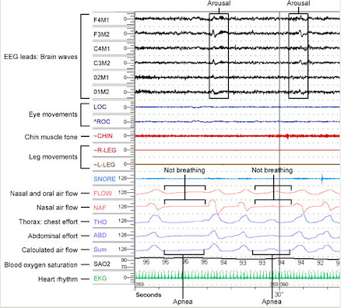
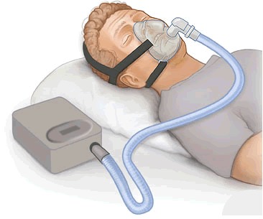
Diagnosis and treatment
Polysomnography is preferred diagnostic procedure for OSA
The gold standard treatment for OSA is continuous positive airway pressure (CPAP)therapy, which results in reduction of sleep hypoxia, and improvement of sleep quality

Slide 4
Comorbidities of OSA
Cardiovascular and cerebrovascular diseases (e.g. systemic hypertension,ischemic heart disease, stroke)
Arrythmias
Glucose metabolism disorders
Metabolic syndrome
Gastro-esophageal reflux
Psychiatric diseases (e.g. Depression, anxiety)

Slide 5
OSA and depression
Depression is common comorbidity of OSA with prevalence among OSA patients up to 20-40%
Possible links between OSA and depression:
Disturbance of sleep/wake cycle
Immune system alterations
Chronic inflammation
Microbiota dysfunction
Dysregulation of neurotransmitter systems e.g. Gamma-aminobutyric acid (GABA)
CPAP therapy implementation reduces mood disorders in OSA patients

Slide 6
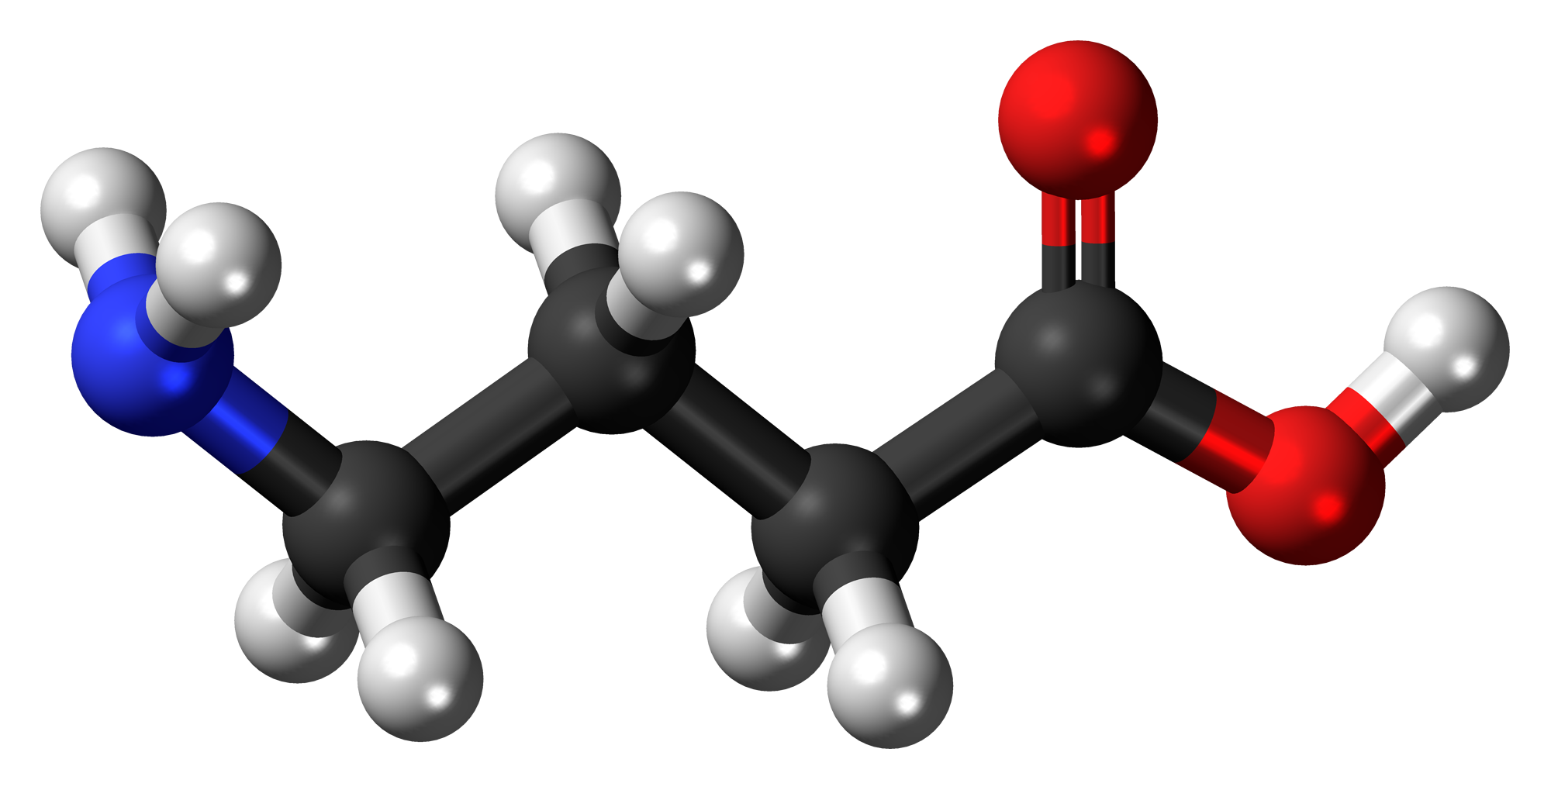
GABAergic system in OSA and depression
GABA is the most important inhibitory neurotransmitter in central nervous system
GABA mainly regulates: sleep/wake cycle, pain transmission, neurodevelopment, neuroendocrine and cardiovascular systems
GABAergic dysregulation may lead to both sleep (insomnia) and mood disorders (depression)
GABAergic dysfuncion promotes increase in glutamate concentration leading to excitotoxicity and neurodegeneration

Slide 7
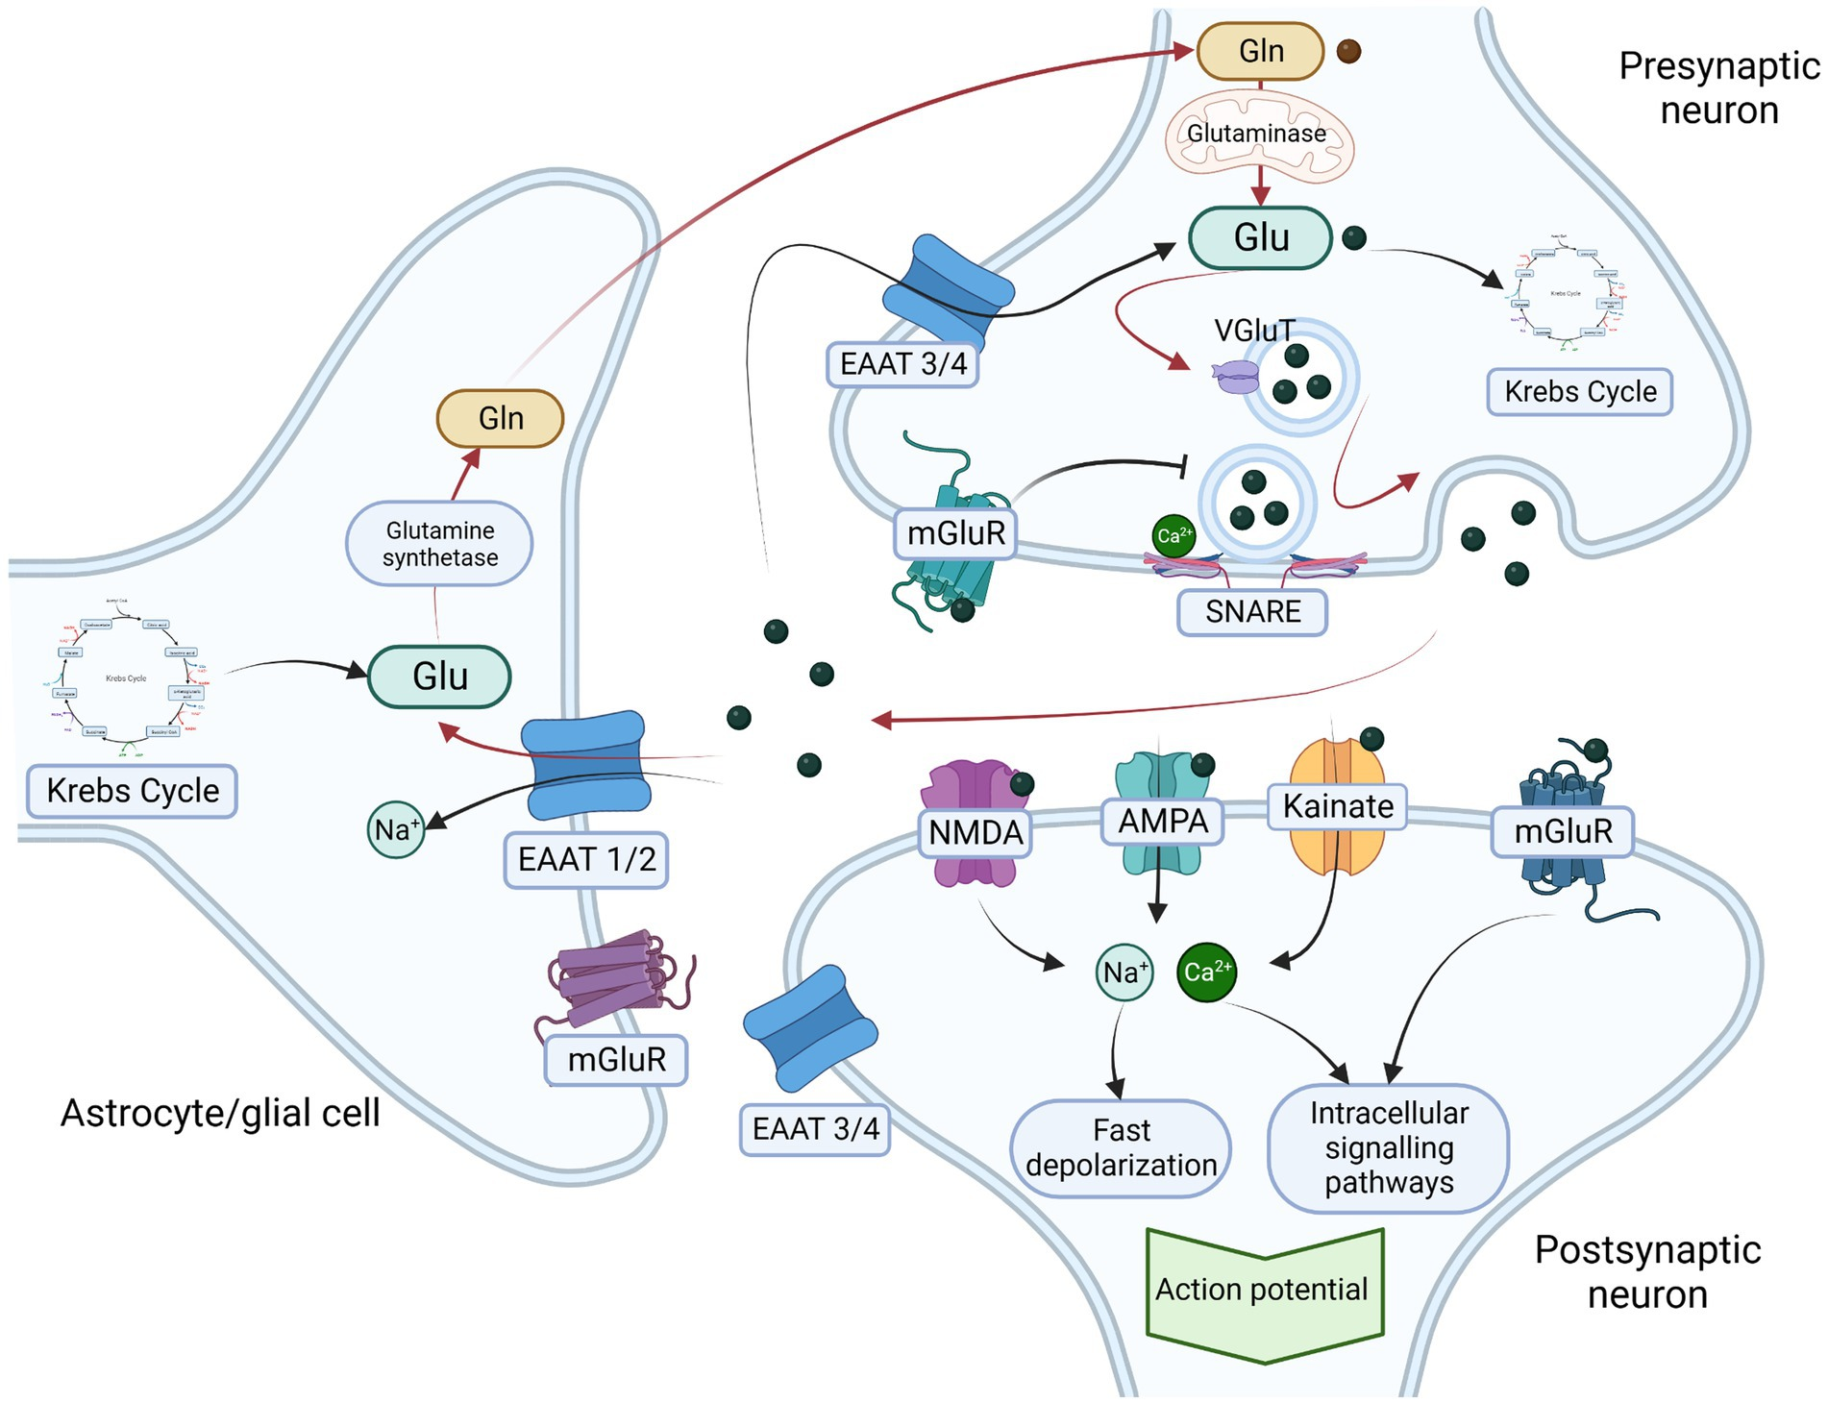
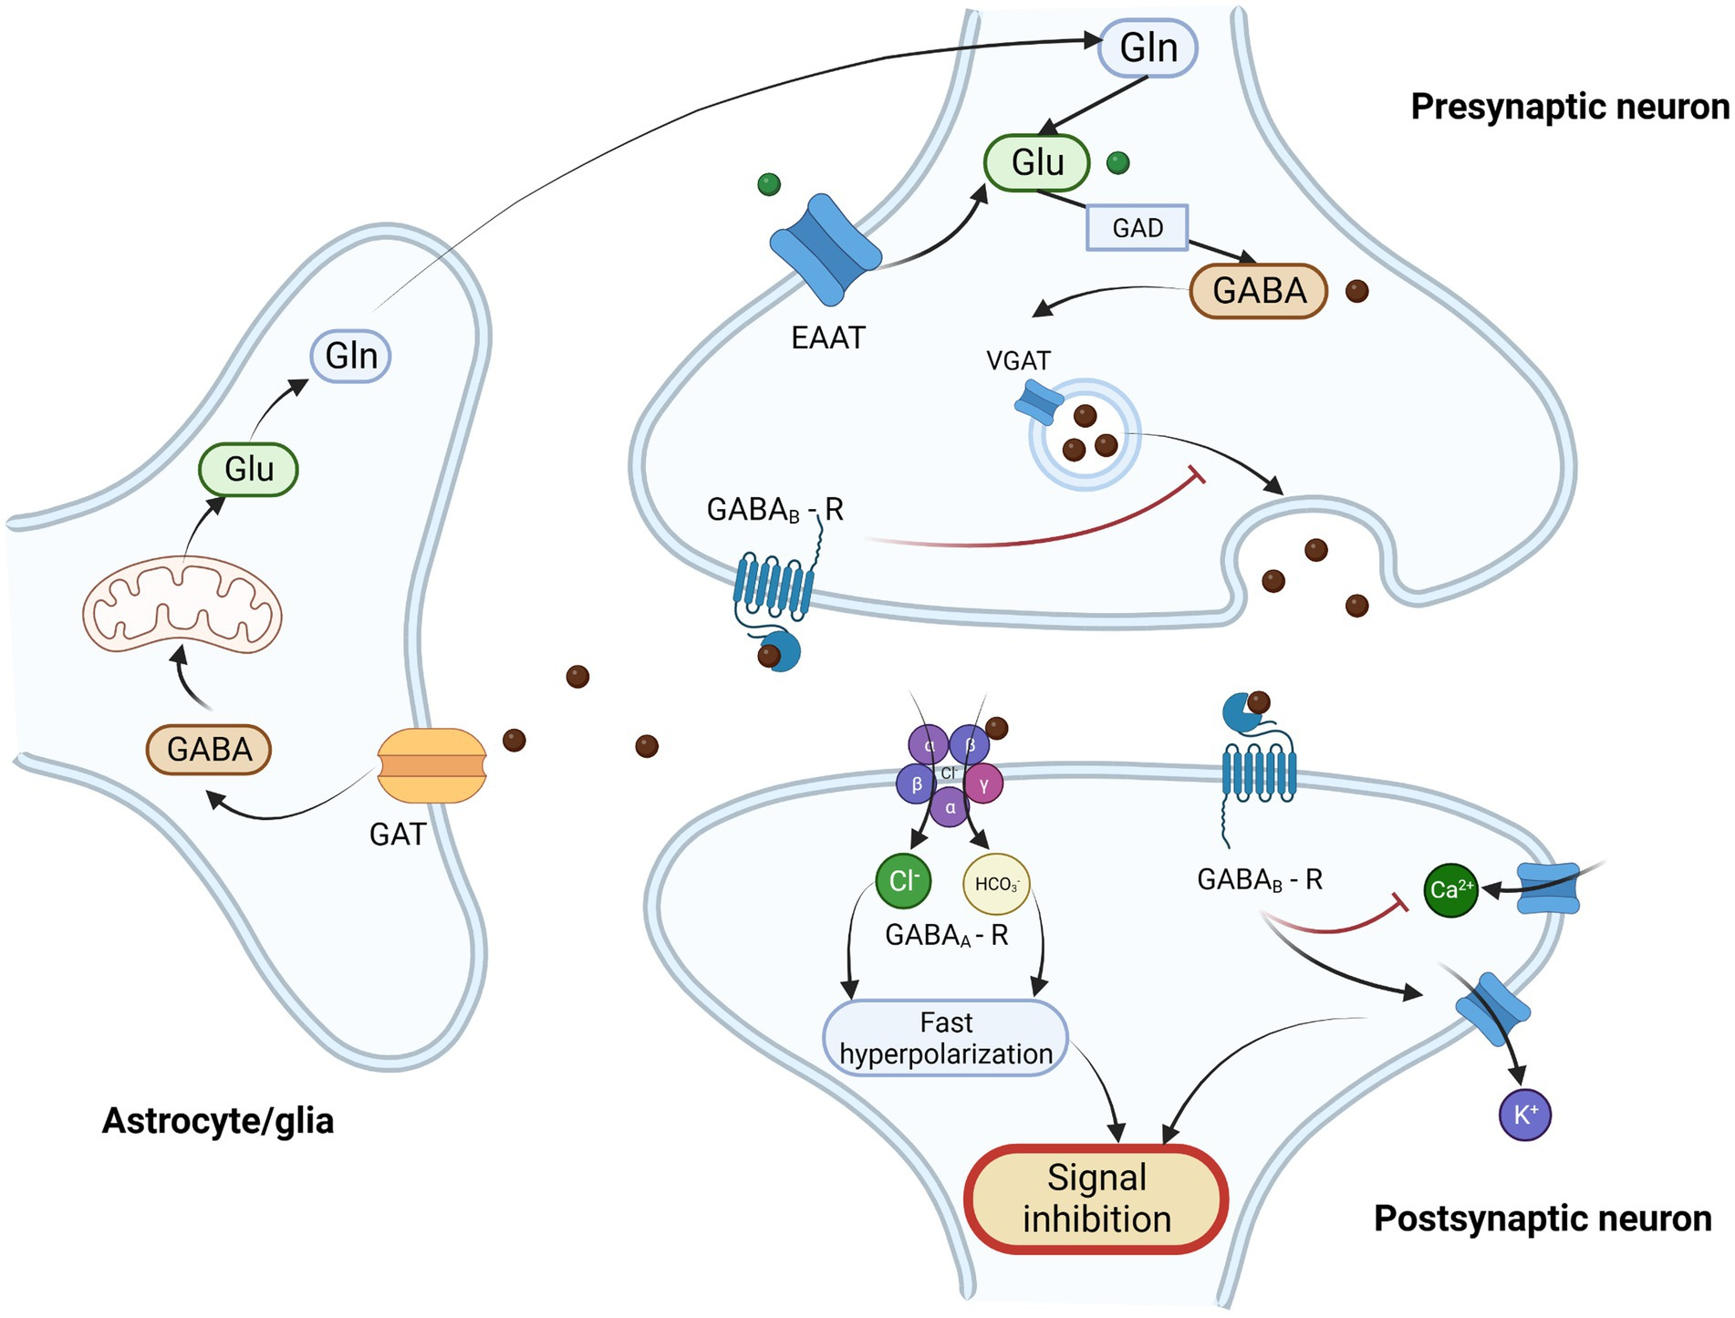
GABAergic system in OSA and depression
OSA promotes ↑ glutamate levels and ↓ GABA levels in central nervous system
Increased excitotoxic state leads to neurodegeneration
↓ GABA concentration in CNS is associated with the development of mood disorders
Does serum GABA concentration may be a marker of depression in OSA patients?

Slide 8
Aims of the study
To establish the impact of OSA and its severity on GABA-ergic and glutamatergic neurotransmission
To study the utility of GABA serum level as a plausible biomarker of affective disorders in the group of OSA patients

Slide 9
Hypothesis
Obstructive sleep apnea patients have lower serum GABA and higher glutamate level.
Decreased GABA is linked with aggravation of depression symptoms assessed with Beck depression inventory (BDI) in the group of OSA patients.

Slide 10
Methodology
Polysomnography and blood sample collection,
Questionnaire collection: Beck Depression Inventory (BDI) and Pittsburgh Sleep Quality Index (PSQI) and Athens Insomnia Scale (AIS)
Assignment to 4 groups:
Patients with OSA and BDI <19
Patients with OSA and BDI >19
Patients without OSA and BDI <19
Patients without OSA and BDI >19
Measurements of GABA and glutamate concentrations in serum using enzyme linked immunosorbent assay (ELISA)

Slide 11
Plan of the study
Recruitment of patients, collection of peripheral blood sample and questionnaire data
Determination of serum GABA and glutamate concentration from peripheral blood samples using ELISA
Generation of study database including clinical, questionnaire and laboratory data.
Statistical analysis and interpretation of the obtained results

Slide 12
Advancement of the project and achievements
Recruitment of patients and collection of data
Learning laboratory techniques related to ELISA assays
Publications:
Kaczmarski Piotr, Sochal Marcin; Strzelecki Dominik; Bialasiewicz Piotr; Gabryelska, Agata. (2023). Influence of glutamatergic and GABAergic neurotransmission on obstructive sleep apnea. Frontiers in Neuroscience. 17. 10.3389/fnins.2023.1213971. (IF=4,3)
Jaromirska Julia; Kaczmarski Piotr; Strzelecki Dominik; Sochal Marcin; Bialasiewicz Piotr; Gabryelska Agata. (2023). Shedding light on neurofilament involvement in cognitive decline in obstructive sleep apnea and its possible role as a biomarker. Frontiers in Psychiatry. 14. 10.3389/fpsyt.2023.1289367. (IF = 4,7)
Karuga Filip; Kaczmarski Piotr; Bialasiewicz Piotr; Szmyd Bartosz; Jaromirska Julia; Grzybowski Filip; Gebuza Piotr; Sochal Marcin; Gabryelska, Agata. (2023). REM-OSA as a Tool to Understand Both the Architecture of Sleep and Pathogenesis of Sleep Apnea-Literature Review. Journal of Clinical Medicine. 12. 10.3390/jcm12185907. (IF=3,9)

