Slide 1
Search for markers of selected chronic microvascular complications of diabetes in patients with MODY diabetes
Julia Grzybowska-Adamowicz
Supervisor: prof. dr hab. n. med Agnieszka Zmysłowska
Department of Clinical Genetics, Medical University of Lodz

Slide 2
Aims
Evaluation of the prevalence of diabetic eye disease and diabetic neuropathy in patients with GCK-MODY and HNF1A-MODY based on laboratory tests, OCTA, ENG studies and clinical assessment of patients.
Analysis of the indicators of the microvascular complications of diabetes in relation to the profile of circulating miRNAs, the pathogenic variants present in the GCK/HNF1A genes and routine parameters of the clinical course of diabetes.

Slide 3
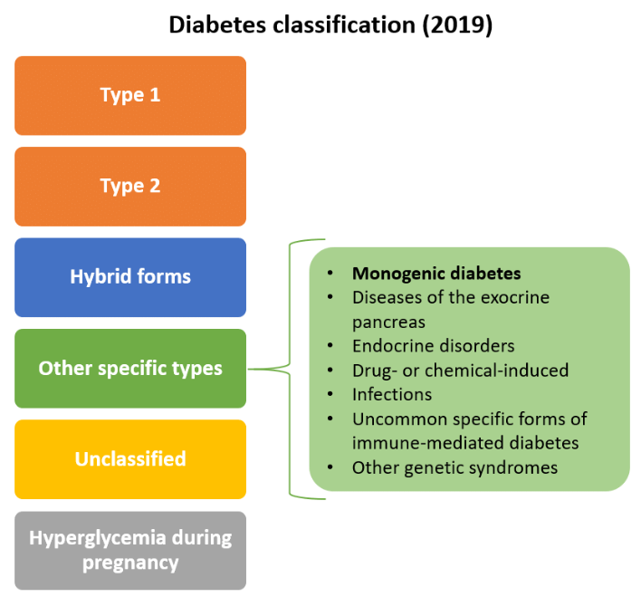
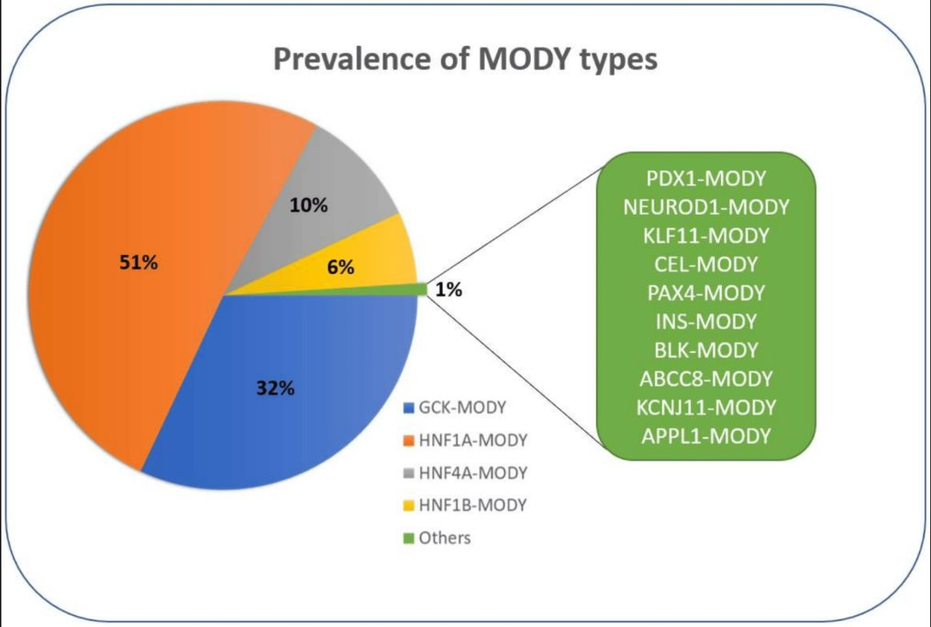
Introduction

Slide 4
GCK-MODY
HNF1A-MODY
Most common type of MODY
caused by a mutation in GCK gene
non-progressive mild hyperglycemia
Treatment: diet and physical activity, insulin therapy during pregnancy
Pathogenic variants HNF1A gene,
onset is evident during adolescence or early adulthood,
deteriorating glycaemic control with age,
microvascular and macrovascular complications are commonly observed.
Treatment is focused on sulfonylurea drugs.

Slide 5
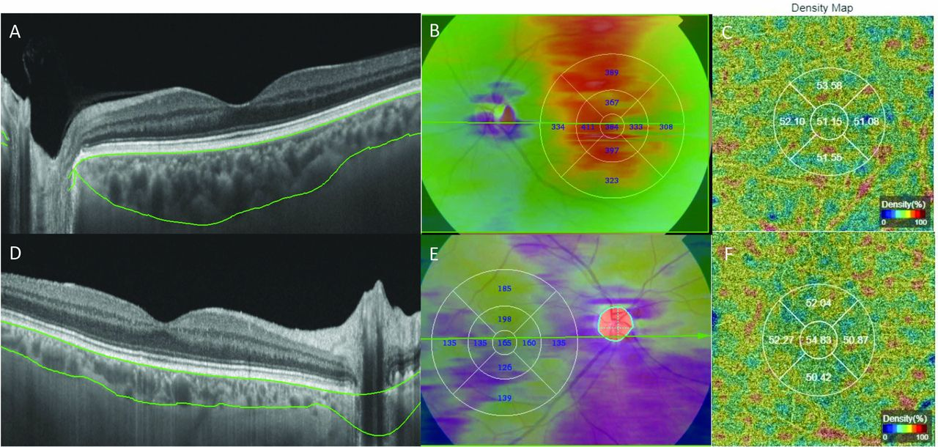
Microvascular complications of diabetes
diabetic retinopathy,
diabetic neuropathy
diabetic nephropathy
Differences in OCTA results in a patient without (A, B, C) and with diabetic kidney disease (D, E, F)
Da Silva MO, Chaves AECDC, Gobbato GC, Lavinsky F, Schaan BD, Lavinsky D. Early choroidal changes detected by swept-source OCT in type 2 diabetes and their association with diabetic kidney disease. BMJ Open Diabetes Res Care. 2022 Nov;10(6):e002938. doi: 10.1136/bmjdrc-2022-002938.

Slide 6
MicroRNAs
MicroRNAs (miRNAs) are short non-coding of ribonucleic acid. MiRNAs are involved in angiogenesis, inflammation, apoptosis and fibrosis in the retina, therefore, play a significant role in the pathogenesis of microvascular complications.
The involvement of miRNAs in diabetic microvascular complications
Ismail A, El-Mahdy HA, Eldeib MG, Doghish AS. miRNAs as cornerstones in diabetic microvascular complications. Mol Genet Metab. 2023 Jan;138(1):106978. doi: 10.1016/j.ymgme.2022.106978.

Slide 7
Plan for the academic year 2023/2024
Acquiring approval from Bioethical Committee
Selecting patients to research, comparison and control group
Applying for Scientific Grant from Polish Society of Diabetology
Participation in the conference of the Polish Society of Diabetology

Slide 8
Progress
Acquiring the approval from Bioethical Committee
Applying for Scientific Grant from Polish Society of Diabetology
Selecting patients to research, comparison and control group – still in progress
20 patients with GCK-MODY diabetes
10 patients with HNF1A-MODY diabetes
15 patients with type 1 diabetes about
16 healthy individuals

Slide 9
Additional activities
Participation in the researches conducted by the unit, among others in the ”TREATWOLFRAM" project.
Submitting an article titled "Continuous glycemic monitoring is useful in managing diabetes related to Wolfram syndrome".
Conducting seminars and clinical exercises as part of the Clinical Genetics classes for students of the English Division faculty and Department of Dentistry.

Slide 10
Thank you for your attention

