Slide 1
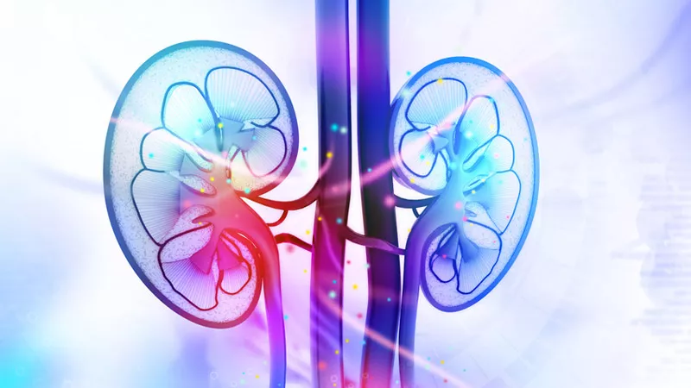
THE ROLE OF SGLT2 INHIBITORS IN PREVENTION OF DIABETIC KIDNEY DISEASE
PhD student: Marlena Frydrysiak M.D.
Supervisor: Prof. Dariusz Moczulski M.D., Ph.D.
Department of Internal Medicine and Nephrodiabetology, Medical University of Lodz

Slide 2
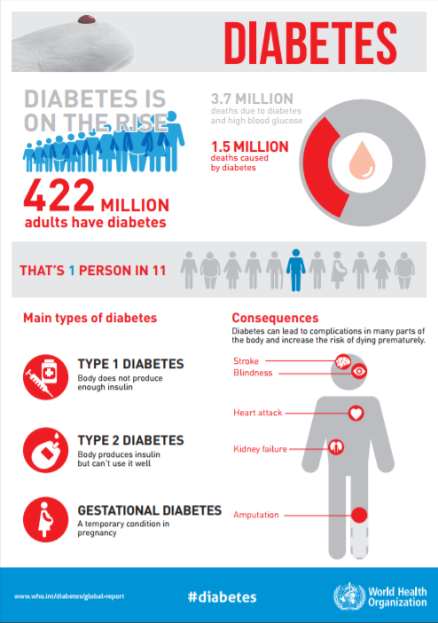
INTRODUCTION Epidemiology of Diabetes:
1 in 11 adult persons have beend diagnosed with diabetes
1 in 4 adults above 60 y.o. in Poland has diabetes
Every 6 seconds someone dies because of diabetes and its complications,
Number of people suffering from diabetes rose from 108 mln in 1980 to 422 mln,
Number of patients worldwide living with diabetes rose more than 3,5 times in the last 35 years
World Health Organization (WHO) predicts that by 2030 diabetes will be the 7-th most common cause of death worldwide
Source: www.who.int

Slide 3
INTRODUCTION Diabetic Kidney Disease:
Most common cause of end-stage renal disease (ESRD) and dialysis in the World
Accounts for an estimated 20-40% of cases of end-stage renal disease
~ one third of patients diagnosed with diabetes mellitus will develop diabetic kidney disease (DKD) (21% with type 1 DM and 20-40% patients with type 2 DM)
The decrease in incidence of diabetic kidney disease has not been observed for more than several decades^{1,2}
[1] Gheith O., Farouk N., Nampoory N., Halim M. A., Al-Otaibi T. Diabetic kidney disease: worldwide difference of prevalence and risk factors. Journal of Nephropharmacology. 2016;5(1):49–56.
[2] Thomas B. The global burden of diabetic kidney disease: time trends and gender gaps. Curr Diabetes Rep. 2019;18.

Slide 4
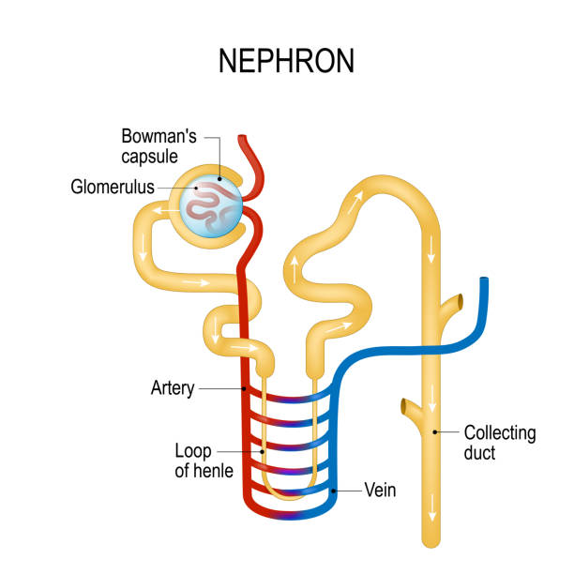
INTRODUCTION Diabetic Kidney Disease -patophysiology
Form of microangiopathy
At initial stage glomerulus basement membrane and mesangium are becoming thicker
As a consequence of previous changes glomeruli becomes hypertrophic, hemodynamic of kidney is distorted and albuminuria appears
Next stage is gradually progressing glomerulosclerosis (focal or diffuse) with tubulointerstitial changes occur and renal function is impaired
Source: iStock by Getty Images

Slide 5
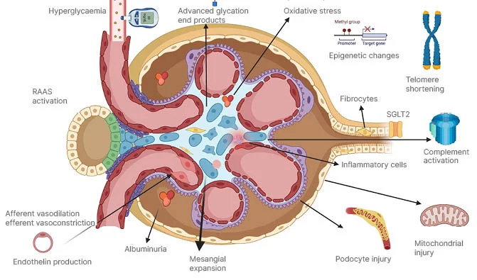
INTRODUCTION Diabetic Kidney Disease -patophysiology
Source: European Medical Journal

Slide 6
Chronic kidney disease should be diagnosed as DKD when:
INTRODUCTION Diabetic Kidney Disease -diagnosis
Albuminuria is present (UACR - urinary albumin excretion expressed as albumin/creatinine ratio) >= 300 mg/g in at least 2 of 3 tests performed within 3 months,
There is albuminuria (UACR) 30-300 mg/g, but there is coexistence of diabetic retinopathy and/or type 1 diabetes lasting at least 10 years,
Glomerular filtration rate values ​​remain < 60 ml/min/1,73 m2 for at least 3 months, even in the absence of other indicators of renal damage, after exclusion of other causes of chronic kidney disease

Slide 7
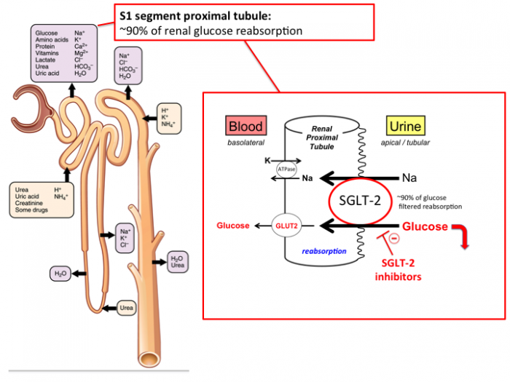
INTRODUCTION Sodium-Glucose Co-Transporter-2 (SGLT2) Inhibitors
Mechanism of Action:
Inhibits the Na-glucose co-transporter 2 (SGLT-2) in the kidney to reduce glucose reabsorption, resulting in increased urinary glucose excretion, and lower plasma glucose.
SGLT-2 is expressed in the proximal tubule and mediates reabsorption of ~90% of filtered glucose
Source: www.sciencedirect.com

Slide 8
INTRODUCTION SGLT2 inhibitors in prevention of diabetic kidney disease
Sodium–glucose cotransporter (SGLT) 2 inhibitors exert multiple effects on diabetic nephropathy (DN). These agents improve glomerular filtration and reduce extracellular matrix (ECM) production, oxidative stress and inflammation. These effects contribute to the reduction of renal fibrosis and albuminuria. CTGF: Connective tissue growth factor; ICAM-1: Intercellular adhesion molecule-1; MCP-1: Monocyte chemoattractant protein-1; NF-κB: Nuclear factor-κB; Nox4: NADPH oxidase 4; ROS: Reactive oxygen species; TGF-β: Transforming growth factor β.
Source: Kawanami, D.; Matoba, K.; Takeda, Y.; Nagai, Y.; Akamine, T.; Yokota, T.; Sango, K.; Utsunomiya, K. SGLT2 Inhibitors as a Therapeutic Option for Diabetic Nephropathy. Int. J. Mol. Sci. 2017, 18, 1083. https://doi.org/10.3390/ijms18051083

Slide 9
PURPOSE, MATERIALS AND METHODS
The aim of the research is to investigate the current usage of SGLT2 inhibitors in prevention of diabetic kidney disease in the population of polish patients with diagnosed type 2 diabetes and impaired renal function.
Sample size will be patients hospitalized in the Department of Internal Medicine and Nephrodiabetology meeting the inclusion criteria. General population study will be patients diagnosed with type 2 diabetes with renal function of at least 20 ml/min/1,73m2 eGFR.
Method will be survey study among the patients meeting the inclusion criteria about usage of SGLT2 inhibitors.

Slide 10
STUDY POPULATION
Inclusion criteria
1. Patients diagnosed with diabetes mellitus type 2.
2. Age 18-90 years.
3. Consent of the patient to be included in the research.
4. Renal function of at least 20 ml/min/1,73m2 eGFR.
Exclusion criteria
1. No consent of the patient to be included in the research.
2. Age below 18 or above 90 y.o.
3. Other (nondiabetic) kidney disease diagnosed.
4. End-stage kidney disease.

Slide 11
Achievements:
1. Participation in courses by Polish Society of Cardiodiabetology (PTKD) for Young Scientists
2. Participation in the conference: „I Łódzko-Warszawskie Konfrontacje Diabetologiczne” by Polish Society of Diabetes Complications Studies - Łódź 27.10.2023 r.
3. Membership in the Polish Society of Diabetes Complications Studies
4. Membership in the Young Nephrologists Club (KMN) of Polish Society of Nephrology (PTN)
5. Speech during XXVII Scientific and Working Group Conference of Polish Society of Nephrology (PTN) "Nefrologia — więcej niż nerki!" - Szczecin, 18–20 maja 2023 r.
6. Participation in the XXIII National Conference of the Working Group by Polish Society of Internal Medicine– online, 17 - 18.05.2024 r.
7. Membership in the Polish Society of Cardiodiabetology
8. Participation in the I-st International Congress by Akademia po Dyplomie Endokrynologia i Diabetologia – online, 14.06.2024 r.
9. Participation in the XXVIII Scientific and Working Group Conference of Polish Society of Nephrology (PTN) „Nefrologia – od nauki do kliniki” - Lublin, 19-22 czerwca 2024 r.

Slide 12
Publications:
Frydrysiak M., Pachniak P., Krysicka A., Moczulski D. Patient with lupus anticoagulant caused aPTT prolongation corrected with prednisolone treatment and later anticoagulation treatment due to chronic atrial fibrillation. Clinical Case Reports. 2023. DOI: https://doi.org/10.1002/ccr3.7284
Frydrysiak M., Zmorska-Nowak J. Infection in patient during chemotherapy. Stany Nagłe po Dyplomie
Frydrysiak M., Strange MI. Stany Nagłe po Dyplomie

Slide 13
THANK YOU FOR YOUR ATTENTTION! marlena.frydrysiak@umed.lodz.pl

