Slide 1
Malignant transformation markers associated with neoangiogenesis in premalignant laryngeal lesions and laryngeal cancer assessed by Narrow Band Imaging
Department of Otolaryngology, Head and Neck Oncology
Medical University of Lodz
lek. Magda Barańska
Public Scientific Review Session,
Interntional Doctoral School, Medical University of Lodz

Slide 2
Narrow Band Imaging

Slide 3
Classification of the lesions
Šifrer, R., Šereg-Bahar, M., Gale, N. et al. The diagnostic value of perpendicular vascular patterns of vocal cords defined by narrow-band imaging. Eur Arch Otorhinolaryngol 277, 1715–1723 (2020). https://doi.org/10.1007

Slide 4
Aim of the study:
correlate vascular changes visible in NBI in:
laryngeal cancer,
precancerous lesions
benign lesions
with the expression of genes and proteins:
LIF (Leukemia Inhibitory Factor),
CXCL9 (ligand 9 of CXC chemokine)
IL-6 (Interleukin 6).

Slide 5
The role of LIF in head and neck cancers?
melanoma: tumour suppresor
nasopharyngeal carcinoma: promotes tumour growth
oral cancer: facilitates the invasion of cancer cells
?
Liu SC, Tsang NM, Chiang WC, Chang KP, Hsueh C, Liang Y, Juang JL, Chow KP and Chang YS: Leukemia inhibitory factor promotes nasopharyngeal carcinoma progression and radioresistance. J Clin Invest. 123:5269–5283. 2013.
Lin TA, Wu TS, Li YJ, Yang CN, Illescas Ralda MM, Chang HH. Role and Mechanism of LIF in Oral Squamous Cell Carcinoma Progression. J Clin Med. 2020 Jan 21;9(2):295. doi: 10.3390/jcm9020295. PMID: 31973037; PMCID: PMC7073607.

Slide 6
Diagnostic and research workup
Ethical Committee of the Medical University of Lodz approval no. RNN 257/20/KE
170 patients
The study is supported by Ministry of Science and Education, Poland, Diamond Grant no. 0137/DIA/2020/49

Slide 7
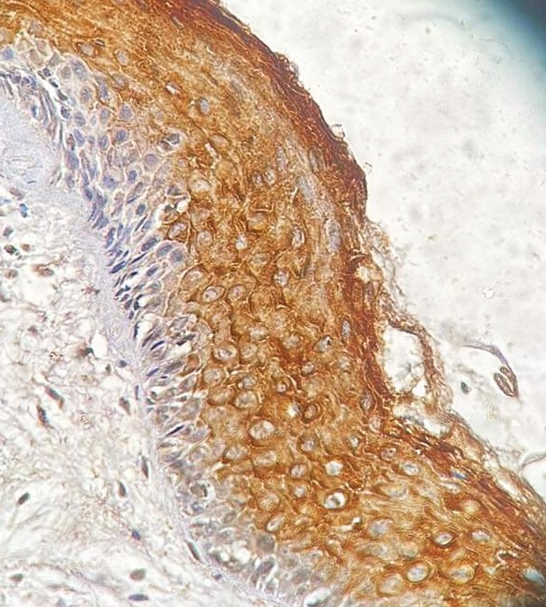
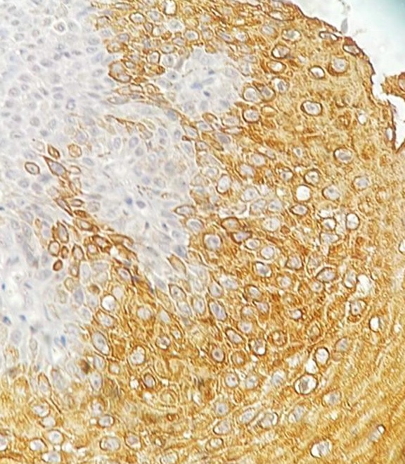
Preliminary results:
Higher expression of LIF in benign laryngeal lesions compared to cancer tissue, p<0.0001
The same tendency was observed in cancer associated fibroblasts.
Low LIF was positively associated with malignancy (OR = 20.31, CI 4.86-46.7).
In the low-grade dysplasia group, LIF expression was higher in epithelial cells than in high-grade dysplasia cases (p=0.04).
Fig 1. Immunohistochemical staining for LIF in benign laryngeal lesion. magn. 200x
Fig 2. Immunohistochemical staining for LIF in
laryngeal squamous cell carcinoma. magn. 200x

Slide 8
Conclusions:
cancerous tissues and high-grade dysplasia presented lower LIF expression compared to the low-grade dysplasia and benign lesion groups,
suppression of LIF in malignant tissue
potential contrast with oral squamous cell carcinoma, where decreased LIF expression may strengthen anti-tumor activity

Slide 9
Malignant transformation markers associated with neoangiogenesis in premalignant laryngeal lesions and laryngeal cancer assessed by Narrow Band Imaging
Department of Otolaryngology, Head and Neck Oncology
Medical University of Lodz
lek. Magda Barańska
Public Scientific Review Session,
Interntional Doctoral School, Medical University of Lodz

