Slide 1
Clinical and immunological assessment of subjects with recurrent angioedema of various etiologies (hereditary, acquired, idiopathic).
Waleed Aman Ur Rahman, MD
Dept. of Immunology and Allergy; Chair of Pulmonology, Rheumatology and Clinical Immunology, Central Teaching Hospital of the Medical University of Lodz

Slide 2
Background
Angioedema is a swelling of lower layers of the skin and/or mucous membranes that can occur at different locations throughout the body, e.g., on the lips, tongue, eyelids, limbs, or the digestive tract mucosae.
The appearance of angioedema results from temporarily increased vascular permeability, which leads to increased leakage of fluid into the surrounding tissues. In most cases, the messenger substance histamine is responsible for this, which is formed mainly in the mast cells of the skin or mucous membranes and is released when they are activated (histaminergic angioedema).

Slide 3
In some subjects one can observe angioedema not caused by histamine but bradykinin.
Bradykinin Mediated AE can be acquired or hereditary.

Slide 4
acquired angioedema (AAE)
Acquired angioedema can be sequel to taking certain medications (e.g., ACE inhibitors, gliptins) or the presence of comorbidities (autoimmune, inflammatory, lympho-/myeloproliferative)
These conditions can contribute to inhibition of thebradykinin degradation or to its increased formation.
Deficiencies of the complement proteins in AAE can be the result of the presence of autoantibodies or increased activation of the classical component pathway

Slide 5
Hereditary angioedema (HAE)
Is a rare condition and genes involved in its pathogenesis are relatively well-defined, although new genes and mutations thereof are still being identified and described. Genetic mutations lead, on different pathways, to deficiency in C1-inhibitor which results in increased bradykinin presence and clinical symptoms of angioedema.

Slide 6
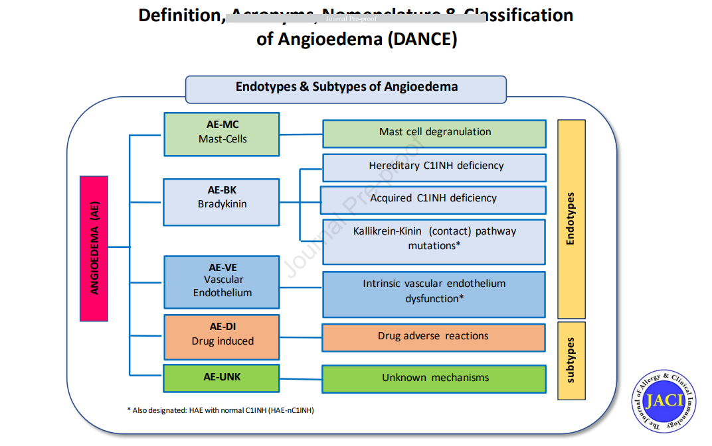
Consensus on Nomenclature and Classification of Angioedema

Slide 7
Epidemiology
Angioedema due to angiotensin-converting enzyme inhibitors (ACEI) is encountered in approx. 1 in 500 ACEI-treated subjects.
Epidemiology of other forms of AAE has not been fully elicidated.
Very crude estimated prevalence of AAE could range between 1:100,000 and 1:500,000 [acc. To Cicardi and Zanichelli Allergy Asthma Clin Immunol 2010]
Hereditary angioedema (HAE) is a rare condition; frequency estimated at approx. 1:50,000

Slide 8
Aims of our research
To provide new insights into clinical and immunological features of angioedema of different etiologies
To attempt to identify the biomarkers that might be used in identifying and differentiating angioedema of different etiologies
To work on the assessment in particular, frequency of the presence of autoantibodies that inhibit C1-inhibitor.
To investigatie potential shifts in biochemical and immune parameters in different forms of angioedema
To assess the utility of immunological and biochemical parameters in describing and identifying patients with different forms of angioedema
To attempt to assess utility of selected immunological and biochemical parameters in prognosing the course and intensity of different forms of angioedema

Slide 9
Study popullation
Group of patients with angioedema of different etiologies, referred to the Center of Asthma and Allergy Diagnosis and Treatment Center at the Central Hospital, Dept. of Immunology and Allergy, Medical University of Lodz (approx. N=150-200)
Control group of healthy subjects, proportionally age and sex-matched to the above-mentioned group (approx. N=30)
Group of patients with already confirmed hereditary angioedema (HAE) being followed and treated at the Department (N=20)

Slide 10
DATA ANALYSIS
Assessment of participating subjects will consist of:
clinical evaluation
Routine laboratory evaluation as provided in the outpatient clinic, for parameters such as
CBC and erythrocyte sedimentation rate (ESR)
CRP
AST, ALT, GGTP, ALP, bilirubin
Serum creatinine and urea
TSH
Urine test
Stool assessment for parasites, G. lamblia and H.pylori antigen
Chest X-ray
Abdominal sonography
C1-inhibitor concentration and activity in plasma
C1q, C3 and C4 complement proteins in plasma.
Immunoglobulin A, G, M levels in serum
Autoantibodies used in screening for connective tissue diseases and vasculitis (ANA, cANCA, pANCA, rheumatoid factor)
Anti-thyroid antibodies (anti-TG, anti-TPO)
Serum protein electrophoresis
Total and specific IgE panel for inhalant and food allergens

Slide 11
Analysis of immunological and biochemical parameters not being part of a routine outpatient evaluation such as
IgA, IgG, IgM autoantibodies against C1-inhibtor in serum
IgG anti-C1q autoantibodies in serum.
Systemic and organ-specific autoantibodies in isotypes other than routinely assessed: anti-thyroid IgE, anti-dsDNA IgE, rheumatoid factor IgE, IgA, IgG. Applicable techniques will be developed in the home laboratory or assessments will be made in cooperation with foreign angioedema centers.
Cytokines with general proinflammatory (TNF-alpha, IL-6) and anti-inflammatory (IL-1receptor antagonist, IL-10) properties
Proteins involved in development of type 2 inflammation (IL-4, -5, -13, -25, -33, ECP, TSLP) and non-type 2 inflammation (IFN-gamma, IL-17, chemokines CXCL1, CXCL8) – selected parameters will have been chosen for analysis

Slide 12
QUESTionNAIRES USED
Angioedema control test (AECT)
Angioedema quality of life questionnaire (AE-QoL)
Angioedema activity score (AAS)

Slide 13
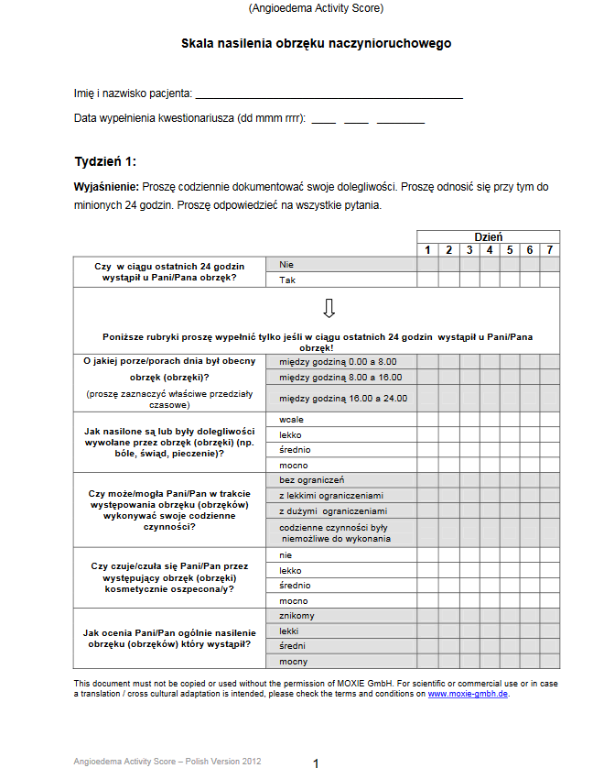
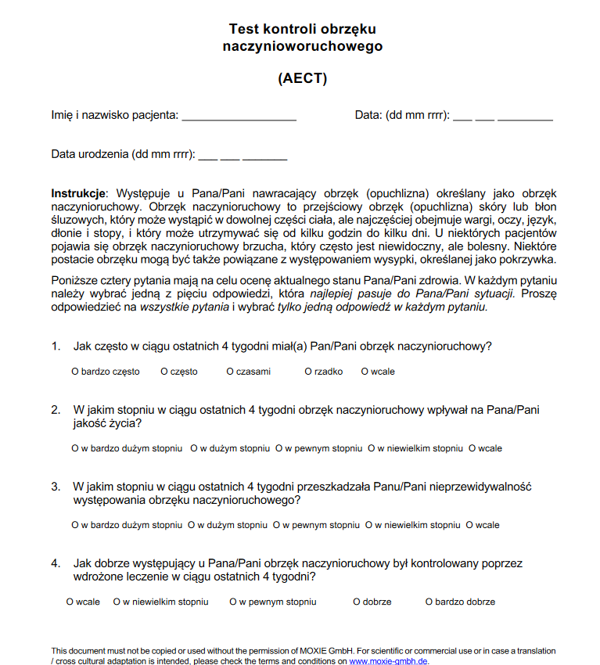

Slide 14
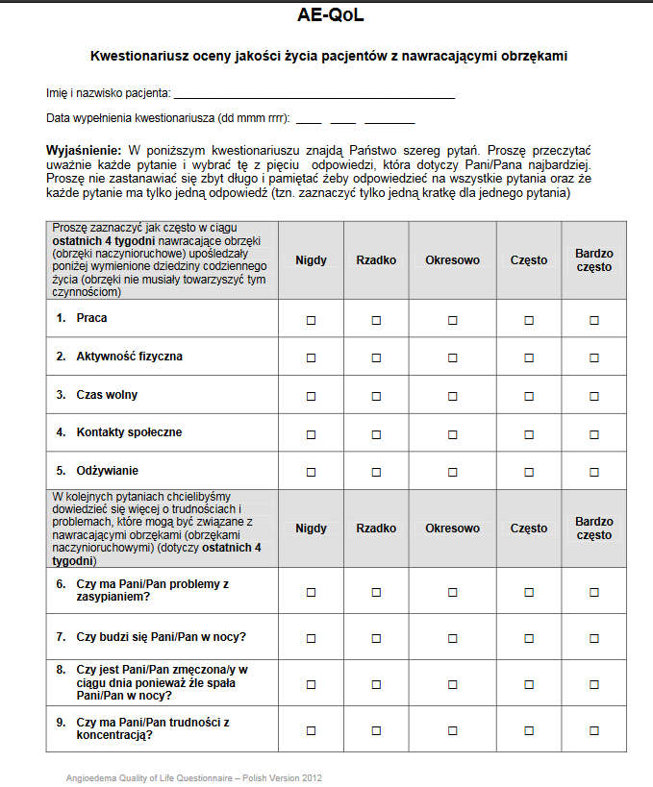
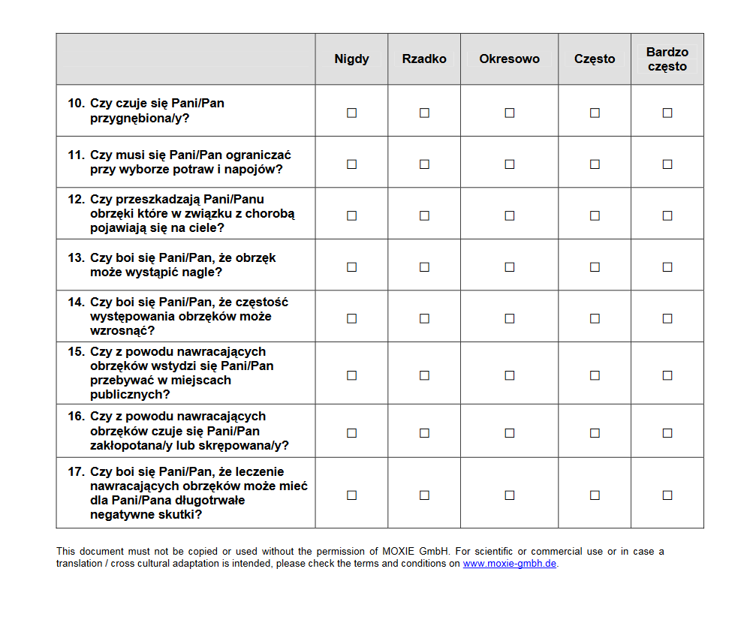

Slide 15
ADVANCE IN RESEARCH
Until now we conducted the literature review regarding the topic, and we are in the process of writing the review paper and expecting to submit the manuscript by the end of June 2024.We have got the approving decision from the bioethical commission. So far 39 patients in total have been recruited, among which were patients with isolated angioedema (i.e., without the presence of urticaria) and the remaining individuals had angioedema with concomitant urticaria.

Slide 16
The subjects with isolated angioedema without concomitant urticaria had normal plasma levels of C1INH and C4. Therefore, diagnosis of type 1 and type 2 hereditary angioedema (HAE) has been excluded.
Samples were sent for genotyping within the framework of ACARE center network to Berlin (Charité clinic).
In addition, serum and plasma samples were acquired and questionnaires obtained from the patient with confirmed HAE as well as from patients with angioedema with urticaria.
Serum and plasma samples were secured in the Biobank from all the recruited subjects and no assessment has been made so far.

Slide 17
We are now planning to select the specific parameters that need to be assessed which is not the part routine clinical assessment. The AE with urticaria group will have also been analyzed from the clinical point of view with the attempt to fit them into the new classification of angioedema, published recently (https://doi.org/10.1016/j.jaci.2024.03.024). We will also attempt to complete the control group from the Biobank-stored samples, reserving the possibility to recruit new subjects in case the matched group is not completed.

Slide 18
THANK YOU

